Slide 1
ROS Crash Course
Class 3

Slide 2
Agenda
-Old HW
-ROS Concepts
-How to Make/Build ROS Packages
-New HW

Slide 3
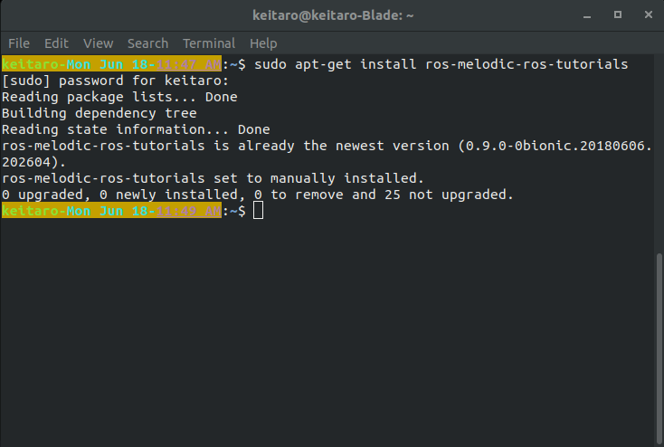
HW
-Please start this download while everyone is showing their HW
-$ sudo apt-get install ros-melodic-ros-tutorials ros-melodic-rqt ros-melodic-rqt-common-plugins
-Don’t worry if you see 0 newly installed that just means you already have it

Slide 4
ROS Concepts
-Master
-Node
-Publisher
-Subscriber
-Topic
-Message

Slide 5
ROS Concepts
-rosservice: a way to send a request and receive a response
-rosparameters: a way to edit the ROS Parameter Server
-ros commands:
-ros[command] convention is used for each shell command
-roscore: starts the rosmaster, rosout, and ros parameter server
-rosrun: runs a ros node
-rostopic: ros command tool used for rostopics

Slide 6
ROS Concepts
-Open a shell and run $ roscore
-In a new shell run $ rosrun turtlesim turtlesim_node
-In a new shell run $ rosrun turtlesim turtle_teleop_key
-In a new shell run $ rostopic echo /turtle1/cmd_vel
-Finally position all of them so that you can see the turtlesim screen and the last three terminals
-Using your arrows keys try to move the turtle around

Slide 7
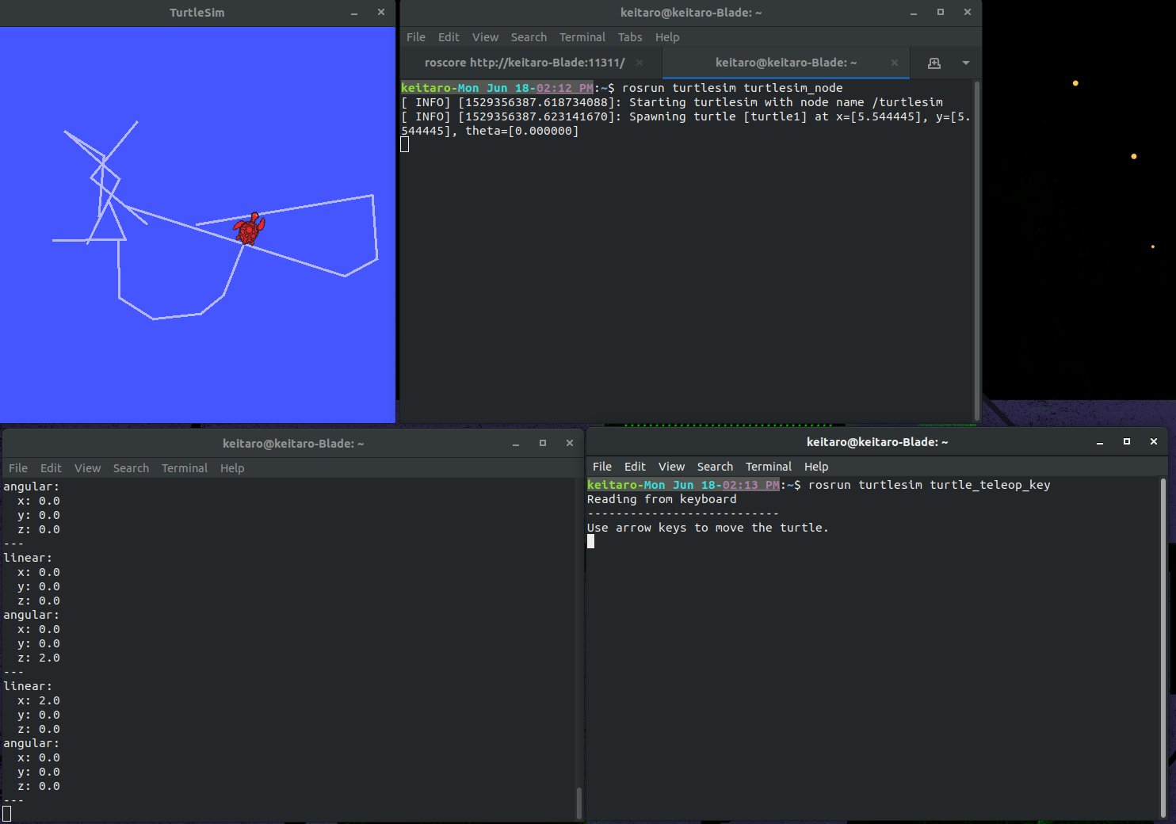
ROS Concepts

Slide 8
ROS Concepts
-Now open a new shell and run $ rosservice call /clear
-In the same terminal run $ rosservice call /spawn 1 2 3 “test”
-In the same terminal run $ rosparam set /background_g 150
-Then run $ rosservice call /clear

Slide 9
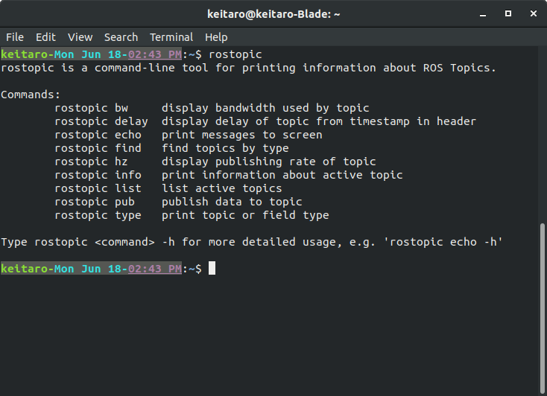
ROS Concepts
In the same terminal run $ rostopic -h

Slide 10
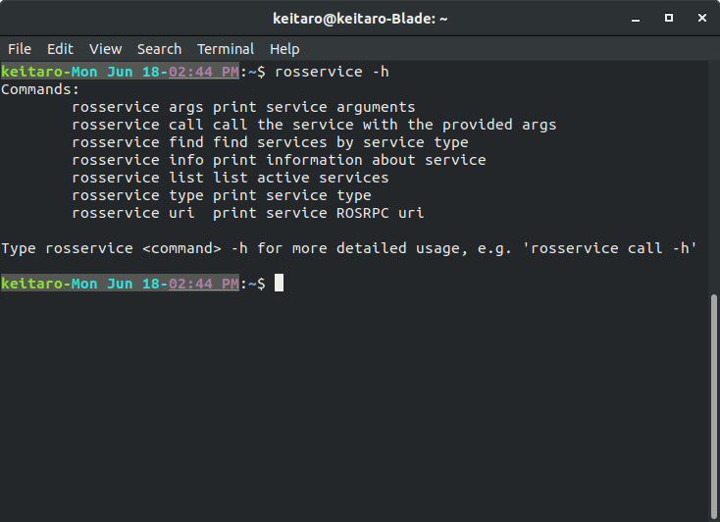
ROS Concepts
-Now try running $ rosservice -h

Slide 11
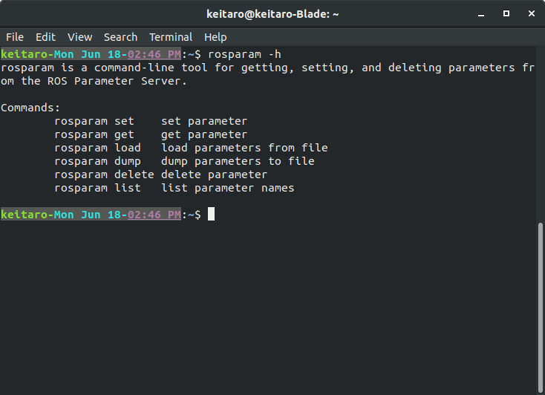
ROS Concepts
-Finally try running $ rosparam -h

Slide 12
ROS Concepts
-These ros commands are useful
-roscd
-rosls
-rosed

Slide 13
How to Make/Build ROS Package
-Catkin (http://wiki.ros.org/catkin/conceptual_overview)
-The compiler used for ROS code
-Catkin Workspace (http://wiki.ros.org/catkin/workspaces)
-Build: where the compiler builds the src code
-src: where the src code for any ros code live
-devel: a development environment when making install targets

Slide 14
How to Make/Build ROS Package
-Now in a new shell run the following commands:
-$ cd ~/catkin_ws/src
-$ catkin_create_pkg [your name]_test_pkg std_msgs geometery_msgs rospy roscpp
-The format for catkin_create_pkg is
-$ catkin_create_pkg [pkg name] [dependency 1] [dependency 2] …
-You will now see the new package in the src folder

Slide 15
How to Make/Build ROS Package
-In the new package folder you will see the following
-include folder: for any header files you need
-src folder: for the main .cpp or .py files
-CMakeLists.txt: the instructions for catkin on how to build the package
-package.xml: for storing information about the package for ros

Slide 16
New HW
-Make 2 new nodes so that you can control 3 different turtles in turtlesim at the same time.
-Make them in the new package you just made this class
-Use the turtlesim and this tutorial for reference on source code (http://wiki.ros.org/ROS/Tutorials/WritingPublisherSubscriber%28c%2B%2B%29)
-Email me the finished package before class #4

