Slide 1
ROS Crash Course
Class 6

Slide 2
Agenda
-Creating custom msg and srv
-Running rosservice from a node
-HW

Slide 3
Creating custom msg and srv
-what does a msg and a srv look like and what are the differences?
Msg (Pose.msg)
float32 x
float32 y
float32 theta
float32 linear_velocity
float32 angular_velocity
Srv (AddTwoInts.srv)
int64 a
int64 b
---
int64 sum

Slide 4
Creating custom msg and srv
-what does a msg and a srv look like and what are the differences?
Msg (Pose.msg)
float32 x
float32 y
float32 theta
float32 linear_velocity
float32 angular_velocity
geometry_msgs/Twist twist
-all of the variables in a msg are meant for the subscriber
-it is possible to reference other msgs within a msg
Srv (AddTwoInts.srv)
int64 a
int64 b
---
int64 sum
-the first two are meant for the service to use then the last one is the response back

Slide 5
Creating custom msg and srv
-how to add them to a package
-first cd into your ros package
-then make a new directory called “msg”
-go into your new directory and run
$ gedit test.msg
-now add
Int64 count
-to it and save

Slide 6
Creating custom msg and srv
-Open a new shell and go into your package again and make a new directory “srv” Don’t go the new directory yet
-now run the following command
$ roscp rospy_tutorials AddTwoInts.srv srv/AddTwoInts.srv
-You just copied the add two ints service from another package to yours the format for the command is as follows
$ roscp [name of package you’re copying from] [file to copy] [path to paste to]

Slide 7
Creating custom msg and srv
-Now open up the package.xml for your package
Add these lines where they belong
<build_depend>message_generation</build_depend>
<exec_depend>message_runtime</exec_depend>
-now save the file

Slide 8
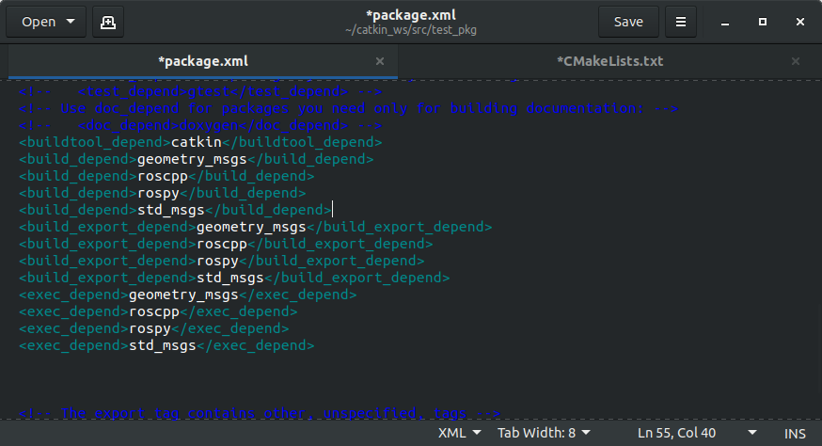
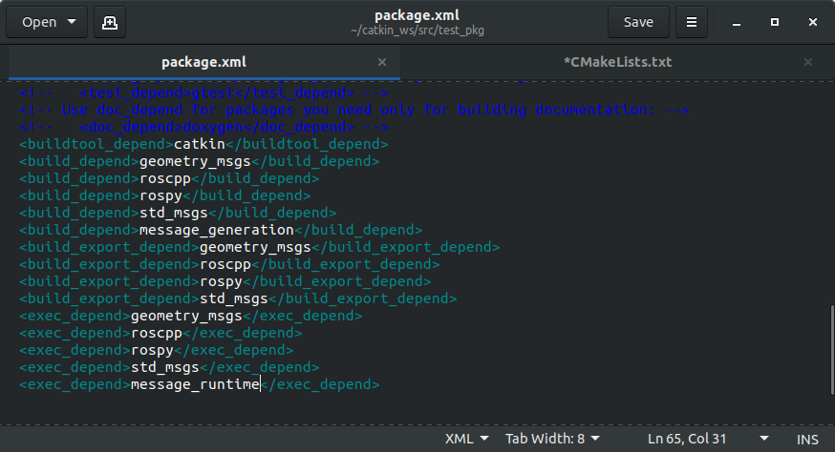
Creating custom msg and srv

Slide 9
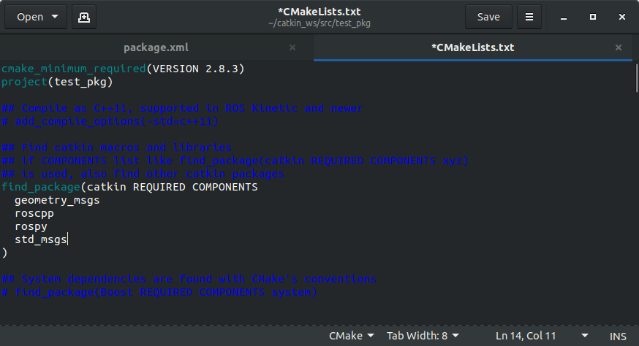
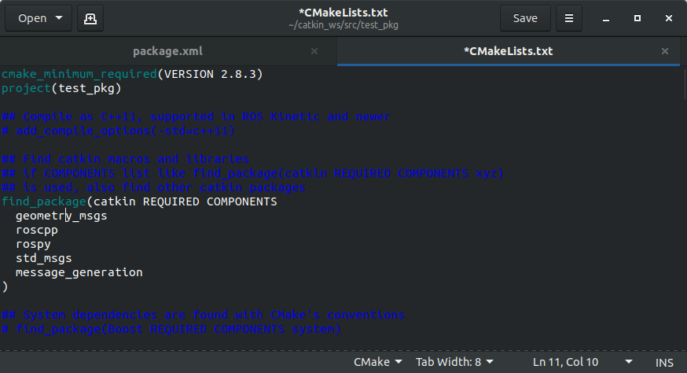
Creating custom msg and srv
-Now open your CMakeLists.txt file and add message_generation to your find_package

Slide 10
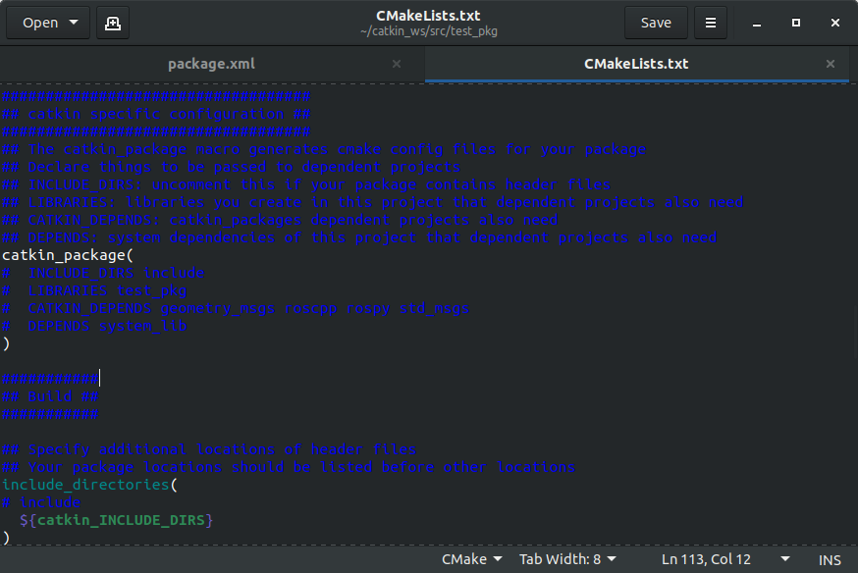
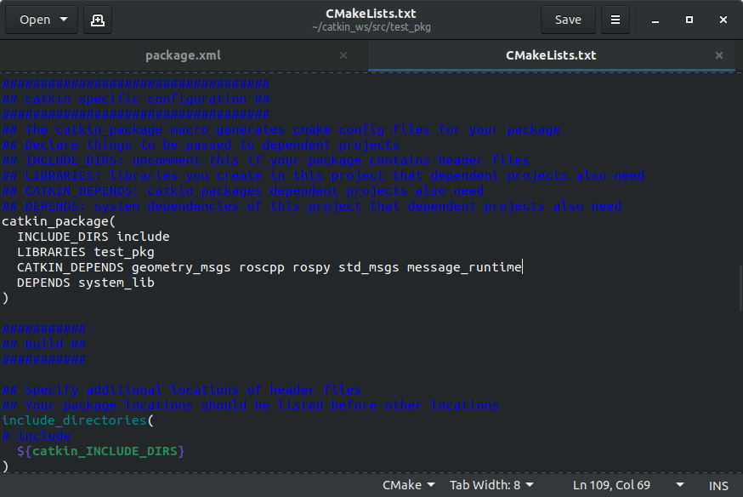
Creating custom msg and srv
-Find the catkin_package() function uncomment it and add message_runtime as a CATKIN_DEPENDS variable

Slide 11
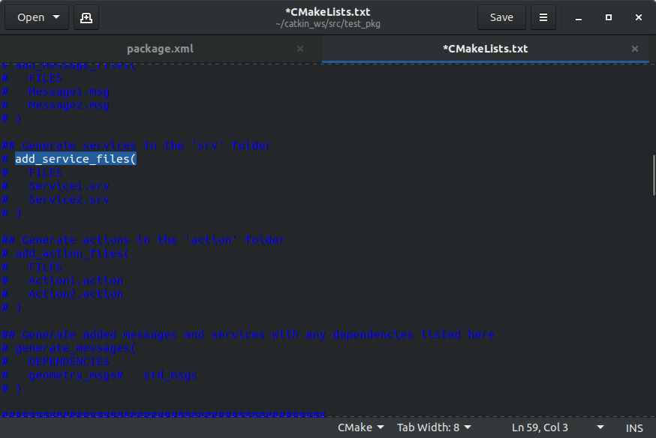
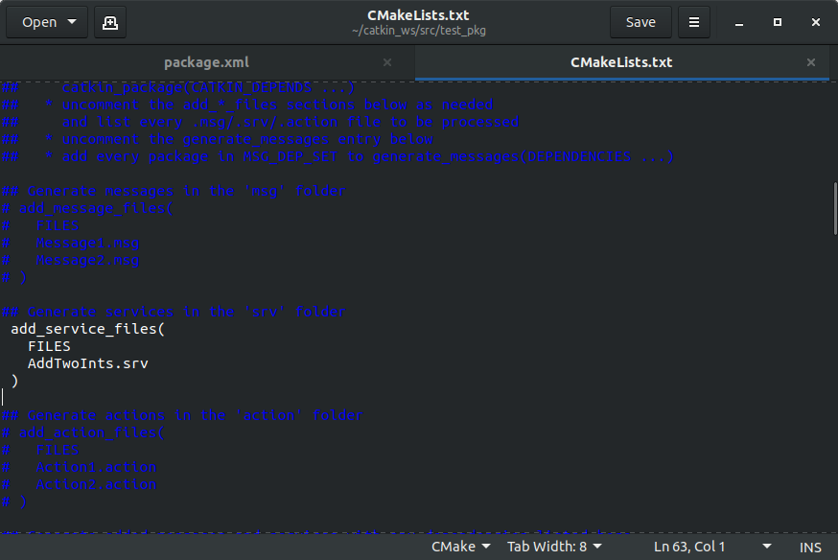
Creating custom msg and srv
-Now uncomment the add_service_files() function, delete the placeholder srvs and add yours to it

Slide 12
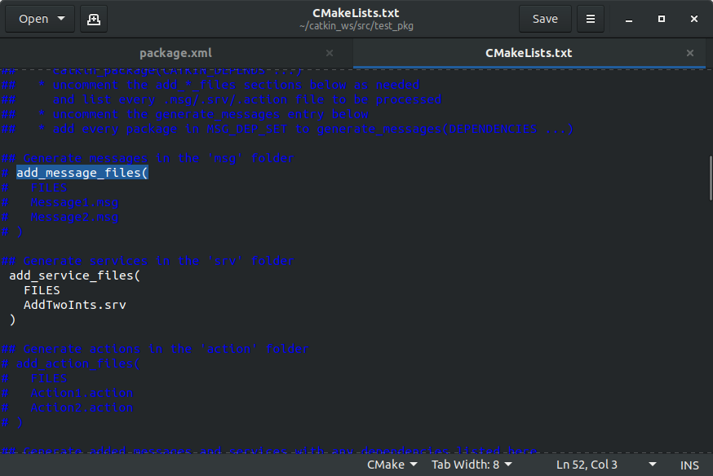
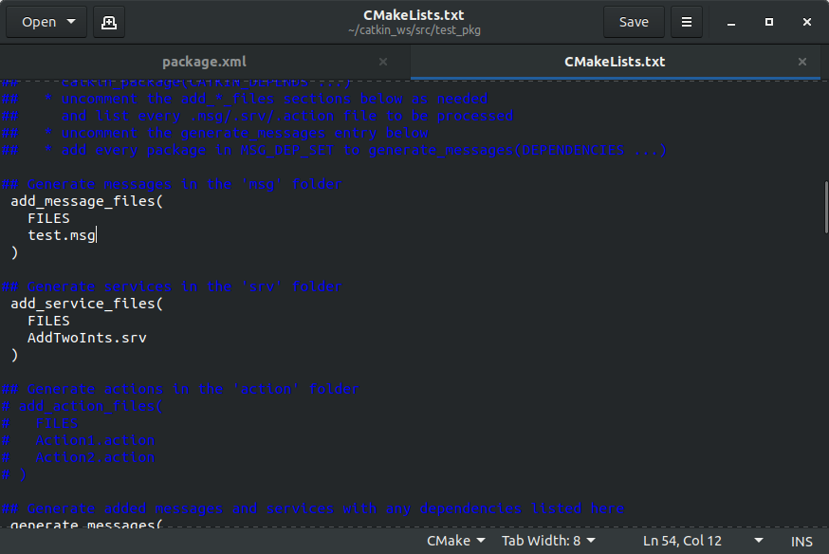
Creating custom msg and srv
-Now find the add_message_files() function uncomment it and replace the placeholder msg files with the one we made

Slide 13
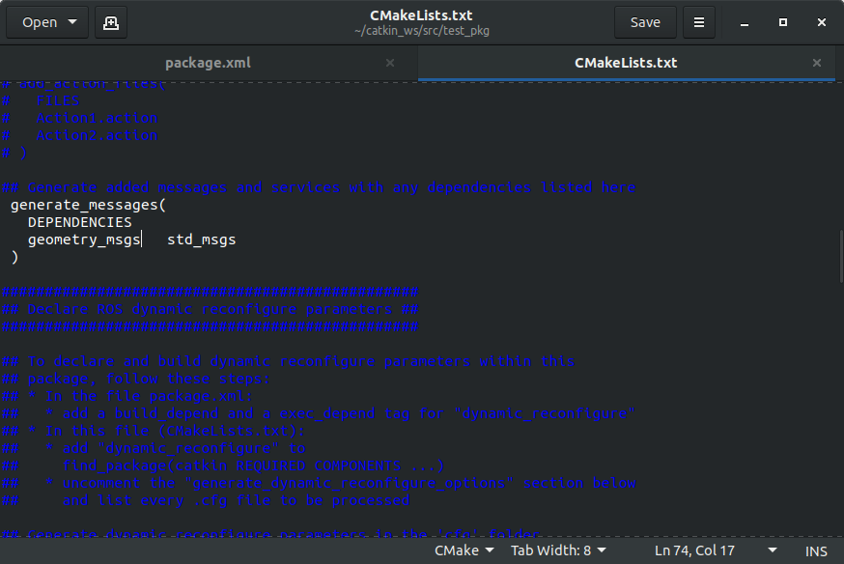
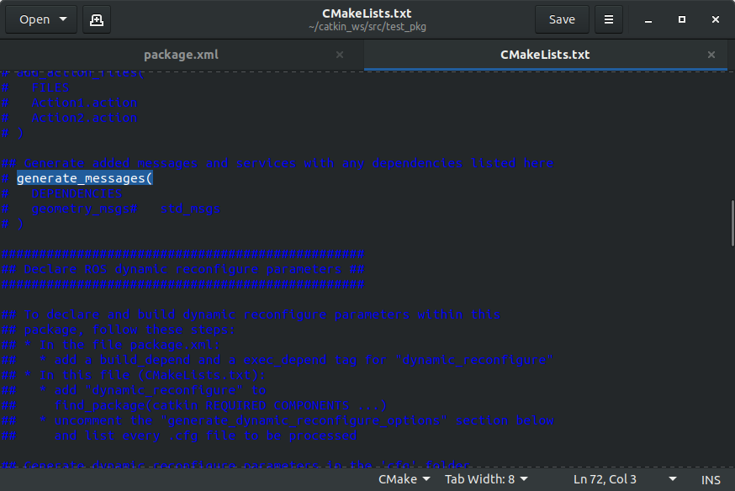
Creating custom msg and srv
-Finally uncomment the generate_messages()
-and run catkin_make

Slide 14
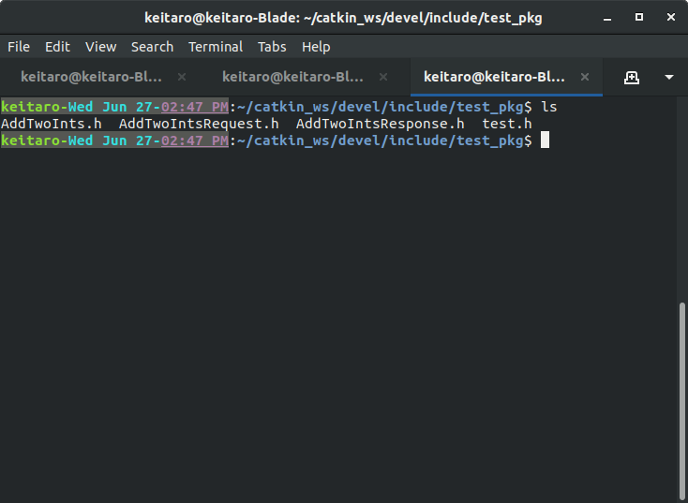
Creating custom msg and srv
-After running catkin_make you can find the header files generated for the msg and srv files in the ~/catkin_ws/devel/include/[your package name] directory

Slide 15
Running rosservice from a node
-There are two sets of code when running a rosservice from a node:
-Server
-The code that is waiting for a request and sending a response
-Client
-The code sending the request and waiting for the response

Slide 16
Running rosservice from a node
-Please refer to the “server” code
#include “test_pkg/AddTwoInts.h”
This is to add the srv to this code so we can use it. All msg and srv files made have a corresponding .h file in the build folder

Slide 17
Running rosservice from a node
bool add(test_pkg::AddTwoInts::Request &request,
test_pkg::AddTwoInts::Response &response)
{
response.sum = request.a + request.b;
ROS_INFO(“request: x=%ld, y=%ld”,(long int)request.a, (long int)request.b);
ROS_INFO(“sending back response: %ld”, (long int)response.sum);
return true;
}
The function used to when a request is sent to the server from the client. Similar to how a subscriber runs when a msg is received over a topic these functions need to be bool so as to know if the service is successful or not

Slide 18
Running rosservice from a node
ros::ServiceServer service = n.advertiseService(“add_two_ints”, add);
Similar to how a msg is sent over a topic there is a name for each service that the request and response must be sent over.

Slide 19
Running rosservice from a node
-Please refer to the “client” code
#include “test_pkg/AddTwoInts.h”
Don’t forget to add the header for the srv so the code know the format

Slide 20
Running rosservice from a node
if(argc != 3)
{
ROS_INFO(“usage: add_client X Y”);
return 1;
}
This will exit the code if the user doesn’t give the two numbers to add at the time of running

Slide 21
Running rosservice from a node
ros::ServiceClient client = n.serviceClient<test_pkg::AddTwoInts>(“add_two_ints”);
Similar to the subscriber code to tell the code where to sent the service request
Note how there isn’t a buffer variable since there is no need for one

Slide 22
Running rosservice from a node
test_pkg::AddTwoInts service;
service.request.a = atoll(argv[1]);
service.request.b = atoll(argv[2]);
This is defining and populating the service request to be sent to the server

Slide 23
Running rosservice from a node
if(client.call(service))
{
ROS_INFO(“Sum: %ld”, (long int)service.response.sum);
}
else
{
ROS_ERROR(“Failed to call service add_two_ints”);
Return 1;
}
This is the code that is sending the request and waiting for the response from the server. Though in this code it is only run once. You could run it multiple times by having it inside of a loop. There is no need for the ros::spin() code for a service.

Slide 24
Running rosservice from a node
-If you haven’t already add both codes into your src directory of your ros package as “server.cpp” and “client.cpp”
-Then open your CMakeLists.txt file and add the codes as executables by adding the following code to the bottom of your file.
add_executable(add_server src/server.cpp)
target_link_libraries(add_server ${catkin_LIBRARIES})
add_dependencies(add_server test_pkg_gencpp)
add_executable(add_client src/client.cpp)
target_link_libraries(add_client ${catkin_LIBRARIES})
add_dependencies(add_client test_pkg_gencpp)

Slide 25
Running rosservice from a node
-Finally run catkin_make from your workspace directory
-To run the service run
$ roscore
-Then in another shell run
$ rosrun [your package name] add_server
-Finally in another shell run
$ rosrun [your package name] add_client 5 2

Slide 26
HW
-Create a node that allows you to run the clear, reset, kill, and spawn services all from one node that is able to freely do it for up to 3 different turtles. You should still be able to freely move all three individually from each other.
-Edit your previous node so that you can send a custom msg to another node you will make that can call the clear, reset, kill, spawn, and one of the teleport services at will for up to three turtles. After which it will tell the user to “stop spawning turtles”
-the location for the teleports are the center, top left, and top right of the simulator.
-hint: use the teleport_absolute or teleport_relative services to do this.
-extra credit if you can choose which turtle goes where when teleporting

