Slide 1
OpenCV Tutorial
OpenCV 2.4.3
Windows 7
Microsoft Visual C++ Express 2010

Slide 2
OpenCV Tutorial
Installing Microsoft Visual C++ 2010 Express
http://www.microsoft.com/visualstudio/eng/downloads#d-2010-express
Visual C++ NOT Visual Basic/Studio

Slide 3
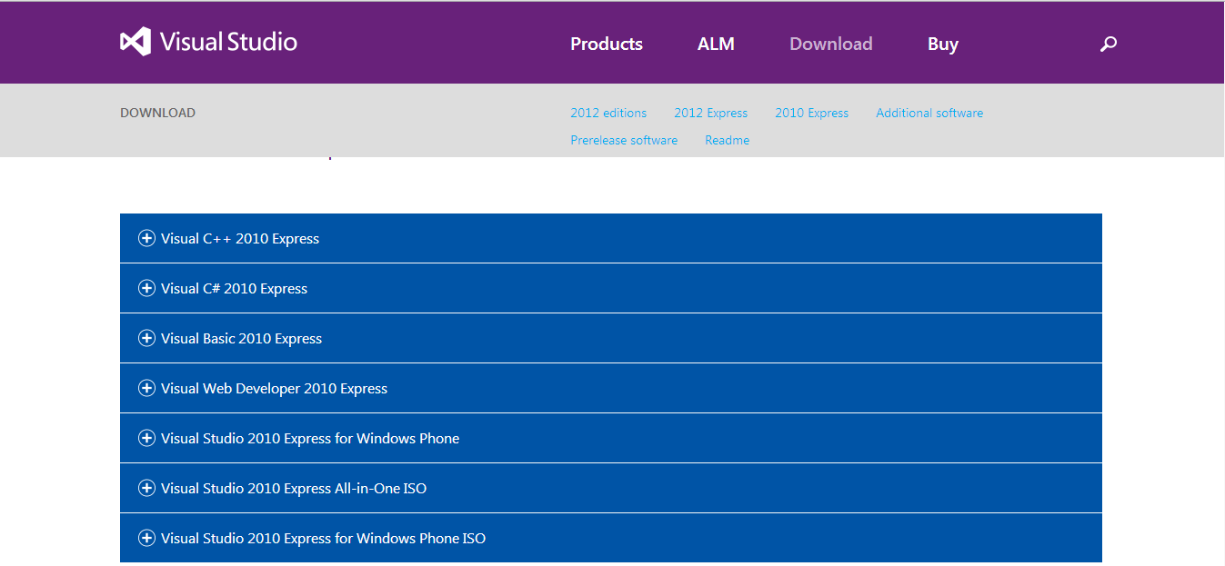
Microsoft Visual C++ 2010 Express

Slide 4
OpenCV Tutorial
Installing OpenCV 2.4.3
http://sourceforge.net/projects/opencvlibrary/files/opencv-win/2.4.3/
“OpenCV-2.4.3.exe”
Not the latest!

Slide 5
Installation Reference Sites
https://www.youtube.com/watch?v=2i2bt-YSlYQ
http://stackoverflow.com/questions/10901905/installing-opencv-2-4-3-in-visual-c-2010-express

Slide 6
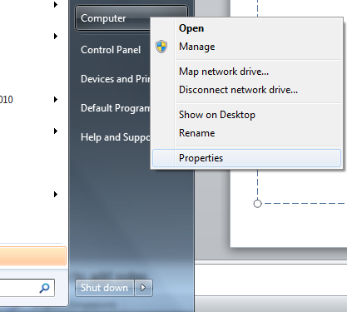
Environment Variable
Add OpenCV to PATH
Go to “Start Menu” and right click on “Computer”
Select “Properties”

Slide 7
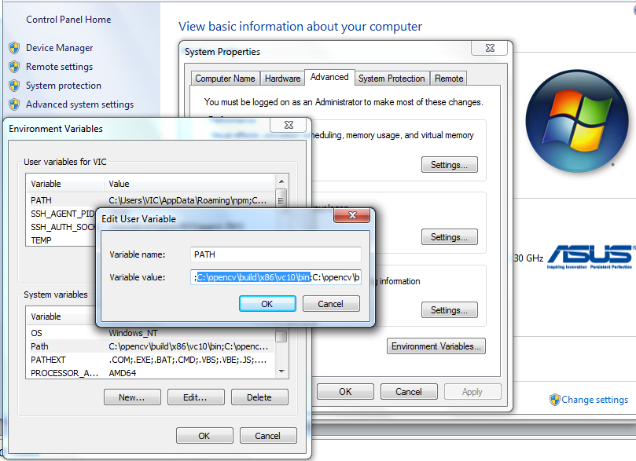
Environment Variable
Go to “Advanced system settings”
Go to “Environment Variables…”

Slide 8
Environment Variable
There is a “path” in each of the 2 sub windows
Add this line (highlighted in blue) to the “variable value”
Path\to\your\opencv\directory\opencv\build\x86\vc10\bin
Use x86 for 64-bit computer and x64 for 32-bit ones

Slide 9
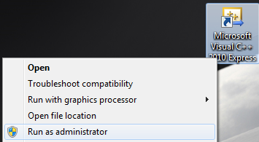
MSVC++ 2010
Go to Microsoft Visual C++ on Start menu or Desktop Shortcut and right click
Choose “Run as adminstrator”
Grants permission to use webcam etc.

Slide 10
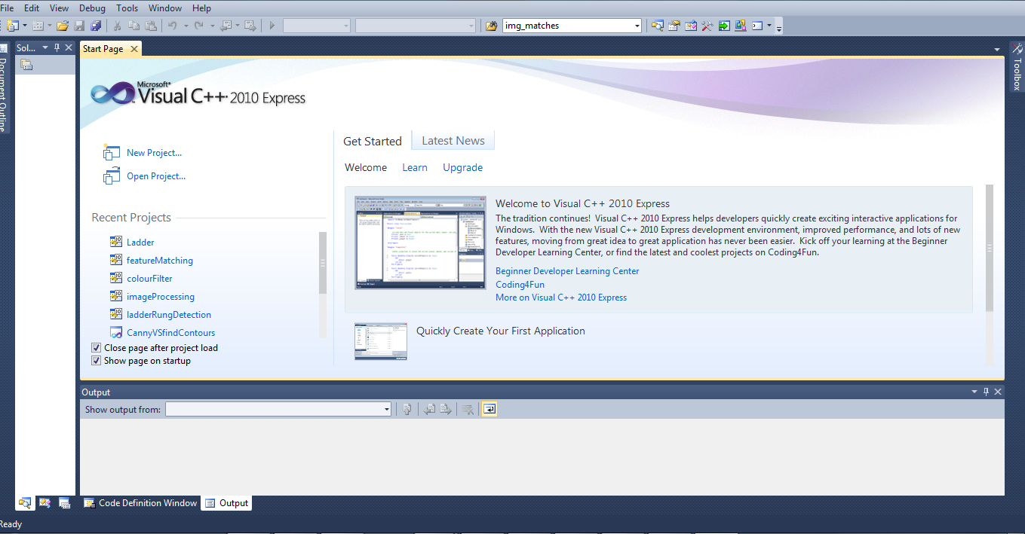
MSVC++ 2010
Click “New Project” on Start Up Page

Slide 11
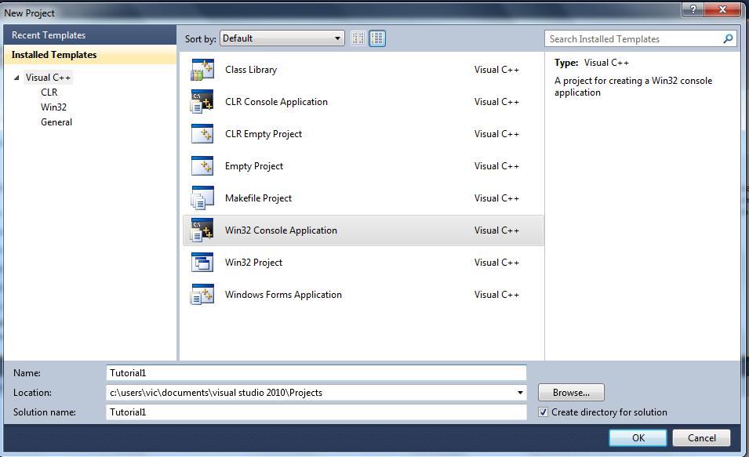
MSVC++ 2010
Choose Win32 Console Application and give your project a name (“tutorial1”)

Slide 12
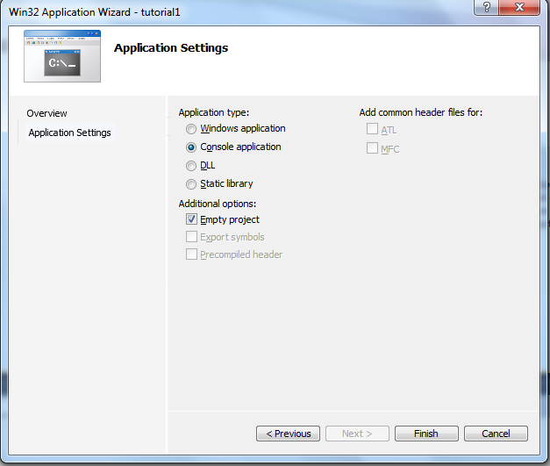
MSVC++ 2010
Click “Next”
Choose the following configuration
Click “Finish”

Slide 13
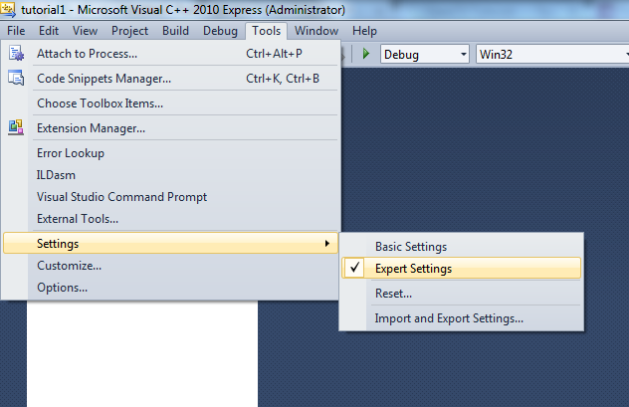
MSVC++ 2010
Change settings to “Expert settings”
Show you all the necessary things on your interface

Slide 14
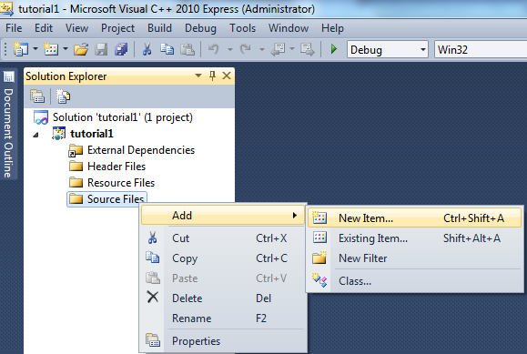
MSVC++ 2010
In Solution Explorer, right click on “Source Files”
Add “New Item”

Slide 15
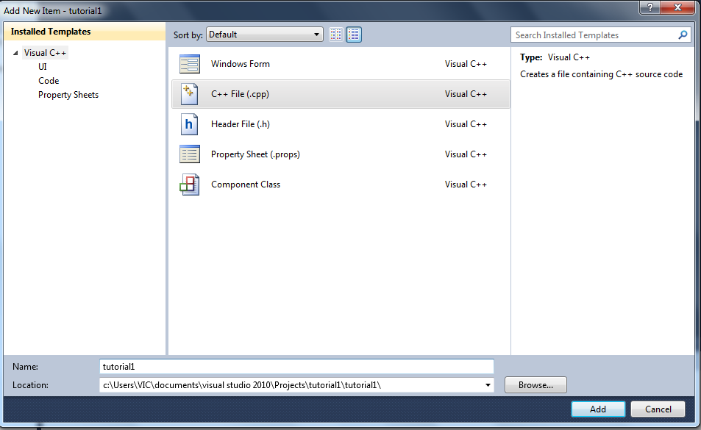
MSVC++ 2010
Choose C++ file and give it a name
We will just work with 1 class

Slide 16
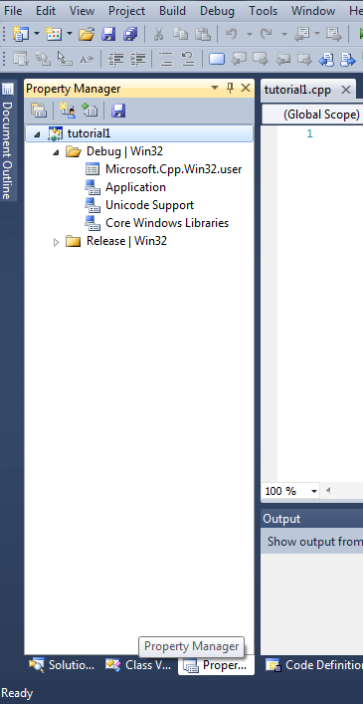
MSVC++ 2010
Navigate to “Property Manager” circled in red
Debug and Release Builds
Work on Debug

Slide 17
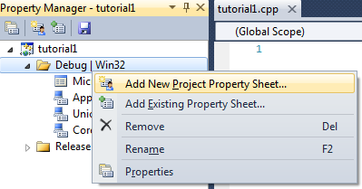
MSVC++ 2010
Right click on “Debug|Win32” and “Add New Project Property Sheet”
Give directions to the locations of libraries

Slide 18
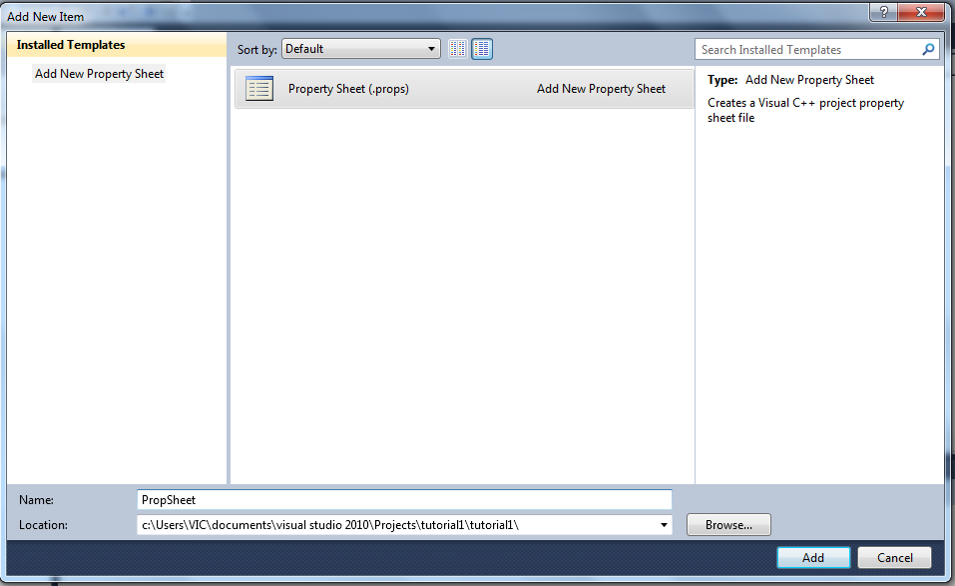
MSVC++ 2010
Make a new “Property Sheet” and give it a name

Slide 19
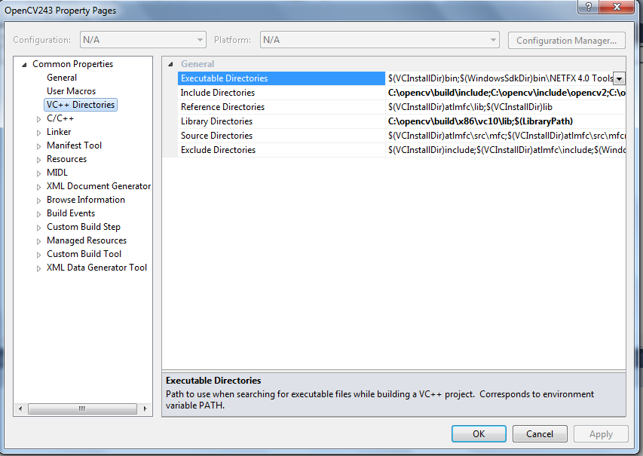
MSVC++ 2010
Click on the property sheet and go to VC Directories
The rows with BOLD world are where we are going to make changes

Slide 20
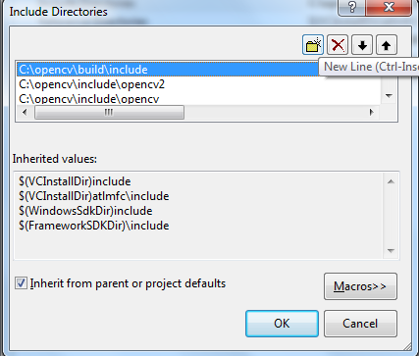
MSVC++ 2010
Right click on the “Include Directories” row and select “<Edit…>”
Click “New Line”
Add these 4 lines
Path\to\your\opencv\dir\opencv\include
Path\to\your\opencv\dir\opencv\build\include
Path\to\your\opencv\dir\opencv\build\include\opencv
Path\to\your\opencv\dir\opencv\build\include\opencv2

Slide 21
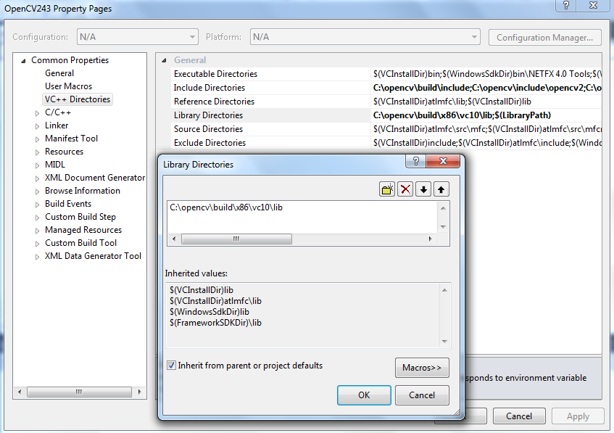
MSVC++ 2010
For “Library Directories”, add the library path
Path\to\your\opencv\dir\opencv\build\x86\vc10\lib

Slide 22
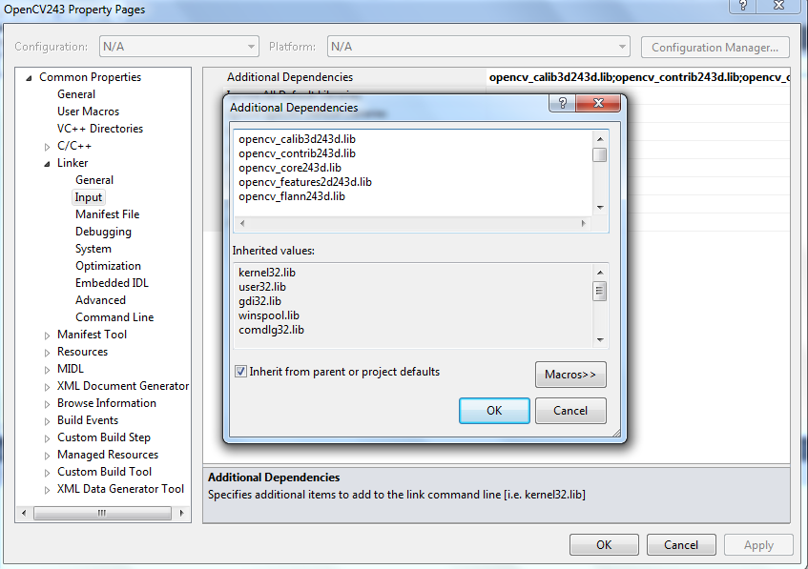
MSVC++ 2010
Go to “Linker”, “Input” “Additional Dependencies” and key in the object library files found in: Path\to\your\opencv\dir\opencv\build\x86\vc10\lib

Slide 23
MSVC++ 2010
Add only the object library files with the letter “d” at the end
It is for the Debug Build that we are going to use
Those without “d” is for the release build

Slide 24
MSVC++ 2010
List of object library files to include
opencv_calib3d243d.lib
opencv_contrib243d.lib
opencv_core243d.lib
opencv_features2d243d.lib
opencv_flann243d.lib
opencv_gpu243d.lib
opencv_haartraining_engined.lib
opencv_highgui243d.lib
opencv_imgproc243d.lib
opencv_legacy243d.lib
opencv_ml243d.lib
opencv_nonfree243d.lib
opencv_objdetect243d.lib
opencv_photo243d.lib
opencv_stitching243d.lib
opencv_ts243d.lib
opencv_video243d.lib
opencv_videostab243d.lib

Slide 25
Template
#include "opencv2/highgui/highgui.hpp"
#include "opencv2/imgproc/imgproc.hpp"
#include <iostream>
using namespace cv;
using namespace std;
Mat original;//global
int main(int argc, char** argv)
{
VideoCapture cap(0);
if(!cap.isOpened())
return -1;
while(1)
{
cap >> original;//get new image
imshow("original",original);//show image in a window
if(waitKey(30) >= 0) break;
}
return 0;
}

Slide 26
Resources
OpenCV API
http://docs.opencv.org/modules/refman.html
Documents all the available OpenCV functions
Use?
Argument number and types?

Slide 27
Functions
void Canny(InputArray image, OutputArray edges, double threshold1, double threshold2, int apertureSize=3, bool L2gradient=false )
Parameters:
image – single-channel 8-bit input image.
edges – output edge map; it has the same size and type as image .
threshold1 – first threshold for the hysteresis procedure.
threshold2 – second threshold for the hysteresis procedure.
apertureSize – aperture size for the Sobel() operator.
L2gradient – a flag, indicating whether a more accurate norm should be used to calculate the image gradient magnitude ( L2gradient=true ), or whether the default norm is enough ( L2gradient=false ).

Slide 28
Functions
void cvtColor(InputArray src, OutputArray dst, int code, int dstCn=0 )
Parameters:
src – input image: 8-bit unsigned, 16-bit unsigned ( CV_16UC... ), or single-precision floating-point.
dst – output image of the same size and depth as src.
code – color space conversion code (see the description below).
The conventional ranges for R, G, and B channel values are:
0 to 255 for CV_8U images
0 to 65535 for CV_16U images
0 to 1 for CV_32F images
dstCn – number of channels in the destination image; if the parameter is 0, the number of the channels is derived automatically from src and code .

Slide 29
Going Further
OpenCV Tutorials
http://docs.opencv.org/doc/tutorials/tutorials.html
YouTube Channels on Image Processing
https://www.youtube.com/user/HoffWilliam?feature=watch

Slide 30
Some Videos
http://www.pdnotebook.com/2012/07/measuring-angles-in-opencv/
https://www.youtube.com/watch?v=GPTMvFeYzzk
https://www.youtube.com/watch?v=nP-l3ApSDX8

