Slide 1
DASL 107 Introduciton to ROS Class #1

Slide 2
Agenda
Install Ubuntu
Why Learn ROS?
What is ROS?
Install ROS

Slide 3
Install Ubuntu
Plug in the USB while computer is off
Turn on and go into boot mode (Usually f12 but could be different)
Install Ubuntu
Make sure not to connect to wifi during installation
The school wifi has added security that makes it harder to connect to

Slide 4
Why Learn ROS?
It’s used in robots across different industries
Military (ROS-M)
Manufacturing (ROS-I)
Academia (ROS 1/2)
Modular design
Easy to reuse code in various projects
Easy to add/change functionality (Rapid Prototying)
Distributed Computation
Can run across multiple computers and robots

Slide 5
What is ROS?
Robot Operating System (ROS)
Communication Middleware Layer

Slide 6
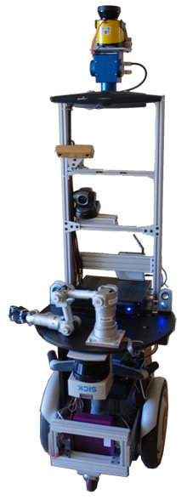
What is ROS?
2007 Stanford Artificial Intelligence Lab
Switchyard
STAIR robot
2008 Willow Garage
2013 Open Source Robotics Foundation (OSRF)

Slide 7
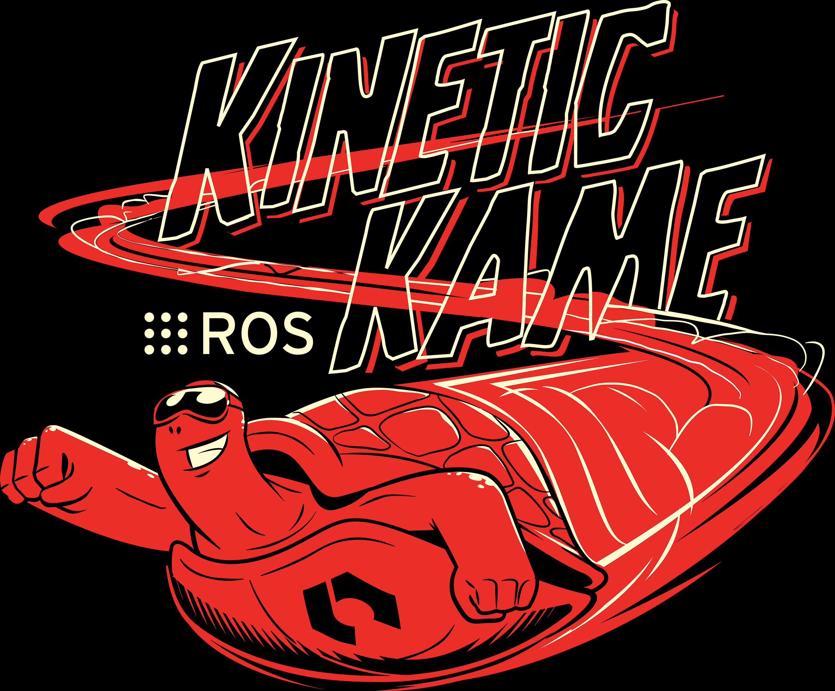
Install ROS
For every version of Ubuntu there is a version of ROS made specifically for it.
For Ubuntu 16.04 use ROS Kinetic
For Ubuntu 18.04 use ROS Melodic

Slide 8
Install ROS
Go to the corresponding instructions and follow them carefully
Kinetic (http://wiki.ros.org/kinetic/Installation/Ubuntu)
Melodic (http://wiki.ros.org/melodic/Installation/Ubuntu)

