Slide 1
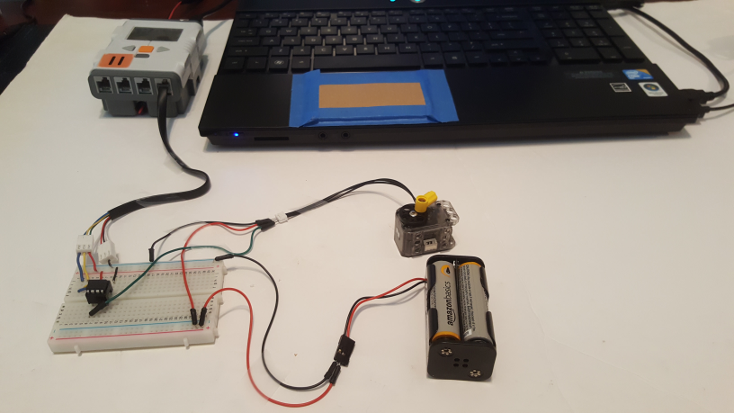
Last updated 06/13/19
Dynamixel XL-320 to LEGO NXT Connection Via MAX485 Chip
Preamble: The LEGO NXT’s Port 4 is a RS-485 serial port. RS-485 operates at +/-12 Volts. However the Dynamixel XL-320 operates its serial lines on TTL (i.e. 0 to 5 Volt) levels. As such, a Maxim MAX485 TTL-to-RS485 converter chip is used.
NXT Port 4
Dynamixel XL-320 (ID# 3)
Four AA Battery pack
MAX485 TTL-to-485 chip

Slide 2
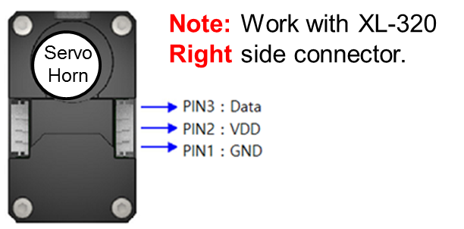
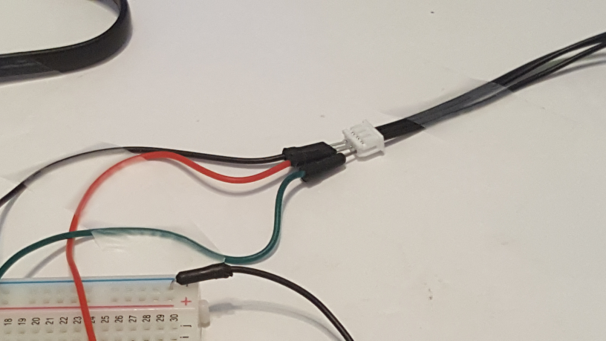
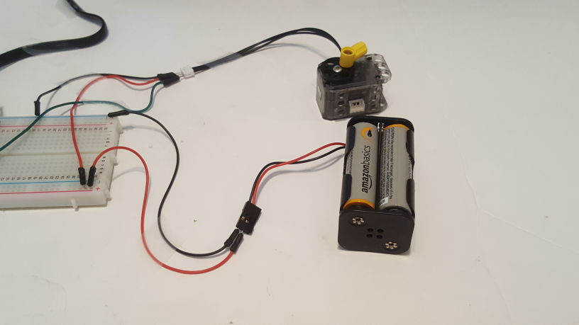
Last updated 06/13/19
Step 1: 6 Volt Motor (Dynamixel XL-32) Voltage wiring
http://emanual.robotis.com/docs/en/dxl/x/xl320/#control-table-of-eeprom-area - Datasheet of XL-320 shows pins connections. From top-view (i.e. looking into servo horn)
RED Jumper
To Breadboard
BLK Jumper
Battery GND and XL-320 Pin 3 (GND) tied
Close-up of Molex Connector
+6V line (RED) and XL-320 Pin 2 (VDD) tied
Insert male black and red jumper wires into the XL-320’s Molex connector. Attach other ends into breadboard.
Insert Battery pack’s +6V and GND lines into breadboard

Slide 3
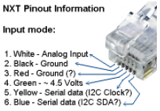
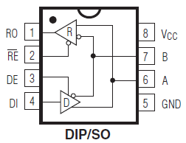
Last updated 06/13/19
Step 2: NXT to MAX485 Wiring
One splices an standard NXT cable and connects wires into Breadboard
Recall that an NXT cable has the following wire colors and functions
NXT 4.5V into Pin 8
NXT SCL into Pin 7
NXT SDA into Pin 6
NXT GND into Pin 5
Maxim MAX485 Chip
Spliced NXT Cable
NXT 4.5V (GRN) with RED Jumper
RED to VCC (Pin 8)
NXT SDA (BLU)
BLK to GND (Pin 5)
YLW to B (Pin 7)
NXT SCL (YLW)
NXT GND (BLK)
BLU to A (Pin 6)
Insert NXT 4.5 V, SCL, SDA, and GND lines into breadboard
Connect jumpers between NXT lines and MAX485 chip. Note: The GRN wire stemming from Pin 2 of MAX485 explained in Step 3

Slide 4
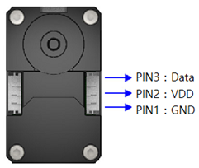
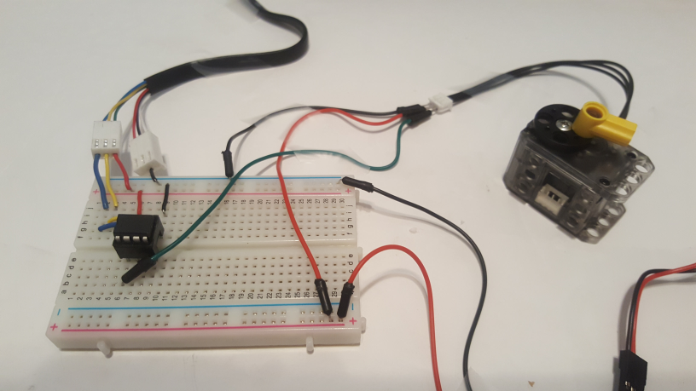
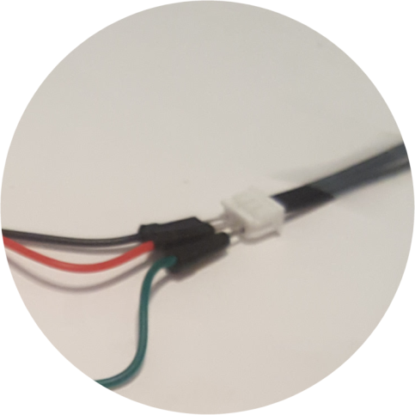
Last updated 06/13/19
Step 3: MAX485 to Dynamixel XL-320 Wiring
DATA to MAX485 Pin 1 (GRN) Jumper
GNDs tied to Breadboard GND
Maxim MAX485 Chip
XL-320 Molex Connector
GRN Jumper from MAX485 Pin 1 (RO) to XL-320 Pin 3 (Data)
Close-up: GRN jumper wire inserts into Molex connector, which is the XL-320 Pin 3 (Data)
Connect a jumper wire (GRN) between the MAX485 Pin 1 (R0) and XL-320 Molex connector Pin 3 (Data)

Slide 5
Last updated 06/13/19
Step 4: Sample NXC code to rotate CW and CCW (helloDynamixelXl320-1.0a.nxc)
// FILE: helloDynamixelXl320-1.0a.nxc
// DATE: 06/13/19 10:36
// AUTH: P.Oh
// DESC: NXT commands Dynamixel XL-320 CW and CCW rotation
// REFS: Norberto Torres-Reyes tutorial and RotateMotor.nxc
// NOTE: If factory default XL-320 used, then ID is 0x01
// ID of 0xFE commands any and all XL-320 motors
// This example uses an XL-320 configured with ID# 3
#include "DynamixelXL320.h"
#define ID_ALL_MOTORS 0XFE // 0XFE commands all XL-320 motors
#define ID_MOTOR01 0X03 // Assumes Motor 1 configured with ID = 3
task main() {
UseRS485();
RS485Enable();
RS485Uart(HS_BAUD_57600, HS_MODE_8N1); //57600 baud, 8bit, 1stop, no parity
while(true){
Wait(2000);
Servo(ID_MOTOR01,900,200); // rotate to motor position 900, speed 200
Wait(2000);
Servo(ID_MOTOR01,0,200); // counter-rotate to 0 at speed 200
} // end while
} // end main
NB: Need to include DynamixelXL320.h file (too large to show in these slides) in same directory as above NXC program. Note: ID 3 is the sticker on the XL-320 denoted in these slides. Red text shows this as 0x03 (or 3 decimal) which was set via Dynamixel Wizard before running this code.
Congratulations! You connect the NXT to a Dynamixel XL-320 via a MAX485 Chip

