Slide 1
Last updated 06/13/19
Dynamixel XL-320 to LEGO NXT Connection Via DROX Board
Preamble: The LEGO NXT’s Port 4 is a RS-485 serial port. RS-485 operates at +/-12 Volts. However the Dynamixel XL-320 operates its serial lines on TTL (i.e. 0 to 5 Volt) levels. As such, a TTL-to-RS485 converter (DROX Board) is used.
NXT Port 4
Dynamixel XL-320 (ID# 3)
DROX TTL-to-485 converter
Four AA Battery pack

Slide 2
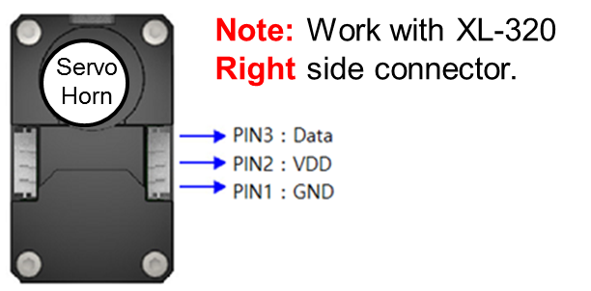
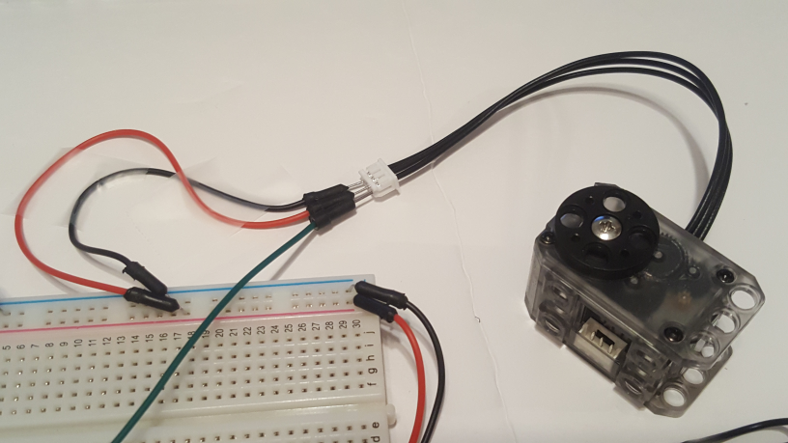
Last updated 06/13/19
Step 1: 6 Volt Motor (Dynamixel XL-32) Voltage wiring
http://emanual.robotis.com/docs/en/dxl/x/xl320/#control-table-of-eeprom-area - Datasheet of XL-320 shows pins connections. From top-view (i.e. looking into servo horn)
RED Jumper
To Breadboard
BLK Jumper
Close-up
Insert male black and red jumper wires into the XL-320’s Molex connector. Attach other ends into breadboard.
Insert Battery pack’s +6V and GND lines into breadboard as well

Slide 3
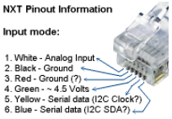
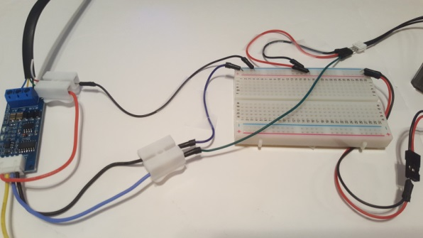
Last updated 06/13/19
Step 2: NXT to DROX Wiring
One splices an standard NXT cable and connects wires into the DROX’s screw terminals.
Recall that an NXT cable has the following wire colors and functions
DROX Pinout diagram https://www.droking.com/ttl-to-rs485-module-dc-3.0v-30v-rs485-to-ttl-mutual-conversion-hardware-automatic-flow-control-module-converter-module?search=ttl%20to%20rs485&description=true
NXT SCK (YLW) to DROX B- Terminal
NXT GND (RED) to Breadboard GND line
Breadboard GND line
NXT SDA (BLU) to DROX A+ Terminal
Spring-loaded wire connector
NXT GND (BLK) to DROX GND Terminal
NXT 4.5 V (GRN) to DROX VCC (RED) wire
DROX VCC (RED) wire
Close-up of NXT cable (red circle)

Slide 4
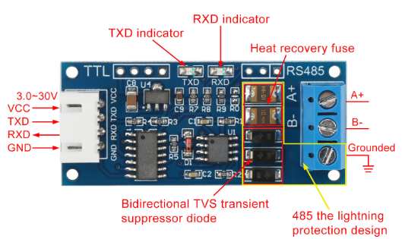
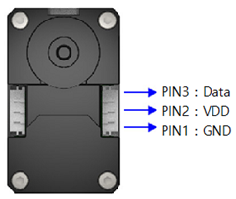
Last updated 06/13/19
Step 3: DROX to Dynamixel XL-320 (TTL) Wiring
DATA to RXD (BLU) Jumper
GNDs tied to Breadboard GND
Close-up of DROX GND (red circle)
Close-up of DROX RXD (black circle)
XL-320 Molex Pin 3 (Data)
Breadboard GND line
DROX GND (BLK) to Breadboard GND via jumper wire (BLK)
DROX RXD (BLU) to XL-320 Data via jumper wire (GRN)
Insert DROX GND (BLK) into one end of spring connector and a black jumper wire into the other end. Insert end of jumper into breadboard GND line
Insert DROX RXD (BLU) into one end of spring connector and a green jumper wire into the other end. Insert end of jumper into XL-320 Molex connector (Pin 3: Data)

Slide 5
Last updated 06/13/19
Step 4: Sample NXC code to rotate CW and CCW (helloDynamixelXl320-1.0a.nxc)
// FILE: helloDynamixelXl320-1.0a.nxc
// DATE: 06/13/19 10:36
// AUTH: P.Oh
// DESC: NXT commands Dynamixel XL-320 CW and CCW rotation
// REFS: Norberto Torres-Reyes tutorial and RotateMotor.nxc
// NOTE: If factory default XL-320 used, then ID is 0x01
// ID of 0xFE commands any and all XL-320 motors
// This example uses an XL-320 configured with ID# 3
#include "DynamixelXL320.h"
#define ID_ALL_MOTORS 0XFE // 0XFE commands all XL-320 motors
#define ID_MOTOR01 0X03 // Assumes Motor 1 configured with ID = 3
task main() {
UseRS485();
RS485Enable();
RS485Uart(HS_BAUD_57600, HS_MODE_8N1); //57600 baud, 8bit, 1stop, no parity
while(true){
Wait(2000);
Servo(ID_MOTOR01,900,200); // rotate to motor position 900, speed 200
Wait(2000);
Servo(ID_MOTOR01,0,200); // counter-rotate to 0 at speed 200
} // end while
} // end main
NB: Need to include DynamixelXL320.h file (too large to show in these slides) in same directory as above NXC program. Note: ID 3 is the sticker on the XL-320 denoted in these slides. Red text shows this as 0x03 (or 3 decimal) which was set via Dynamixel Wizard before running this code.
Congratulations! You connect the NXT to a Dynamixel XL-320 via a DROX TTL-to-RS485 board

