Slide 1
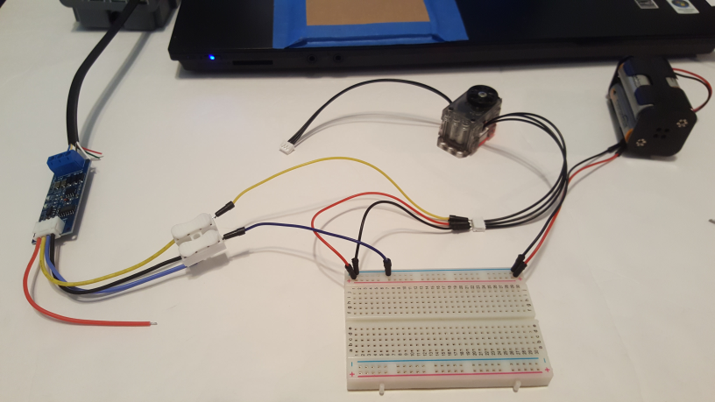
Dynamixel XL-320 to LEGO NXT Connection
Last updated 06/11/19
Preamble: The LEGO NXT’s Port 4 is a RS-485 serial port. RS-485 operates at +/-12 Volts. However the Dynamixel XL-320 operates its serial lines on TTL (i.e. 0 to 5 Volt) levels. As such, a TTL-to-RS485 converter is used.
Dynamixel XL-320
NXT Port 4
DROX TTL-to-485 converter
Four AA Battery pack

Slide 2
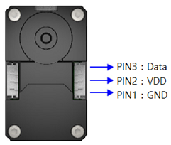
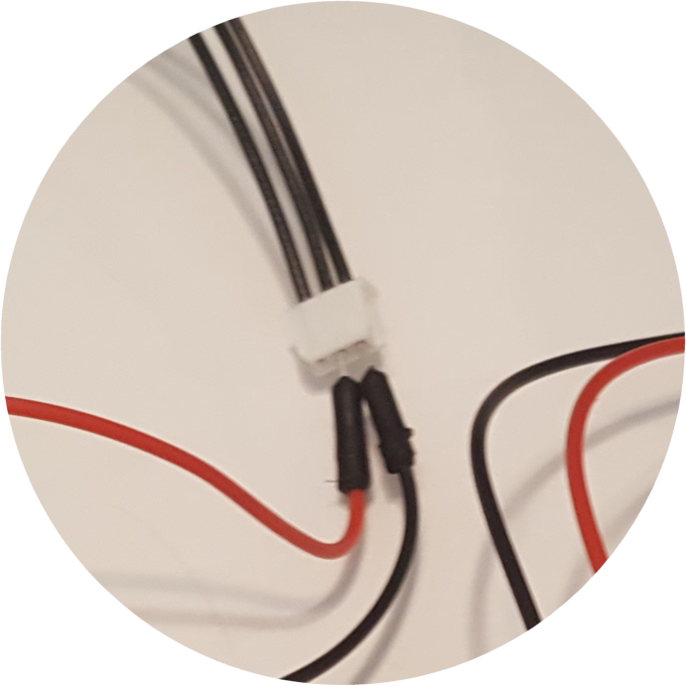
Last updated 06/11/19
Step 1: 6 Volt Motor (Dynamixel XL-32) Voltage wiring
Note: Work with XL-320 Right side connector.
Datasheet of XL-320 shows pins connections.
http://emanual.robotis.com/docs/en/dxl/x/xl320/#control-table-of-eeprom-area
NB: left figure is from Top i.e. looking into the servo horn
Servo
Horn
Insert male black and red jumper wires into the XL-320’s Molex connector. Attach other ends into breadboard. Insert Battery pack’s +6V and GND lines into breadboard as well
Not connected
RED Jumper
BLK Jumper
Close-up
Four AA Battery pack

Slide 3
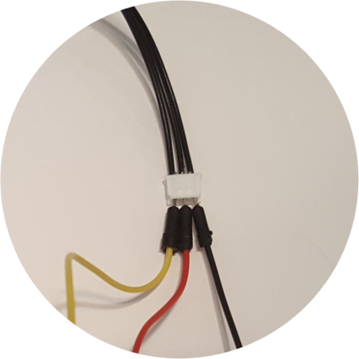
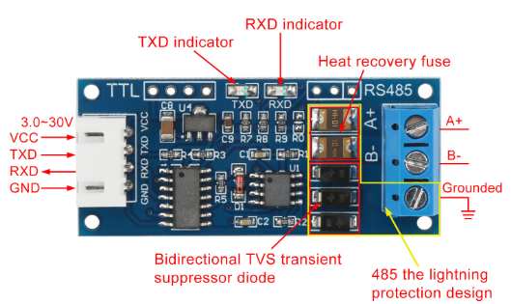
Last updated 06/11/19
Step 2: DROX to Dynamixel XL-320 (TTL) Wiring
DROX Pinout diagram https://www.droking.com/ttl-to-rs485-module-dc-3.0v-30v-rs485-to-ttl-mutual-conversion-hardware-automatic-flow-control-module-converter-module?search=ttl%20to%20rs485&description=true
XL-320 DATA Pin 3 (YLW)
DROX TXD wire (YLW)
Jumper from DROX TXD connects to XL-320 Pine 3 (Data)
Jumper from DROX GND to Breadboard GND and XL-320 GND
DROX GND wire (BLK)
DATA to TXD: YLW Jumper
GNDs tied to Breadboard GND

Slide 4
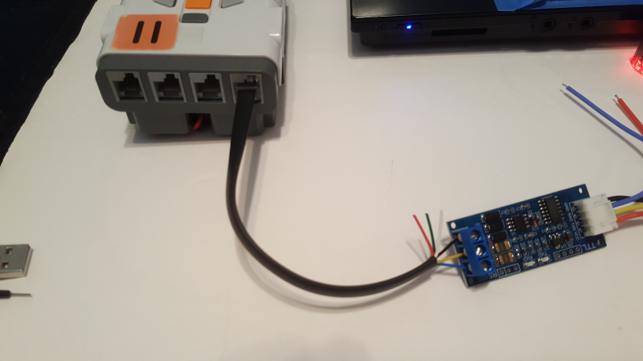
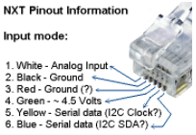
Last updated 06/11/19
Step 3: DROX to NXT Wiring (RS-485)
Splice NXT cable
Insert YLW (SDA), BLU (SCL) and BLK (GND) wires into the DROX screw terminal
DROX (A+) to NXT (SDA Pin 6)
DROX (B-) to NXT (SCL Pin 5)
DROX (GND) to NXT (GND Pin 2)

Slide 5
Last updated 06/11/19

Slide 6
Last updated 06/11/19

