Slide 1
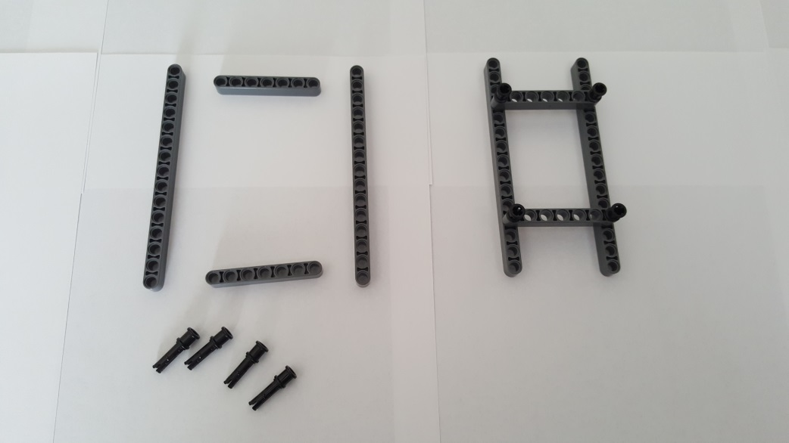
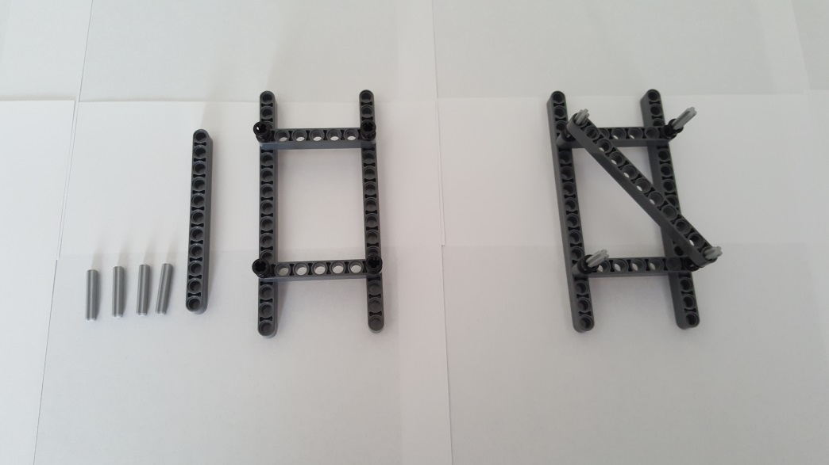
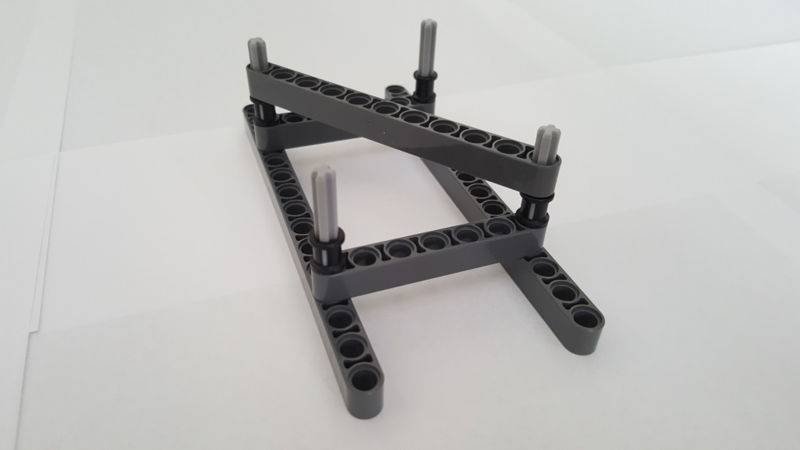
Step A: Truss Sub-Assembly
Step A-1: Lower Truss
2x 15-Beam 32278
1x 11-Beam 32525
2x
7-Beam 32524
4th hole
4x Pin 3L with Stop Bush 32054
4x 3-Axle 4519
Gather parts (left). Insert two Pin 3L at each end of 7-Beam. Repeat with other 7-Beam. Connect 7-Beams to 4th hole of 15-Beam. Finished step (right)
Gather parts (left). Insert a 3-Axle in each Pin 3L’s Stop Bush. Lay 11-Beam diagonally across 3-Axles. Finished step (right)
Close-up of Finished step

Slide 2
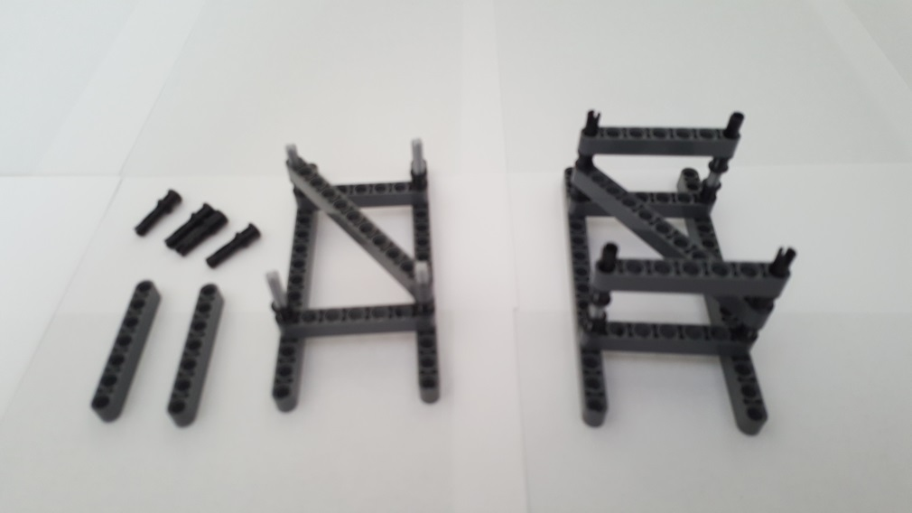
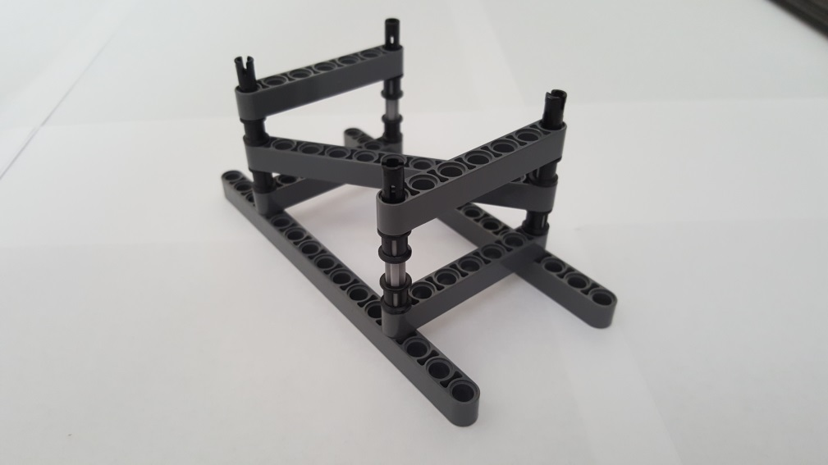
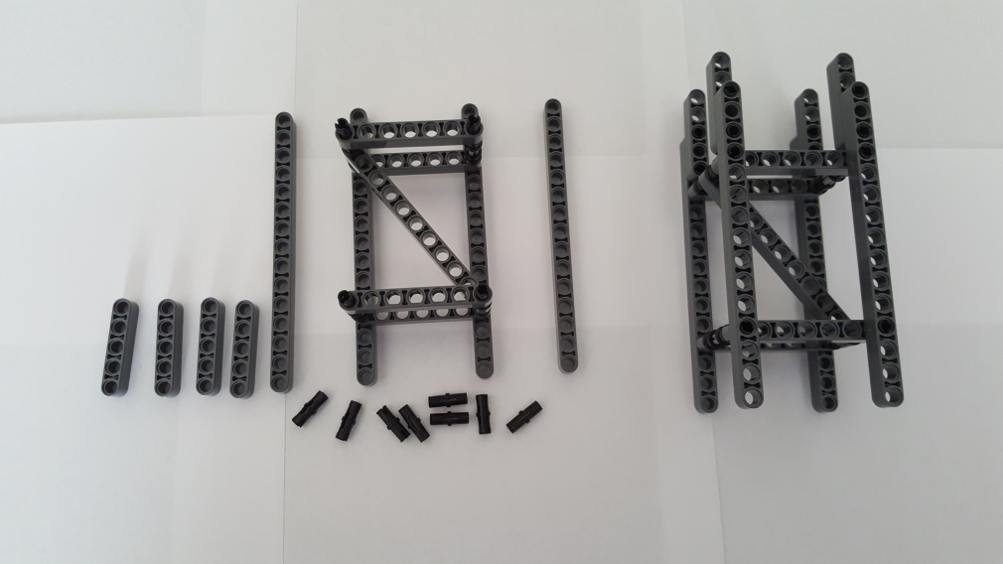
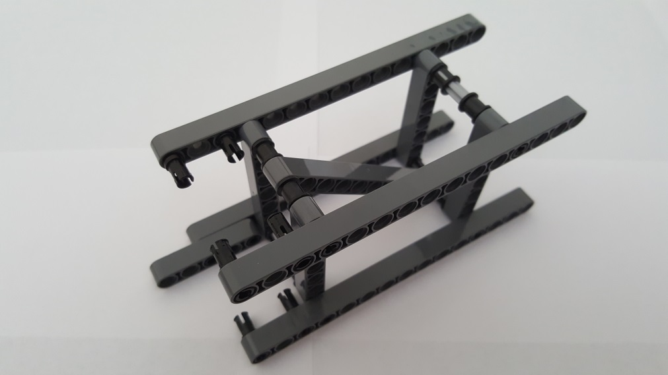
4x Pin 3L with Stop Bush 32054
2x 7-Beam 32524
Gather parts (left). Insert each Pin 3L Stop Bush over the 3-Axle. Connect 7-Beam over each Pin 3L. Finished step (right)
Close-up of Finished step
2x 15-Beam 32278
4x 5-Beam 32316
8x Friction Pin 2780
Gather parts (left). Connect 15-Beams over Pin 3L. Connect 5-Beam to 15-Beam with Friction Pins Finished step (right)
Close-up: Red arrows show where Friction Pins are inserted into 15-Beam and 5-Beam. The remaining 6 Friction Pins are also seen

Slide 3
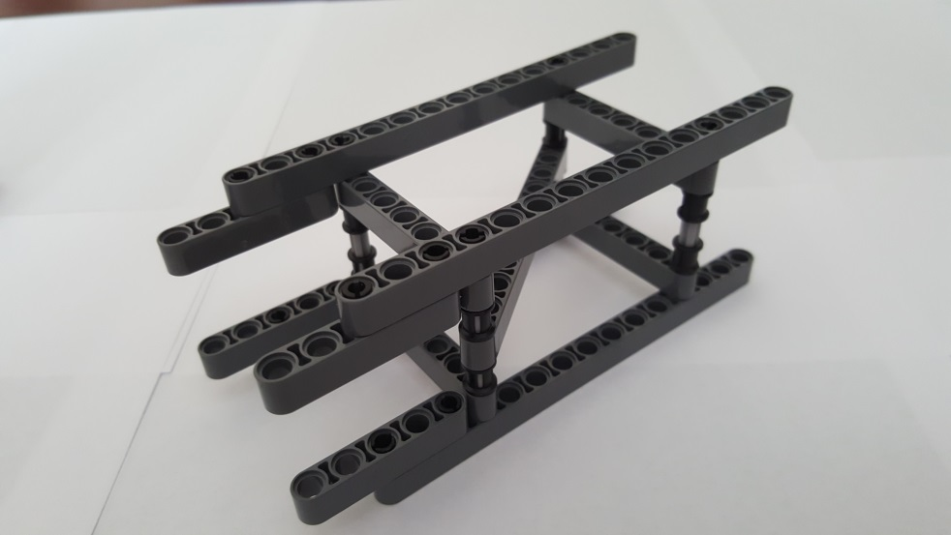
Completed Lower Truss
Close-up of Finished brace. Red arrows point to locations of Friction Pins to connect 5-Beams to 15-Beams

Slide 4
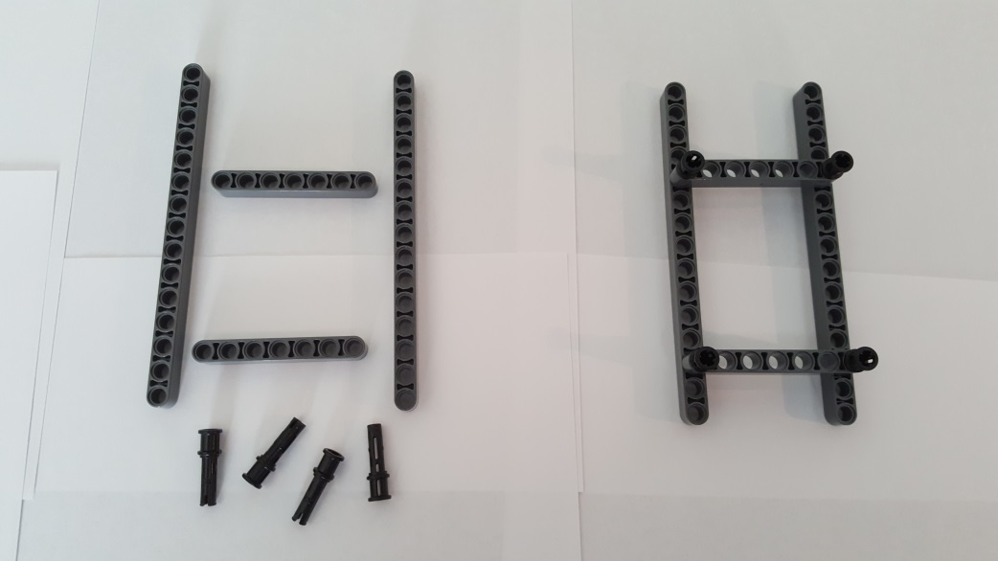
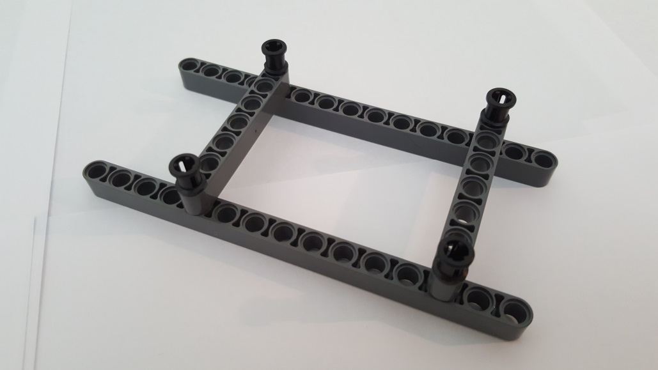
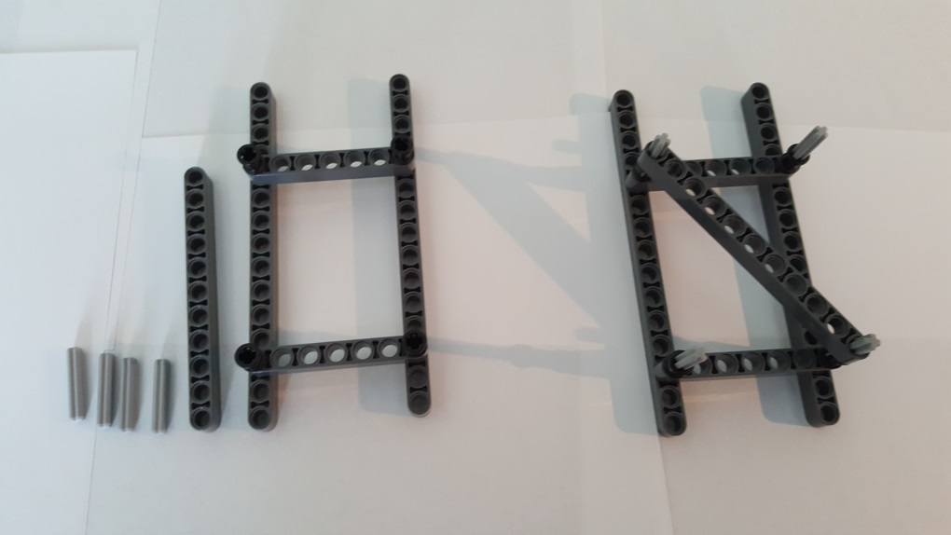
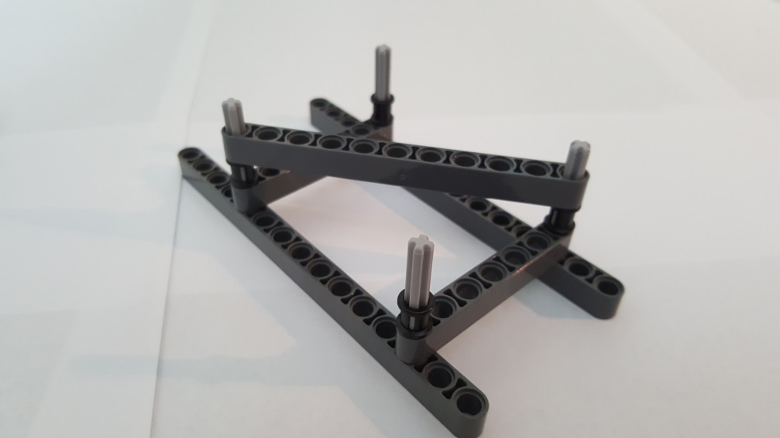
Step A-2: Middle Truss
2x 15-Beam 32278
2x 7-Beam 32524
3rd hole of 15-beam
4x Pin 3L with Stop Bush 32054
5th hole of 15-beam
Gather parts (left). Insert two Pin 3L at each end of 7-Beam. Repeat with other 7-Beam. Connect 7-Beams to 3rd and 5th holes of 15-Beam. Finished step (right)
Close-up of finished step
1x 11-Beam
32525
4x 3-Axle 4519
Gather parts (left). Insert each 3-Axle into each Pin 3L’s Stop Bush. Diagonally lay11-Beam over Axles
Close-up of finished step

Slide 5
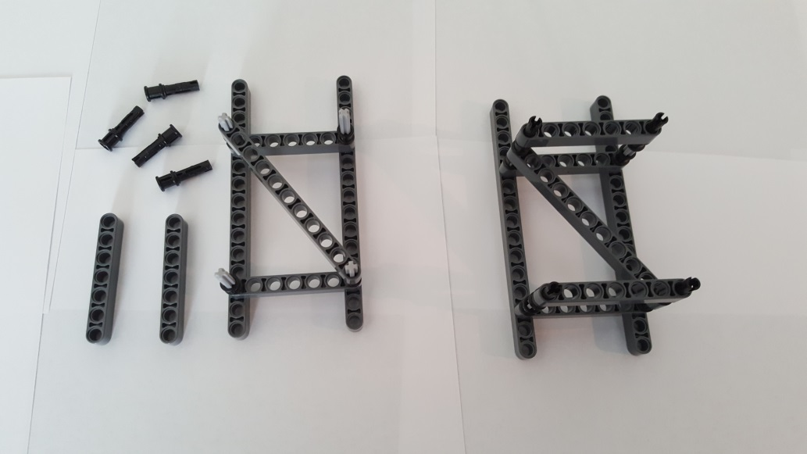
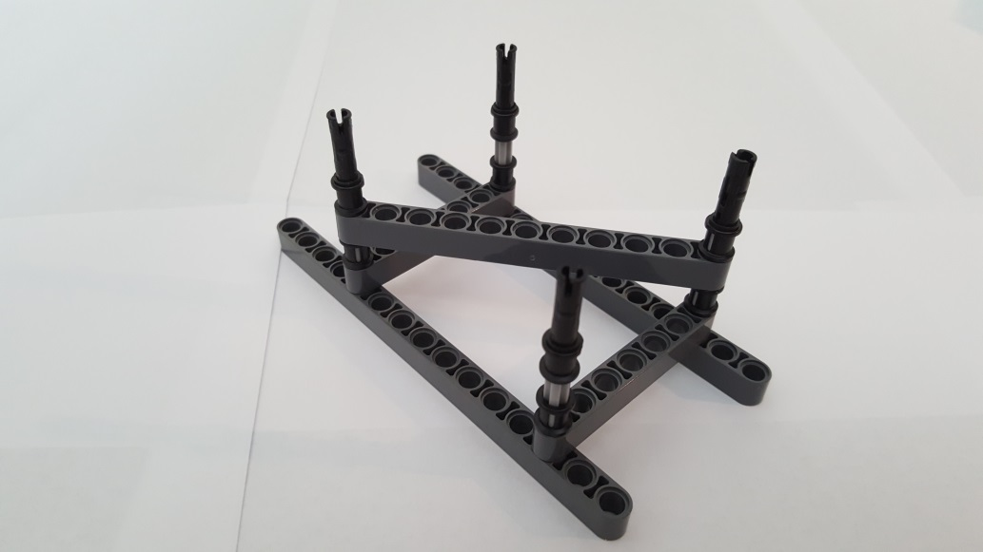
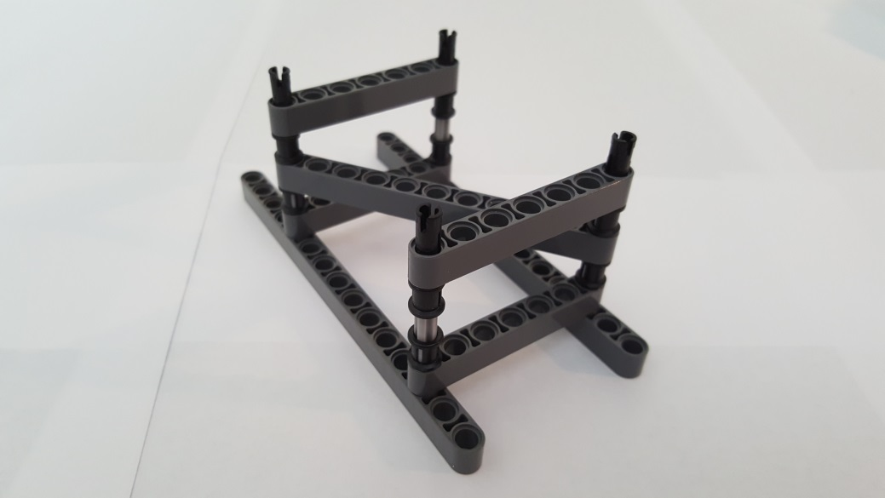
4x Pin 3L with Stop Bush 32054
2x 7-Beam 32524
Gather parts (left). Insert each Pin 3L’s Stop Bush into 3-Axle. Insert 7-Beam over Pin 3L peg. Finished step (right)
Close-up: Red Arrows show a Pin 3L’s Stop Bush inserted over a 3-Axle.
Close-up: 7-Beam inserted into Ping 3L

Slide 6
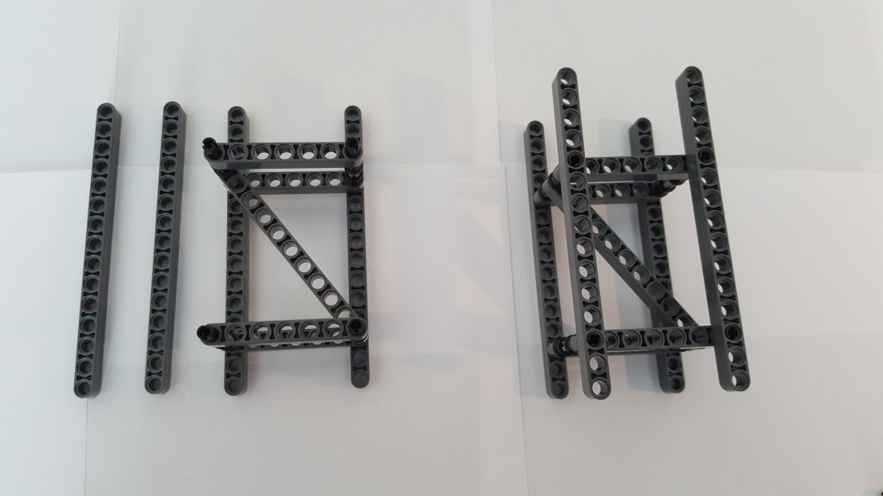
2x 15-Beam 32278
4 open holes
Completed Middle Truss
(NB: Has 4 open holes in 15-Beam)
Gather parts (left). Insert 15-Beam over Pin 3L pegs. Finished step (right)

Slide 7
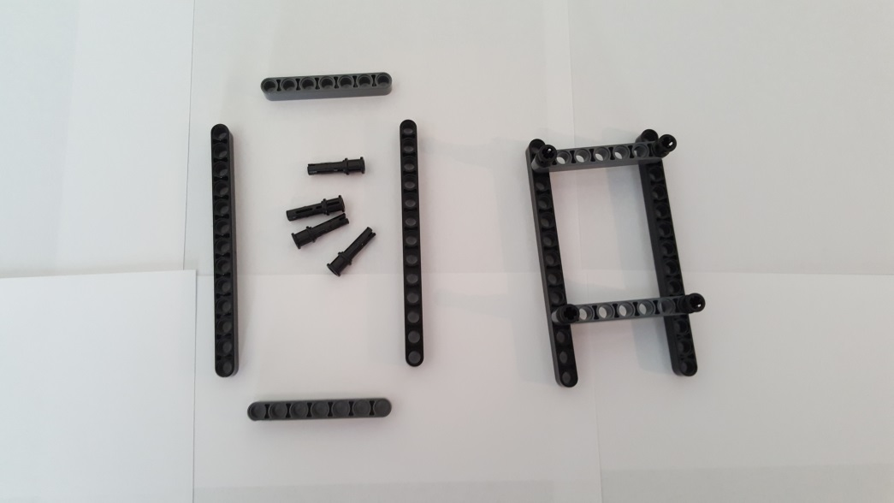
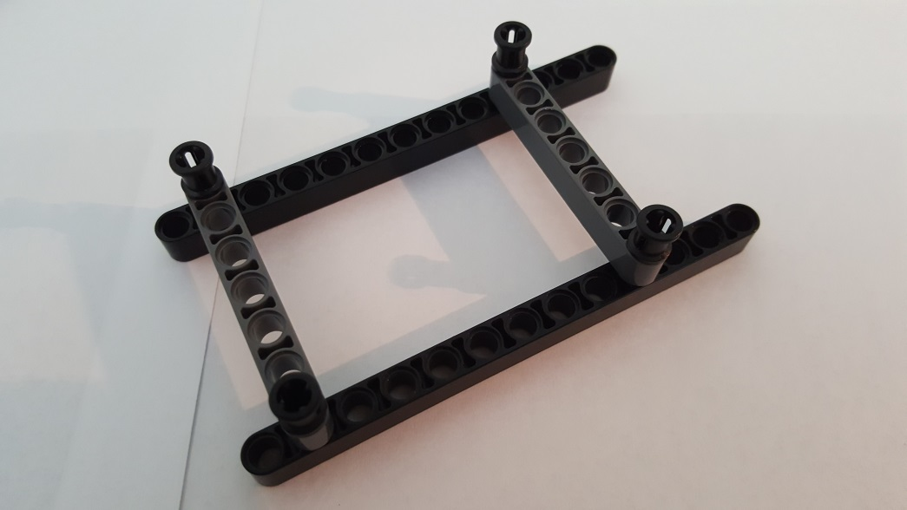
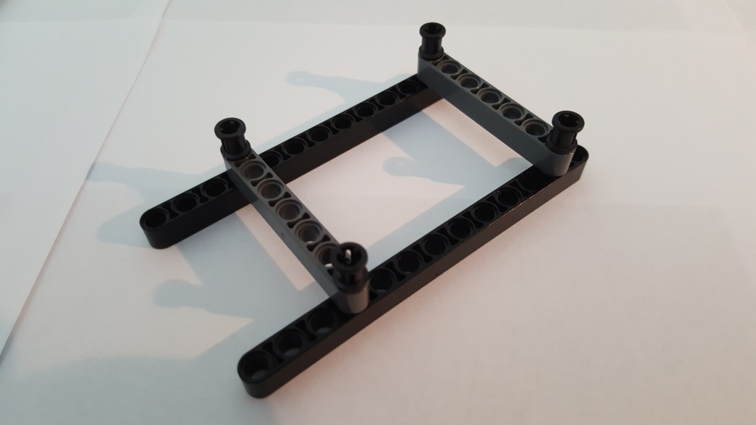
Step A-3: Upper Truss
2x 13-Beam 41239
4x Pin 3L with Stop Bush 32054
2x 7-Beam 32524
Gather parts (left). Insert two Pin 3L at each end of 7-Beam. Repeat with other 7-Beam. Connect 7-Beams to 2nd and 4th holes of 13-Beam. Finished step (right)
Close-up: Red Arrows show Pin 3L inserted into 2nd and 4th holes of 13-Beam
2nd hole of 13-Beam
4th hole of 13-Beam

Slide 8
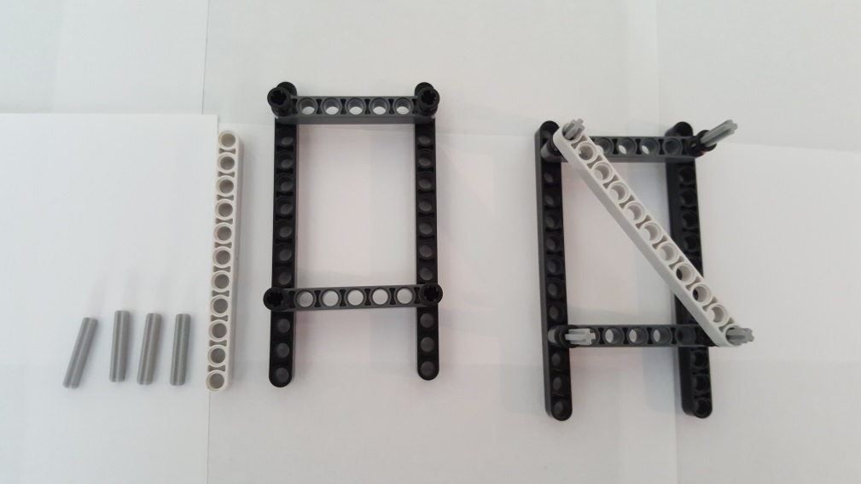
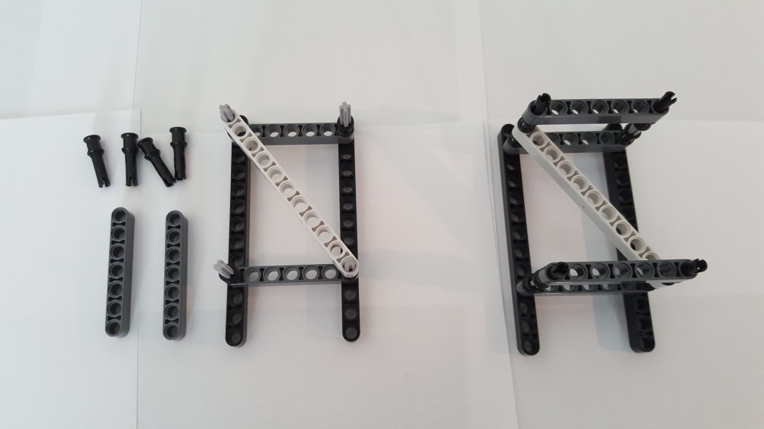
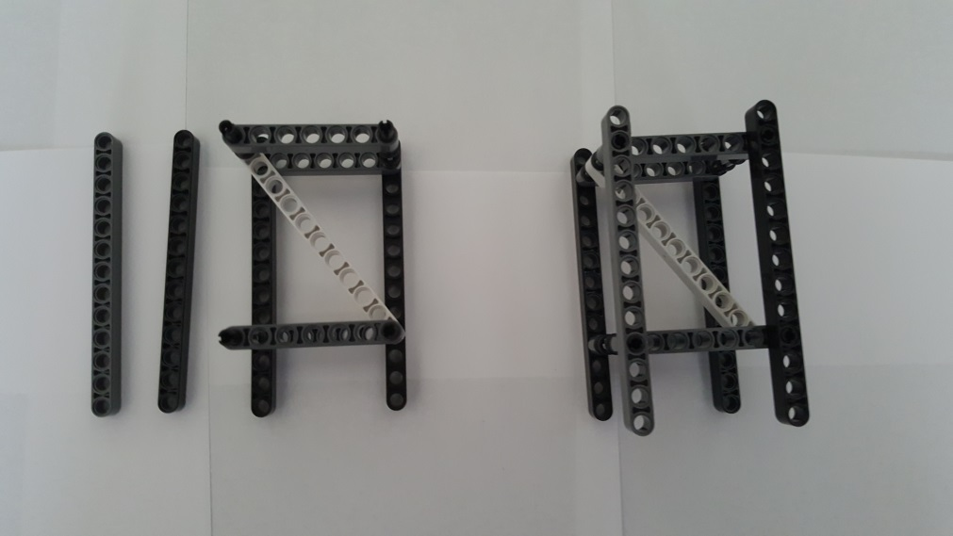
1x 11-Beam 32525
4x Pin 3L with Stop Bush 32054
4x 3-Axle 4519
2x 7-Beam 32524
Gather parts (left). Insert 3-Axles into Pin 3L’s Stop Bush. Lay 11-Beam diagonally across. Finished step (right)
Gather parts (left). Insert Pin 3L’s Stop Bush onto 3-Axles. Insert 7-Beams onto Pin 3L’s pins. Finished step (right)
2x 13-Beam 41239
Completed Upper Truss
Gather parts (left). Insert 13-Beams over Pin 3L’s pins. Finished step (right)

Slide 9
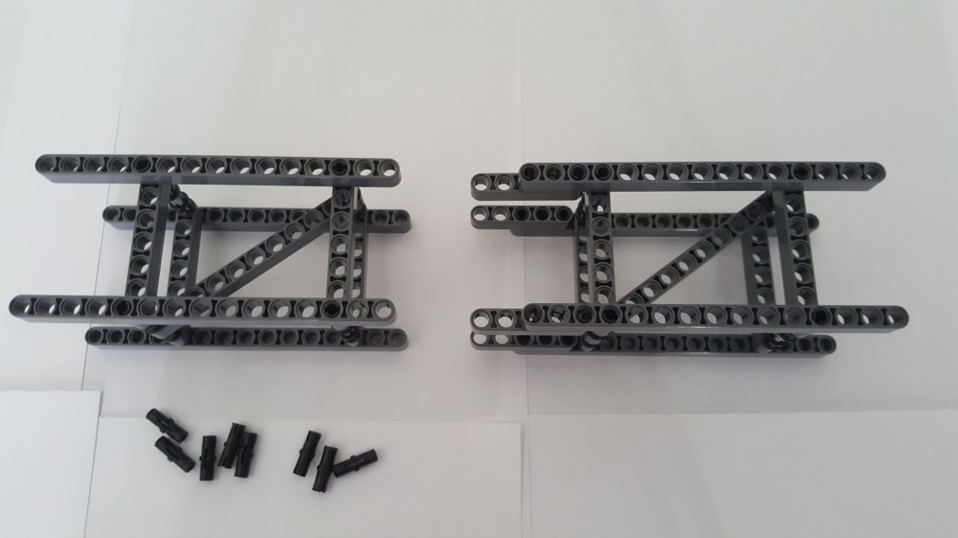
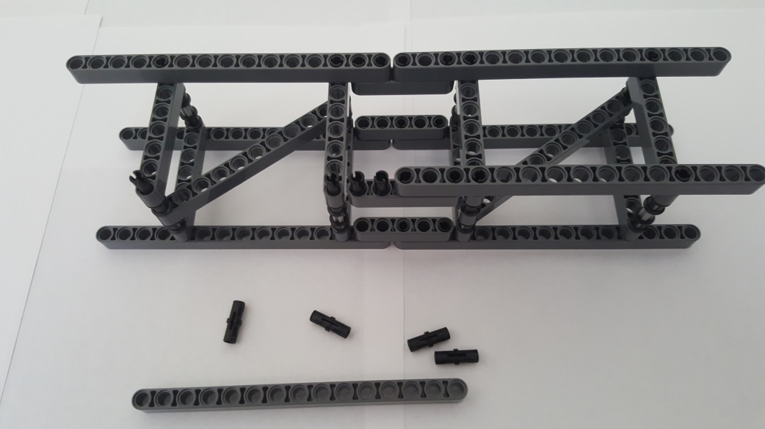
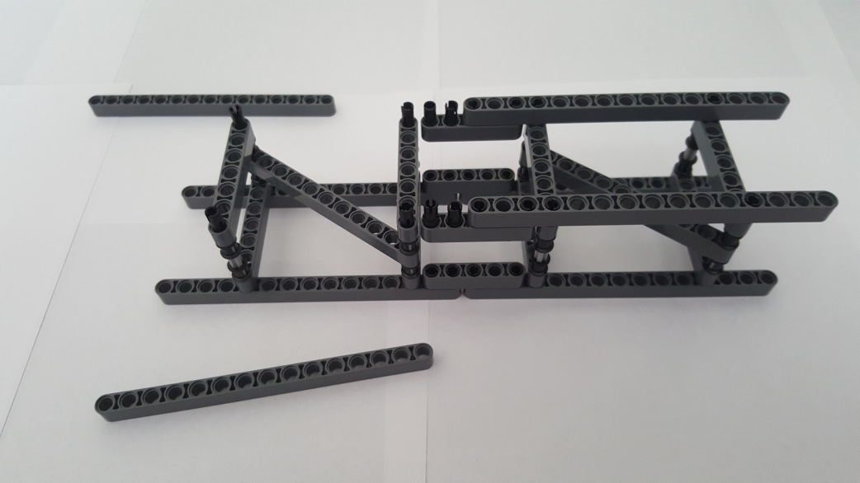
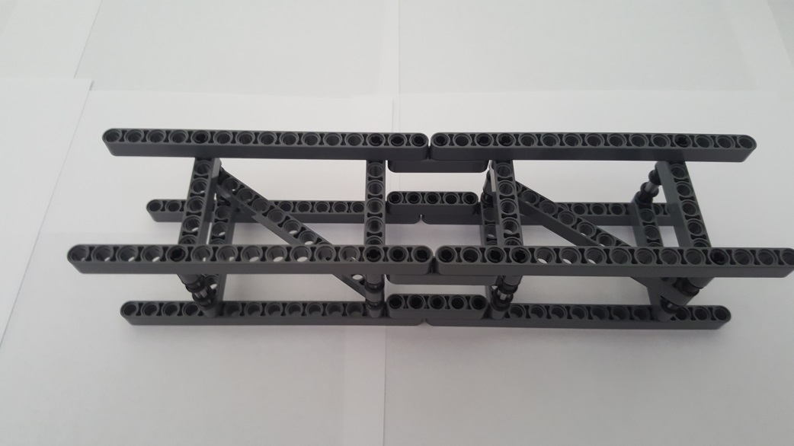
Step A-4: Lower-to-Middle Truss Connection
Middle Truss
Lower Truss
Lower-to-Middle Truss Connection
8x Friction Pin 2780
Gather parts Lower (Step A-1) and Middle (Step A-2) trusses. Note the orientation (red arrows) of diagonal braces
Insert friction pins. Top 4 red down-arrows show a completed connection. Bottom 2 red up-arrows show friction pins exposed. Note orientation of diagonal braces
Flip over. 15-Beams removed to make connection easier. Note orientation of diagonal braces
Completed Lower-to-Middle Truss Connection

Slide 10
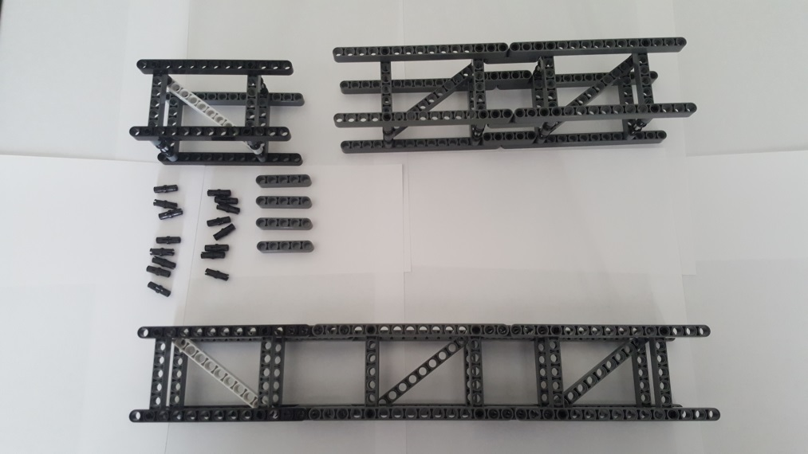
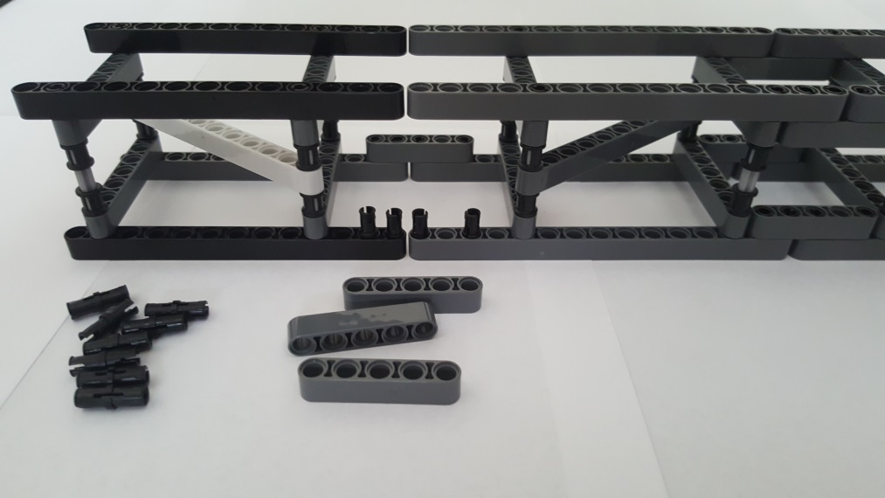
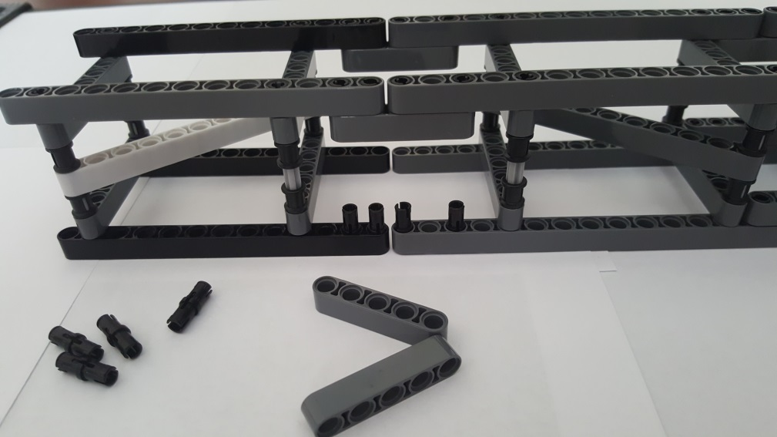
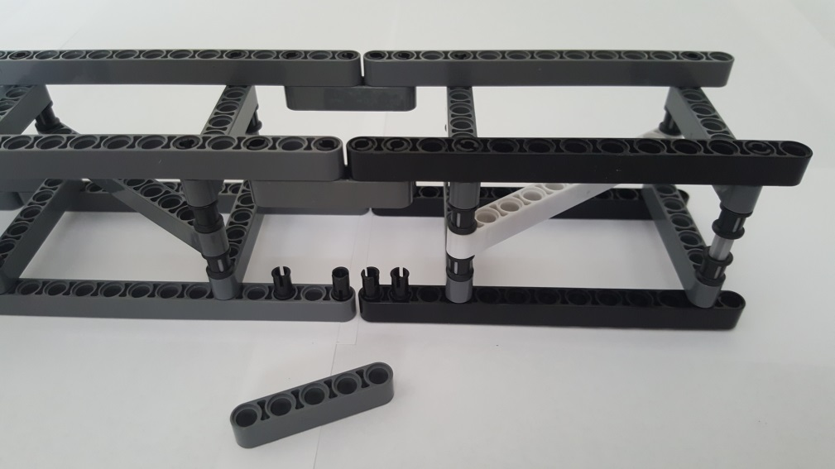
Step A-5: Upper Truss Connection
Upper Truss
16x Friction Pin 2780
Lower-to-Middle Truss Connection
4x 5-Beam 32316
Gather Lower-to-Middle Truss Connection (Step A-4). Bottom assembly: Goal is to connect Upper Truss (Step A-3) to the Lower-to-Middle Truss Connection. Note: Red arrows show diagonal orientation
Insert 8 Friction Pins (red arrows) and use 5-Beam to attach Upper Truss to the Lower-to-Middle Truss Connection
5-Beam attached
Flip over. Insert 4 friction pins
Connect 5-Beam. Flip over. Insert remaining 4 friction pins.

Slide 11
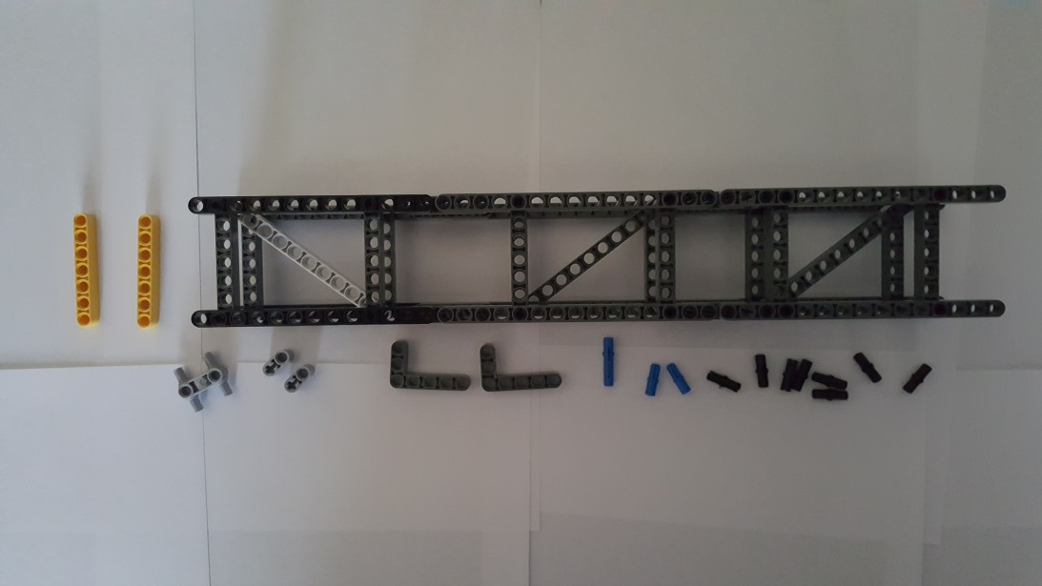
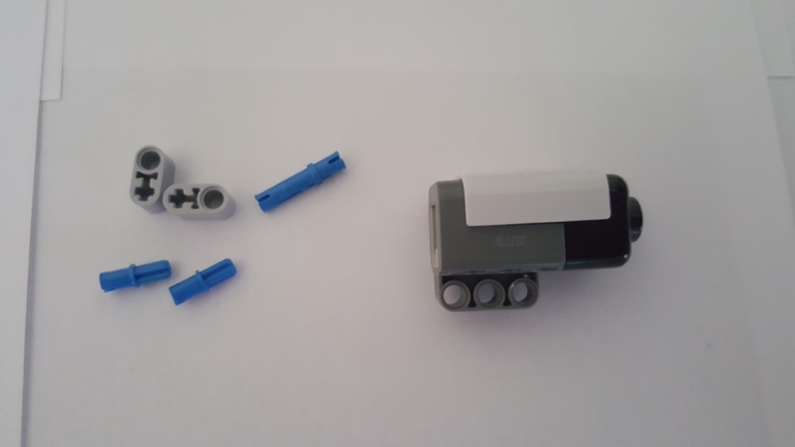
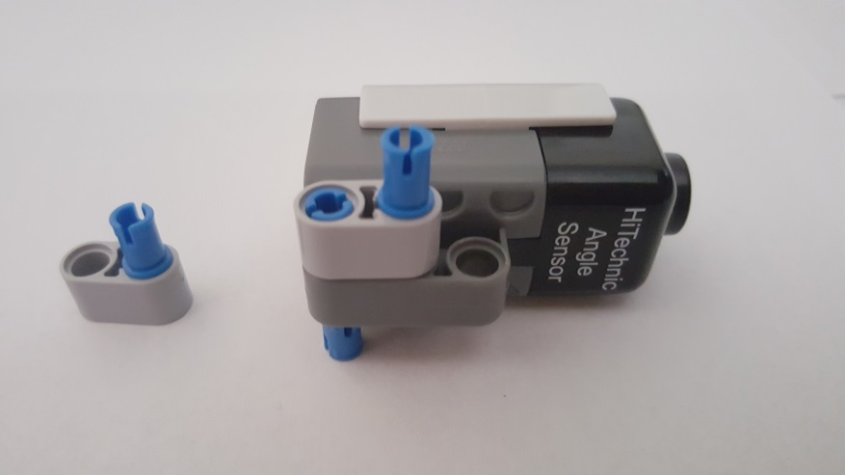
Step B: Angle Sensor Sub-assembly
Step B-1: Angle Mount
2x 7-Beam 32524
1x 4 Pin 3L Connector 48989
Completed 3-stage Truss (Step A-5)
2x 1x2 Beam Pin and Axle Hole 60483
2x 3x5 Liftarm 32526
2x Long Pin 6558
2x Axle Pin 43093
8x Friction Pin 2780
Gather Parts and the Completed Truss (from Step A-5)
Hi Technic Angle Sensor https://www.hitechnic.com/cgi-bin/commerce.cgi?preadd=action&key=NAA1030
Long Pin
Insert Long Pin in Angle Sensor Mount. Attach 1x2 Beam Pin and Axle. Attach Axle Pin into 1x2 Beam Pin and Axle

Slide 12
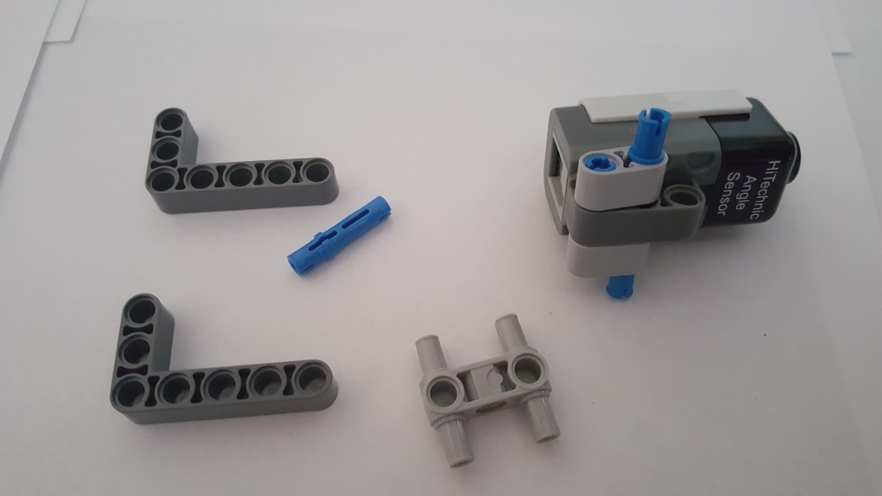
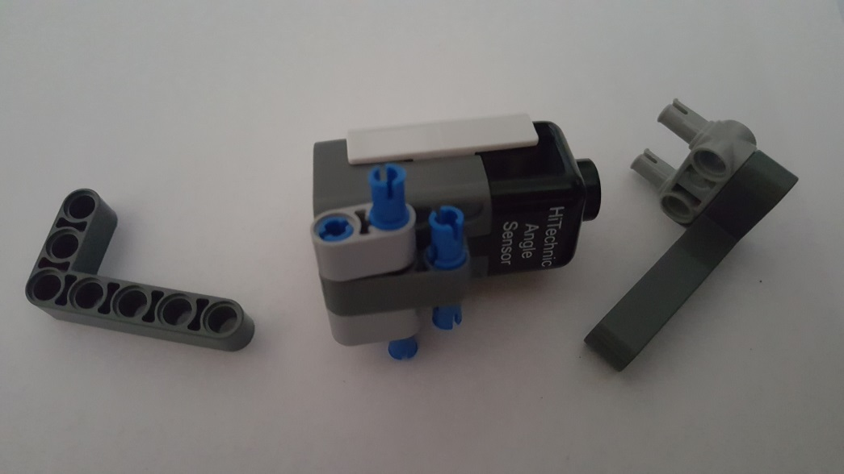
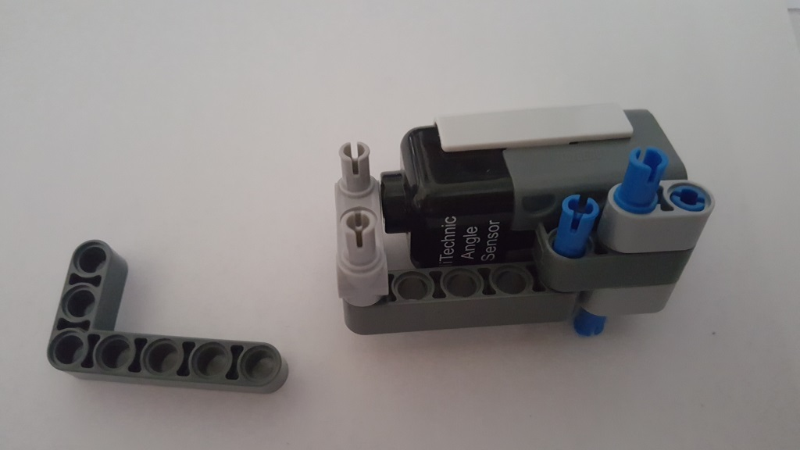
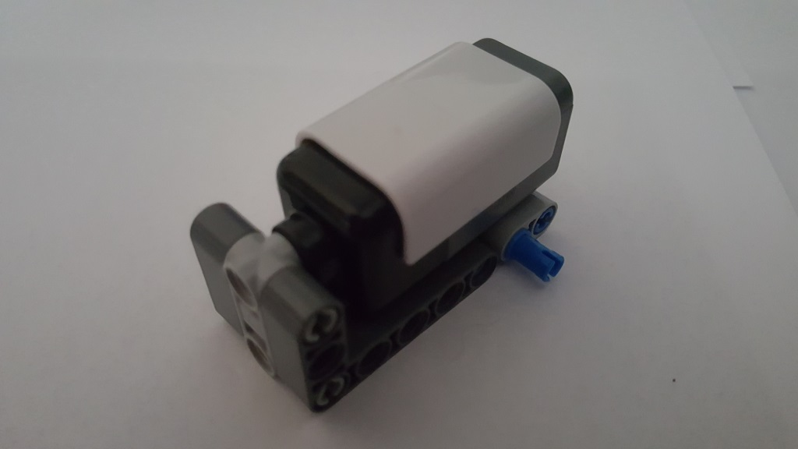
Long Pin
Flip-over sensor to attach remaining 1x2 Beam Hole and Axle
Insert Long Pin in Angle Sensor. Attach 4 Pin 3L into 3x5 Liftarm
Attach 3x5 Liftarm onto pins and flip-over
Attach remaining 3x5 Liftarm onto pins

Slide 13
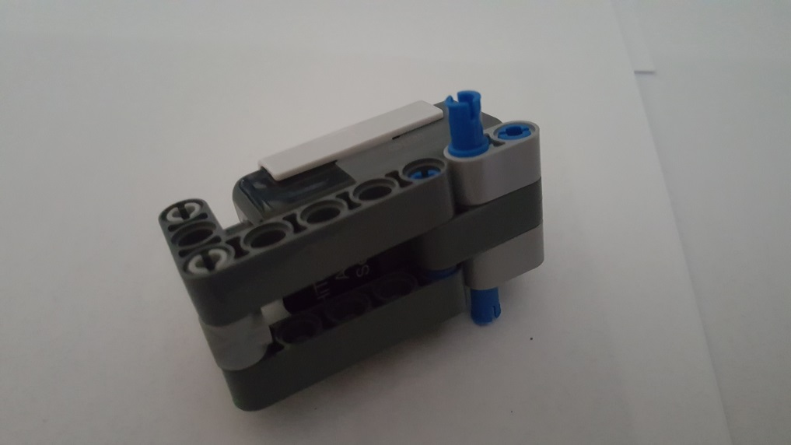
Completed Angle Sensor Mount

Slide 14
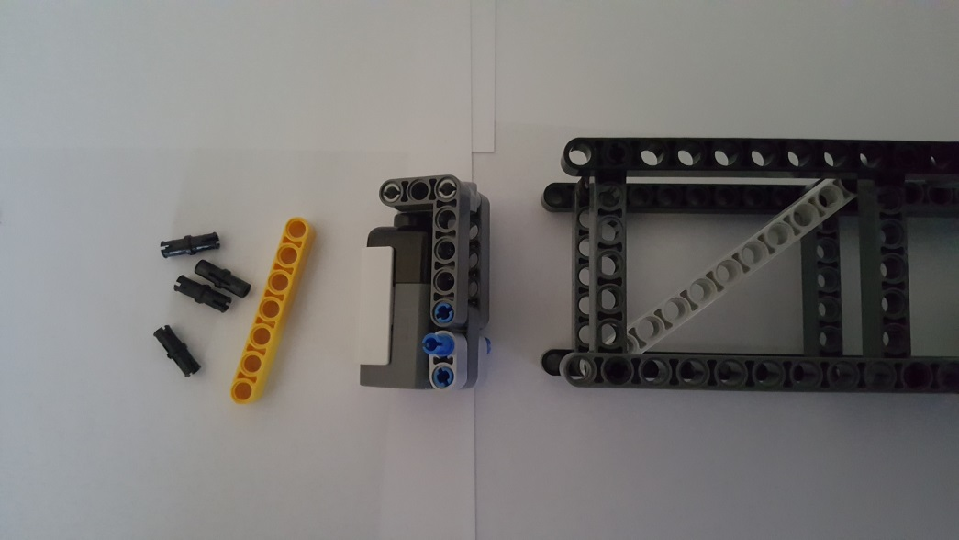
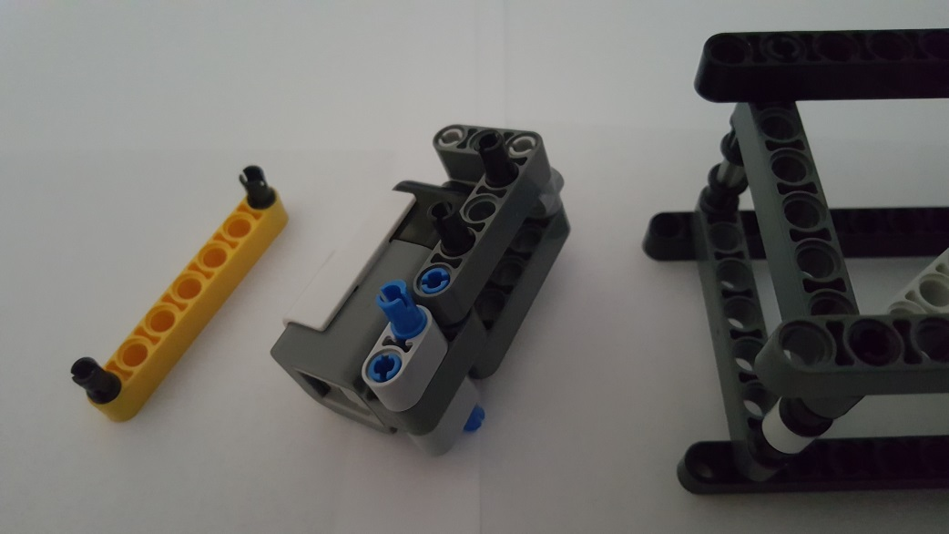
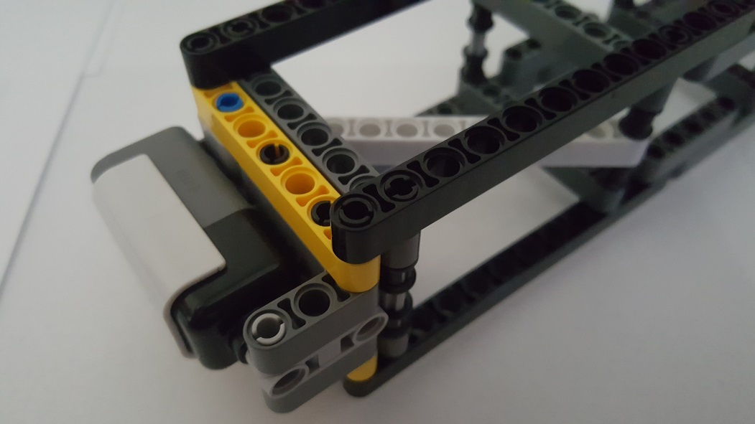
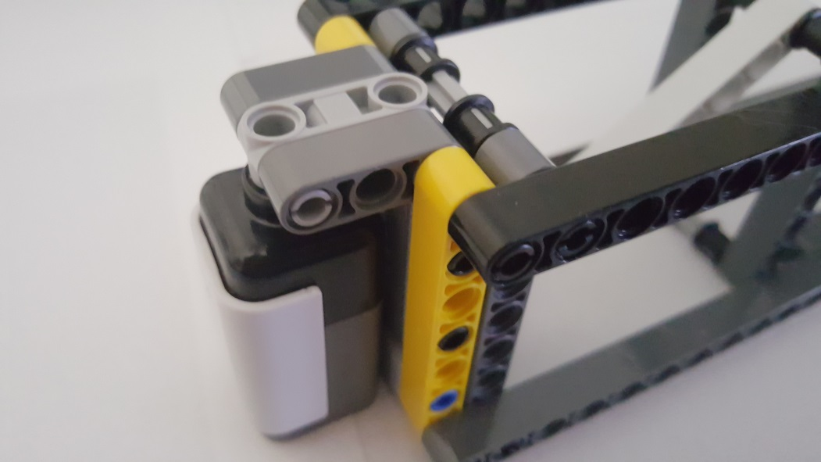
Step B-2: Angle-to-Truss Connection
Gather 4 Friction Pins and 1 7-Beam from Step B-1, the Angle Sensor Mount from Step B-1, and Truss Sub-Assembly from Step A-5
Insert 2 Friction Pins at the ends of one of the 7-Beams. Insert 2 Friction Pins on the Sensor Mount
Attach 7-Beam to Sensor Mount. Then, Attach to the Truss Sub-Assembly
Repeat for other 7-Beam

Slide 15
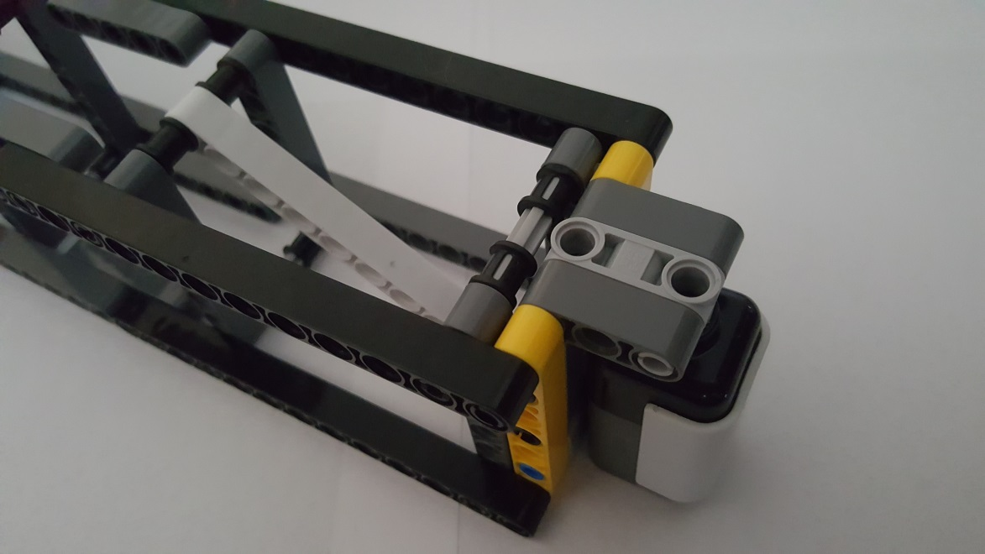
Completed Angle Sensor to Truss Sub-Assembly

Slide 16
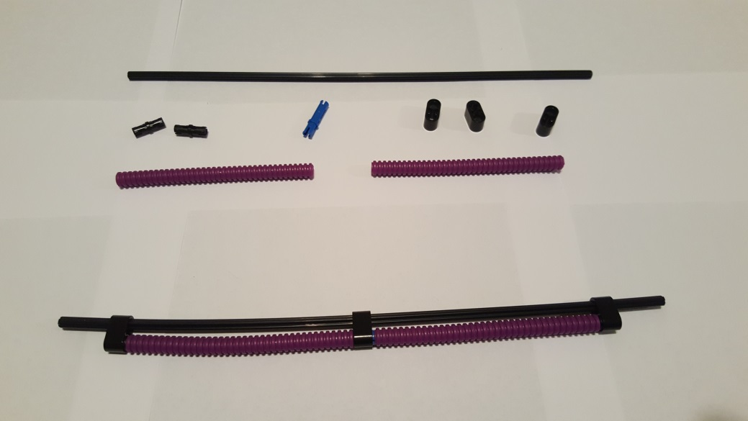
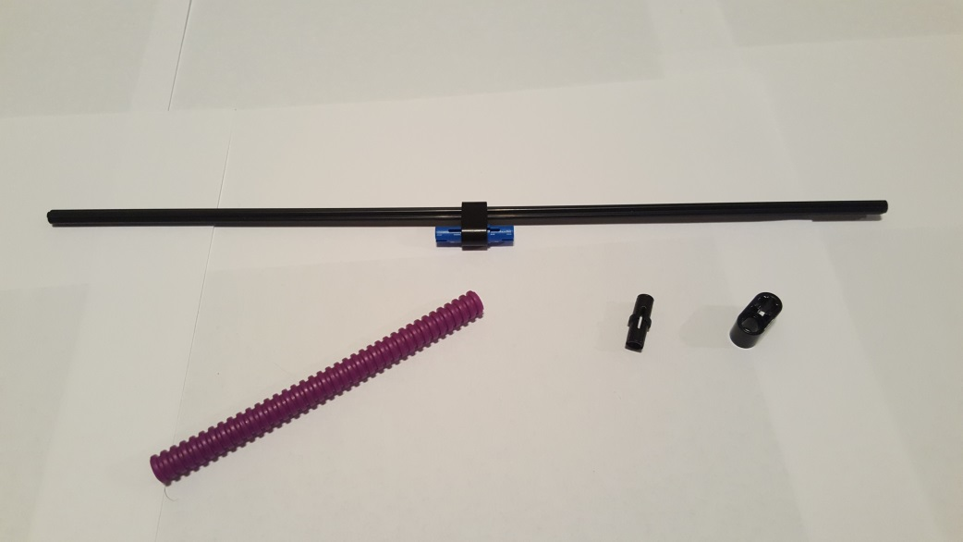
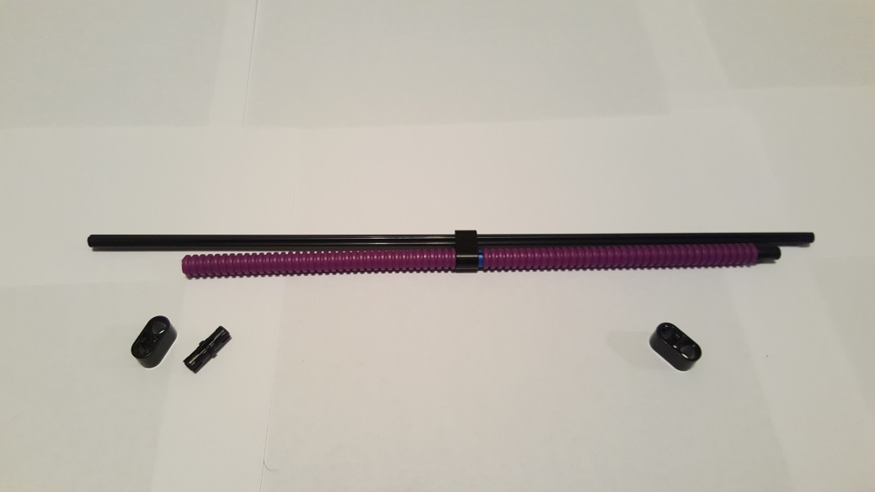
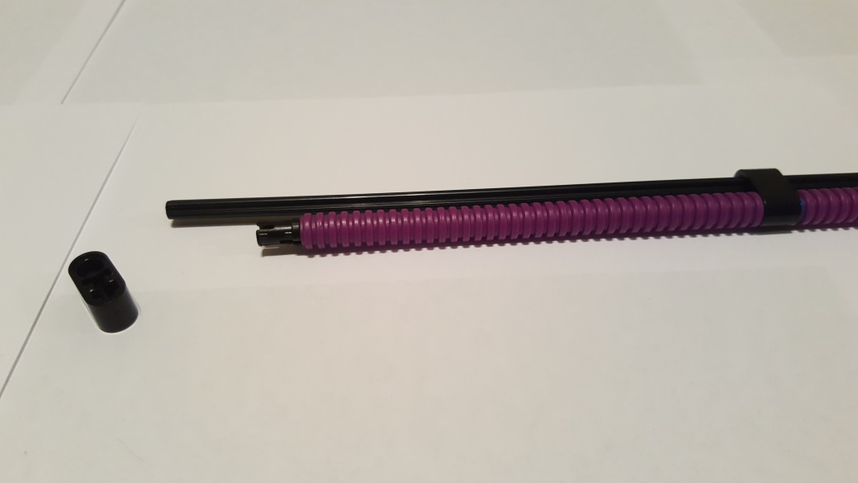
Step C: Pendulum and Wiring Sub-Assembly
Step C-1: Pendulum
1x Axle-32 50450
3x Pin and Axle Liftarm 1x2
60483
2x Friction Pin 2780
1x Long Pin 6558
2x Ribbed Hose 12L 7mm 78c12
Gather parts (top) to form wire assembly (bottom)
Slide Pin-Axle Liftarm onto Axle-32. Insert Long Pin into Pin-Axle Liftarm
Attach Ribbed Hoses to Long Pin. Attach Friction Pin to end of one of the Ribbed Hoses
Repeat by inserting remaining Friction Pin into end of other Ribbed Hose

Slide 17
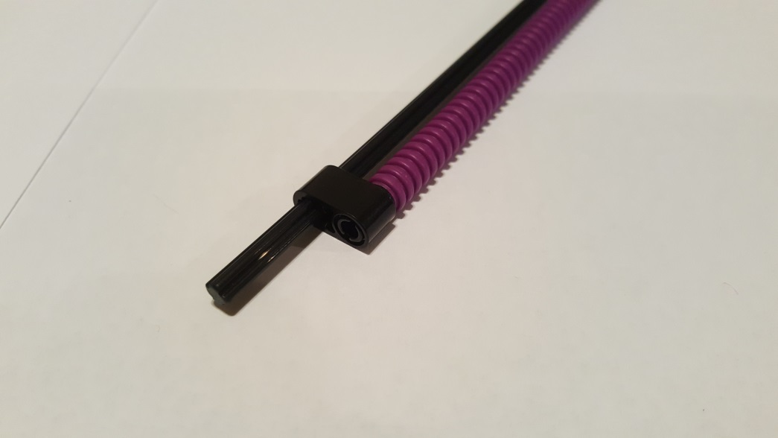
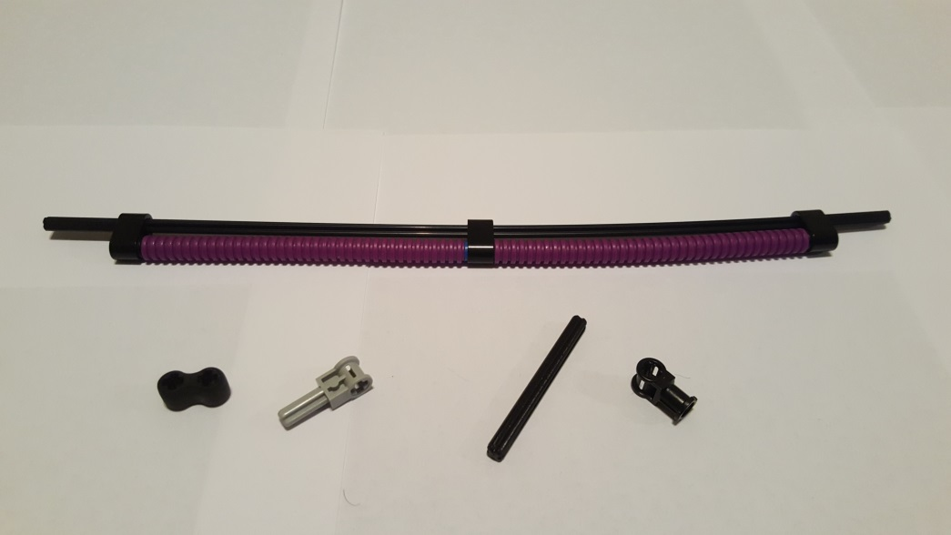
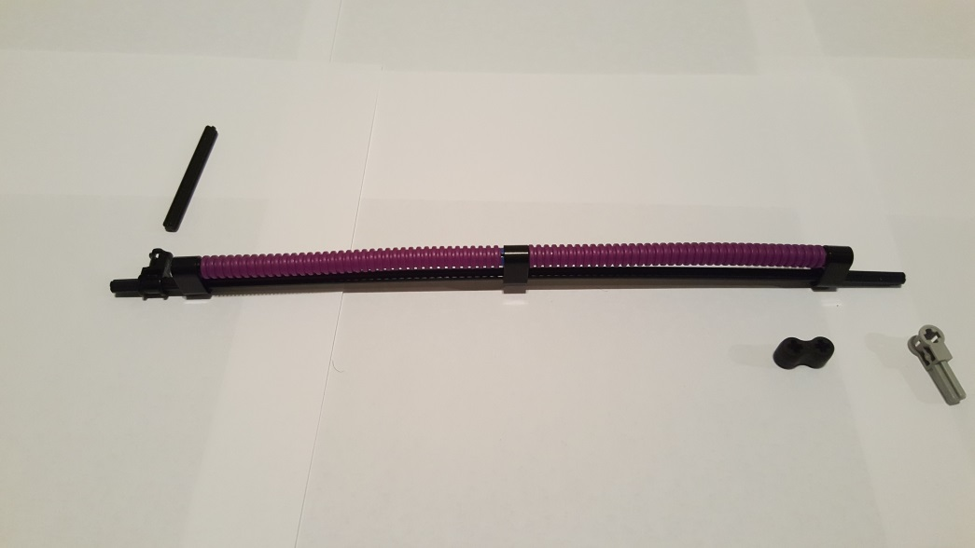

1x Pole Reverser Handle 6553
1x Axle Connector with Axle Hole 32039
1x Rubber Double Axle Connector 45590
1x Axle-6 3706
Slide Pin-Axle Liftarm onto Axle-32 and connect to Friction Pin. Repeat for other end. Hoses should be aligned with Axle-32
Gather Parts for Motor Mount
At a later step, the Axle-6 will connect pendulum to Angle Sensor
Note orientation (Ribbed Hoses on top). Slide Axle Connector with Axle Hole onto Axle-32
Close-up (Note the 90-deg orientation of Part 32039 (Axle Connector with Axle Hole) with Ribbed Hose

Slide 18




Insert Part 45590 (Rubber Double Axle Connector) onto Part 6553 (Pole Reverser Handle). Slide result onto Axle-32
Close-up 1. Note orientation.
At a later step, motorized prop will insert here
Close-up 2. Note orientation.
Close-up 3. Note orientation.

Slide 19


Completed Pendulum
Insert Axle-6 into Part 32039 (Axle Connector with Axle Hole).
Close-up

Slide 20


Step C-2: Mounting Pendulum to Angle Sensor
Gather Pendulum(from Step C-1) and Angle Sensor to Truss Sub-Assembly (from Step B-2). Note Red Arrow location
Red Arrow shows where Pendulum attached to Angle Sensor via Axle-6

Slide 21



Close-up 1: Red Arrow shows Axle-6 inserted into Angle Sensor. Axle-6 connects Pendulum to Angle Sensor
Close-up 2: Note orientation of Motor Mount at the end of the Pendulum. Red Arrow is the direction Pendulum will swing when powered by a motorized propeller
Close-up 3: Same as Close-up but face-on perspective. Red Arrow is the direction Pendulum will swing when powered by a motorized propeller

Slide 22


Completed Pendulum mounted to Angle Sensor
Perspective 1: When motorized propeller is mounted on Pendulum, Red Arrow shows that Pendulum will swing toward wall
Perspective 2: When motorized propeller is mounted on Pendulum, Red Arrow shows that Pendulum will swing away from wall

Slide 23




Step D: Base Sub-Assembly
1x Beam-3 32523
1x Beam-7 32524
1x Beam=15 32278
7x Friction Pin 2780
Gather parts: Note orientation of Brick (LCD on top)
Insert 5 Friction Pins at the bottom of the Brick (Red Arrows)
Attach Beam-3 and Beam-15 to Brick. NB: Red Arrow shows there is no space between the two Beams
Rotate Brick and insert 2 Friction Pins into Brick (Red Arrows)

Slide 24




1x 3x5 Liftarm 32526
3x 5-Beam 32316
8x Friction Pin 2780
Attached Beam-7 to Brick
Gather parts: Note orientation of Brick
Insert the 8 Friction Pins into Brick’s side (Note: Orientation of Brick)
Connect two Beam-5 elements onto Friction Pins

Slide 25




Attach 3x5 Liftarm and remaining Beam-5 to Brick. Note: Red Arrow shows no space between Liftarm and Beam-5
Close-up
1x Beam-9 40490
1x Beam-7 32524
8x Friction Pin 2780
Gather Parts: Note orientation of Brick
Insert the 8 Friction Pins as shown

Slide 26


Completed Base Sub-Assembly
Attach Beam-7 to the Beam-15 and Beam-9
Alternative Perspective View of previous step

Slide 27




Step E: Base-to-Truss Attachment
4x Friction Pin 2780
4x 2x2 Perpendicular Pin Connector 40489
Gather Pendulum-Truss (from Step C-2) and Base Assembly (from Step D). Top View seen. Note orientation of Pendulum-Truss, and left of Base
Gather Parts: Attach Pendulum-Truss to the Friction Pins in Base Assembly.
Insert 2 Friction Pins (see Red Arrow)
Attach 2x2 Perpendicular Pin Connectors to Friction Pins. This secures the Pendulum-Truss to Base Assembly

Slide 28



Insert Friction Pin (Red Arrow) and attach one 2x2 Perpendicular Pin Connector
Repeat previous step on other side; Insert Friction Pin (Red Arrow) and attach one 2x2 Perpendicular Pin Connector
Completed Truss-to-Base Attachment
Top View: Note orientation of Brick and Pendulum-Truss

Slide 29




Step F: Wiring Harness to Truss Attachment
3x Axle Pin 43093
2x Ribbed Hose 12L 7mm 78c12
2x Friction Pin 2780
3x Axle-Pin Connector 6536
1x Long Pin 6558
Gather Parts: Note orientation of Truss-to-Base Attachment
Insert Long Pin into Part 6536 (Axle-Pin Connector). Insert Axle Pin into Connector
Hole 20
Hole 1
(Top of Truss)
Hole 10
Attach resulting part into Truss. Arrow notes position is 20 holes from top of Truss
Attach Ribbed Hoses to ends of Long Pin. Attach Friction Pins to both ends of Ribbed Hoses (see Red Arrows)

Slide 30



Hole 1
(Top of Truss)
Brick’s LCD is here
Insert Axle Pin into Axle-Pin Connector. Attach result to Truss. Red Arrow show 7th hole position from top of Truss
Final Wiring Harness to Truss (Plan View). Ribbed Hoses should be relative straight and aligned to Truss
Completed Wiring Harness to Truss Attachment
Brick’s LCD is here
Alternative View: Note orientation of Brick and Wiring Harness

Slide 31




Step G: Motor-prop Mount and Wiring
Gather Parts: Pictured are: the Pendulum Arm (detached from the Truss i.e. from Step C), a motor-prop with wire, and a package of #16 Plastic Canvas Needles.
First detach the Rubber Double Axle Connector (45590) from the Pendulum Arm. Then, insert the motor-prop into this Rubber Double Axle Connector. The fit, while tight, provides a stable mount
Re-attach the motor-prop to the Pendulum Arm (Red Arrow).
Close-up: Note that motor-prop is in the bottom part of the Rubber Double Axle Connector (Red Arrow)

Slide 32




Gather Parts: This motor-prop used 36 AWG wire. A canvas needle will make threading into the Ribbed Hoses and Friction Pins easier
Thread the motor’s wires into the 1x2 Pin and Axle Liftarm.
Remove the Ribbed Hose if needed, to pass the motor’s wires thru the Friction Pin (Red Arrow)
After passing thru the Friction Pin, thread the motor’s wires into the Ribbed Hose

Slide 33




Reconnect the Ribbed Hose to its Friction Pin (Red Arrow), making sure to there’s no wire slack or pinched wire
Remove the other Ribbed Hose and thread the motor’s wire thru the Long Pin
Pull the remaining wire thru the Long Pin
Thread the motor’s wire thru the Ribbed Hose

Slide 34




Reconnect the Ribbed Hose to its Long Pin (Red Arrow). Again, make sure to there’s no wire slack or pinched wire
Thread the motor’s wires thru the Friction Pin
After threading thru, reconnect the Ribbed Hose to the Friction Pin (Red Arrow)
Close-up

Slide 35




Re-attach Pendulum to Angle Sensor. Thread motor’s wire thru bottom part of connector (Red Arrow)
Pass needle below the Angle Sensor mount (Red Arrow), pulling motor’s wire and reducing slack
Pass needle thru the Beam’s hole (Red Arrow).
Close-up (Red Arrow).

Slide 36




Next, thread thru the Axle-Pin Connector
Close-up
Remove the Ribbed Hose. Thread motor’s wire thru the Friction Pin
Thread thru the Ribbed Hose

Slide 37




Re-attach Ribbed Hose. Thread thru Long Pin
Detach other Ribbed Hose and thread motor’s wire thru it
Re-attach Ribbed Hose to Long Pin. Thread motor’s wire thru Friction Pin and Axle-Pin Connector
Re-attach Ribbed Hose to Friction Pin. Make sure there’s no slack or pinching of the motor’s wire

Slide 38




Completion – motor’s wire exits the Axle-Pin
Completed wiring thru harness. Leave some slack (Red Arrows) in the motor’s wire so that the Pendulum can swing freely
Standard NXT Cable with one end cut off
2-Position Screw-less Position Block (Amazon https://www.amazon.com/gp/product/B01JRDHVKM/ref=oh_aui_detailpage_o05_s01?ie=UTF8&psc=1)
Gather Parts: Shown is a spliced NXT cable and a 2-position Terminal Black
Alternative view: Only the Black and White wires in the NXT Cable will be used. Hence they are stripped

Slide 39




Press down on the 2-Position Terminal Block (Red Arrows) and insert the NXT Cable’s Black and White wires
On the opposite end of the 2-Position Terminal Block (Red Arrows), push and insert the Motor-Prop’s wires
Brick Port A
For this particular motor-prop, the red and black wires are connected the NXT Cable’s white and black wires. This polarity will be check when the motor is powered
Insert the NXT Cable into the Brick’s Port A (Red Arrow)

Slide 40




Should rotate Clockwise
Close-up of Prop. Note the profile (Red Arrow) shows blade sloping downwards
Looking into the prop, the blade should rotate clockwise
Viewed from this perspective, the Pendulum at rest will be $θ=0$ degrees. When the motor-prop rotates (Red Arrow direction), the Pendulum will rise (Dash Red Arrow) and $θ$ will increase positively
Alternative View. If motor rotates clockwise (Red Arrow), the blade “cut” into the air and Pendulum will lift towards Brick (Dash Red Arrow)

Slide 41


Brick Input Port 1
Lastly, connect one end of a Long NXT cable into the Angle Sensor (Red Arrow)
Connect the other end of the Long NXT cable into Input Port 1 (Red Arrow) of the Brick
Completed Motor-Prop Mounting and Wiring
Congratulations! LEGO DCP Build Completed and Ready for Testing and Experimentation

