Slide 1






Side view of pedestal
`
Antenna
$$φ(t)$$
Difference
Amplifier
Power
Amplifier
$$v_{i}$$
$$v_{i}−v_{o}$$
Motor Voltage
Gears
Voltage proportional to desired angle
Error
$$e(t)$$
Motor
Shaft Encoder
Data Hold
$$v_{o}$$
Voltage proportional to angle
Binary Code
Motor
Shaft
$$θ(t)$$
Top view of pedestal

Slide 2













Input Gain
Power Amplifier
Motor/antenna
$$Θ_{i}(s)$$
$$V_{i}(s)$$
$$E(s)$$
$$Θ(s)$$
+
$$K$$
-
$$V_{o}(s)$$
Sensor
Input Gain
Power Amplifier
Motor/antenna
$$Θ_{i}(s)$$
$$V_{i}(s)$$
$$E(s)$$
$$Θ(s)$$
+
$$K=\frac{10V}{V}$$
$$G_{p}=\frac{20}{s(s+6)}$$
0.04
-
$$V_{o}(s)$$
0.04
Sensor

Slide 3









$$G_{1}(s)$$
+
$$E(s)$$
$$C(s)$$
+
$$G_{2}(s)$$
$$E(s)$$
$$M(s)$$
$$C(s)$$
$$G_{1}(s)$$
$$G_{2}(s)$$
© Copyright Paul Oh

Slide 4















$$R(s)$$
$$E(s)$$
$$M(s)$$
$$C(s)$$
+
$$G_{c}(s)$$
$$G_{p}(s)$$
-
$$H(s)$$
$$G_{2}(s)$$
$$E(s)$$
+
$$R(s)$$
+
+
$$M(s)$$
$$C(s)$$
$$G_{1}(s)$$
$$G_{3}(s)$$
-
$$H(s)$$
© Copyright Paul Oh

Slide 5








$$R(s)$$
$$E(s)$$
$$M(s)$$
$$C(s)$$
+
$$G_{1}(s)$$
$$G_{2}(s)$$
-
$$H_{2}(s)$$
+
+
$$H_{1}(s)$$
© Copyright Paul Oh

Slide 6


$$R(s)$$
$$E(s)$$
$$M(s)$$
$$C(s)$$
+
Compensator
$$G_{c}(s)$$
$$G_{p}(s)$$
-
Sensor
$$H(s)$$
© Copyright Paul Oh

Slide 7
$$G_{1}(s)$$
+
$$E(s)$$
$$C(s)$$
+
$$G_{2}(s)$$
$$E(s)$$
$$M(s)$$
$$C(s)$$
$$G_{1}(s)$$
$$G_{2}(s)$$
© Copyright Paul Oh

Slide 8
Block Diagrams
Definition:
A block diagram of a system is a pictorial representation of the functions performed by each component and of the flow of signals
All system variables are linked to each other thru functional blocks
Functional block (or simply blocks) is a symbol for the mathematical operation on the input signal to the block that produces the output
The transfer function of a component is usually entered in the block
Blocks are connected by arrows to indicate signal flow
Dimensions of the output signal from the block are the dimensions of the input multiplied by the dimensions of the transfer function in that block
© Copyright Paul Oh

Slide 9



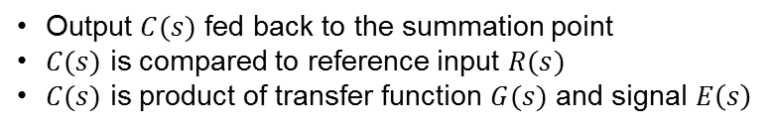




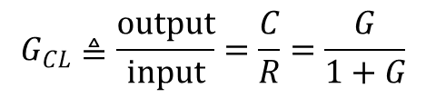
Block Diagram of a Closed Loop system
$$R(s)$$
$$E(s)$$
$$C(s)$$
+
Output $C(s)$ fed back to the summation point
$C(s)$ is compared to reference input $R(s)$
$C(s)$ is product of transfer function $G(s)$ and signal $E\left(s\right)$
$$G(s)$$
-
$$E=R−C \text{but} \text{also} \text{have} \text{that} C=GE \text{hence} \text{say} C=G(R−C)$$
Thus have $C+GC=GR \text{or} C\left(1+G\right)=GR \text{thus} \text{closed}\text{−}\text{loop} \text{relationship} \text{is}$
$$R(s)$$
$$C(s)$$
$$G_{CL}≜\frac{\text{output}}{\text{input}}=\frac{C}{R}=\frac{G}{1+G}$$
Or, pictorially have
$$G_{CL}(s)$$
© Copyright Paul Oh

Slide 10
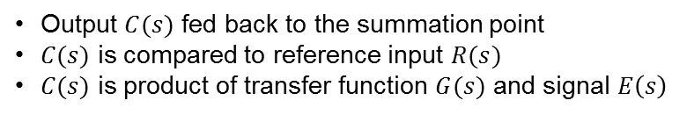
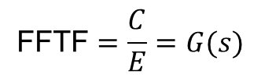




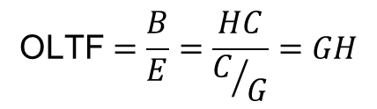



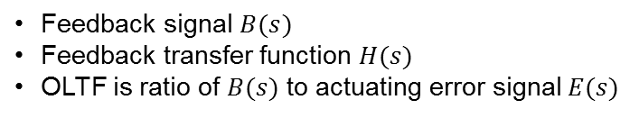
Open-Loop Transfer Function (OLTF)
$$R(s)$$
$$E(s)$$
$$C(s)$$
Output $C(s)$ fed back to the summation point
$C(s)$ is compared to reference input $R(s)$
$C(s)$ is product of transfer function $G(s)$ and signal $E\left(s\right)$
+
$$G(s)$$
-
Additionally
$$B(s)$$
$$H(s)$$
Feedback signal $B(s)$
Feedback transfer function $H(s)$
OLTF is ratio of $B(s) \text{to} \text{actuating} \text{error} \text{signal} E(s)$
$$B=HC \text{and} \text{have} C=GE$$
Hence
$$\text{OLTF}=\frac{B}{E}=\frac{HC}{C/G}=GH$$
Feed-Forward Transfer Function (FFTF)
FFTF is the ratio of the output $C(s) \text{to} \text{the} \text{actuating} \text{error} \text{signal} E(s)$
$$\text{FFTF}=\frac{C}{E}=G(s)$$
If $H\left(s\right)=1 \text{then} \text{the} \text{OLTF} \text{and} \text{FFTF} \text{are} \text{the} \text{same}$
© Copyright Paul Oh

Slide 11




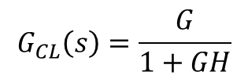


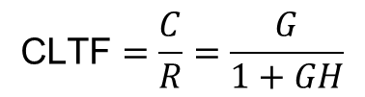




Closed-Loop Transfer Function (CLTF)
$$R(s)$$
$$E(s)$$
$$C(s)$$
+
$$G(s)$$
-
$$B(s)$$
$$H(s)$$
$$C=GE \text{and} \text{have} E=R−B$$
also have $B=HC$ hence $E=R−HC$
Eliminating $E$ from these equations yields $C=G\left(R−HC\right)$ or $C\left(1+GH\right)=GR$ hence:
$$\text{CLTF}=\frac{C}{R}=\frac{G}{1+GH}$$
$$R(s)$$
$$C(s)$$
$$G_{CL}\left(s\right)=\frac{G}{1+GH}$$
Or, pictorially have
© Copyright Paul Oh

Slide 12

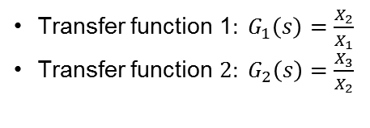







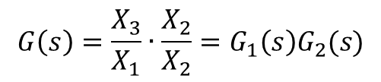
Transfer Function of Cascaded Elements
$$X_{1}(s)$$
$$X_{2}(s)$$
$$X_{3}(s)$$
Transfer function 1$: G_{1}\left(s\right)=\frac{X_{2}}{X_{1}}$
Transfer function $2: G_{2}\left(s\right)=\frac{X_{3}}{X_{2}}$
$$G_{1}(s)$$
$$G_{2}(s)$$
Then can say $G\left(s\right)=\frac{X_{3}}{X_{1}}\text{now} \text{multiply} \text{top} \text{and} \text{bottom} \text{b}y X_{2} \text{yields}\text{:}$
$$X_{1}(s)$$
$$X_{3}(s)$$
$$G\left(s\right)=\frac{X_{3}}{X_{1}}∙\frac{X_{2}}{X_{2}}=G_{1}\left(s\right)G_{2}(s)$$
Or, pictorially have
$$G_{1}\left(s\right)G_{2}(s)$$
Assumes input impedance second element is infinite
Assumes output of first element is not affected by connecting to second element
Transfer function of whole systems is thus product of the transfer functions of the individual elements
© Copyright Paul Oh

Slide 13










Example: Kuo p. 105
Example: Simplify the block diagram shown below
$$H_{1}(s)$$
$$R(s)$$
+
$$C(s)$$
+
+
$$G(s)$$
-
$$H_{2}(s)$$
Solution:
Step 1: Look for parallel blocks to simplify structures
$$\frac{H_{1}(s) }{G(s)}$$
$$R(s)$$
+
$$C(s)$$
+
+
$$G(s)$$
-
$$H_{2}(s)$$
© Copyright Paul Oh

Slide 14


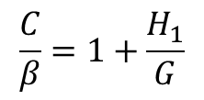








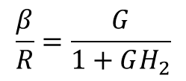








Example: Kuo p. 105
Step 2 Recognize closed-loop relationships
$$δ$$
$$\frac{H_{1}(s) }{G(s)}$$
$$R(s)$$
$$α$$
$$β$$
+
$$C(s)$$
+
+
$$G(s)$$
-
$$γ$$
$C=β+δ=β+\left(\frac{H_{1}}{G}\right)β=β(1+\frac{H_{1}}{G}$)
$$H_{2}(s)$$
Alternatively
$$\frac{C}{β}=1+\frac{H_{1}}{G}$$
$$β=Gα=G\left(R−γ\right)=G(R−H_{2}β)$$
$$β$$
$$C(s)$$
Factoring, have
$$β\left(1+GH_{2}\right)=GR$$
$$1+\frac{H_{1}}{G}$$
$$\frac{β}{R}=\frac{G}{1+GH_{2}}$$
Alternatively
$$R(s)$$
$$β$$
$$\frac{G}{1+GH_{2}}$$
© Copyright Paul Oh

Slide 15
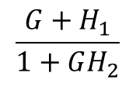


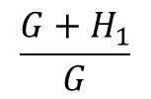

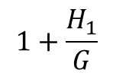



Example: Kuo p. 105
Step 3 Combine blocks
$$δ$$
$$\frac{H_{1}(s) }{G(s)}$$
$$R(s)$$
$$α$$
$$β$$
+
$$C(s)$$
+
+
$$G(s)$$
-
$$γ$$
$$H_{2}(s)$$
$$R(s)$$
$$β$$
$$C(s)$$
$$\frac{G}{1+GH_{2}}$$
$$1+\frac{H_{1}}{G}$$
$$\frac{G+H_{1}}{G}$$
Final Answer
$$R(s)$$
$$C(s)$$
$$\frac{G+H_{1}}{1+GH_{2}}$$
© Copyright Paul Oh

