Slide 1
Lecture: Block Diagrams
© Copyright Paul Oh

Slide 2
Block Diagrams
Definition:
A block diagram of a system is a pictorial representation of the functions performed by each component and of the flow of signals
All system variables are linked to each other thru functional blocks
Functional block (or simply blocks) is a symbol for the mathematical operation on the input signal to the block that produces the output
The transfer function of a component is usually entered in the block
Blocks are connected by arrows to indicate signal flow
Dimensions of the output signal from the block are the dimensions of the input multiplied by the dimensions of the transfer function in that block
© Copyright Paul Oh

Slide 3



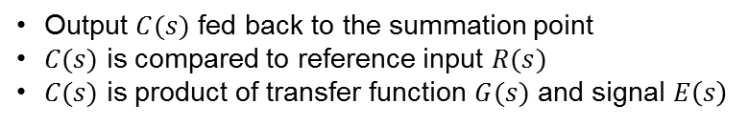




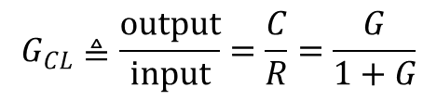
Block Diagram of a Closed Loop system
$$R(s)$$
$$E(s)$$
$$C(s)$$
+
Output $C(s)$ fed back to the summation point
$C(s)$ is compared to reference input $R(s)$
$C(s)$ is product of transfer function $G(s)$ and signal $E\left(s\right)$
$$G(s)$$
-
$$E=R−C \text{but} \text{also} \text{have} \text{that} C=GE \text{hence} \text{say} C=G(R−C)$$
Thus have $C+GC=GR \text{or} C\left(1+G\right)=GR \text{thus} \text{closed}\text{-}\text{loop} \text{relationship} \text{is}$
$$R(s)$$
$$C(s)$$
$$G_{CL}≜\frac{\text{output}}{\text{input}}=\frac{C}{R}=\frac{G}{1+G}$$
Or, pictorially have
$$G_{CL}(s)$$
© Copyright Paul Oh

Slide 4
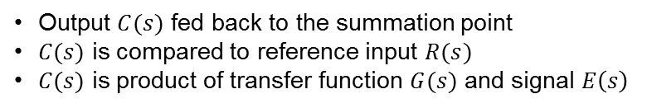
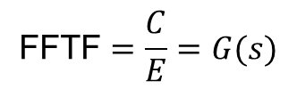




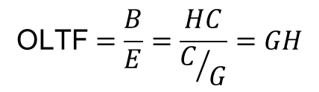



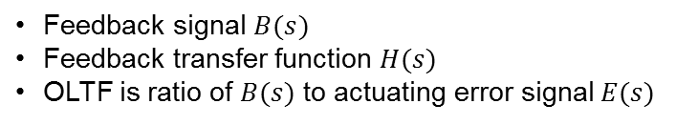
Open-Loop Transfer Function (OLTF)
$$R(s)$$
$$E(s)$$
$$C(s)$$
Output $C(s)$ fed back to the summation point
$C(s)$ is compared to reference input $R(s)$
$C(s)$ is product of transfer function $G(s)$ and signal $E\left(s\right)$
+
$$G(s)$$
-
Additionally
$$B(s)$$
$$H(s)$$
Feedback signal $B(s)$
Feedback transfer function $H(s)$
OLTF is ratio of $B(s) \text{to} \text{actuating} \text{error} \text{signal} E(s)$
$$B=HC \text{and} \text{have} C=GE$$
Hence
$$\text{OLTF}=\frac{B}{E}=\frac{HC}{C/G}=GH$$
Feed-Forward Transfer Function (FFTF)
FFTF is the ratio of the output $C(s) \text{to} \text{the} \text{actuating} \text{error} \text{signal} E(s)$
$$\text{FFTF}=\frac{C}{E}=G(s)$$
If $H\left(s\right)=1 \text{then} \text{the} \text{OLTF} \text{and} \text{FFTF} \text{are} \text{the} \text{same}$
© Copyright Paul Oh

Slide 5




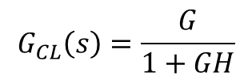


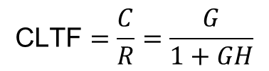




Closed-Loop Transfer Function (CLTF)
$$R(s)$$
$$E(s)$$
$$C(s)$$
+
$$G(s)$$
-
$$B(s)$$
$$H(s)$$
$$C=GE \text{and} \text{have} E=R−B$$
also have $B=HC$ hence $E=R−HC$
Eliminating $E$ from these equations yields $C=G\left(R−HC\right)$ or $C\left(1+GH\right)=GR$ hence:
$$\text{CLTF}=\frac{C}{R}=\frac{G}{1+GH}$$
$$R(s)$$
$$C(s)$$
$$G_{CL}\left(s\right)=\frac{G}{1+GH}$$
Or, pictorially have
© Copyright Paul Oh

Slide 6

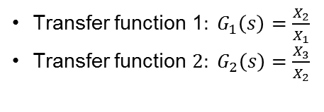







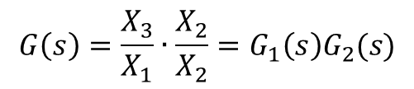
Transfer Function of Cascaded Elements
$$X_{1}(s)$$
$$X_{2}(s)$$
$$X_{3}(s)$$
Transfer function 1$: G_{1}\left(s\right)=\frac{X_{2}}{X_{1}}$
Transfer function $2: G_{2}\left(s\right)=\frac{X_{3}}{X_{2}}$
$$G_{1}(s)$$
$$G_{2}(s)$$
Then can say $G\left(s\right)=\frac{X_{3}}{X_{1}}\text{now} \text{multiply} \text{top} \text{and} \text{bottom} \text{b}y X_{2} \text{yields}\text{:}$
$$X_{1}(s)$$
$$X_{3}(s)$$
$$G\left(s\right)=\frac{X_{3}}{X_{1}}∙\frac{X_{2}}{X_{2}}=G_{1}\left(s\right)G_{2}(s)$$
Or, pictorially have
$$G_{1}\left(s\right)G_{2}(s)$$
Assumes input impedance second element is infinite
Assumes output of first element is not affected by connecting to second element
Transfer function of whole systems is thus product of the transfer functions of the individual elements
© Copyright Paul Oh

