Slide 1
Lecture: Poles and Zeros
© Copyright Paul Oh

Slide 2
Recall Objective
Design a controller so that the DCP reaches steady-state angle $θ_{ss}$ in a desired settling time $t_{s}$ with desired overshoot $θ\left(t\right)≤θ_{\text{max}}$ for all time $t$.
Recall Damped Compound Pendulum Equations of Motion
Linearized 2nd order differential equation assumes small angles
Bar length [m]
Pivot to CG distance [m]
Mass of pendulum [kg]
General 2nd order form
Moment of Inertia
Viscous damping coefficient
© Copyright Paul Oh

Slide 3
Tedious Math: Time domain differential equation
2nd order damped system
Yields complex roots
Time domain (homogeneous) solution. Constants $A_{1}$ and $A_{2}$ (initial conditions)
(1)
Small real root will yield long settling times
Can be shown:
Time constant
(2)
2% settling time
© Copyright Paul Oh

Slide 4
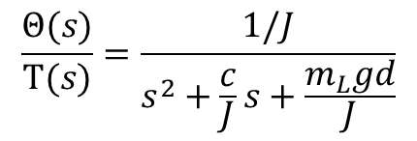
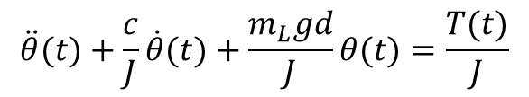
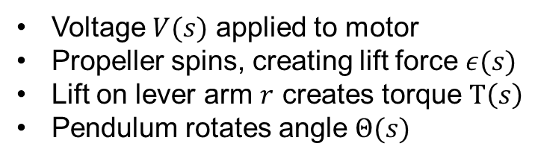
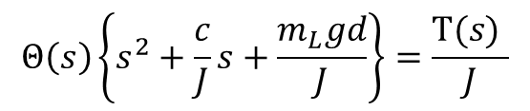
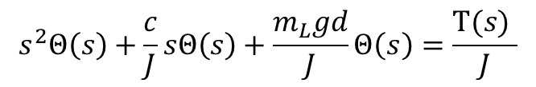
Easier Math I: Laplace Domain
(Linearized) Equation of motion for DCP with motor-prop
$$\ddot{θ}(t)+\frac{c}{J}\dot{θ}(t)+\frac{m_{L}gd}{J}θ(t)=\frac{T(t)}{J}$$
Apply Laplace such that
Voltage $V(s)$ applied to motor
Propeller spins, creating lift force $ε(s)$
Lift on lever arm $r$ creates torque $Τ\left(s\right)$
Pendulum rotates angle $Θ(s)$
Hence have
$$s^{2}Θ\left(s\right)+\frac{c}{J}sΘ\left(s\right)+\frac{m_{L}gd}{J}Θ\left(s\right)=\frac{Τ(s) }{J}$$
$$Θ\left(s\right)\left\{s^{2}+\frac{c}{J}s+\frac{m_{L}gd}{J}\right\}=\frac{Τ(s) }{J}$$
Or
Which in transfer function form is:
Which in block diagram form is:
$$\frac{Θ(s)}{Τ(s)}=\frac{1/J}{s^{2}+\frac{c}{J}s+\frac{m_{L}gd}{J}}$$
[rad]
© Copyright Paul Oh

Slide 5
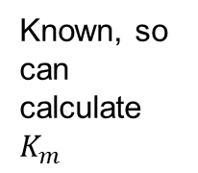
Calculating Constants
[rad]
Theory: can calculate lift force if have propeller pitch and radius dimensions, air density and motor angular velocity.
Experimentally, apply known voltage V and pendulum will eventually reach steady-state. Recall
At steady-state angular acceleration and velocity are zero. The torque at this known voltage is calculated by:
Known, so can calculate $K_{m}$
And hence
All known or measurable, so can calculate $T_{ss}$
© Copyright Paul Oh

Slide 6
Open-Loop Transfer Function
[rad]
OLTF:
Suppose our DCP has
Nm/V
m
(3)
kgm
2
kg
Laplace domain OL Transfer function
Nms/rad
© Copyright Paul Oh

Slide 7
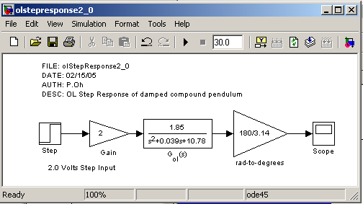
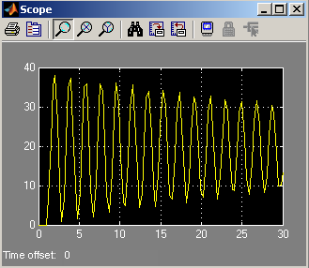
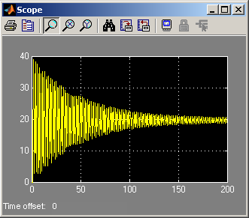
OLTF Simulations
Simulink
© Copyright Paul Oh

Slide 8
Simulation reveals long settling time. This is consistent with the low viscous damping coefficient. Poles of the characteristic equation reveal the large oscillations. Recall from (1)
Roots of the denominator (i.e. the poles) are:
Small real root will yield long settling times
In other words, the system is bordering on the margin of stability. Recall Equations (1) and (2).
© Copyright Paul Oh

Slide 9
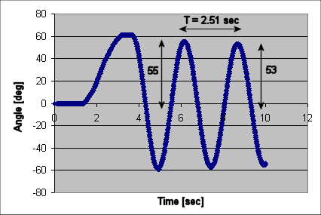
System Poles and Zeros – What are they?
Control Designer’s Goal:
(1)
Create compensators that yield desired damping and rise time.
(2A)
In other words, place poles where one wants them
(2B)
© Copyright Paul Oh

Slide 10
Calculated the following:
rad/s
poles
© Copyright Paul Oh

Slide 11
Matches experimental data!
© Copyright Paul Oh

Slide 12
Where are we going with this?
It’s called the characteristic equation because it connotes system properties
Poles are the roots of the characteristic equation. As such, the describe stability through
and
Question: can we alter the locations of the poles? If we can, then we change the characteristic of the system…
Answer: This is exactly what the control engineer does. One popular method is called “pole placement” control
© Copyright Paul Oh

