Slide 1
Lecture: Poles and Zeros
© Copyright Paul Oh

Slide 2
Recall Objective
Design a controller so that the DCP reaches steady-state angle $θ_{ss}$ in a desired settling time $t_{s}$ with desired overshoot $θ\left(t\right)≤θ_{\text{max}}$ for all time $t$.
Recall Damped Compound Pendulum Equations of Motion
Linearized 2nd order differential equation assumes small angles
Bar length [m]
Pivot to CG distance [m]
Mass of pendulum [kg]
General 2nd order form
Moment of Inertia
Viscous damping coefficient
© Copyright Paul Oh

Slide 3
Tedious Math: Time domain differential equation
2nd order damped system
Yields complex roots
Time domain solution
(1)
Small real root will yield long settling times
Can be shown:
Time constant
(2)
2% settling time
© Copyright Paul Oh

Slide 4
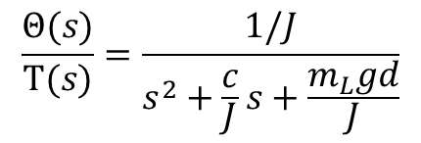
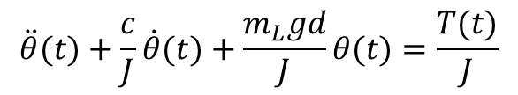
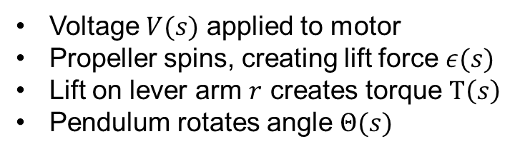
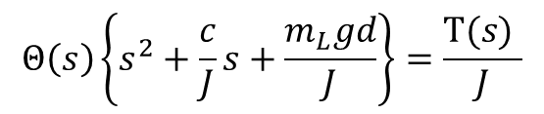
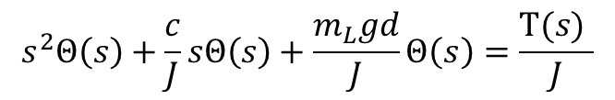
Easier Math I: Laplace Domain
(Linearized) Equation of motion for DCP with motor-prop
$$\ddot{θ}(t)+\frac{c}{J}\dot{θ}(t)+\frac{m_{L}gd}{J}θ(t)=\frac{T(t)}{J}$$
Apply Laplace such that
Voltage $V(s)$ applied to motor
Propeller spins, creating lift force $ε(s)$
Lift on lever arm $r$ creates torque $Τ\left(s\right)$
Pendulum rotates angle $Θ(s)$
Hence have
$$s^{2}Θ\left(s\right)+\frac{c}{J}sΘ\left(s\right)+\frac{m_{L}gd}{J}Θ\left(s\right)=\frac{Τ(s) }{J}$$
$$Θ\left(s\right)\left\{s^{2}+\frac{c}{J}s+\frac{m_{L}gd}{J}\right\}=\frac{Τ(s) }{J}$$
Or
Which in transfer function form is:
Which in block diagram form is:
$$\frac{Θ(s)}{Τ(s)}=\frac{1/J}{s^{2}+\frac{c}{J}s+\frac{m_{L}gd}{J}}$$
[rad]
© Copyright Paul Oh

Slide 5
© Copyright Paul Oh

Slide 6
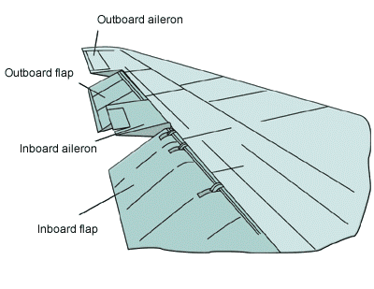

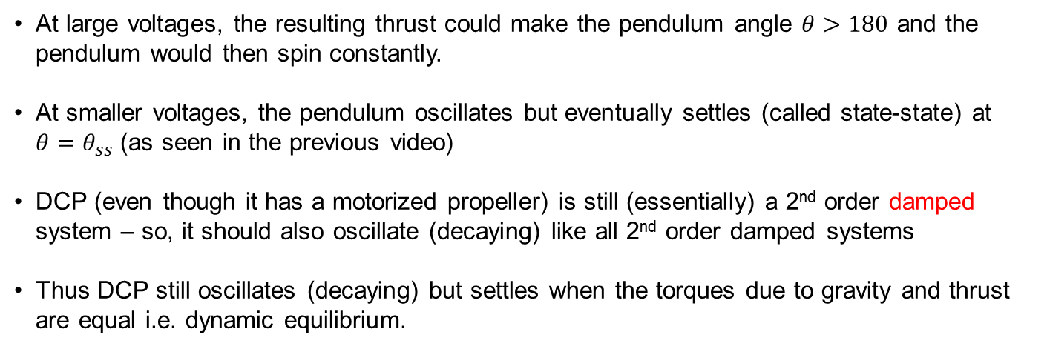
Why Care about DCP?
Answer to Previous Question
At large voltages, the resulting thrust could make the pendulum angle $θ>180$ and the pendulum would then spin constantly.
At smaller voltages, the pendulum oscillates but eventually settles (called state-state) at $θ=θ_{ss}$ (as seen in the previous video)
DCP (even though it has a motorized propeller) is still (essentially) a 2nd order damped system – so, it should also oscillate (decaying) like all 2nd order damped systems
Thus DCP still oscillates (decaying) but settles when the torques due to gravity and thrust are equal i.e. dynamic equilibrium.
Why care: 2nd order systems everywhere; from airplane ailerons to hard drive arms. DCP is a “simple” case study that can extend to all 2nd order systems
© Copyright Paul Oh

Slide 7
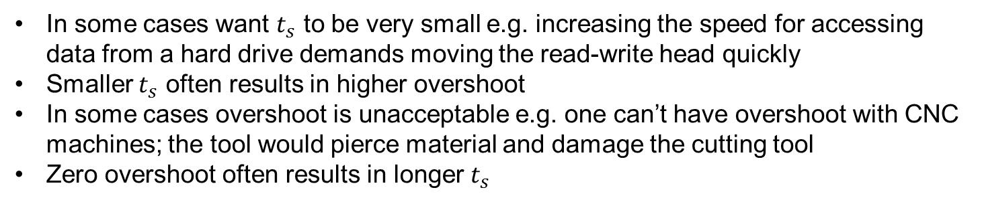
Objective
Design a controller so that the DCP reaches steady-state angle $θ_{ss}$ in a desired settling time $t_{s}$ with desired overshoot $θ\left(t\right)≤θ_{\text{max}}$ for all time $t$.
In some cases want $t_{s}$ to be very small e.g. increasing the speed for accessing data from a hard drive demands moving the read-write head quickly
Smaller $t_{s}$ often results in higher overshoot
In some cases overshoot is unacceptable e.g. one can’t have overshoot with CNC machines; the tool would pierce material and damage the cutting tool
Zero overshoot often results in longer $t_{s}$
Controller design seeks to balance/compromise settling time (i.e. performance) and overshoot (i.e. stability).
© Copyright Paul Oh

Slide 8
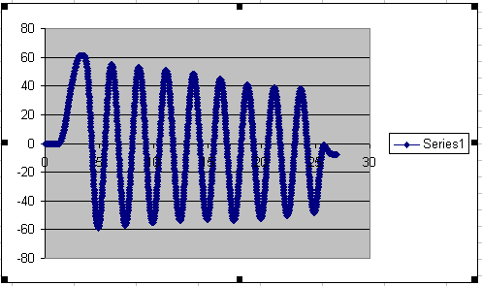
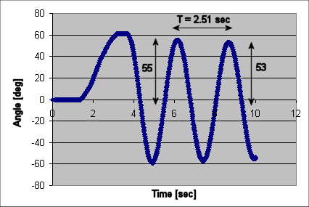
2nd Order Damped System
Response is an exponentially decaying sinusoid defined by natural frequency $ω_{n}$ and damping ratio $ζ$
n
Natural Frequency [rad/s]
(1)
Damping ratio
(2A)
Period [sec]
Angle [rad]
(2B)
© Copyright Paul Oh

Slide 9
DCP is a 2nd order damped system
Equations of Motion
(3)
Linearized 2nd order differential equation assumes small angles
Bar length [m]
Pivot to CG distance [m]
Mass of pendulum [kg]
Moment of Inertia
Viscous damping coefficient
© Copyright Paul Oh

Slide 10
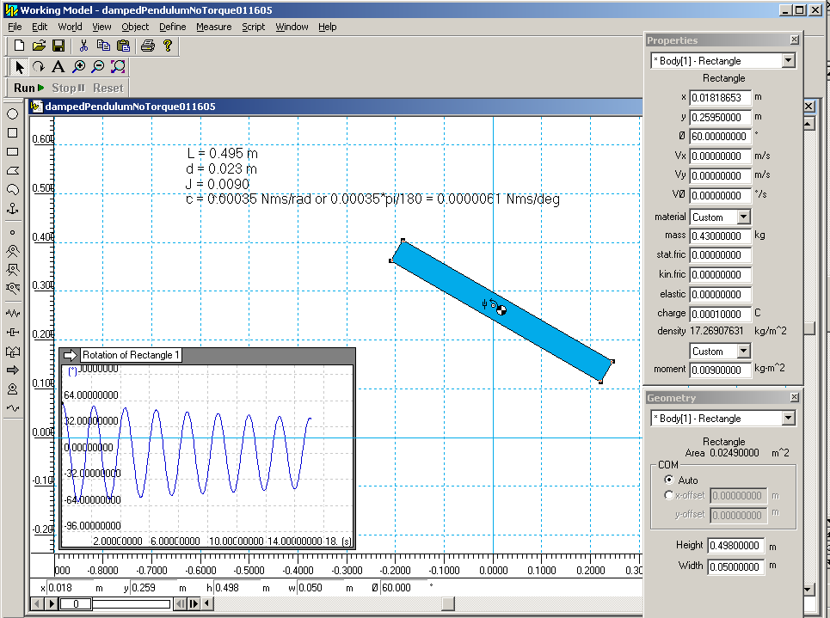
System Identification by Matching Coefficients
Compare (1) and (3)
(4A)
Yields:
(4B)
Now can create a model for simulation
© Copyright Paul Oh

