Slide 1
Lecture: Objectives and Preamble
© Copyright Paul Oh

Slide 2
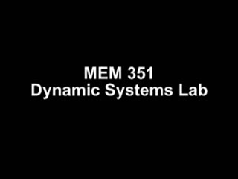
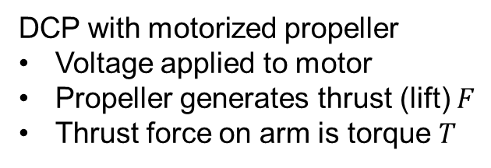
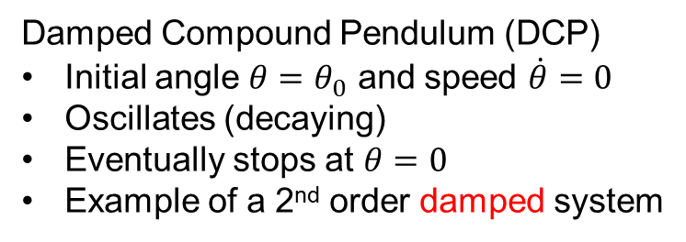
Motivating Question
Damped Compound Pendulum (DCP)
Initial angle $θ=θ_{0}$ and speed $\dot{θ}=0$
Oscillates (decaying)
Eventually stops at $θ=0$
Example of a 2nd order damped system
DCP with motorized propeller
Voltage applied to motor
Propeller generates thrust (lift) $F$
Thrust force on arm is torque $T$
Question
When voltage is applied to DCP with motorized propeller, what does the pendulum do?
Does the pendulum rise slowly? Quickly? Rises and stops? Oscillates? Why?
© Copyright Paul Oh

Slide 3
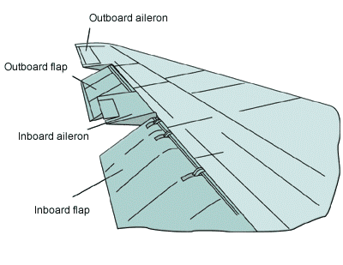

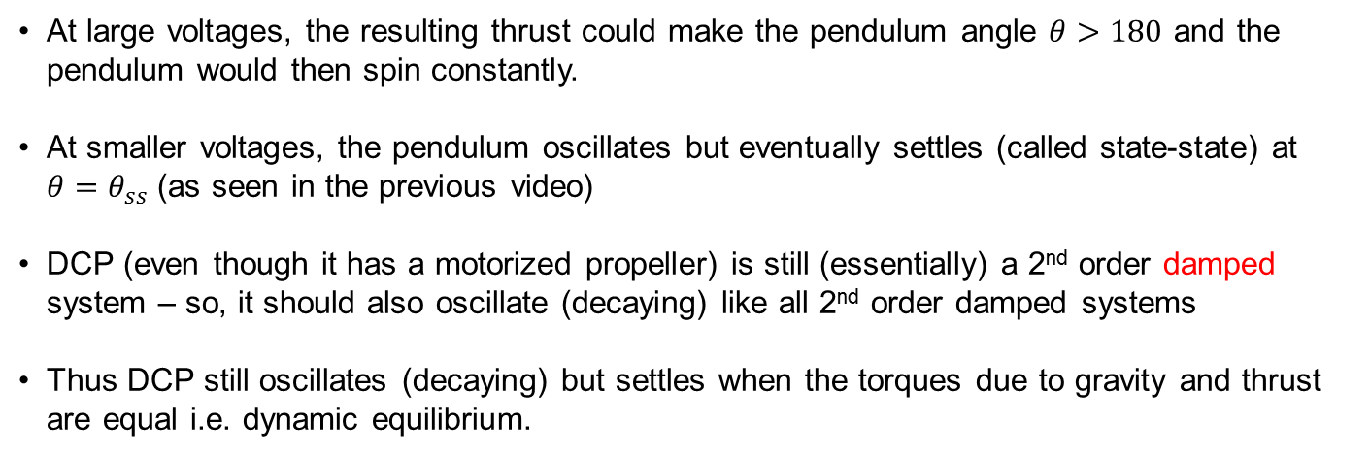
Why Care about DCP?
Answer to Previous Question
At large voltages, the resulting thrust could make the pendulum angle $θ>180$ and the pendulum would then spin constantly.
At smaller voltages, the pendulum oscillates but eventually settles (called state-state) at $θ=θ_{ss}$ (as seen in the previous video)
DCP (even though it has a motorized propeller) is still (essentially) a 2nd order damped system – so, it should also oscillate (decaying) like all 2nd order damped systems
Thus DCP still oscillates (decaying) but settles when the torques due to gravity and thrust are equal i.e. dynamic equilibrium.
Why care: 2nd order systems everywhere; from airplane ailerons to hard drive arms. DCP is a “simple” case study that can extend to all 2nd order systems
© Copyright Paul Oh

Slide 4
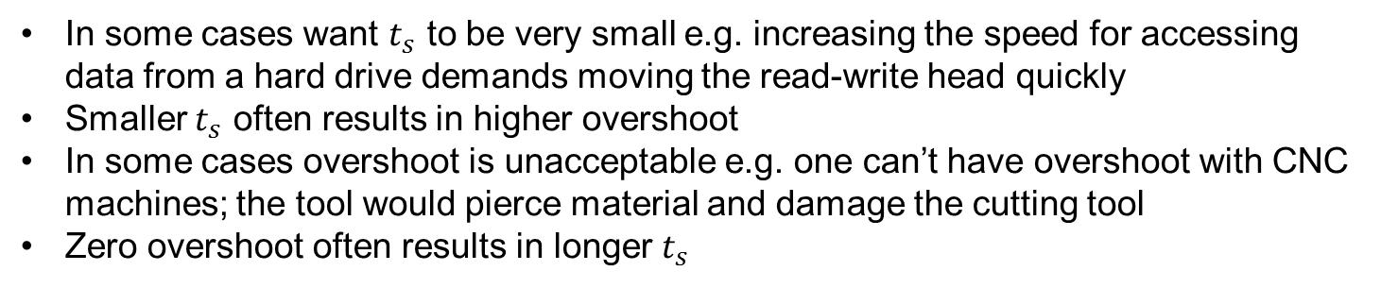
Objective
Design a controller so that the DCP reaches steady-state angle $θ_{ss}$ in a desired settling time $t_{s}$ with desired overshoot $θ\left(t\right)≤θ_{\text{max}}$ for all time $t$.
In some cases want $t_{s}$ to be very small e.g. increasing the speed for accessing data from a hard drive demands moving the read-write head quickly
Smaller $t_{s}$ often results in higher overshoot
In some cases overshoot is unacceptable e.g. one can’t have overshoot with CNC machines; the tool would pierce material and damage the cutting tool
Zero overshoot often results in longer $t_{s}$
Controller design seeks to balance/compromise settling time (i.e. performance) and overshoot (i.e. stability).
© Copyright Paul Oh

Slide 5
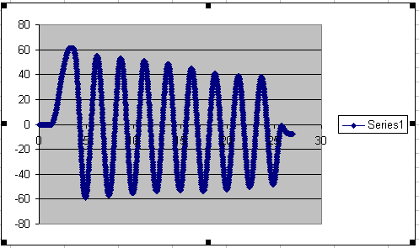
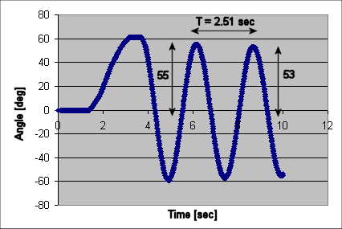
2nd Order Damped System
Response is an exponentially decaying sinusoid defined by natural frequency $ω_{n}$ and damping ratio $ζ$
n
Natural Frequency [rad/s]
(1)
Damping ratio
(2A)
Period [sec]
Angle [rad]
(2B)
© Copyright Paul Oh

Slide 6
DCP is a 2nd order damped system
Equations of Motion
(3)
Linearized 2nd order differential equation assumes small angles
Bar length [m]
Pivot to CG distance [m]
Mass of pendulum [kg]
Moment of Inertia
Viscous damping coefficient
© Copyright Paul Oh

Slide 7
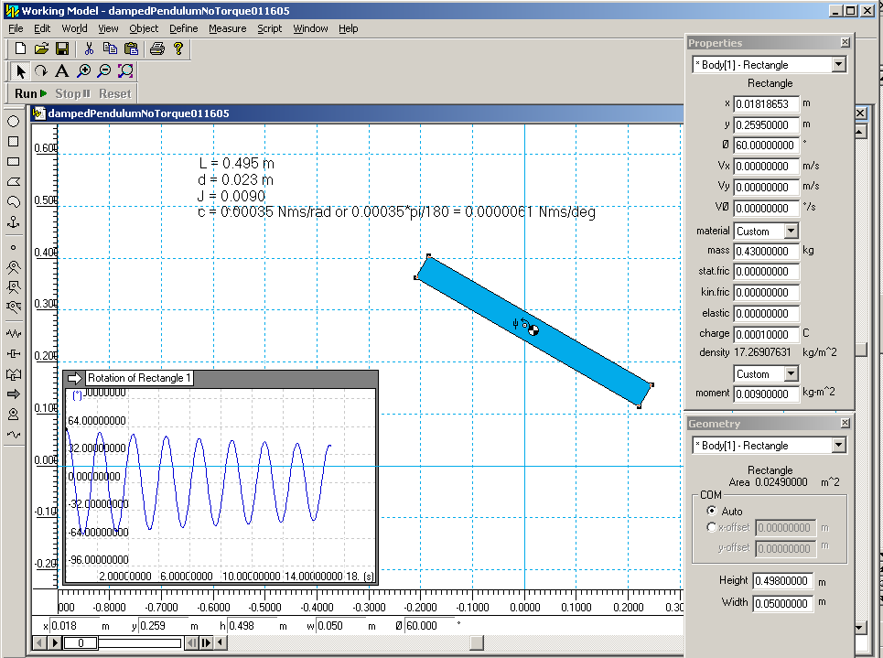
System Identification by Matching Coefficients
Compare (1) and (3)
(4A)
Yields:
(4B)
Now can create a model for simulation
© Copyright Paul Oh

