Slide 1
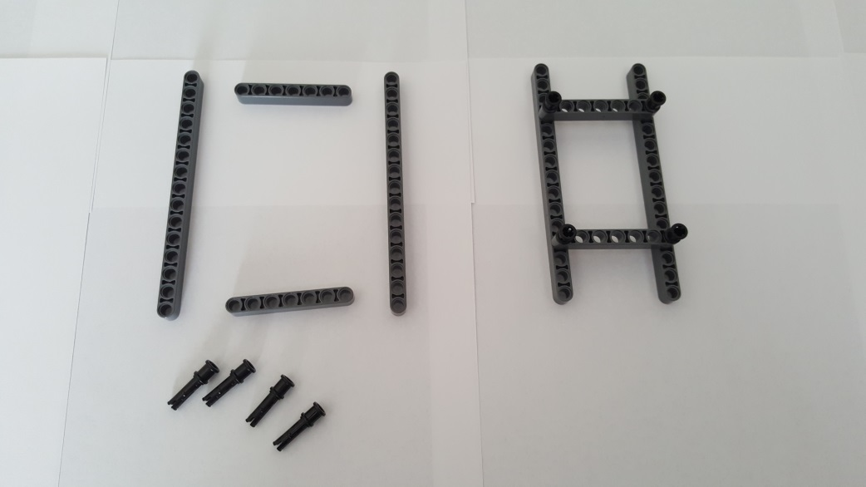
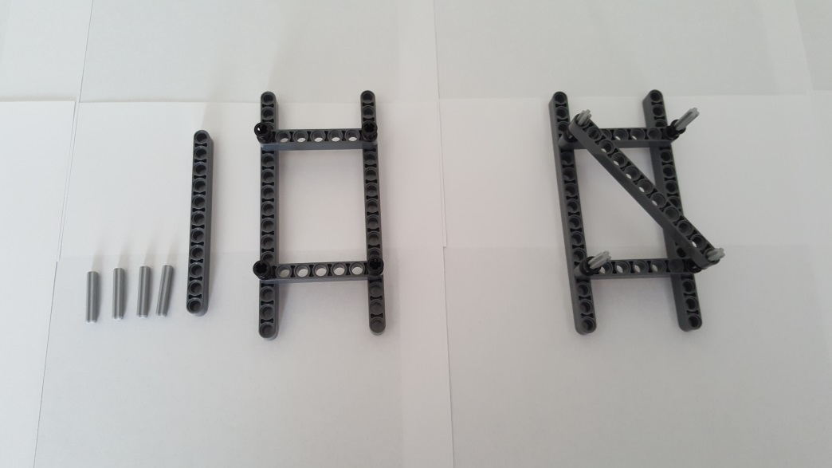
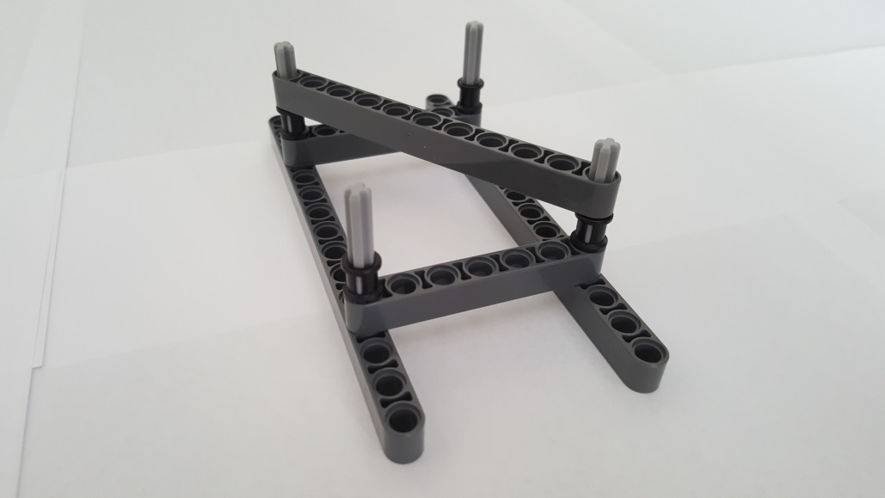
Step A: Truss Sub-Assembly
Step A-1: Lower Truss
2x 15-Beam 32278
1x 11-Beam 32525
2x
7-Beam 32524
4th hole
4x Pin 3L with Stop Bush 32054
4x 3-Axle 4519
Gather parts (left). Insert two Pin 3L at each end of 7-Beam. Repeat with other 7-Beam. Connect 7-Beams to 4th hole of 15-Beam. Finished step (right)
Gather parts (left). Insert a 3-Axle in each Pin 3L’s Stop Bush. Lay 11-Beam diagonally across 3-Axles. Finished step (right)
Close-up of Finished step

Slide 2
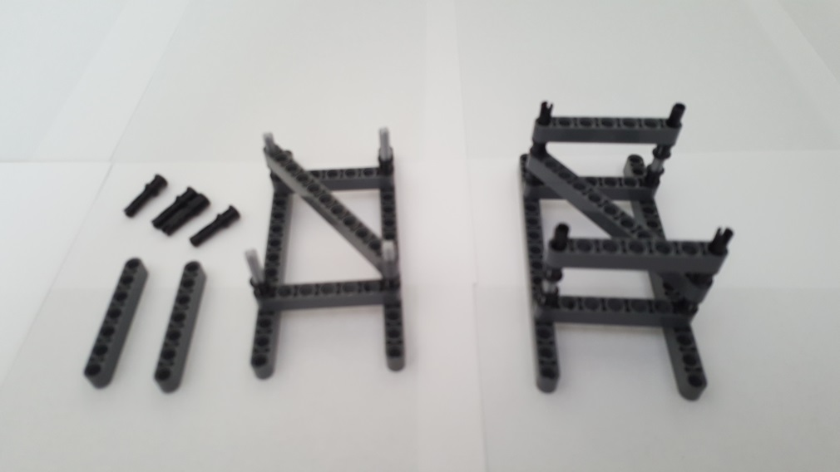
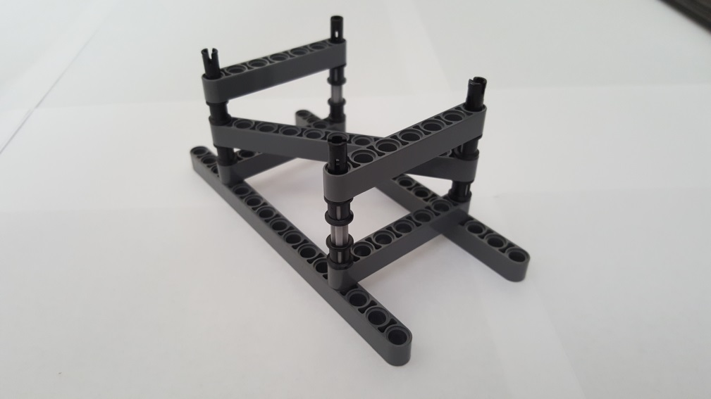
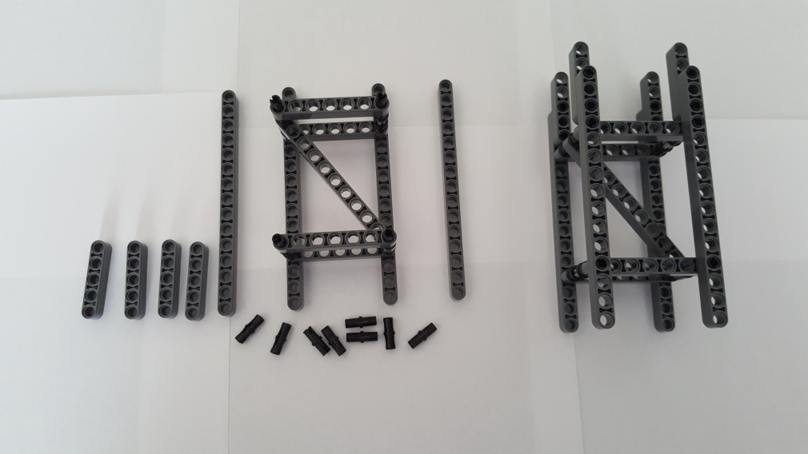
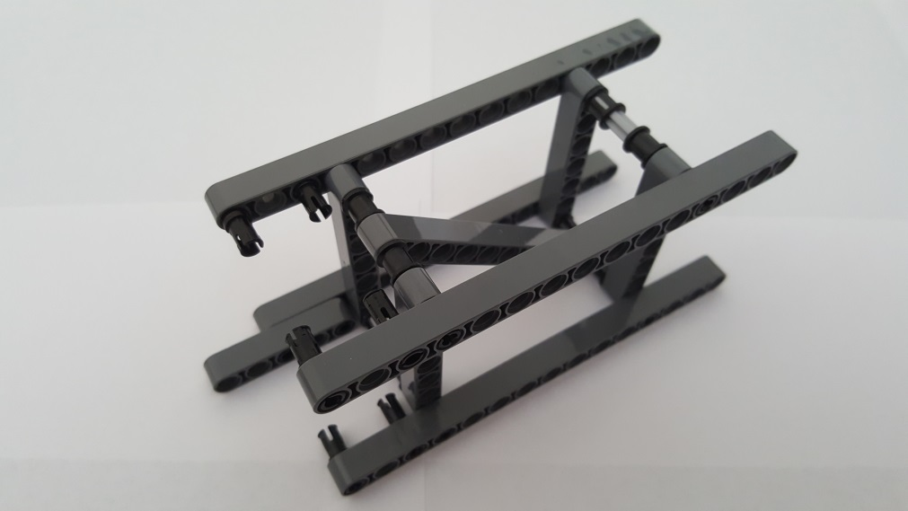
4x Pin 3L with Stop Bush 32054
2x 7-Beam 32524
Gather parts (left). Insert each Pin 3L Stop Bush over the 3-Axle. Connect 7-Beam over each Pin 3L. Finished step (right)
Close-up of Finished step
2x 15-Beam 32278
4x 5-Beam 32316
8x Friction Pin 2780
Gather parts (left). Connect 15-Beams over Pin 3L. Connect 5-Beam to 15-Beam with Friction Pins Finished step (right)
Close-up: Red arrows show where Friction Pins are inserted into 15-Beam and 5-Beam. The remaining 6 Friction Pins are also seen

Slide 3
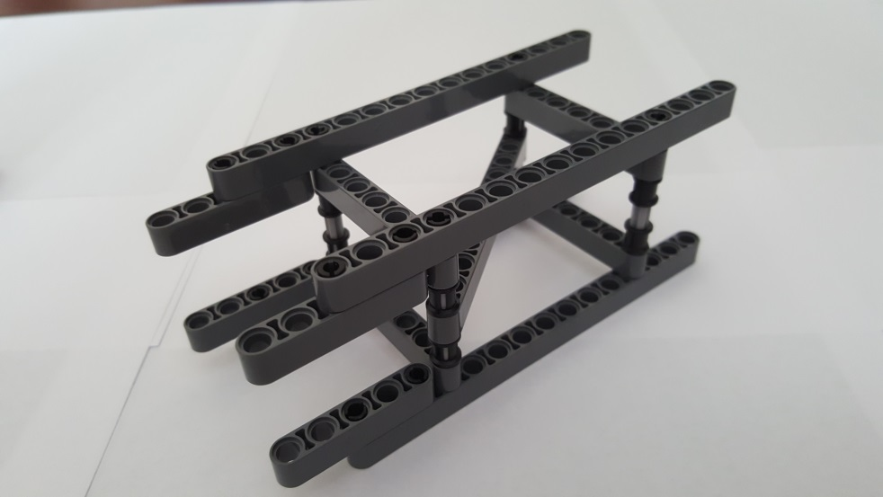
Completed Lower Truss
Close-up of Finished brace. Red arrows point to locations of Friction Pins to connect 5-Beams to 15-Beams

Slide 4
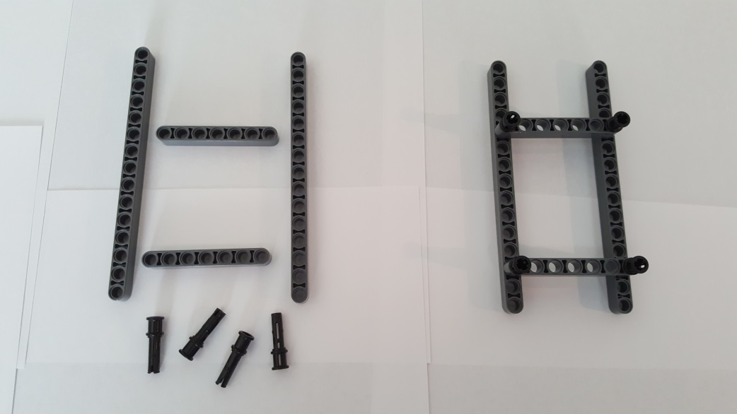
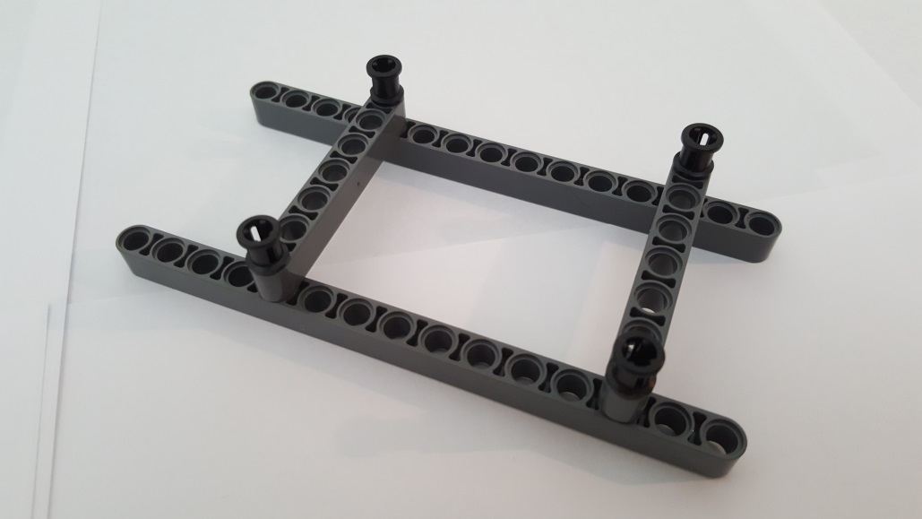
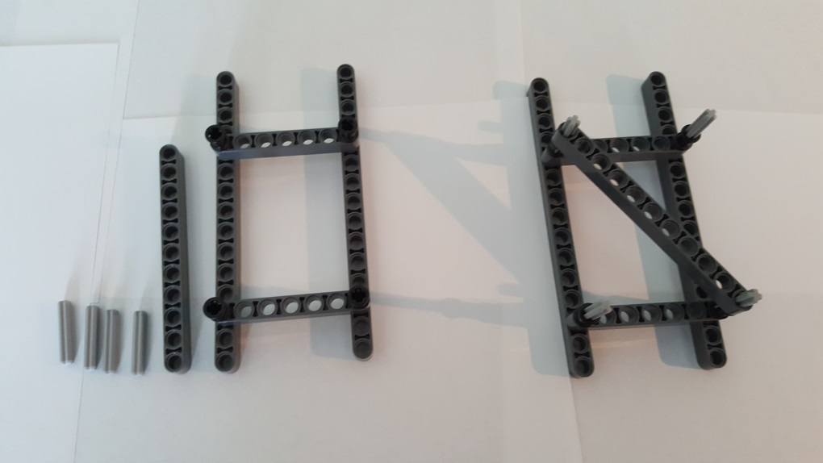
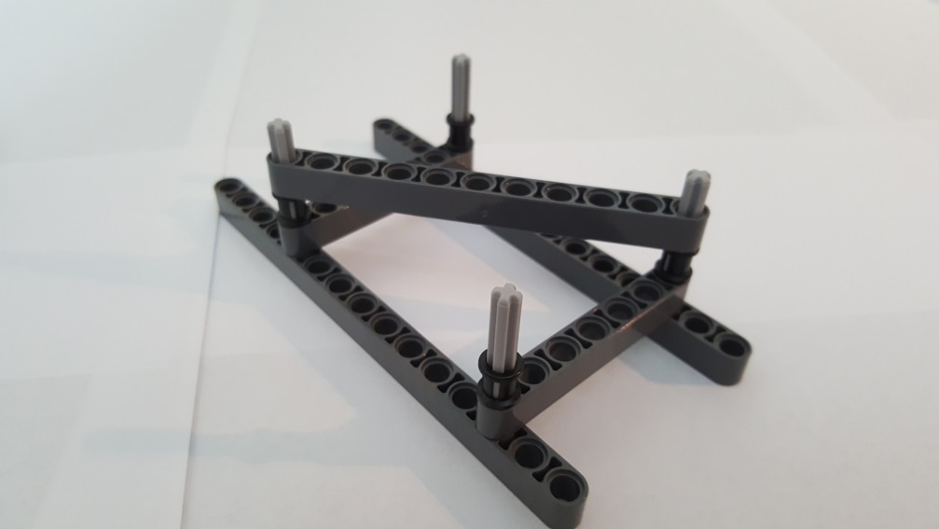
Step A-2: Middle Truss
2x 15-Beam 32278
2x 7-Beam 32524
3rd hole of 15-beam
4x Pin 3L with Stop Bush 32054
5th hole of 15-beam
Gather parts (left). Insert two Pin 3L at each end of 7-Beam. Repeat with other 7-Beam. Connect 7-Beams to 3rd and 5th holes of 15-Beam. Finished step (right)
Close-up of finished step
1x 11-Beam
32525
4x 3-Axle 4519
Gather parts (left). Insert each 3-Axle into each Pin 3L’s Stop Bush. Diagonally lay11-Beam over Axles
Close-up of finished step

Slide 5
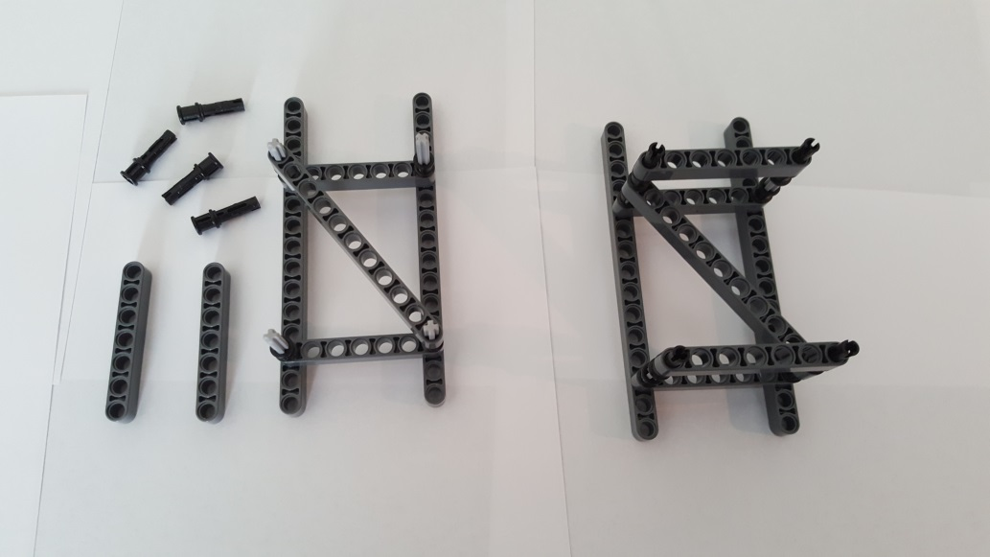
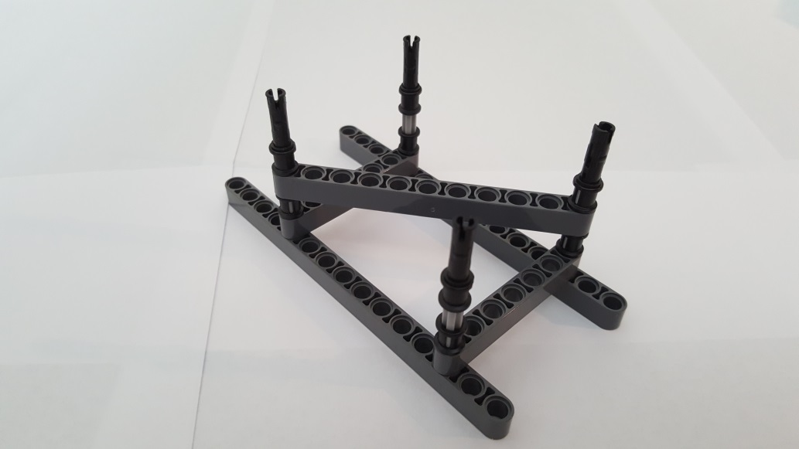
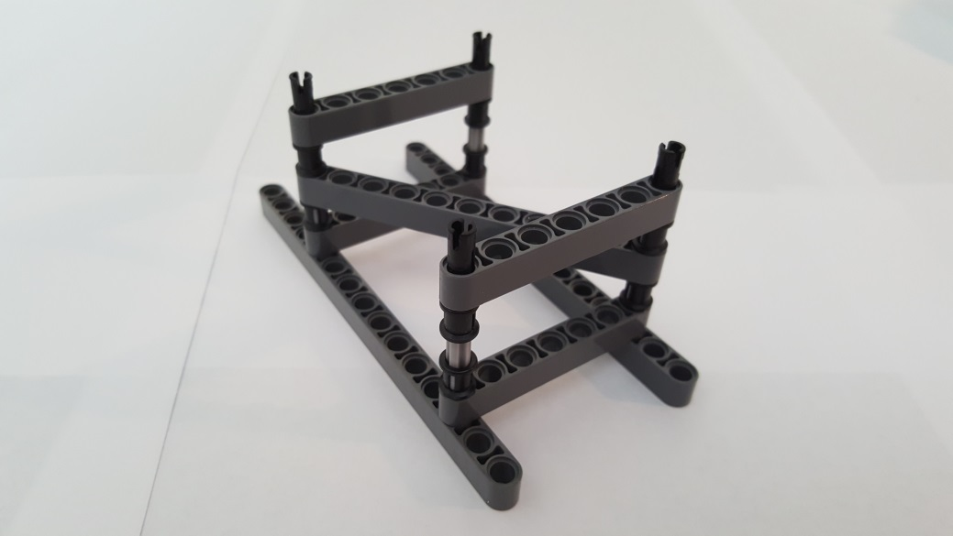
4x Pin 3L with Stop Bush 32054
2x 7-Beam 32524
Gather parts (left). Insert each Pin 3L’s Stop Bush into 3-Axle. Insert 7-Beam over Pin 3L peg. Finished step (right)
Close-up: Red Arrows show a Pin 3L’s Stop Bush inserted over a 3-Axle.
Close-up: 7-Beam inserted into Ping 3L

Slide 6
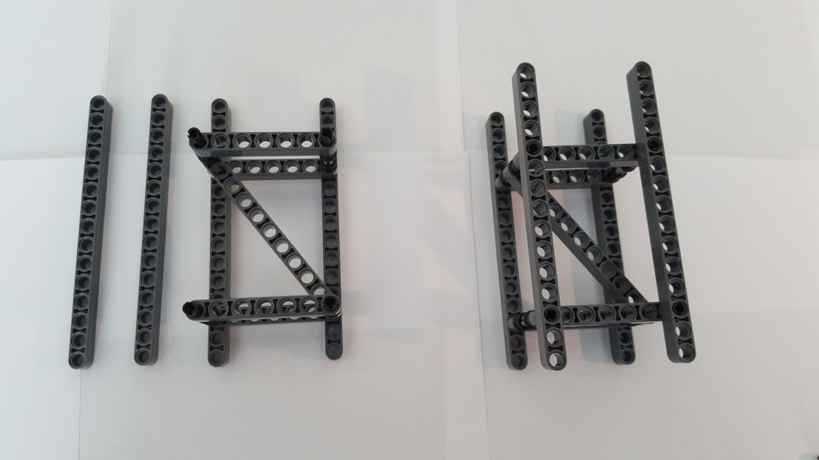
2x 15-Beam 32278
4 open holes
Completed Middle Truss
(NB: Has 4 open holes in 15-Beam)
Gather parts (left). Insert 15-Beam over Pin 3L pegs. Finished step (right)

Slide 7
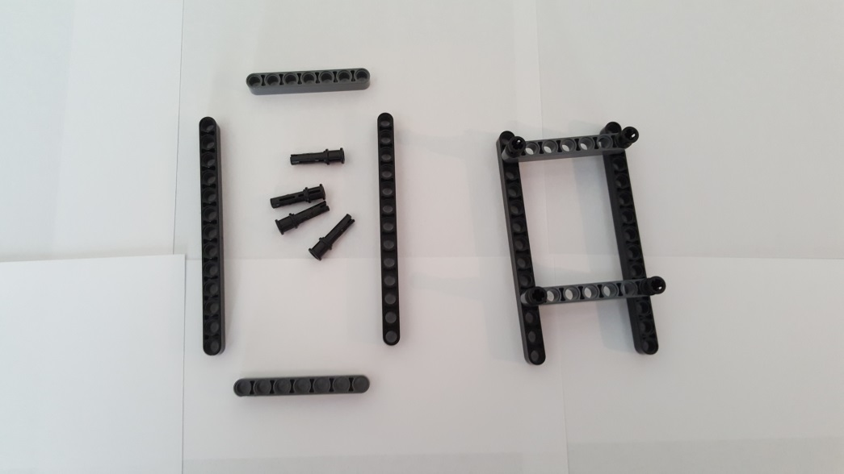
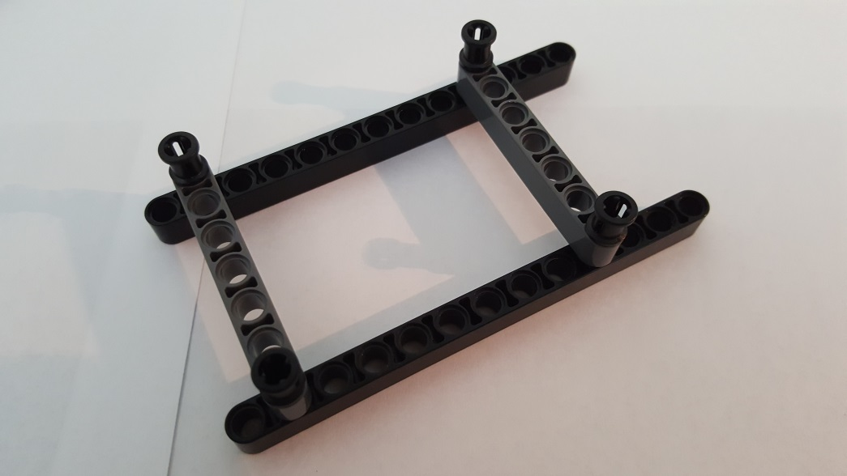
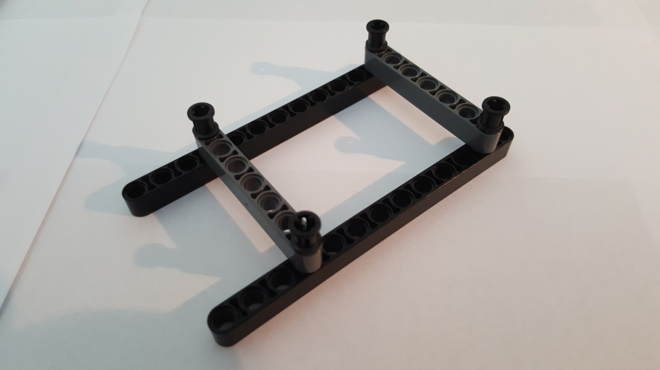
Step A-3: Upper Truss
2x 13-Beam 41239
4x Pin 3L with Stop Bush 32054
2x 7-Beam 32524
Gather parts (left). Insert two Pin 3L at each end of 7-Beam. Repeat with other 7-Beam. Connect 7-Beams to 2nd and 4th holes of 13-Beam. Finished step (right)
Close-up: Red Arrows show Pin 3L inserted into 2nd and 4th holes of 13-Beam
2nd hole of 13-Beam
4th hole of 13-Beam

Slide 8
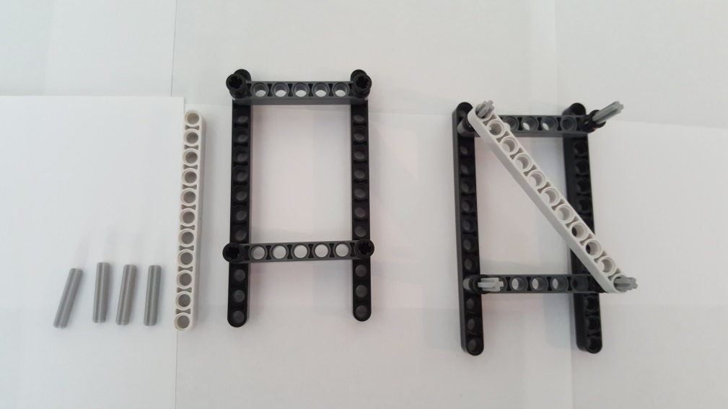
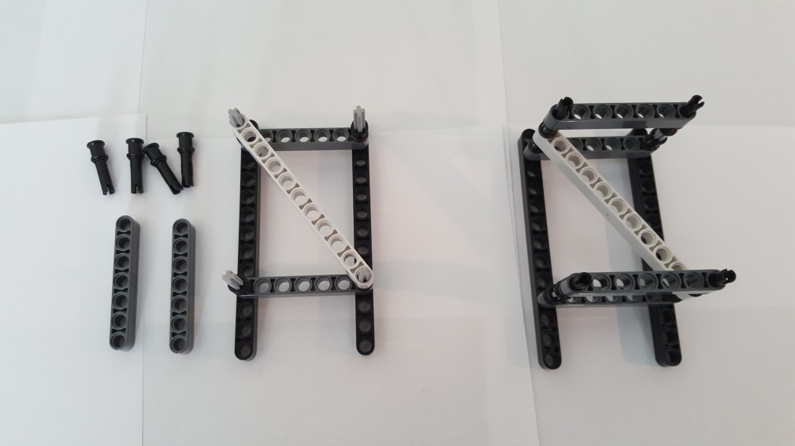
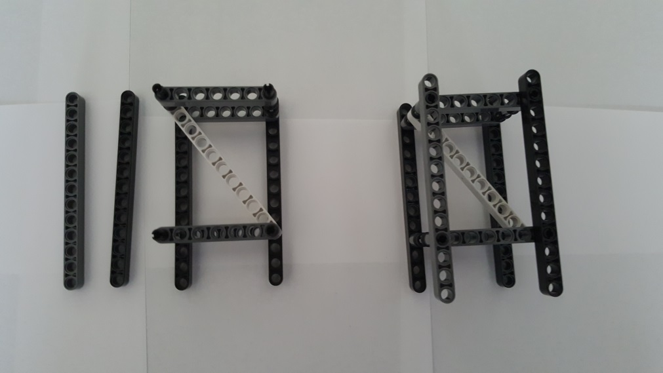
1x 11-Beam 32525
4x Pin 3L with Stop Bush 32054
4x 3-Axle 4519
2x 7-Beam 32524
Gather parts (left). Insert 3-Axles into Pin 3L’s Stop Bush. Lay 11-Beam diagonally across. Finished step (right)
Gather parts (left). Insert Pin 3L’s Stop Bush onto 3-Axles. Insert 7-Beams onto Pin 3L’s pins. Finished step (right)
2x 13-Beam 41239
Completed Upper Truss
Gather parts (left). Insert 13-Beams over Pin 3L’s pins. Finished step (right)

Slide 9
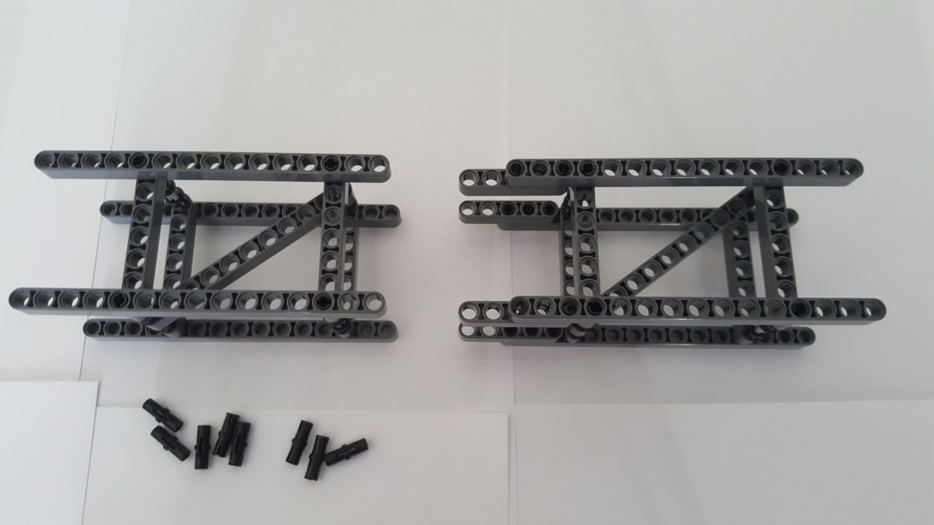
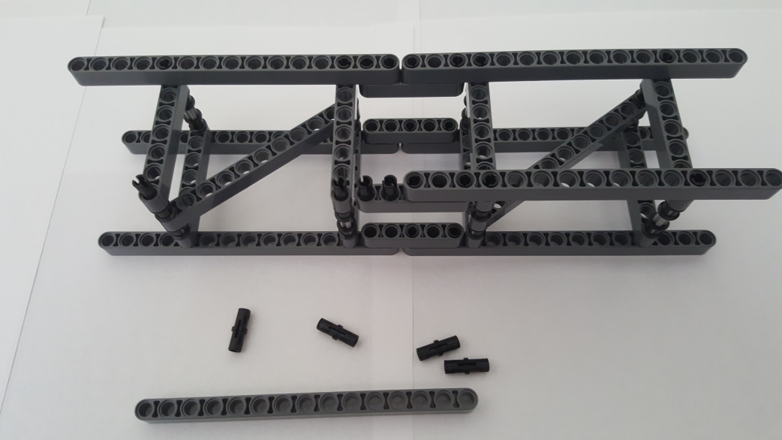
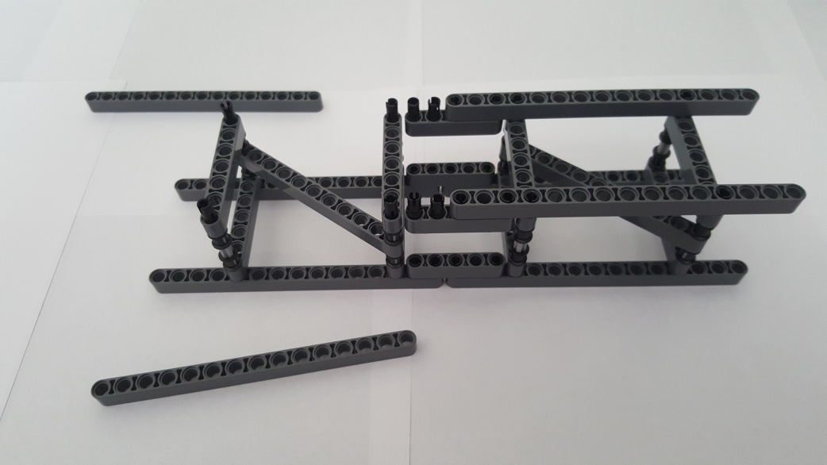
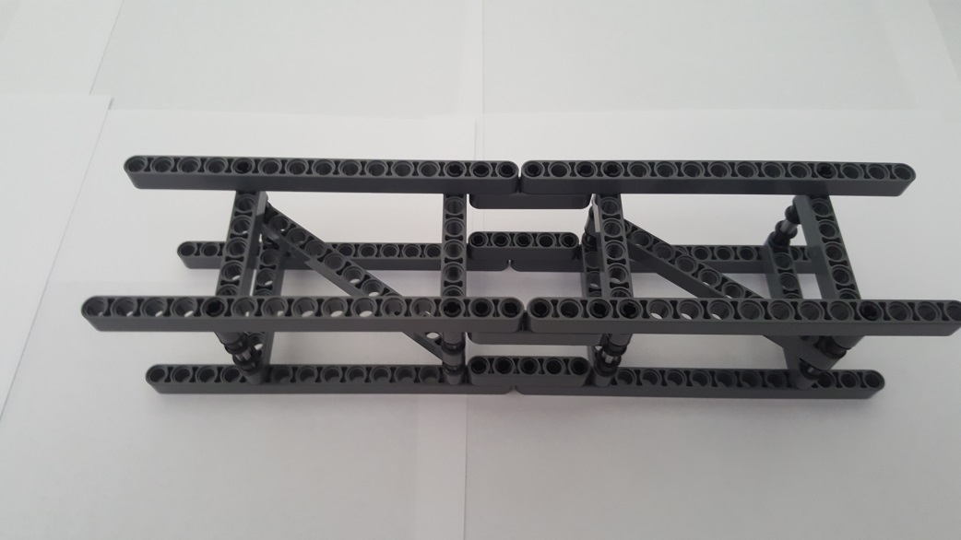
Step A-4: Lower-to-Middle Truss Connection
Middle Truss
Lower Truss
Lower-to-Middle Truss Connection
8x Friction Pin 2780
Gather parts Lower (Step A-1) and Middle (Step A-2) trusses. Note the orientation (red arrows) of diagonal braces
Insert friction pins. Top 4 red down-arrows show a completed connection. Bottom 2 red up-arrows show friction pins exposed. Note orientation of diagonal braces
Flip over. 15-Beams removed to make connection easier. Note orientation of diagonal braces
Completed Lower-to-Middle Truss Connection

Slide 10
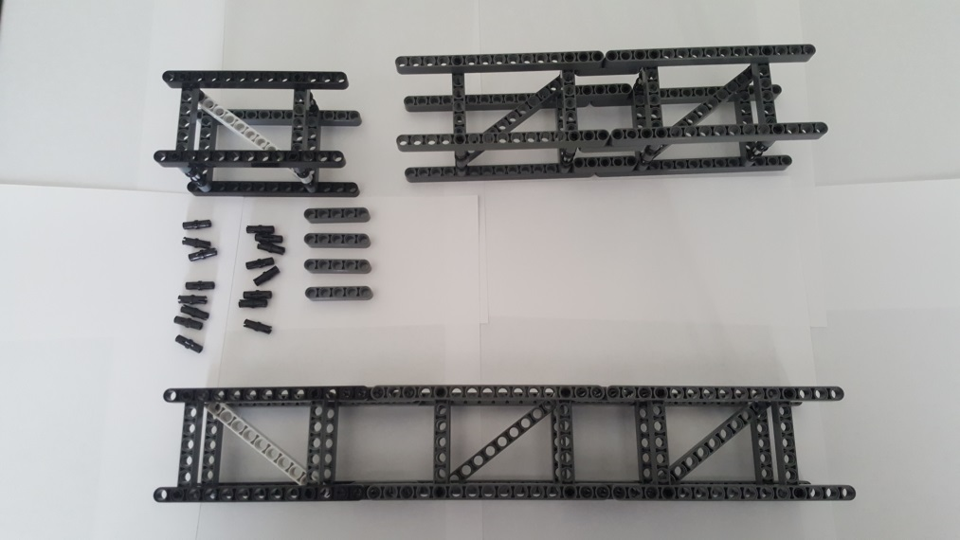
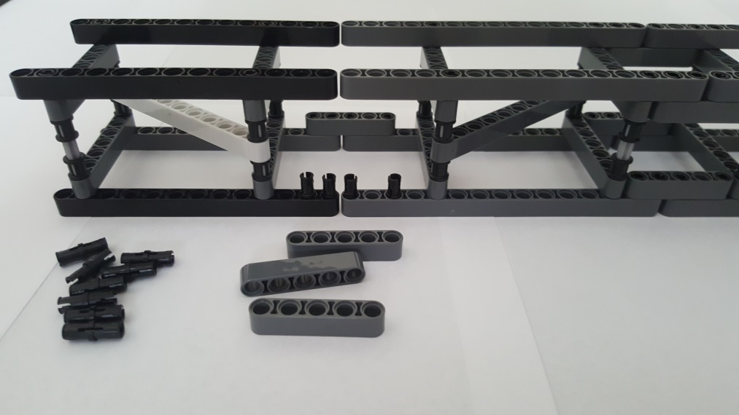
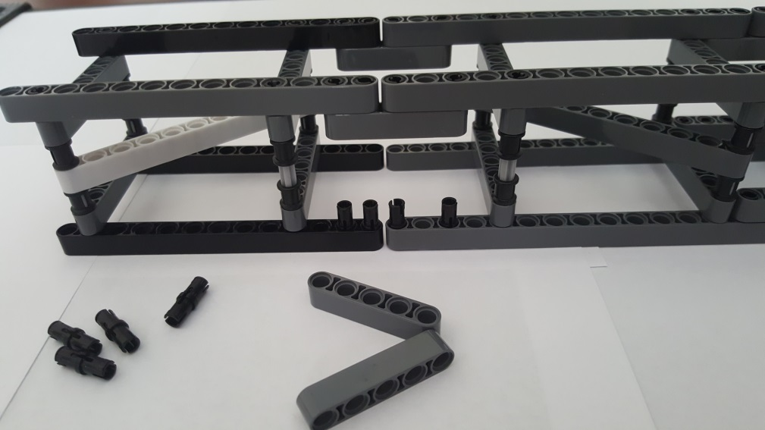
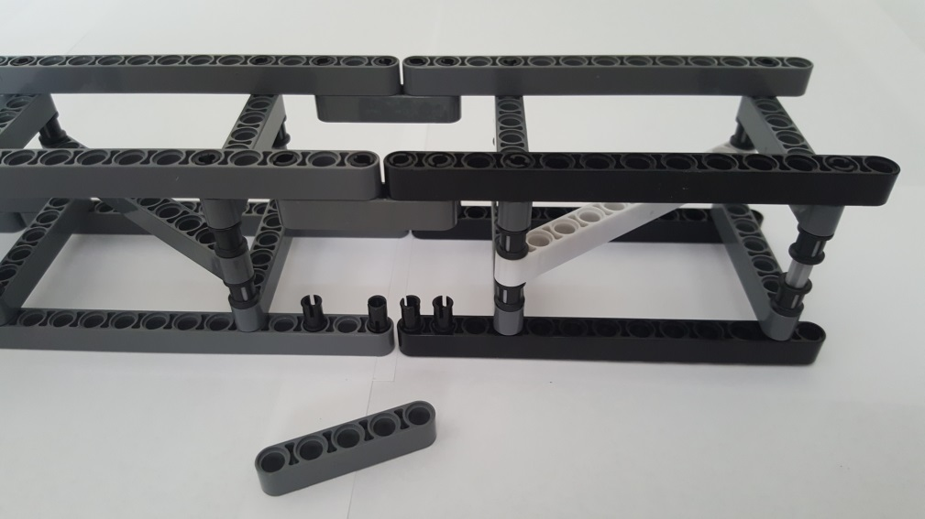
Step A-5: Upper Truss Connection
Upper Truss
16x Friction Pin 2780
Lower-to-Middle Truss Connection
4x 5-Beam 32316
Gather Lower-to-Middle Truss Connection (Step A-4). Bottom assembly: Goal is to connect Upper Truss (Step A-3) to the Lower-to-Middle Truss Connection. Note: Red arrows show diagonal orientation
Insert 8 Friction Pins (red arrows) and use 5-Beam to attach Upper Truss to the Lower-to-Middle Truss Connection
5-Beam attached
Flip over. Insert 4 friction pins
Connect 5-Beam. Flip over. Insert remaining 4 friction pins.

Slide 11
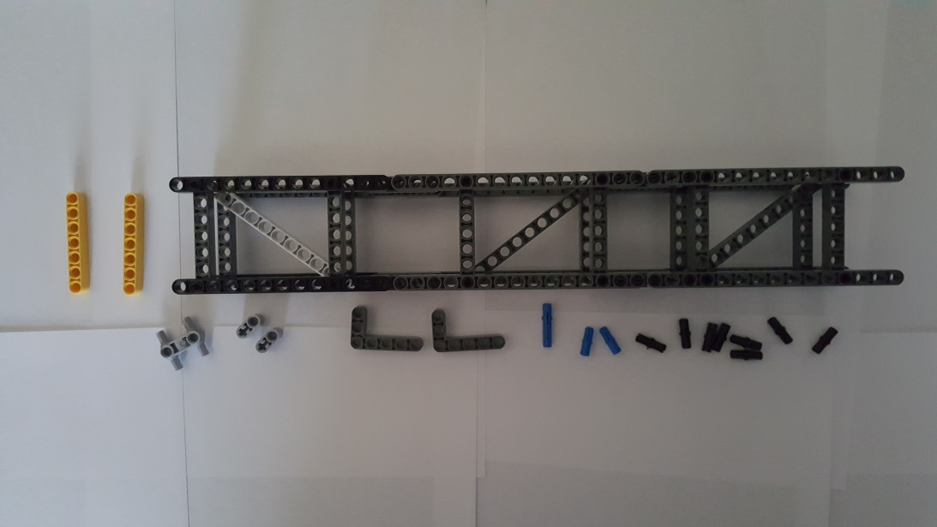
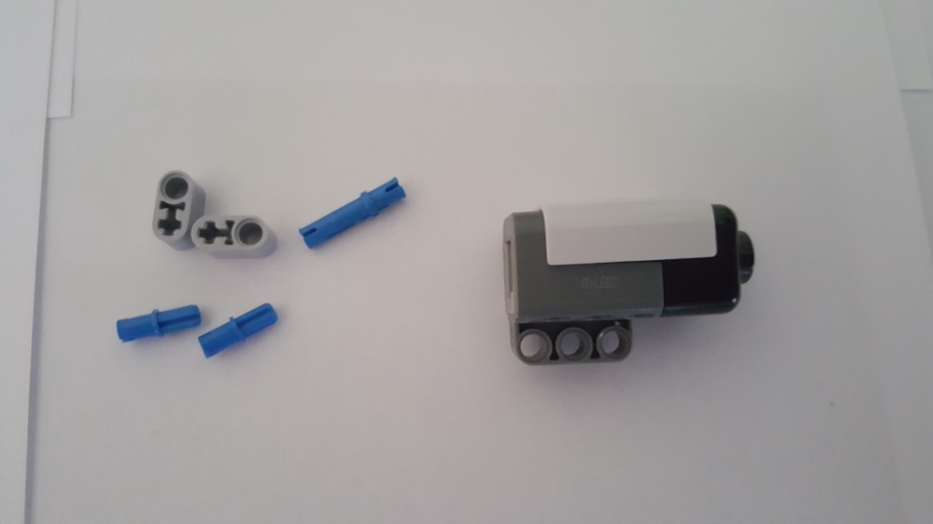
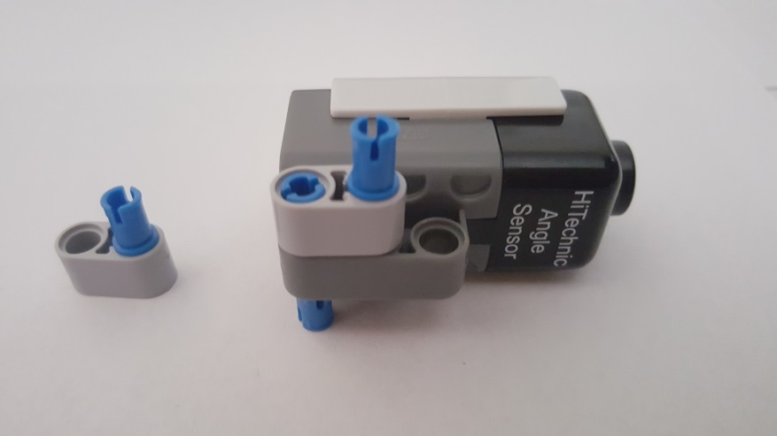
Step B: Angle Sensor Sub-assembly
Step B-1: Angle Mount
2x 7-Beam 32524
1x 4 Pin 3L Connector 48989
Completed 3-stage Truss (Step A-5)
2x 1x2 Beam Pin and Axle Hole 60483
2x 3x5 Liftarm 32526
2x Long Pin 6558
2x Axle Pin 43093
8x Friction Pin 2780
Gather Parts and the Completed Truss (from Step A-5)
Hi Technic Angle Sensor https://www.hitechnic.com/cgi-bin/commerce.cgi?preadd=action&key=NAA1030
Long Pin
Insert Long Pin in Angle Sensor Mount. Attach 1x2 Beam Pin and Axle. Attach Axle Pin into 1x2 Beam Pin and Axle

Slide 12
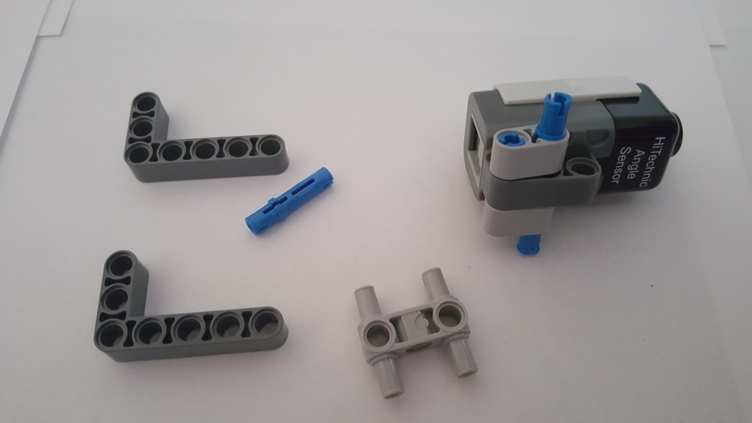
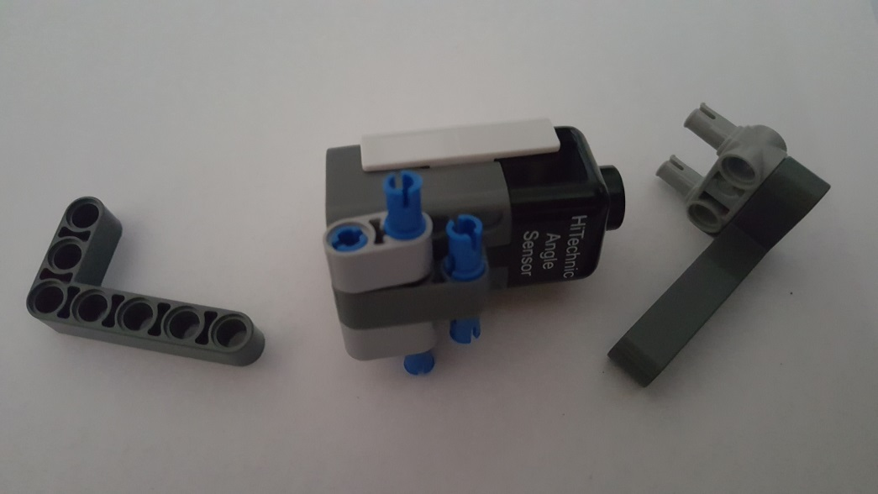
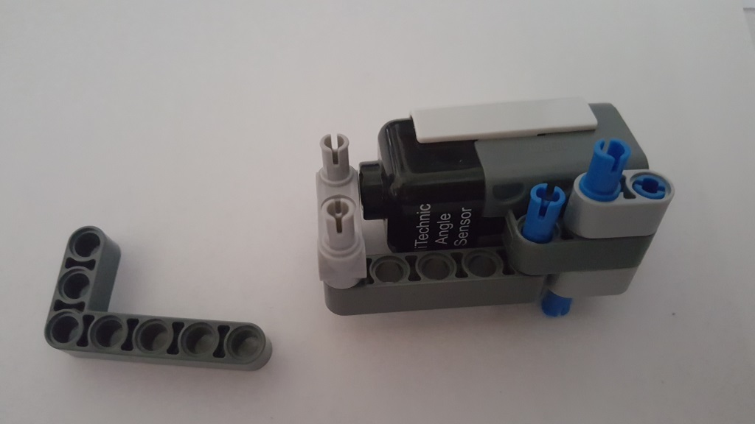
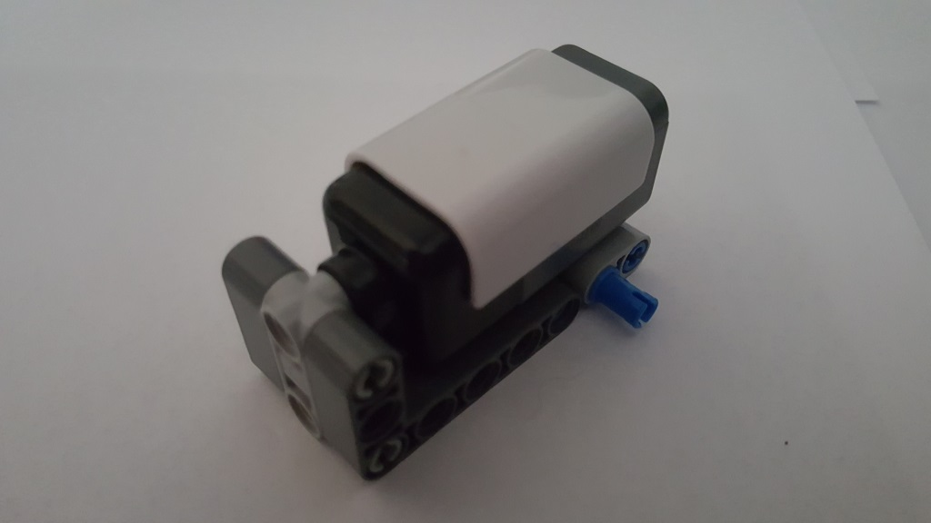
Long Pin
Flip-over sensor to attach remaining 1x2 Beam Hole and Axle
Insert Long Pin in Angle Sensor. Attach 4 Pin 3L into 3x5 Liftarm
Attach 3x5 Liftarm onto pins and flip-over
Attach remaining 3x5 Liftarm onto pins

Slide 13
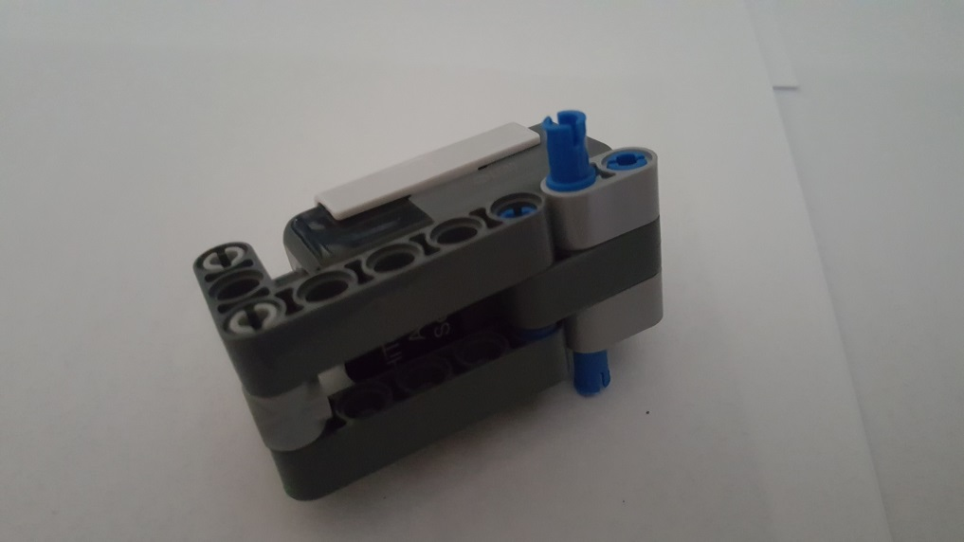
Completed Angle Sensor Mount

Slide 14
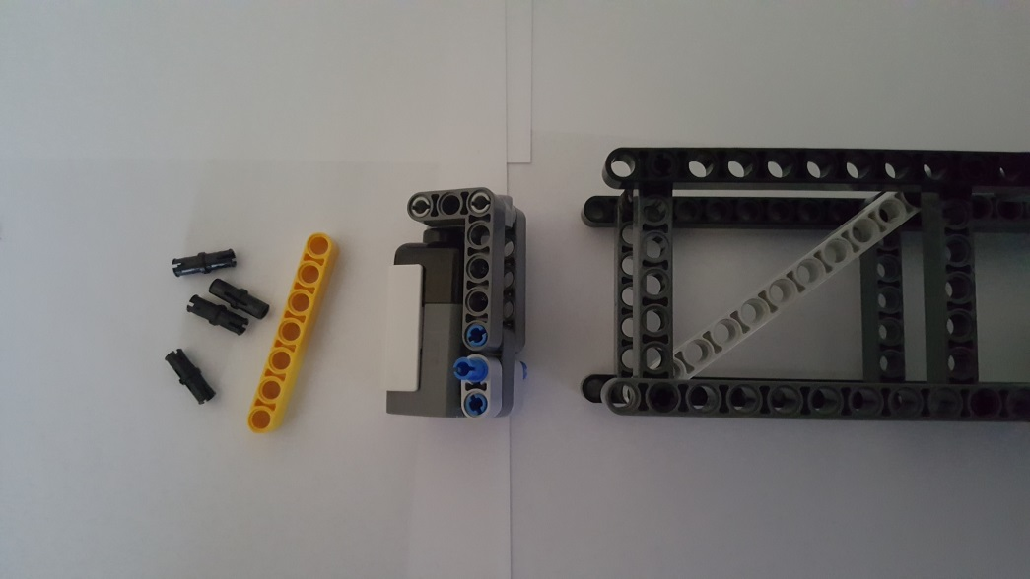
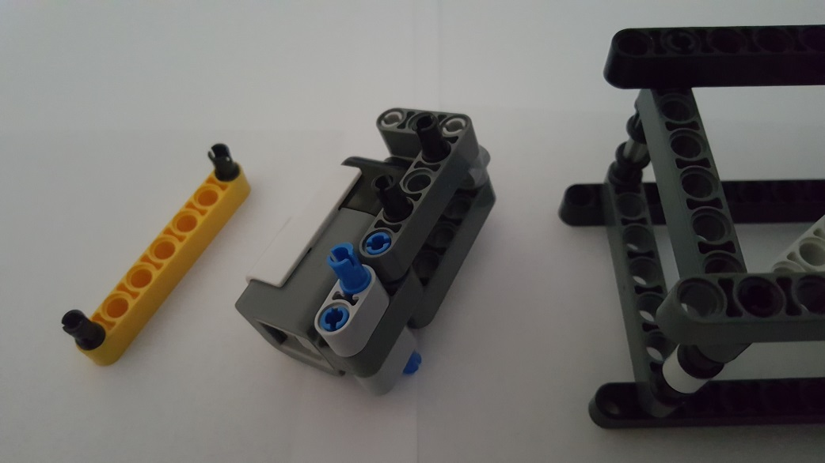
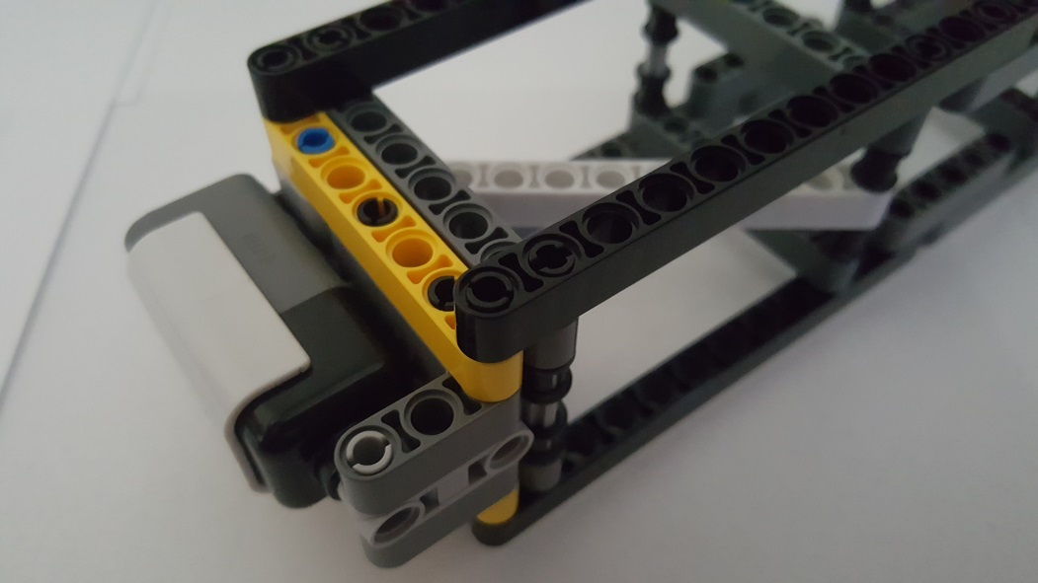
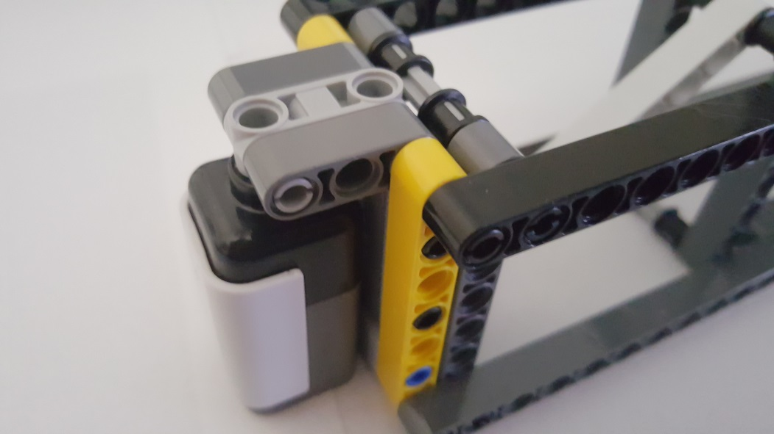
Step B-2: Angle-to-Truss Connection
Gather 4 Friction Pins and 1 7-Beam from Step B-1, the Angle Sensor Mount from Step B-1, and Truss Sub-Assembly from Step A-5
Insert 2 Friction Pins at the ends of one of the 7-Beams. Insert 2 Friction Pins on the Sensor Mount
Attach 7-Beam to Sensor Mount. Then, Attach to the Truss Sub-Assembly
Repeat for other 7-Beam

Slide 15
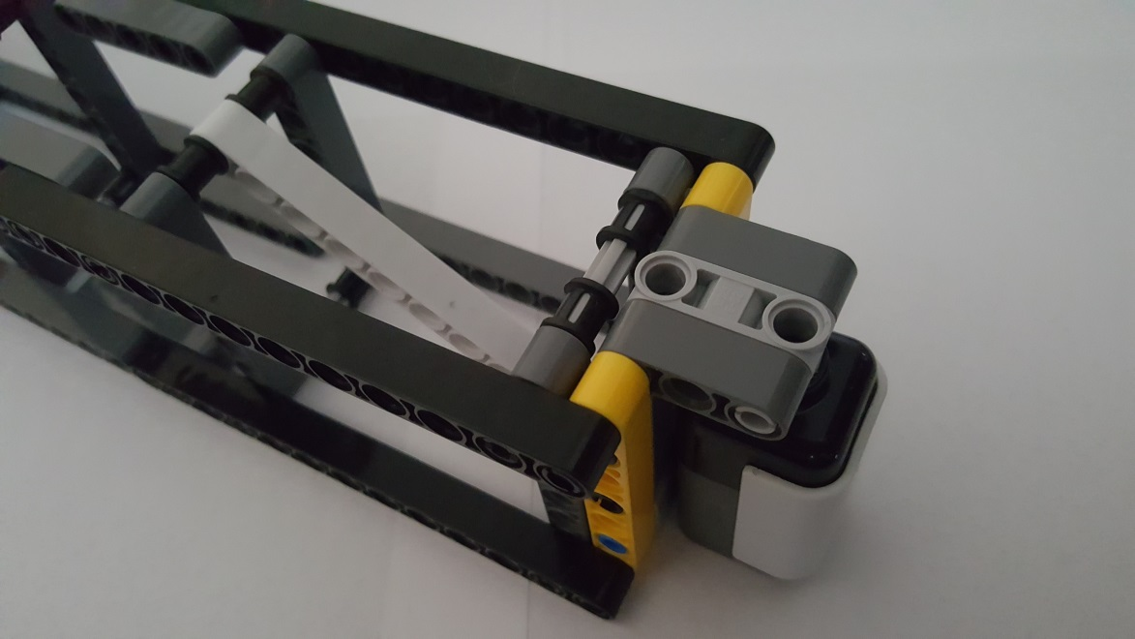
Completed Angle Sensor to Truss Sub-Assembly

Slide 16
Step C: Base Sub-Assembly
Stuff to do:
Need those 90-deg hooking parts (don’t know name)
Step D: Pendulum Sub-Assembly
Step E: Cabling Channels Assembly
Step F: Motorized-Propeller Wiring
Step G: NXT Cable hook-ups

