Slide 1
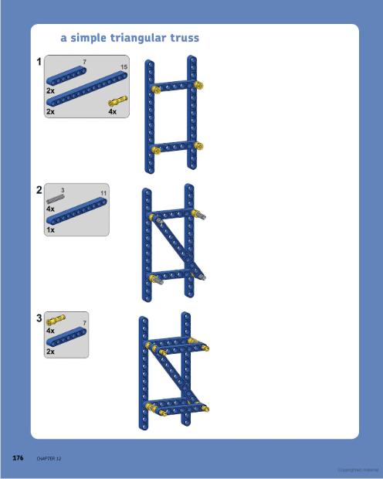
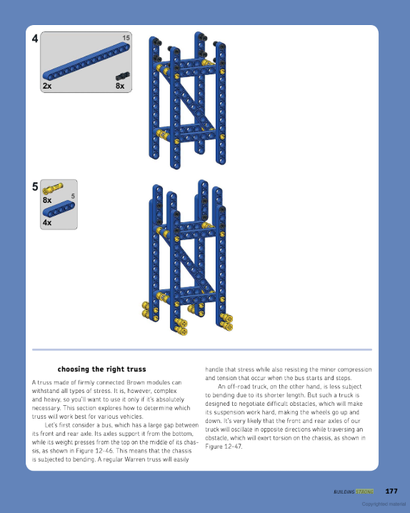
From https://books.google.com/books?id=VJe7DQAAQBAJ&pg=PA179&lpg=PA179&dq=lego+build+strong+tower+mast&source=bl&ots=hOQ7Yqww2_&sig=EgZjuewKo63hQS-vK1OQqIiaqgw&hl=en&sa=X&ved=2ahUKEwjMl-aPisvcAhUOB3wKHUhEBLEQ6AEwEXoECAQQAQ#v=onepage&q=lego%20build%20strong%20tower%20mast&f=true

