Slide 1
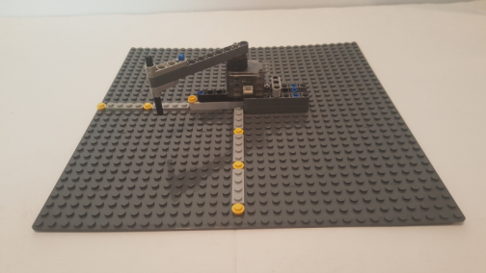
© Paul Oh, 2019
Last updated 12/14/19
Dynamixel XL-320 1-DOF Planar Manipulator
Preamble: Lego pieces adhere to a strict spacing, namely 8 mm between studs. This fact can be leveraged to easily measure lengths. Lengths are needed to kinematically define a robot manipulator’s properties. Lego servos, like the NXT motor, have substantial backlash. By contrast, the XL-320 servo has little backlash and is significantly smaller and lighter than Lego motors. Using M2.5 fasteners, one can easily attach Lego parts to the XL-320.
Objective: Construct a 1-DOF planar manipulator with the XL-320 and Lego
XL-320 Lego-based 1-DOF Planar Manipulator

Slide 2
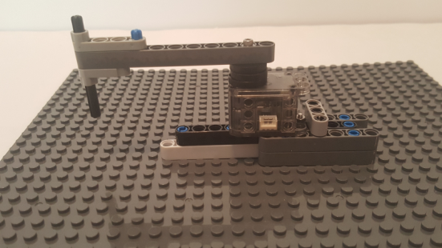
© Paul Oh, 2019
Last updated 12/14/19
Step 1: Manipulator Arm to XL-320 Servo
15th Stud
1 Baseplate 32 x 32
(3811)
9th Stud
2 3/8M Flat Washers 21/32” OD
1 Cross Axle Peg
(43093)
1 Liftarm 1 x 3 Crank
(33299)
1 M2.5 washer
1 Beam 11 (64290)
1 Axle 6 (3706)
1 M2.5 x 20 MM hex screw
1 Liftarm 1 x 4 Thin with Stud Connector (2825)
1A: Attach Lego-based Servo Mount on Baseplate at location (red arrows). Gather components
1B: Fasten M2.5 screw thru washer, Beam 11, 2 flat washers to XL-320 horn. Insert crank on Beam 11
1C: Attach Liftarm 1 x 4 and secure with Axle 6

Slide 3
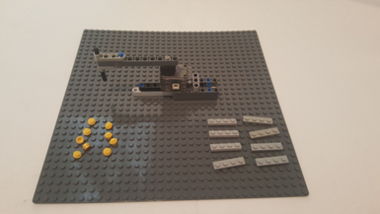
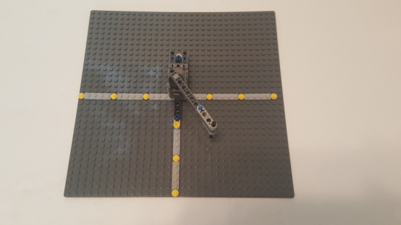

© Paul Oh, 2019
Last updated 12/14/19
Step 2: Cartesian Planar Workspace
9 Plate Round 1x1
(4072)
8 Plate 1x4
(3710)
2A: Gather components to define Cartesian axes
2B: (Yellow) 1x1 Round Plates define 5-stud spacing. Insert them between 1x4 Plates.
Congratulations! This is an XL-320 Lego-based 1-DOF planar manipulator. Studs are spaced 8 mm apart. The Cartesian workspace will help test the manipulator’s positioning accuracy
2C: $±\text{X}$ axis is -15 to +15 studs. +Y axis is +15 studs

