Slide 1
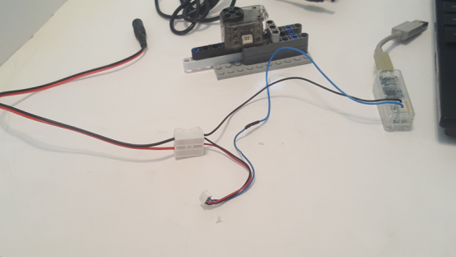
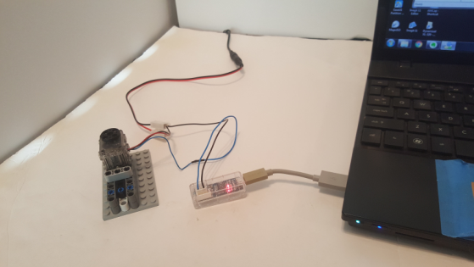
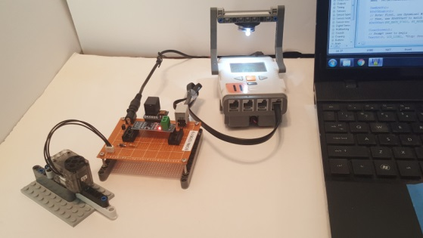
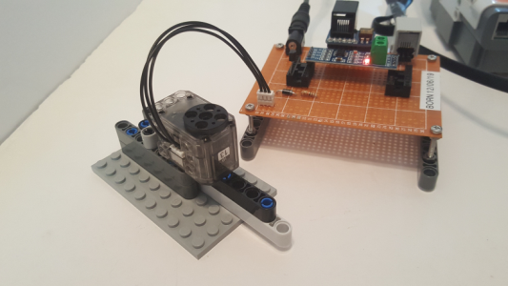
© Paul Oh, 2019
Last updated 12/14/19

Slide 2
9V Power Supply with 2.5 MM x 5.5 MM Jack
2.5 MM x 5.5 MM Pigtail
JST EHR-03 female connector
Spring Connector
Robotis U2D2 USB Servo Controller
Molex 51065-0300 female connector

Slide 3
© Paul Oh, 2019
Last updated 12/14/19
JST EHR-03 female connector
Robotis U2D2 USB Servo Controller

Slide 4
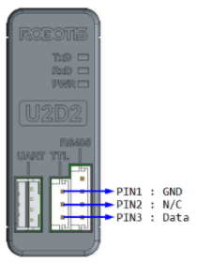
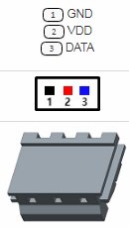
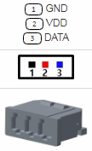
© Paul Oh, 2019
Last updated 12/14/19
Wall Wart 9V (Red) to Molex VCC (Red)
Wall Wart GND (Black) to Molex GND (Black)
Wall Wart GND (Black) to JST GND (Black)
JST Data (Blue) to Molex Data (Blue)
9V Wall Wart to Pigtail Connection
JST EHR-03
Molex 51065-0300
Robotis U2D2 USB Servo Controller

Slide 5
© Paul Oh, 2019
Last updated 12/14/19

Slide 6
© Paul Oh, 2019
Last updated 12/14/19

Slide 7
© Paul Oh, 2019
Last updated 12/14/19

Slide 8
© Paul Oh, 2019
Last updated 12/14/19

