Slide 1
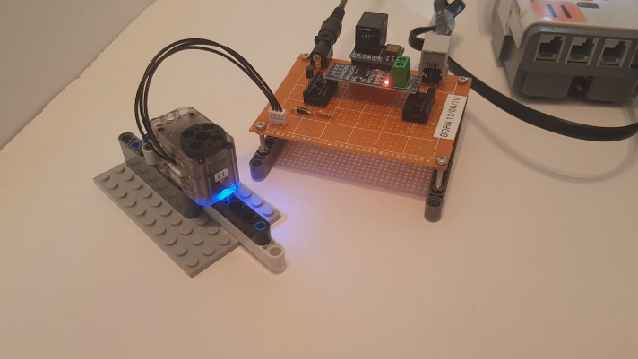
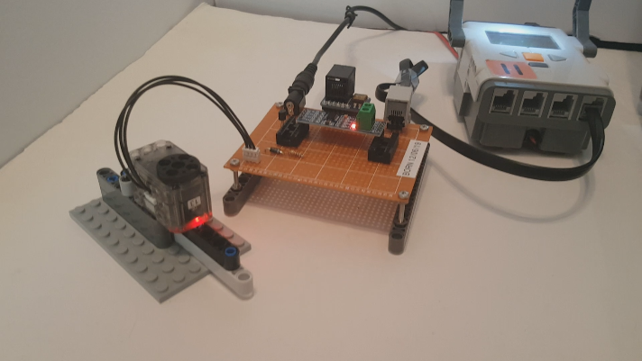
© Paul Oh, 2019
Last updated 12/15/19
NXC Programming Dynamixel XL-320 - LED
Preamble: The Lego NXT Brick ‘s Port 4 features a RS-485 port. Since the XL-320 uses RS-485 to interface with microprocessors, NXC programming can communicate to the XL-320. The XL-320 has a multi-colored LED. Demonstrating LED control would be a “Hello World” program to begin understanding NXT-to-XL320 communications.
Objective: Set up hardware connections between the NXT Brick and XL-320 servo
NXC Programming of NXT Brick changes XL-320 LED color

Slide 2
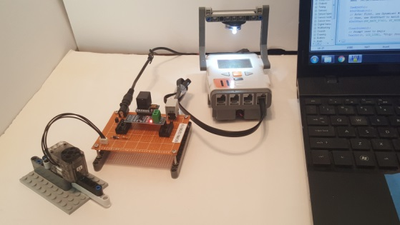
© Paul Oh, 2019
Last updated 12/14/19
Step 1: Manipulator Arm to XL-320 Servo
9V wall wart (not shown) to AC outlet
9V pigtail for powering XL-320
NXT Port 4
Molex 3P-XL 3-wire cable
NXT Cable
MAX485 TTL-RS485 Board
NPN C1815 Transistor (for Half-Duplex)
Mezzanine Breadboard
XL-320 Servo and Lego-based Mount

Slide 3
© Paul Oh, 2019
Last updated 12/15/19
Mezzanine Board Close-up
NXT Adapter (not used)
NXT Female Socket
NPN C1815 Transistor (for Half-Duplex)
Molex 3P-XL (3-wire) cable
Congratulations! The hardware connections are now set for NXC programming of the XL-320

