Slide 1
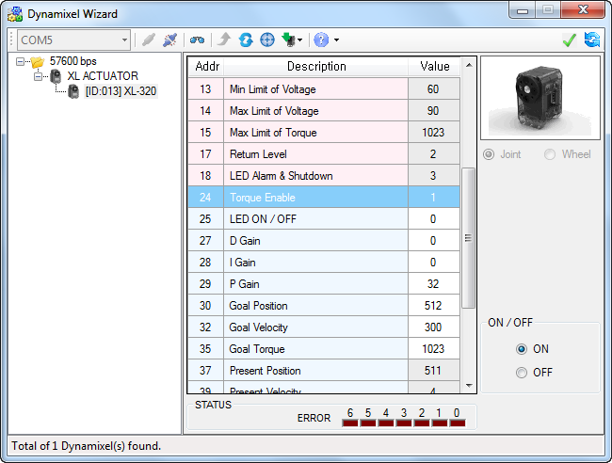
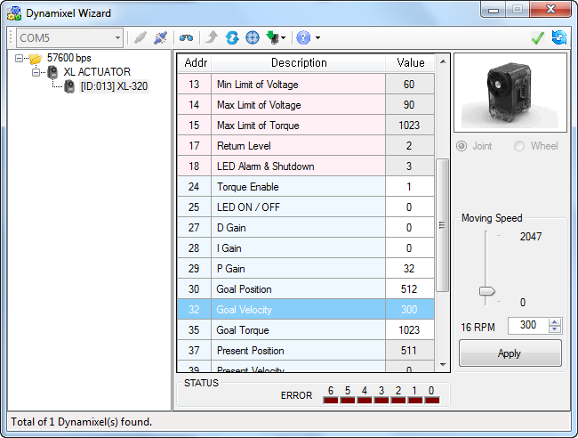
XL-320 Dynamixel Wizard Settings and Screenshots
Last updated 12/14/19
Torque Enable: see setting is “1” and hence “ON”. Also see that Joint and Wheel modes are Grey, but Joint is selected
Goal Velocity: Type 300 and Apply

Slide 2
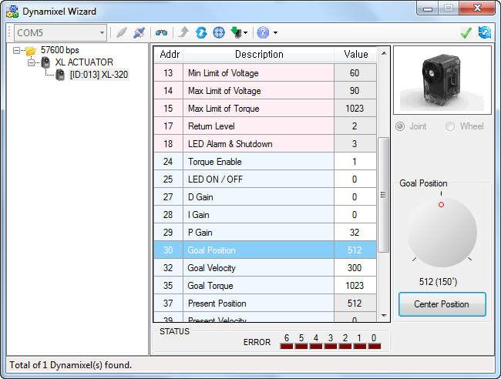
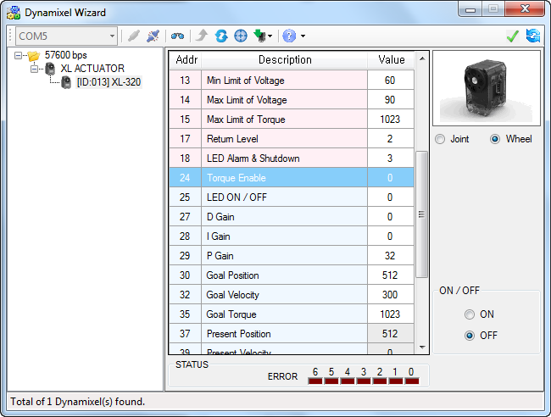
XL-320 Dynamixel Wizard Settings and Screenshots
Last updated 12/14/19
Goal Position: Click “Center Position”. Can also click and drag dial to rotate XL-320. Motor rotates to desired angle
Torque Enable: Choose “OFF” and select “Wheel”

Slide 3
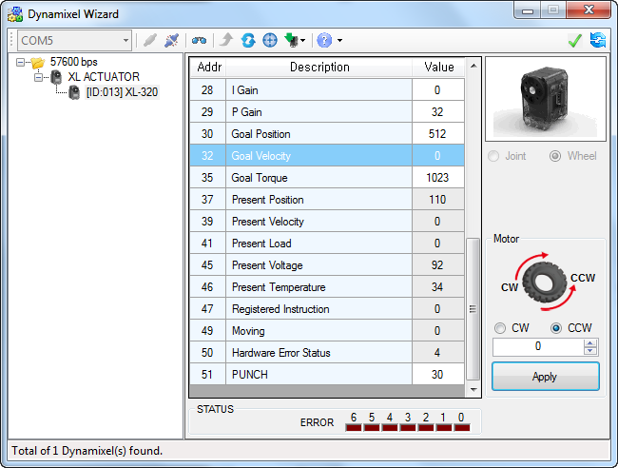
XL-320 Dynamixel Wizard Settings and Screenshots
Last updated 12/14/19
Goal Velocity: Type “300” and hit Apply; motor will rotate continuously (i.e. Wheel mode). Experiment with selecting CW and CCW and different velocities (must hit “Apply”. Type 0 and push Apply to stop motor

Slide 4
XL-320 Dynamixel Wizard Settings and Screenshots
Last updated 12/14/19

Slide 5
XL-320 Dynamixel Wizard Settings and Screenshots
Last updated 12/14/19

Slide 6
XL-320 Dynamixel Wizard Settings and Screenshots
Last updated 12/14/19

Slide 7
XL-320 Dynamixel Wizard Settings and Screenshots
Last updated 12/14/19

Slide 8
XL-320 Dynamixel Wizard Settings and Screenshots
Last updated 12/14/19

Slide 9
XL-320 Dynamixel Wizard Settings and Screenshots
Last updated 12/14/19

Slide 10
XL-320 Dynamixel Wizard Settings and Screenshots
Last updated 12/14/19

Slide 11
XL-320 Dynamixel Wizard Settings and Screenshots
Last updated 12/14/19

