Slide 1
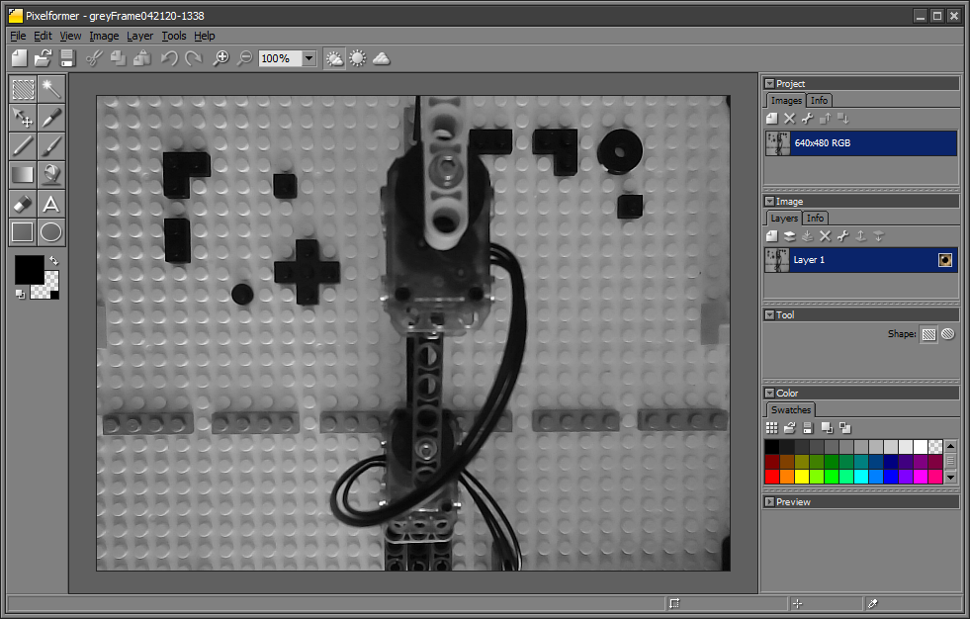
Objective: Calculate camera’s lens focal length
Sample grey-scale image captured from Scilab as a PNG file and imported into Pixelformer.
Black Lego 1x1 round studs are on the top left and right corners…
However, the camera’s FOV misses the top-left one and gets about half of the top-right one.
Baseplate studs are clear and can be counted for calibration purposes.
Also note that lens distorts image a bit and baseplate is not fully aligned with lens imaging sensor
(3, 601)
14 studs
greyFrame042120-1338.png
(307, 601)
Recall, 17 Bricks between base plate and camera’s lens. Each Brick measures $6 \text{mm}$ high. Thus $z=17×6 \text{mm}\text{ + 1} \text{mm}\text{ (}\text{due} \text{to} \text{last} \text{stud}\text{)}=103 \text{mm}$
A ruler measures the height (black brace) to be $11.3$ cm. Alternatively, one counts 14 stud spacings hence $H=14×8 \text{mm}=1\text{12 }\text{mm}=11.2 \text{cm}$ which is close to ruler measurement
Answer: Hence $f=z\frac{h}{H}=103 \text{mm}\frac{303 \text{pixels}}{112 \text{mm}}=278.65$ pixels
Ref: focalLengthCalculations-042220
© Copyright Paul Oh 2020

Slide 2
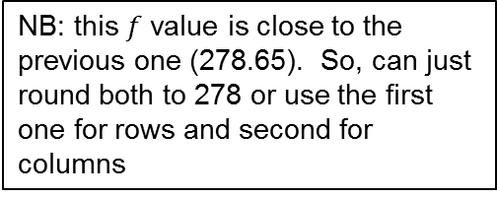
(308, 20)
12 studs
(308, 279)
greyFrame042120-1338.png
Recall, 17 Bricks between base plate and camera’s lens. Each Brick measures $6 \text{mm}$ high. Thus $z=17×6 \text{mm}\text{ + 1} \text{mm}\text{ (}\text{due} \text{to} \text{last} \text{stud}\text{)}=103 \text{mm}$
A ruler measures the height (black brace) to be $9.5$ cm. Alternatively, one counts 12 stud spacings hence $H=12×8 \text{mm}=\text{96 }\text{mm}=9.\text{5} \text{cm}$ which is close to ruler measurement
NB: this $f$ value is close to the previous one (278.65). So, can just round both to 278 or use the first one for rows and second for columns
Answer: Hence $f=z\frac{h}{H}=103 \text{mm}\frac{(279−20) \text{pixels}}{96 \text{mm}}=277.89$ pixels
Ref: focalLengthCalculations-042220
© Copyright Paul Oh 2020

Slide 3
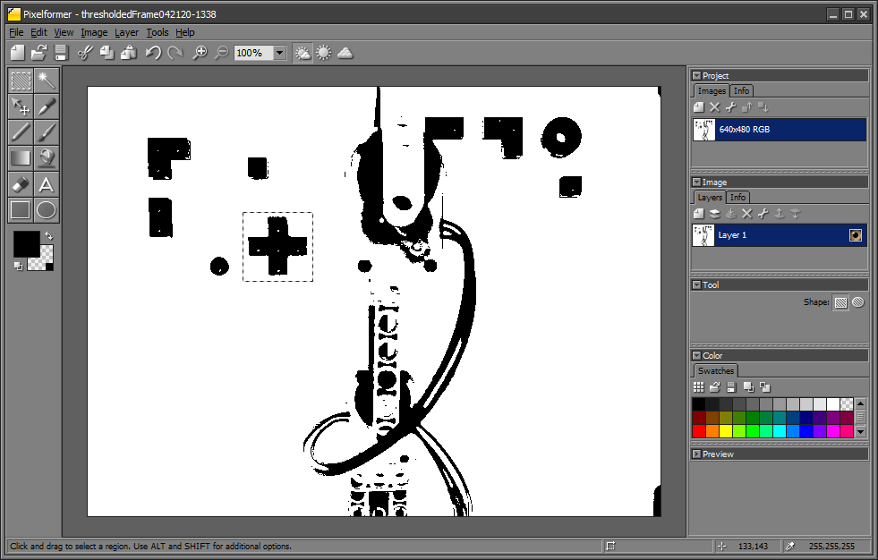
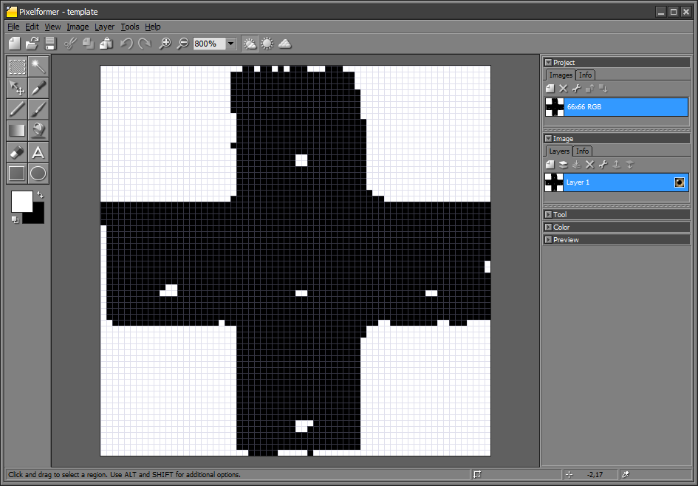
Objective: Map image space (pixels) to robot’s task space
66 rows x 66 cols i.e. (66, 66) template.png
640 x 480: thresholdedFrame.png
Thresholded PNG file from Scilab imported into Pixelformer (left). Target cropped (red box) to yield a template (right) that’s exported as a PNG file.
NB1: Crop to Cross’ perimeter and avoid surrounding white pixels
NB2: Template doesn’t have to be perfectly square – this case just happened to yield one
Ref: focalLengthCalculations-042220
© Copyright Paul Oh 2020

Slide 4
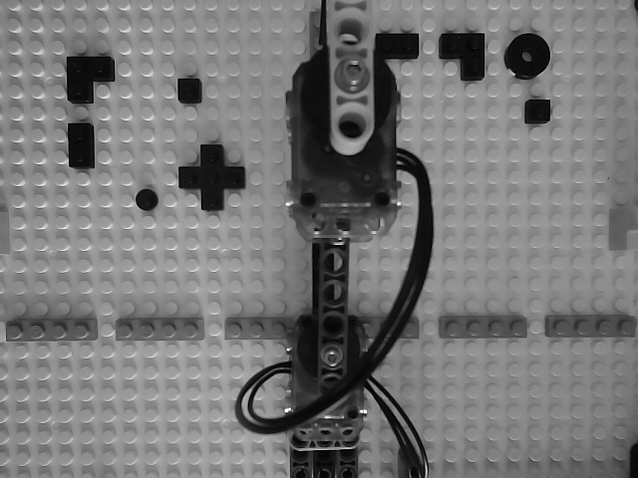





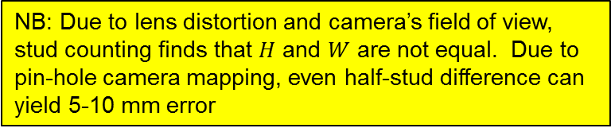







Image frame origin $O_{I}$ yields target center location $(u, v)$ [pix]. Robot’s frame origin $O_{R}$ yields target center location $\left(x,y\right)$ [mm]. Thus need mapping.
$$X$$
$$O_{I}$$
$$V$$
$$u$$
$$y=W−v$$
$$H$$
15 studs
$$v$$
x$=H−u$
$$Y$$
$$W$$
$$O_{R}$$
14.5 studs
$$U$$
NB: Due to lens distortion and camera’s field of view, stud counting finds that $H$ and $W$ are not equal. Due to pin-hole camera mapping, even half-stud difference can yield 5-10 mm error
Ref: focalLengthCalculations-042220
© Copyright Paul Oh 2020

Slide 5



Mapping calculations for (+X, -Y) quadrant
focalLengthCalculations-042420
$$X$$
$$O_{I}$$
$$V$$
$$u$$
$$v$$
$$H$$
15 studs
x$=H−u$
$$Y$$
$$W$$
$$O_{R}$$
$$y=−(v−W)$$
14.5 studs
$$U$$
Ref: focalLengthCalculations-042220
© Copyright Paul Oh 2020

