Slide 1
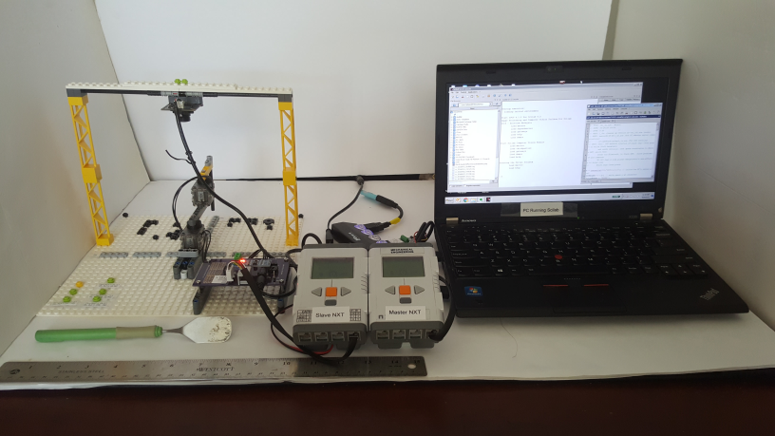
USB camera attaches to PC
XL-320 2-link planar manipulator
PC running Scilab to process video
Camera USB cable to laptop port
Master-Slave Wireless Bluetooth
Black Lego Cross piece
RS485 cable to XL-320 Board
PC USB-to-RS485 cable to NXT (Master)
Slave NXT
Master NXT

Slide 2
