Slide 1
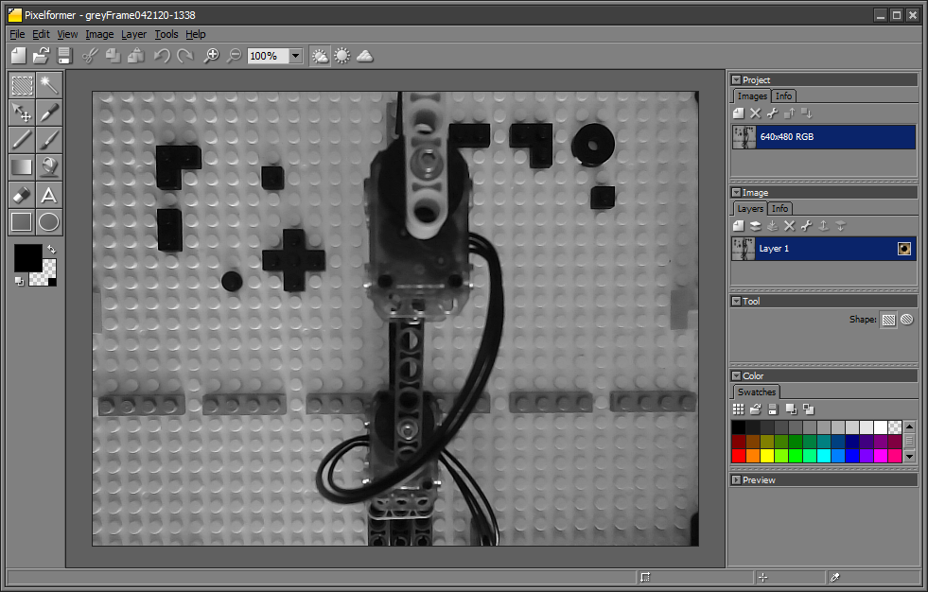
focalLengthCalculations-042220
(3, 601)
14 studs
greyFrame042120-1338.png
(307, 601)
Recall, 17 Bricks between base plate and camera’s lens. Each Brick measures $6 \text{mm}$ high. Thus $z=17×6 \text{mm}\text{ + 1} \text{mm}\text{ (}\text{due} \text{to} \text{last} \text{stud}\text{)}=103 \text{mm}$
A ruler measures the height (black brace) to be $11.3$ cm. Alternatively, one counts 14 stud spacings hence $H=14×8 \text{mm}=1\text{12 }\text{mm}=11.2 \text{cm}$ which is close to ruler measurement
Answer: Hence $f=z\frac{h}{H}=103 \text{mm}\frac{303 \text{pixels}}{112 \text{mm}}=278.65$ pixels

Slide 2
focalLengthCalculations-042220
(308, 20)
12 studs
(308, 279)
greyFrame042120-1338.png
Recall, 17 Bricks between base plate and camera’s lens. Each Brick measures $6 \text{mm}$ high. Thus $z=17×6 \text{mm}\text{ + 1} \text{mm}\text{ (}\text{due} \text{to} \text{last} \text{stud}\text{)}=103 \text{mm}$
A ruler measures the height (black brace) to be $9.5$ cm. Alternatively, one counts 12 stud spacings hence $H=12×8 \text{mm}=\text{96 }\text{mm}=9.\text{5} \text{cm}$ which is close to ruler measurement
Answer: Hence $f=z\frac{h}{H}=103 \text{mm}\frac{(279−20) \text{pixels}}{96 \text{mm}}=277.89$ pixels

Slide 3
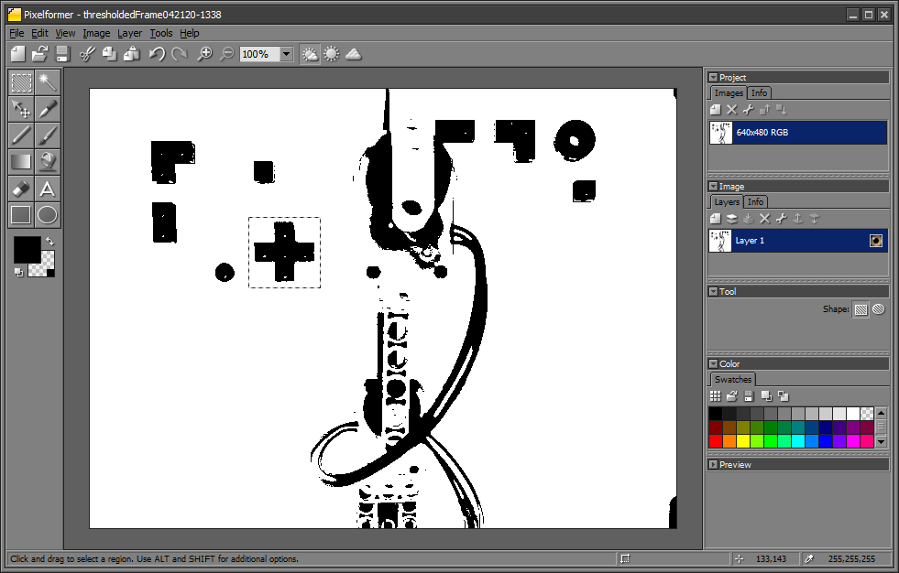
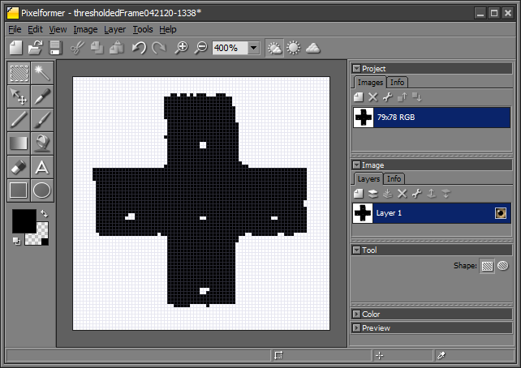
78 rows x 79 cols (78, 79) template042120-1338.png
640 x 480: thresholdedFrame042120-1338.png

Slide 4
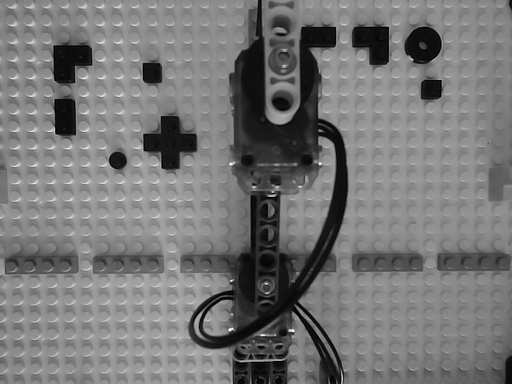












$$X$$
$$O_{I}$$
$$V$$
$$u$$
$$y=W−v$$
$$H$$
15 studs
$$v$$
x$=H−u$
$$Y$$
$$W$$
$$O_{R}$$
14.5 studs
$$U$$
(178, 214) vs SSD (180, 143)

Slide 5



$$X$$
$$O_{I}$$
$$V$$
$$u$$
$$v$$
$$H$$
15 studs
x$=H−u$
$$Y$$
$$W$$
$$O_{R}$$
$$y=v−W$$
14.5 studs
$$U$$
(178, 214) vs SSD (180, 143)

