Slide 1
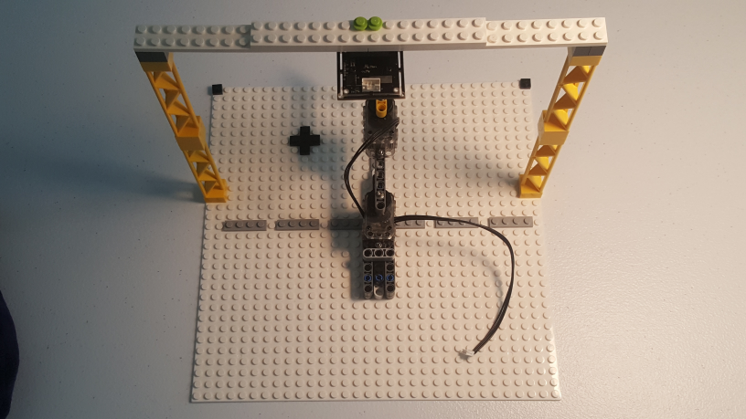
Lego-based USB Camera Tower Build Instructions
legoCameraTowerBuildInstructions-041220a
Copyright (c) 2020, Paul Oh

Slide 2
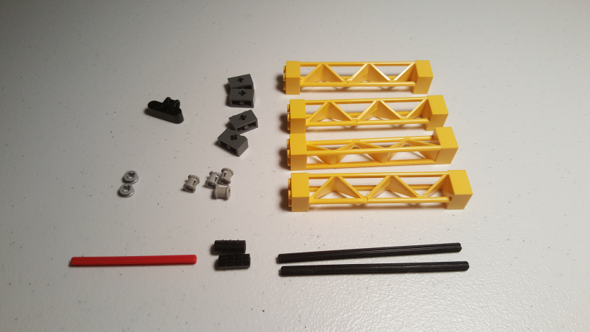
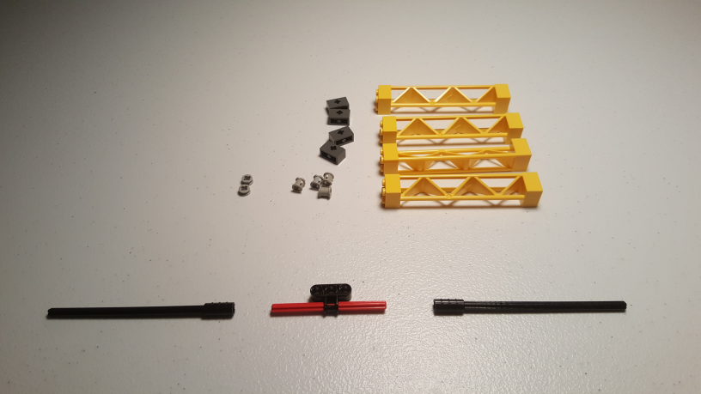
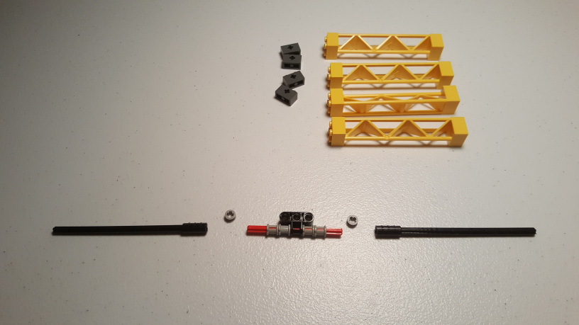
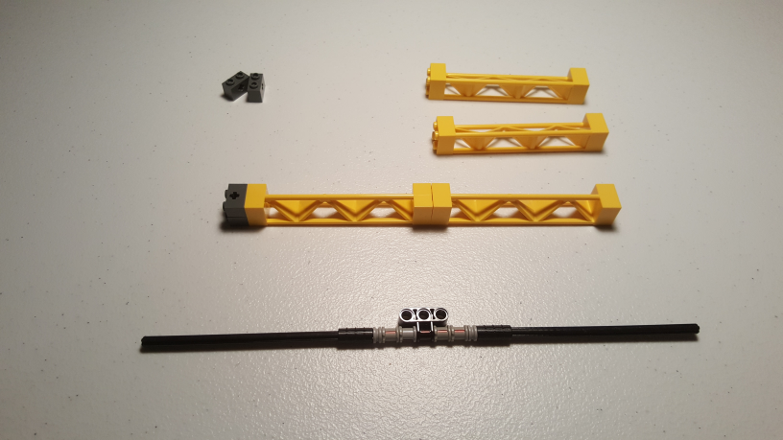
32064 1x2 Brick
with Axlehole
30517 2 x 2 x 10 Girder
Triangular Vertical
63869 Axle and Pin Connector Perpendicular Triple
4265c
1/2 Bush
3713 Bush
3708 Axle 8
6538
Axle Joiner
3708 Axle 12
Step 1: Gather Parts
Step 2: Attach Axle-12 to Axel Joiner. Insert Axle-8 to Axle and Pin Connector triple
Step 3: Slide 2 Bushes to both left and right ends of Axle-8
Step 4: Slide half-bush and connect with Axle-12 thru Axle Joiner. Attach two 1x2 Bricks to Tower (NB: orientation of Brick’s Axle hole and Tower)
legoCameraTowerBuildInstructions-041220a
Copyright (c) 2020, Paul Oh

Slide 3
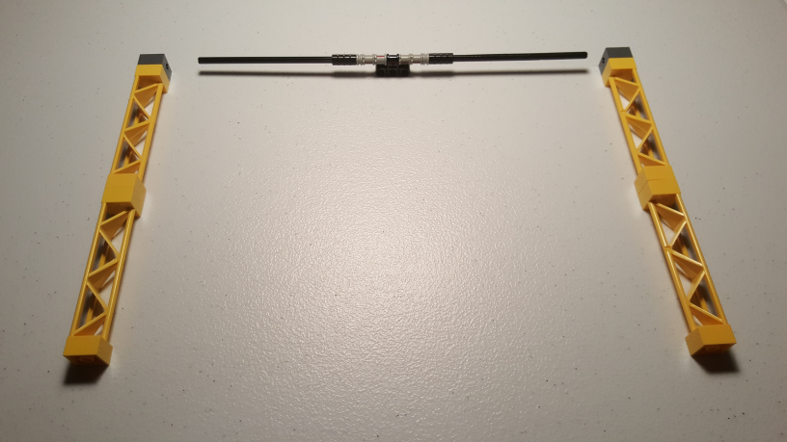
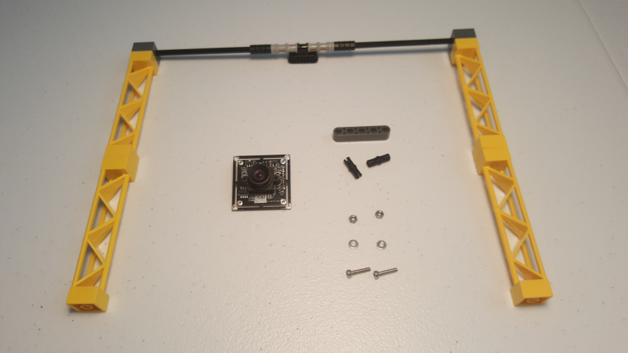
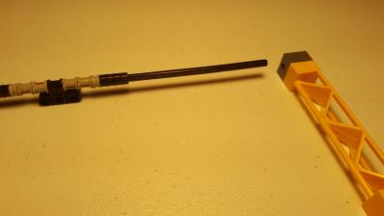
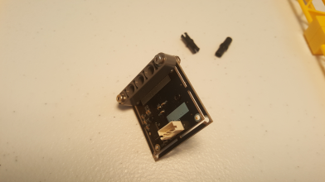
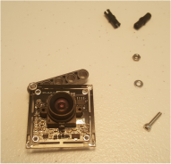
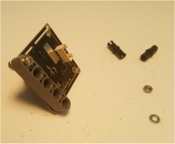
32316 Beam-5
2780 Friction Pegs
M2.5 Nuts
USB Camera Module
M2.5 Washer
M2.5 Bolt-12
Step 5: Attach two 1x2 Bricks to remaining tower. Align Axel holes with left and right Axle-12 parts (see inset photo)
Step 6: Gather Parts. Spinel 2MP full HD USB Camera Module (640x480) FOV 100 degrees Amazon
USB Connector Cable
Mounting holes
Step 7: Screw M2.5 Bolt into Washer and Beam 5 and secure with Nut. NB: Camera orientation and mounting hole locations (2 views above given)
Step 8: Screw remaining M2.5 Bolt
legoCameraTowerBuildInstructions-041220a
Copyright (c) 2020, Paul Oh

Slide 4
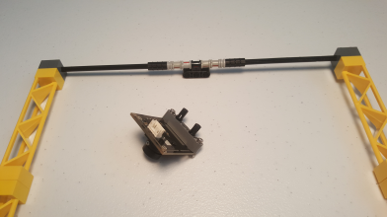
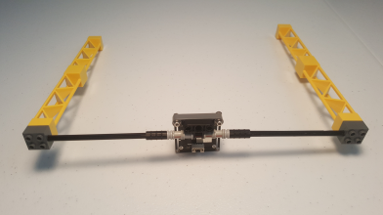
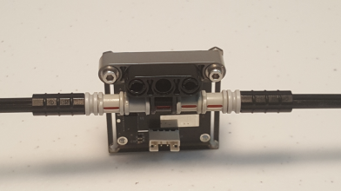
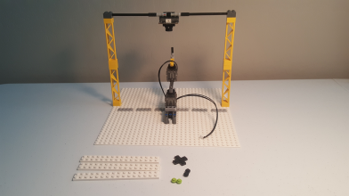
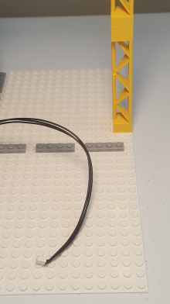
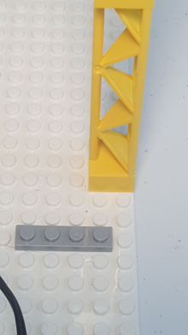
Step 9: Attach 2 Friction Pegs into Beam 5
Step 10: Attach Beam 5 to Axle and Pin Connector Triple. NB: Camera orientation (inset photo)
32x32 Base Plate
(White)
4282
Plate 2x16
15397 Cross (Black)
4073 Plate Round 1x1
(Black and Green)
Step 11: Note spacing (2 right photos) and mount Tower to Base Plate. Gather parts
legoCameraTowerBuildInstructions-041220a
Copyright (c) 2020, Paul Oh

Slide 5
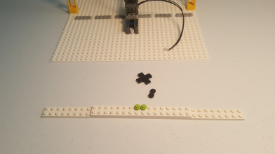
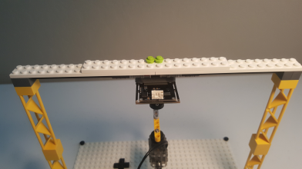
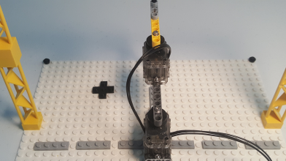
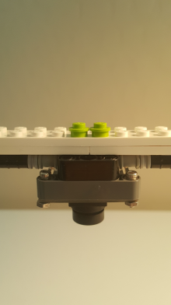
Step 12: Affix 2x16 Plate across two 2x16 plates. Place 1x1 Round in center
Step 13: Attach 2x16 plates to Tower. NB: Camera orientation.
Note how camera’s lens is centered on the 2x16 Beam (as indicated by Green 1x1 Rounds)
Step 14: Attach Black Cross (somewhere near arm) and Black Round 1x1 plates at top left and right corners
Congratulations! Completed construction of a Lego Camera Tower
legoCameraTowerBuildInstructions-041220a
Copyright (c) 2020, Paul Oh

Slide 6
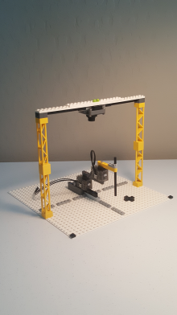
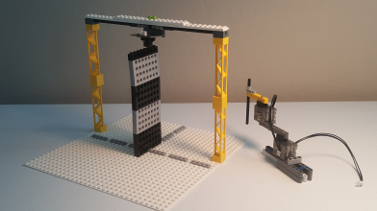
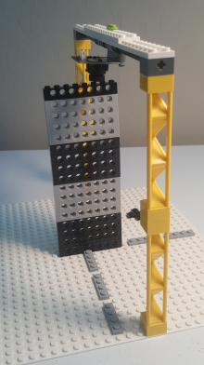
Stack of 17 Technic Bricks between Base Plate and Lens. 17 x 6 mm + 1 mm (due to stud) = 103 mm distance
Completed Lego Camera Tower overlooking 2-DOF planar manipulator
legoCameraTowerBuildInstructions-041220a
Copyright (c) 2020, Paul Oh

