Slide 1
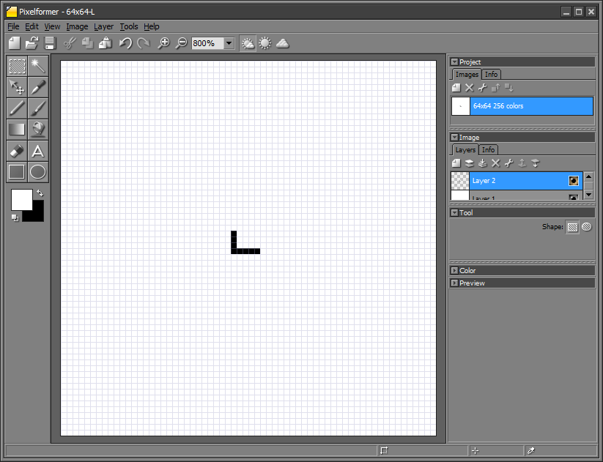
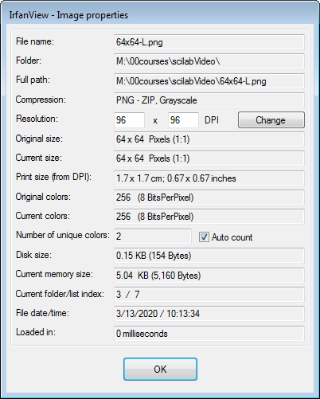
(0,0)
(0,63)
(29,29)
(32,29)
(32,33)
(63,0)
(63,63)
10x10-L-Template.pxf and 10x10-L-Template.pxf (grey-scale)
scilab-matchTemplate-031320a.pptx
© Copyright Paul Oh 2020

Slide 2
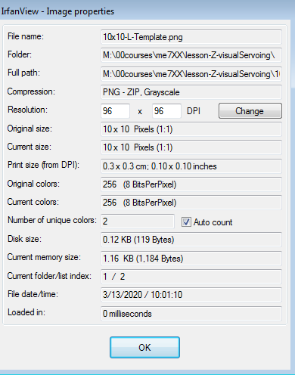
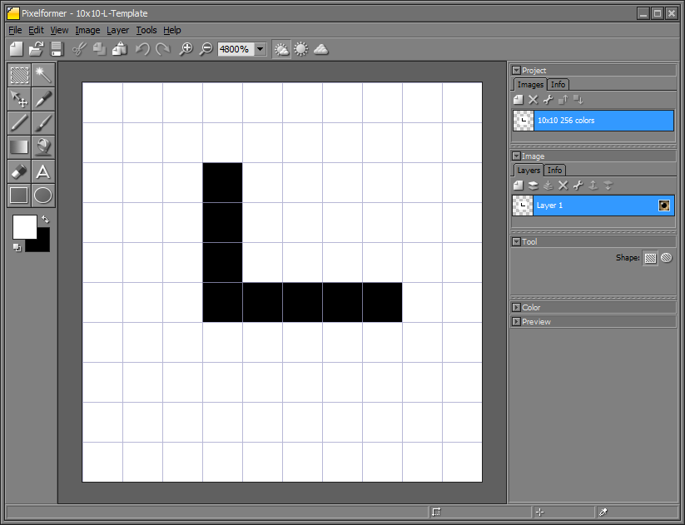
64x64-L.pxf and 64x64-L.png (grey-scale)
scilab-matchTemplate-031320a.pptx
© Copyright Paul Oh 2020

Slide 3
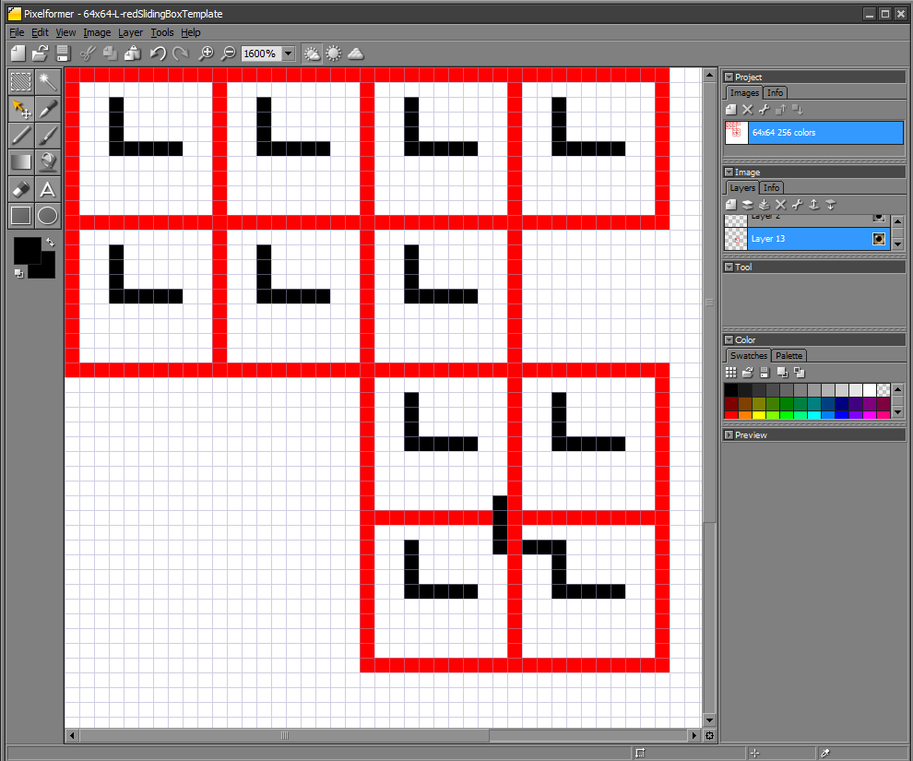
Row 28 and Col 27 result = 0
NB: Scilab begins with Col 1
Pixelformer begins rows and columns with 0.
Thus Scilab (28,27) == Pixelformer row 27, and col 26?
NB: Scilab ends at Col 55
scilab-matchTemplate-031620a.pptx
© Copyright Paul Oh 2020

Slide 4
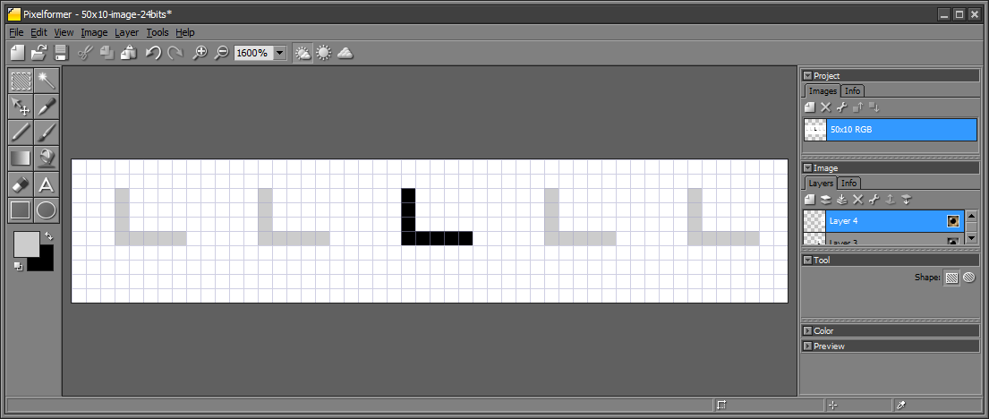
Column 21
(0,0)
(0,49)
(2,23)
(5,23)
(5,27)
(9,0)
(9,49)
scilab-matchTemplate-031720a.pptx
© Copyright Paul Oh 2020

Slide 5
scilab-matchTemplate-031320a.pptx
© Copyright Paul Oh 2020

Slide 6
scilab-matchTemplate-031320a.pptx
© Copyright Paul Oh 2020

Slide 7
scilab-matchTemplate-031320a.pptx
© Copyright Paul Oh 2020

