Slide 1
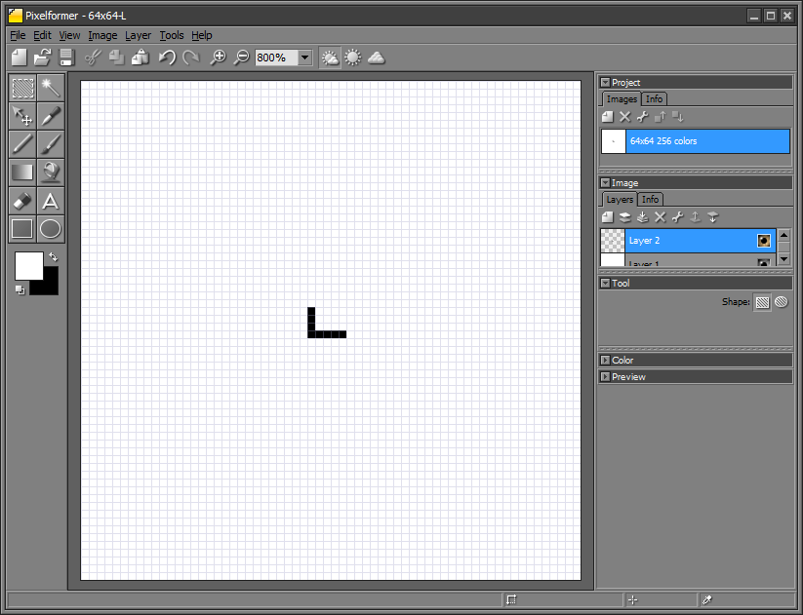
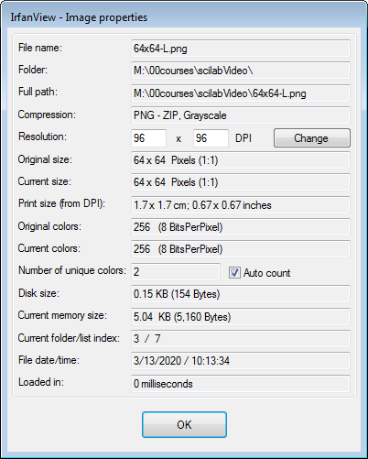
(0,0)
(0,63)
(29,29)
(32,29)
(32,33)
(63,0)
(63,63)
10x10-L-Template.pxf and 10x10-L-Template.pxf (grey-scale)
scilab-matchTemplate-031320a.pptx
© Copyright Paul Oh 2020

Slide 2
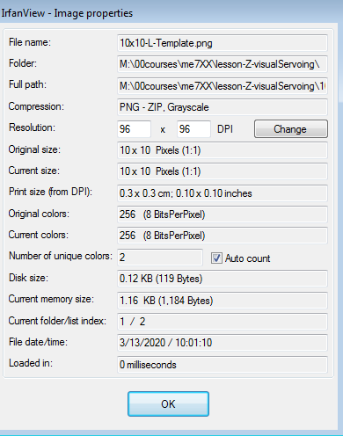
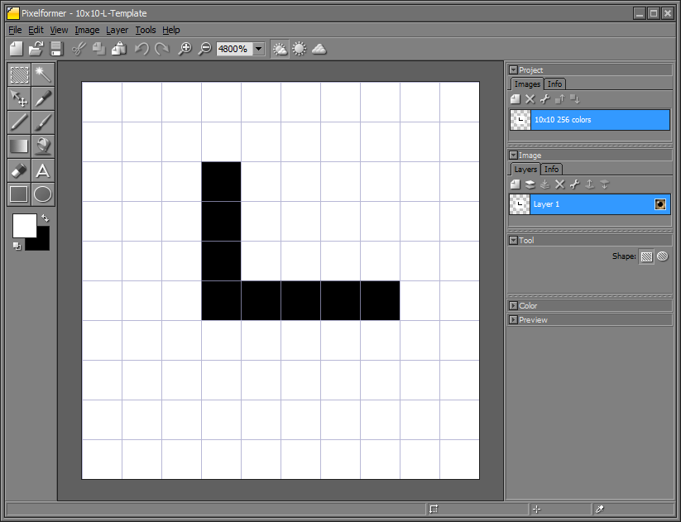
64x64-L.pxf and 64x64-L.png (grey-scale)
scilab-matchTemplate-031320a.pptx
© Copyright Paul Oh 2020

Slide 3
scilab-matchTemplate-031320a.pptx
© Copyright Paul Oh 2020

Slide 4
scilab-matchTemplate-031320a.pptx
© Copyright Paul Oh 2020

