Slide 1
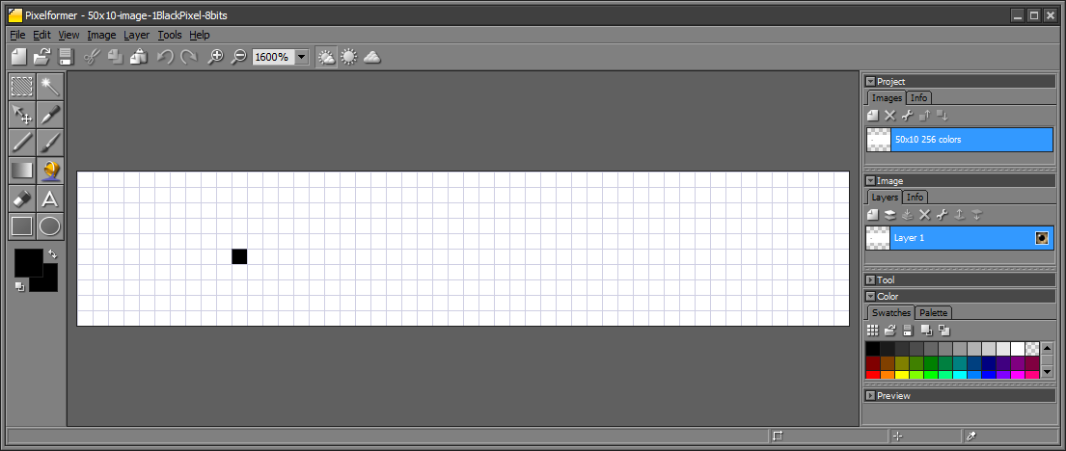
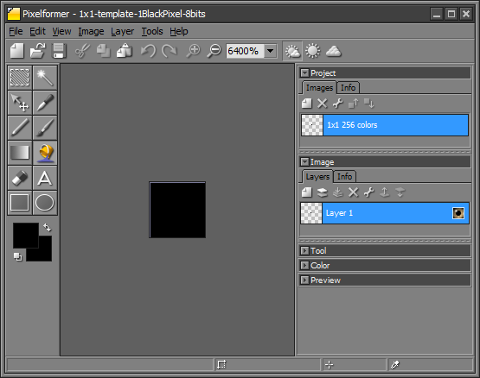
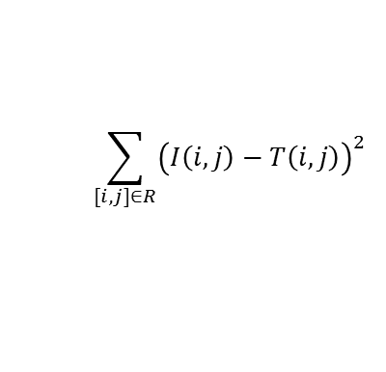
Object Tracking, Template Matching, Region-of-Interest (ROI) Search
(0,0)
(0,49)
(9,0)
(10,5)
(9,49)
Above, is a 50x10 image with one black pixel located at (10,5). The right shows a 1x1 template which a single black pixel. Object tracking is the task of sliding a $(n×m)$ template across a $\left(N×M\right)$ image and comparing their pixel values.
The above example is a sanity check; the 1x1 template $T$ will move thru the 50x10 image $I$= 500 pixels. Similarity measure is a value that reflects the pixel value comparison between an image and template. The sum-of-squared distances (SSD) is the computationally easiest similarity measure:
$$\sum_{[i,j]∈R}{{\left(I\left(i,j\right)−T\left(i,j\right)\right)}^{2}}$$
In SSD, 0 means a perfect match where as the larger the value, the less of a match.
lecture-imageProcessing-TemplateMatching-031820a.pptx
© 2020, Paul Oh

Slide 2
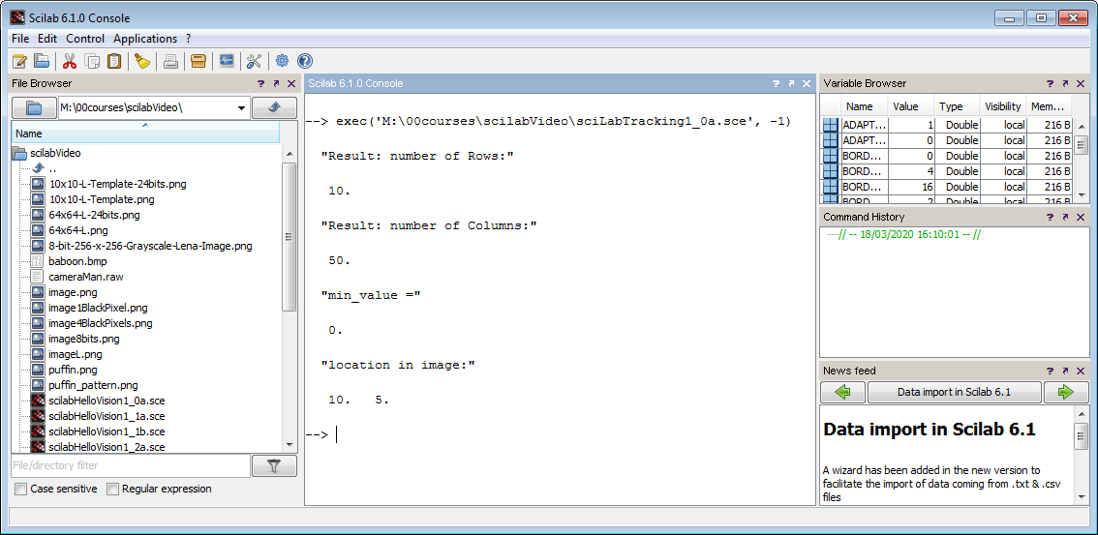
// FILE: sciLabTracking1_0a.sce
// DATE: 03/18/20 16:02
// AUTH: P.Oh
// VERS: 1_0a: SSD tracking of 1x1 black pixel template thru a 50x10 image
// DESC: Goal: Find object in an image.
scicv_Init();
img = imread("M:\00courses\scilabVideo\image1BlackPixel.png");
img_template = imread("template1BlackPixel.png");
img_result = matchTemplate(img, img_template, CV_TM_SQDIFF); // 0 = match
disp("Result: number of Rows:");
disp(Mat_rows_get(img_result));
disp("Result: number of Columns:");
disp(Mat_cols_get(img_result));
/* uncomment if wish to all values
disp("img_result: entire");
disp(img_result(:,:));
*/
[min_value, max_value, min_value_loc, max_value_loc] = minMaxLoc(img_result)
disp("min_value =");
disp(min_value);
disp("location in image:")
disp(min_value_loc);
delete_Mat(img);
delete_Mat(img_template);
delete_Mat(img_result);
Scilab’s matchTemplate function’s SSD similarity measure is called CV_TM_SQDIFF.
As seen in previous 50x10 image file, Scilab successfully reports the row, column position of (10,5)
lecture-imageProcessing-TemplateMatching-031820a.pptx
© 2020, Paul Oh

Slide 3
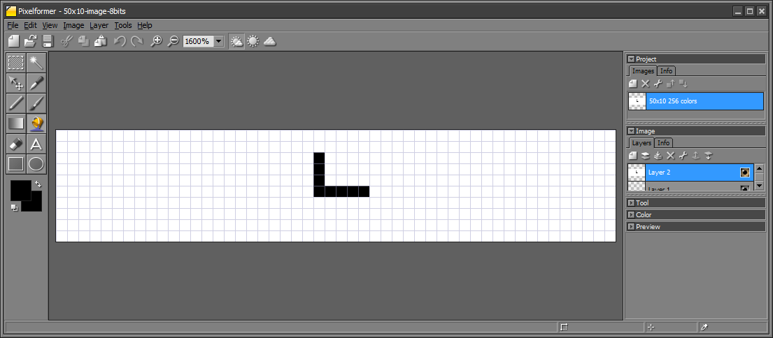
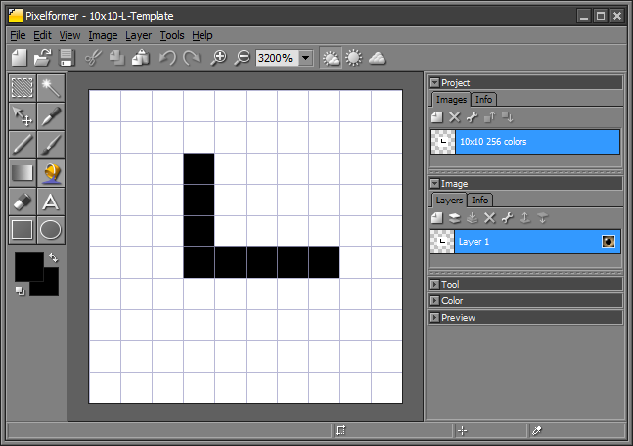
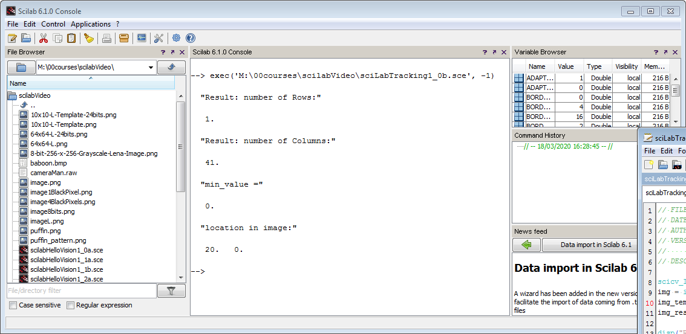
A more interesting case
(0,0)
(0,49)
(2,23)
(5,23)
(5,27)
(9,0)
(9,49)
In this example, the 50x10 image has 8 black pixels that form an L-shaped object. The 10x10 template (right) also has the same object. Again, this template slides across the image, column-by-column (left to right) and then row-by-row (top to bottom).
See sciLabTracking1_0b.sce
Scilab reports there’s 1 row, 41 columns and location is (20,0)!
lecture-imageProcessing-TemplateMatching-031820a.pptx
© 2020, Paul Oh

Slide 4
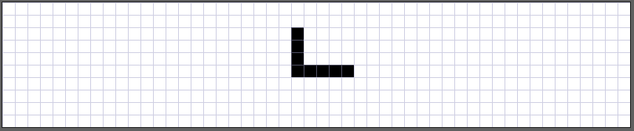
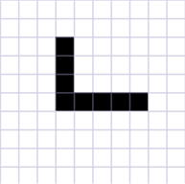
(1) Before sliding
Called Column 0
(2) Slide 1 column to right
(3) Slide 7 columns to right
lecture-imageProcessing-TemplateMatching-031820a.pptx
© 2020, Paul Oh

Slide 5
(4) Slide 15 columns to right – there’s slight overlap
(5) Slide 20 columns to right – perfect overlap
20th Column
SSD = (0, 0)
SSD = (0, 20)
(6) Slide 20 columns to right – perfect overlap
41st Column
lecture-imageProcessing-TemplateMatching-031820a.pptx
© 2020, Paul Oh

Slide 6
Thus, we see why there’s only 1 row: both template and image has 10 rows (the template doesn’t need to slide down).
We see why the match is at column 21: the 10x10 template fits perfectly over the image as shown in (5) above; The SSD value at (0, 20) is zero.
We also see why there the SSD size has 41 columns as shown in (6)
Thus, SSD result is not a 50x10 image but rather a similarity measure. It’s the starting column in the image where the template fits over it.
lecture-imageProcessing-TemplateMatching-031820a.pptx
© 2020, Paul Oh

Slide 7
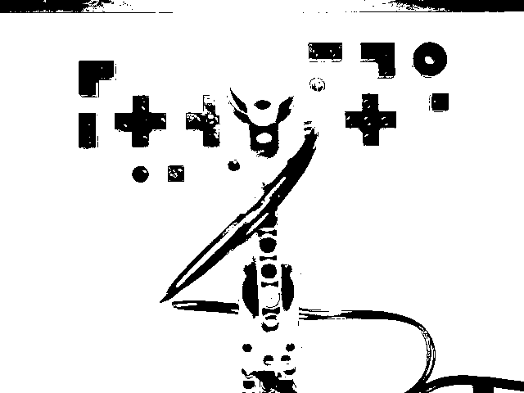
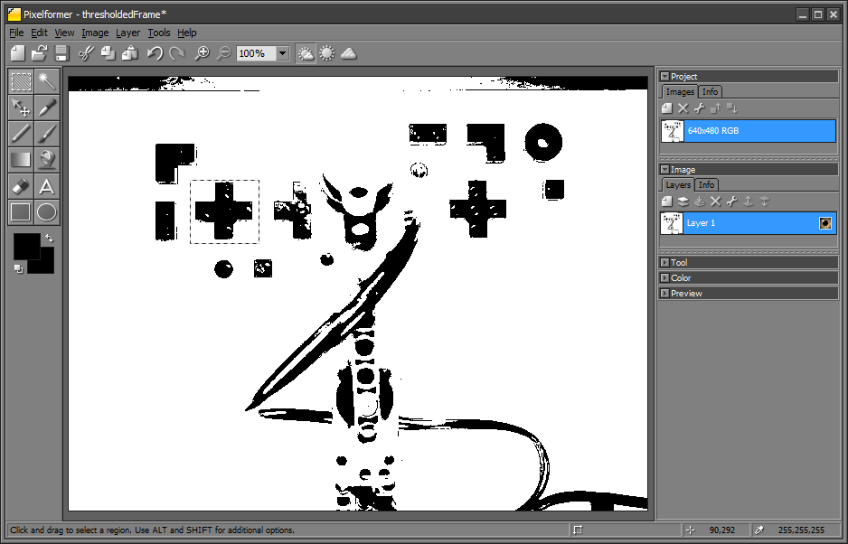
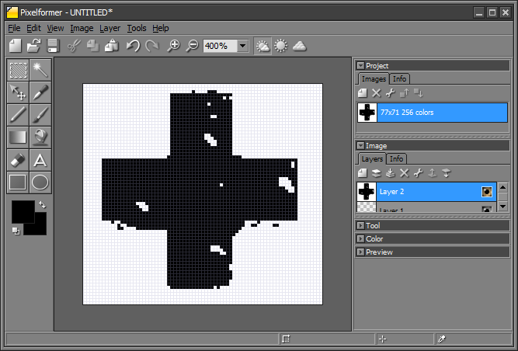
Added on 03/30/20
Result of running M:\00courses\scilabVideo\scilabCameraLego0_1a.sce is this M:\00courses\scilabVideo\thresholdedFrame.png
~(149, 172)
This is a 640 x 480 PNG file
crossTemplate.png: (71 x 77) row x column template
lecture-imageProcessing-TemplateMatching-033020a.pptx
© 2020, Paul Oh

Slide 8
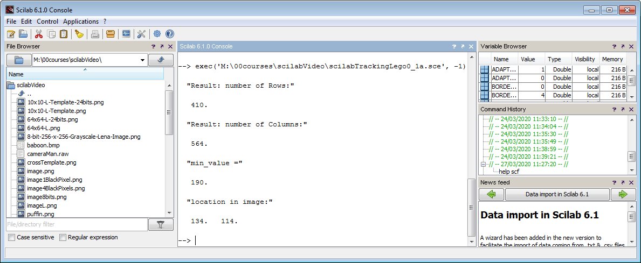
Results running M:\00courses\scilabVideo\scilabTrackingLego0_1a.sce
Added on 03/30/20
Scilab reports there’s 410 rows, 564 columns and location is col 134 and row 114
SSD reports Row 114. Template # Rows = 71. Thus 114 + 71/2 = 149.5
SSD reports Col 134. Template # Cols = 77. Thus 134 + 77/2 = 172.5
Thus the image’s pixel location is (row, col) = (149, 172) which matches previous slide
lecture-imageProcessing-TemplateMatching-033020a.pptx
© 2020, Paul Oh

Slide 9
Added on 03/30/20
Q. How does thresholdedFrame.png pixel (image space) compare to Lego 32 x 32 baseplate?
Lego Stud (0,0)
Image (0,0)
Lego Stud (0,31)
Image (0,639)
Base Frame (0,0)
25.6 cm edge-to-edge
24.8 cm from left-most stud to right-most stud
This is a 640 x 480 PNG file
Note: there are 31 stud spacings (8 mm) between left-most and right-most studs. Hence 31 * 8 mm = 248 mm. Hence, consistent.
lecture-imageProcessing-TemplateMatching-033020a.pptx
© 2020, Paul Oh

Slide 10
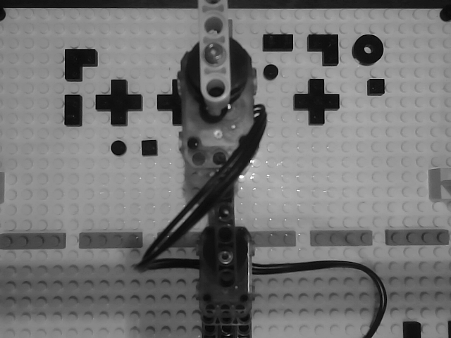
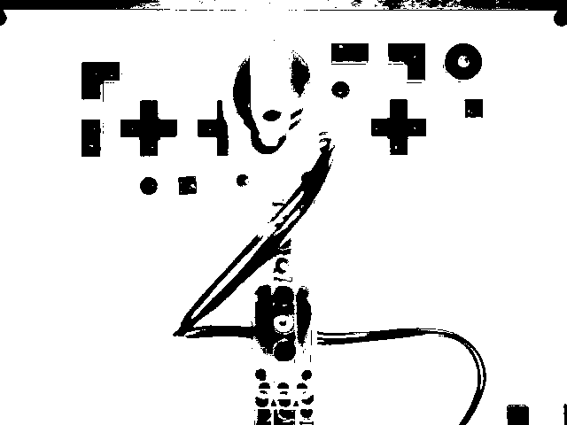
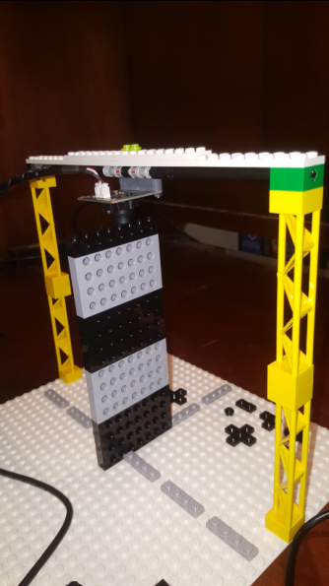
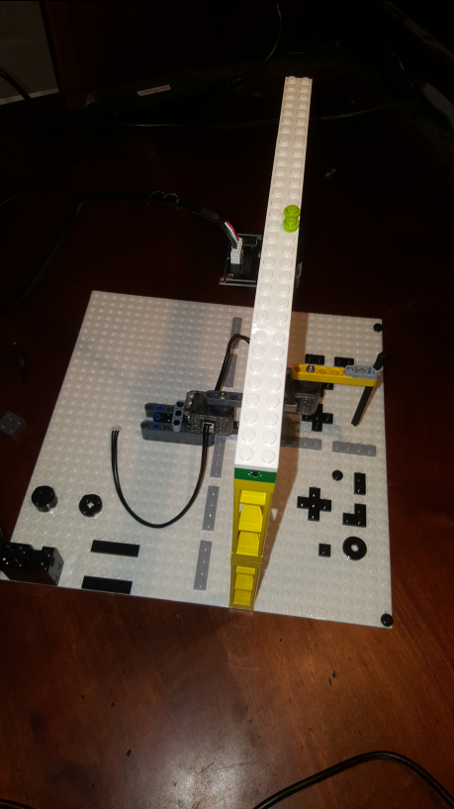
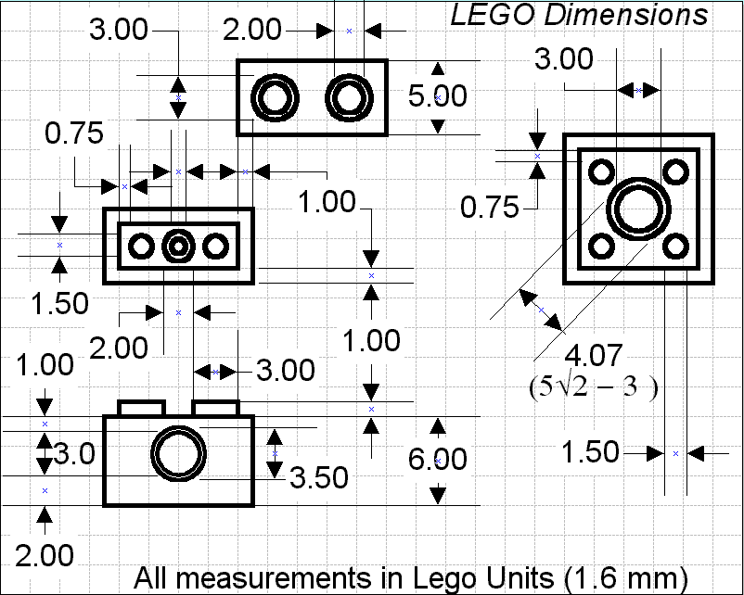
Added on 03/31/20
At this camera height and position, one sees the 1-round studs in the camera’s field-of-view.
The left-most stud is 1 stud away from left edge. Whereas right-most stud is at the right edge.
Base plate to camera lens distance: 17 stacked Bricks.
https://bricks.stackexchange.com/questions/288/what-are-the-dimensions-of-a-lego-brick
Base-to-Lens distance = 17 * 6 mm + 1 mm (due to stud) = 103 mm
lecture-imageProcessing-TemplateMatching-033120a.pptx
© 2020, Paul Oh

Slide 11
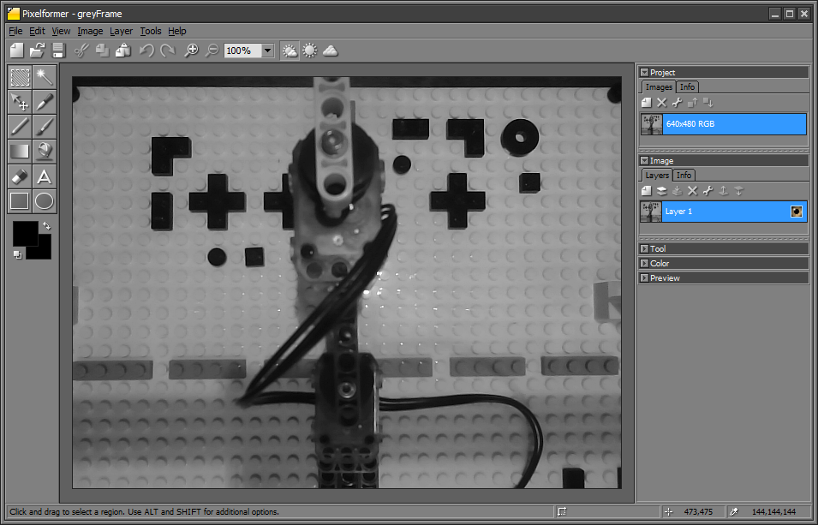




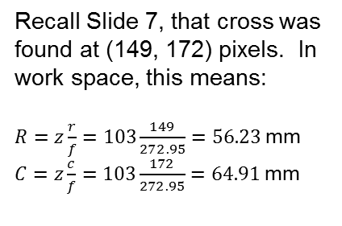



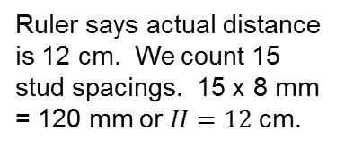
Added on 03/31/20
$\frac{H}{z}=\frac{h}{f}$ then $f=z\frac{h}{H}$
$$H$$
$$z$$
$$f$$
$$h$$
Thus let
$h=336−18=318$pixels
(625,18)
Ruler says actual distance is 12 cm. We count 15 stud spacings. 15 x 8 mm = 120 mm or $H=12$cm.
$f=z\frac{h}{H}=103\frac{318}{120}=272.95$ pixels
(625,336)
Recall Slide 7, that cross was found at (149, 172) pixels. In work space, this means:
$R=z\frac{r}{f}=103\frac{149}{272.95}=56.23$mm
$C=z\frac{c}{f}=103\frac{172}{272.95}=64.91$mm
lecture-imageProcessing-TemplateMatching-033120a.pptx
© 2020, Paul Oh

Slide 12
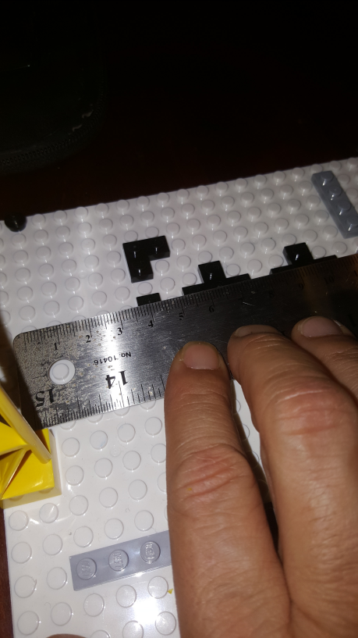
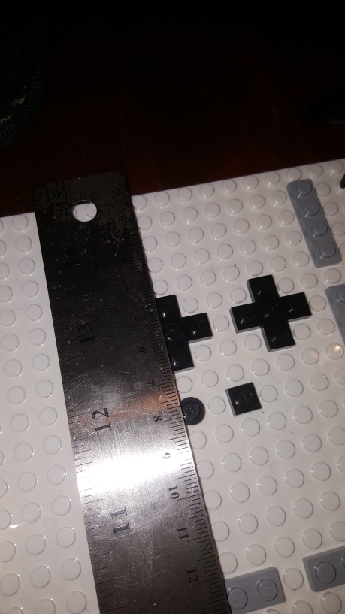
Added on 03/31/20
Cross center at (149, 172) pixels and calculated $R=z\frac{r}{f}=103\frac{149}{272.95}=56.23$mm and $C=z\frac{c}{f}=103\frac{172}{272.95}=64.91$mm
Hence have:
(625,18)
56.23 mm
64.91 mm
(625,336)
Rule distance measures ~64 mm from 2nd stud (due to top-left 1-stud round location) and cross’ center
Rule distance measures ~56 mm. Gave a little of margin (because base plate’s top begins a few pixels from top
Next: need to map base plate coordinates (either in image space or world space) to robot’s workspace. Robot’s origin (0,0) is actually N x M studs away from top left (0,0) of the base plate.
lecture-imageProcessing-TemplateMatching-033120a.pptx
© 2020, Paul Oh

Slide 13
Added on 03/31/20
lecture-imageProcessing-TemplateMatching-033120a.pptx
© 2020, Paul Oh

Slide 14
Added on 03/31/20
lecture-imageProcessing-TemplateMatching-033120a.pptx
© 2020, Paul Oh

