Slide 1
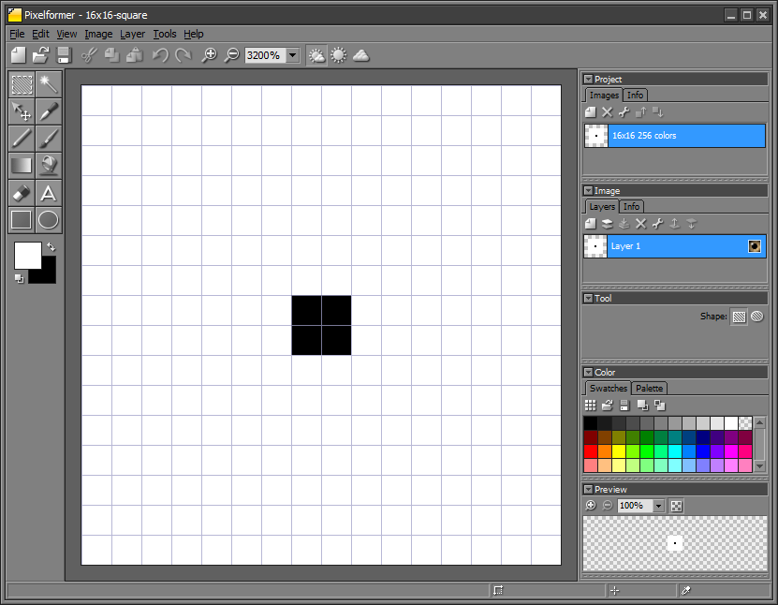
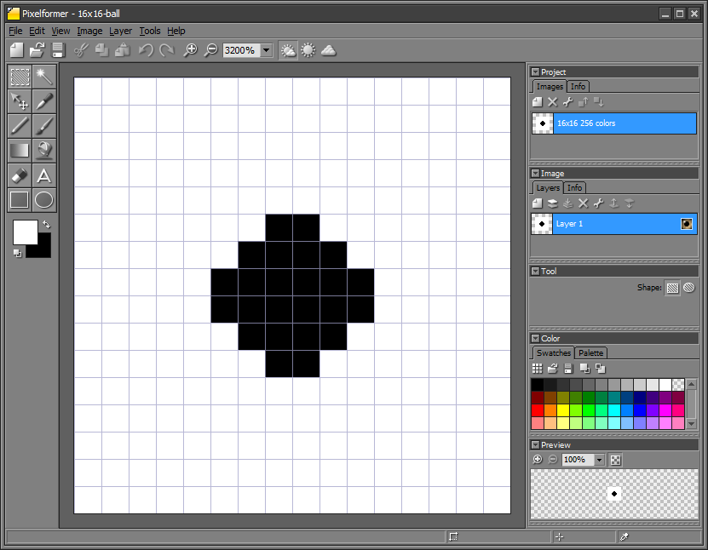
Image Processing: Areas and Centroids
(0,0)
(0,15)
(5,7)
(7,7)
(7,8)
(7,5)
(8,7)
(8,8)
(15,0)
(15,15)
Q1. What is the image’s area spanned by the black pixel?
Using the definition of area, the above has an area of 24 (black pixels).
A1. Area is defined as the number of specific (e.g. black) pixels contained within an object in an image
int area(struct Image *In, int x1, int y1,
int x2, int y2, unsigned char ObjVal) {
long i, j;
int area_value = 0;
for(i=x1; i <= x2; ++i)
for(j=y1; j <= y2; ++j) {
if(pix(In, i, j)==ObjVal) ++area_value;
}
return(area_value);
In this simple 16x16 image, the black square is easily identified as the object. Thus, intuitively, the area = 4.
lecture-imageProcessing-AreaAndCentroid-022520a.pptx
© Copyright Paul Oh 2020

Slide 2
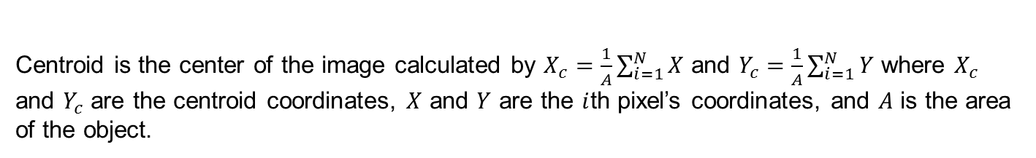
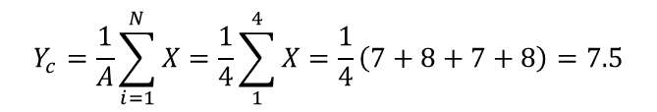
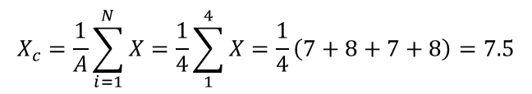
lecture-imageProcessing-AreaAndCentroid-022520a.pptx
Q2. What is the black image’s centroid?
Centroid is the center of the image calculated by $X_{c}=\frac{1}{A}\sum_{i=1}^{N}{X}$ and $Y_{c}=\frac{1}{A}\sum_{i=1}^{N}{Y}$ where $X_{c}$ and $Y_{c}$ are the centroid coordinates, $X$ and $Y$ are the $i$th pixel’s coordinates, and $A$ is the area of the object.
void *centroid(struct Image *In, int x1,
int y1, int x2, int y2,
unsigned char ObjVal,
struct coord *coords) {
long i, j;
int area_value, Xcent = 0, Ycent = 0;
area_value = area(In, x1, y1, x2, y2, ObjVal);
if(area_value == 0) {
coords->x = -1; coords->y = -1;
return 0;
};
for(i=x1; i<=x2; ++i)
for(j=y1; j<=y2; ++j) {
if(pix(In, i, j) == ObjVal) {
Xcent += j;
Ycent += i;
}
}
coords->x = Xcent/area_value + 1;
coords->y = Ycent/area_value + 1;
return 0;
} // end function centroid
(0,0)
(0,15)
Centroid is at (8,8)
(7,7)
(7,8)
(8,7)
(8,8)
(15,0)
(15,15)
$$X_{c}=\frac{1}{A}\sum_{i=1}^{N}{X}=\frac{1}{4}\sum_{1}^{4}{X=\frac{1}{4}\left(7+8+7+8\right)=7.5}$$
$$Y_{c}=\frac{1}{A}\sum_{i=1}^{N}{X}=\frac{1}{4}\sum_{1}^{4}{X=\frac{1}{4}\left(7+8+7+8\right)=7.5}$$
© Copyright Paul Oh 2020

Slide 3
lecture-imageProcessing-AreaAndCentroid-022520a.pptx
Centroid is at (8,8)
(5,7)
(7,5)
$$X_{c}=\frac{1}{A}\sum_{i=1}^{N}{X}=\frac{1}{24}\sum_{1}^{24}{X=\frac{1}{24}\left(5∗2+6∗4+7∗6+8∗6+9∗4+10∗2\right)=\frac{1}{24}\left(10+24+42+48+36+20\right)=\frac{180}{24}=7.5}$$
$$Y_{c}=\frac{1}{A}\sum_{i=1}^{N}{X}=\frac{1}{24}\sum_{1}^{24}{X=\frac{1}{24}\left(5∗2+6∗4+7∗6+8∗6+9∗4+10∗2\right)=\frac{1}{24}\left(10+24+42+48+36+20\right)=7.5}$$
© Copyright Paul Oh 2020

