Slide 1
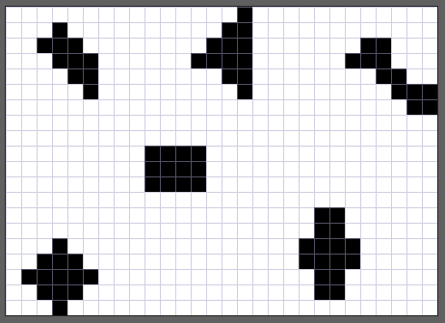
(0, 0)
(0,27)
10 pixels
13 pixels
12 pixels
76 pixels in total
12 pixels
(19, 27)
(19, 0)
13 pixels
16 pixels

Slide 2
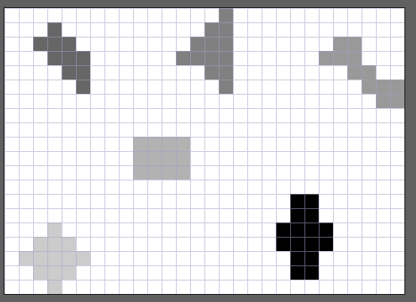
10 pixels
Value = 102
13 pixels
Value = 128
12 pixels
Value = 153
12 pixels
Value = 178
13 pixels
Value = 204
16 pixels
Value = 0

