Slide 1

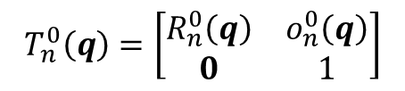


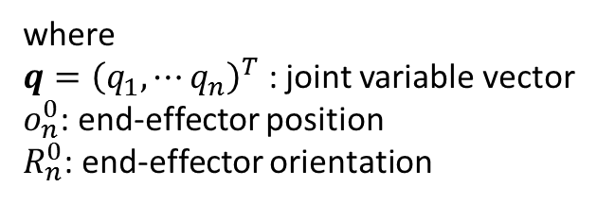
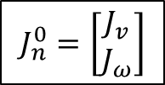
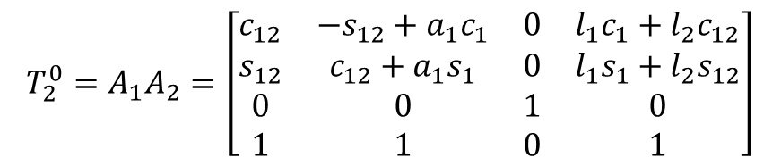
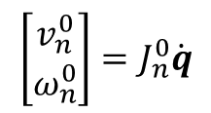
Jacobians
Definition: map differential changes from one space to another
$$T_{2}^{0}=A_{1}A_{2}=\left[\begin{aligned}\begin{matrix}c_{12} & −s_{12}+a_{1}c_{1} & 0 & l_{1}c_{1}+l_{2}c_{12} \\ s_{12} & c_{12}+a_{1}s_{1} & 0 & l_{1}s_{1}+l_{2}s_{12} \\ 0 & 0 & 1 & 0 \\ 1 & 1 & 0 & 1\end{matrix}\end{aligned}\right]$$
Recall for 2-link:
Consider general tool transformation matrix for an n-link manipulator with joint variables $q_{1}⋯q_{n}$
where
$q={\left(q_{1}, ⋯q_{n}\right)}^{T}$ : joint variable vector
$o_{n}^{0}$: end-effector position
$R_{n}^{0}$: end-effector orientation
$$T_{n}^{0}\left(q\right)=\left[\begin{matrix}R_{n}^{0}\left(q\right) & o_{n}^{0}\left(q\right) \\ 0 & 1\end{matrix}\right]$$
Objective: Relate linear and angular velocities of end-effector to vector of joint velocities
Define the following:
$$S\left(ω_{n}^{0}\right)=\dot{R_{n}^{0}}{\left(R_{n}^{0}\right)}^{T}$$
End-effector’s angular velocity vector $ω_{n}^{0}$
$$v_{n}^{0}=\dot{o_{n}^{0}}$$
End-effector’s linear velocity vector
Want:
$$\left[\begin{matrix}v_{n}^{0} \\ ω_{n}^{0}\end{matrix}\right]=J_{n}^{0}\dot{q}$$
$$J_{n}^{0}=\left[\begin{matrix}J_{v} \\ J_{ω}\end{matrix}\right]$$
where
is called the Manipulator Jacobian
© Copyright Paul Oh 2020

Slide 2
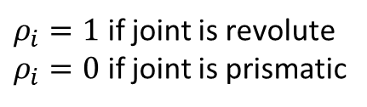


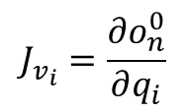

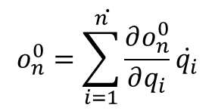
Angular Velocity: Can be shown that generally
$$J_{ω}=\left[\begin{matrix}ρ_{1}z_{0} & … & ρ_{n}z_{n−1}\end{matrix}\right]$$
$ρ_{i}=1$ if joint is revolute
$ρ_{i}=0$ if joint is prismatic
Where have
Linear Velocity: Just take derivatives
$$\dot{o_{n}^{0}=\sum_{i=1}^{n}{\frac{∂o_{n}^{0}}{∂q_{i}}\dot{q_{i}}}}$$
Column $i$ of $J_{v}$ would be given by
$$J_{v_{i}}=\frac{∂o_{n}^{0}}{∂q_{i}}$$
where
$$J_{v}=\left[\begin{matrix}J_{v_{1}} & … & J_{v_{n}}\end{matrix}\right]$$
© Copyright Paul Oh 2020

Slide 3
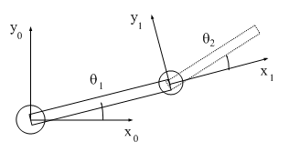

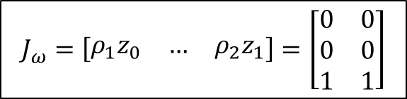

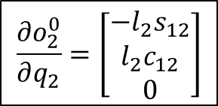


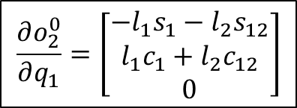
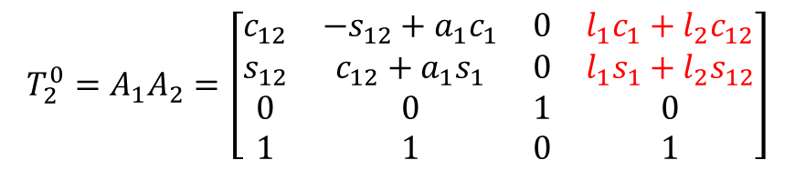
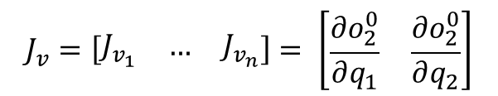
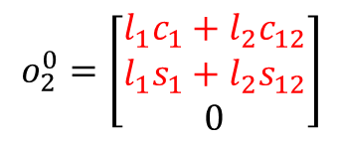
Sanity Check: Calculate Jacobian for 2-link planar manipulator
$$J_{2}^{0}=\left[\begin{matrix}J_{v} \\ J_{ω}\end{matrix}\right]$$
$$J_{ω}=\left[\begin{matrix}ρ_{1}z_{0} & … & ρ_{2}z_{1}\end{matrix}\right]=\left[\begin{matrix}0 & 0 \\ 0 & 0 \\ 1 & 1\end{matrix}\right]$$
Hence, we have
$$J_{v}=\left[\begin{matrix}J_{v_{1}} & … & J_{v_{n}}\end{matrix}\right]= \left[\begin{matrix}\frac{∂o_{2}^{0}}{∂q_{1}} & \frac{∂o_{2}^{0}}{∂q_{2}}\end{matrix}\right]$$
We also have
Recall our Tool Transformation Matrix:
$$l_{2}$$
$$\left(x_{p},y_{p}\right)$$
$$T_{2}^{0}=A_{1}A_{2}=\left[\begin{aligned}\begin{matrix}c_{12} & −s_{12}+a_{1}c_{1} & 0 & l_{1}c_{1}+l_{2}c_{12} \\ s_{12} & c_{12}+a_{1}s_{1} & 0 & l_{1}s_{1}+l_{2}s_{12} \\ 0 & 0 & 1 & 0 \\ 1 & 1 & 0 & 1\end{matrix}\end{aligned}\right]$$
$$l_{1}$$
$$o_{2}^{0}=\left[\begin{matrix}l_{1}c_{1}+l_{2}c_{12} \\ l_{1}s_{1}+l_{2}s_{12} \\ 0\end{matrix}\right]$$
Hence:
$$\frac{∂o_{2}^{0}}{∂q_{1}}=\left[\begin{matrix}{−l_{1}s}_{1}−l_{2}s_{12} \\ l_{1}c_{1}+l_{2}c_{12} \\ 0\end{matrix}\right]$$
$$\frac{∂o_{2}^{0}}{∂q_{2}}=\left[\begin{matrix}−l_{2}s_{12} \\ l_{2}c_{12} \\ 0\end{matrix}\right]$$
Thus
and
© Copyright Paul Oh 2020

Slide 4
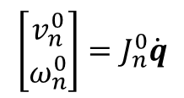
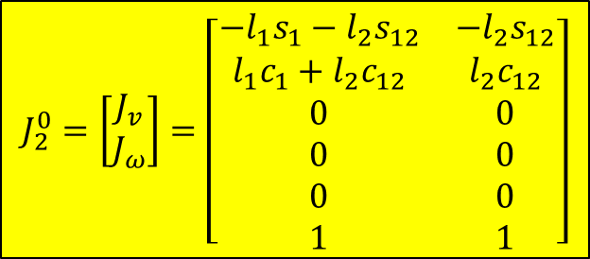

$$J_{2}^{0}=\left[\begin{matrix}J_{v} \\ J_{ω}\end{matrix}\right]=\left[\begin{matrix}{−l_{1}s}_{1}−l_{2}s_{12} & −l_{2}s_{12} \\ l_{1}c_{1}+l_{2}c_{12} & l_{2}c_{12} \\ 0 & 0 \\ 0 & 0 \\ 0 & 0 \\ 1 & 1\end{matrix}\right]$$
Since:
$$\left[\begin{matrix}v_{n}^{0} \\ ω_{n}^{0}\end{matrix}\right]=J_{n}^{0}\dot{q}$$
$$v_{2}^{0}=\left({−l_{1}s}_{1}−l_{2}s_{12}\right)\dot{θ_{1}}−l_{2}s_{12}\dot{θ_{2}}$$
then
$$ω_{2}^{0}=\left(l_{1}c_{1}+l_{2}c_{12}\right)\dot{θ_{1}}+l_{2}c_{12}\dot{θ_{2}}$$
© Copyright Paul Oh 2020

