Slide 1
Robotics
Inverse Kinematics
© Copyright Paul Oh 2020

Slide 2
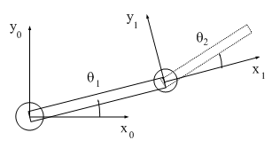


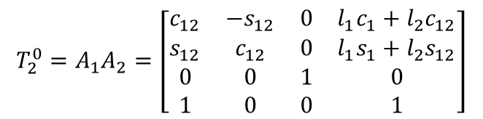




Inverse Kinematics
Big Question: Inverse kinematics (IK) asks what joint parameters are needed to place robot’s end-effector at desired point?
Recall from study of 2-link planar manipulator:
$$T_{2}^{0}=A_{1}A_{2}=\left[\begin{aligned}\begin{matrix}c_{12} & −s_{12} & 0 & l_{1}c_{1}+l_{2}c_{12} \\ s_{12} & c_{12} & 0 & l_{1}s_{1}+l_{2}s_{12} \\ 0 & 0 & 1 & 0 \\ 1 & 0 & 0 & 1\end{matrix}\end{aligned}\right]$$
$$l_{2}$$
$$\left(x_{p},y_{p}\right)$$
$$l_{1}$$
Tool transformation matrix $T_{2}^{0 }$maps tool (end-effector) frame from $x_{2}y_{2}$ to base frame $x_{0}y_{0}$
Problem: Solve $θ_{1}$ and $θ_{2}$ as a function of $x_{p}$ and $y_{p}$
Solution (Algebraic Approach):
Step 1: Solve for $θ_{2}$
From last column of Tool transformation matrix, and figure, see that
$$x_{p}^{2}+y_{p}^{2}={\left(l_{1}c_{1}+l_{2}c_{12}\right)}^{2}+{\left(l_{1}s_{1}+l_{2}s_{12}\right)}^{2}=l_{1}^{2}c_{1}^{2}+l_{2}^{2}c_{12}^{2}+2l_{1}l_{2}c_{1}c_{12}+l_{1}^{2}s_{1}^{2}+l_{2}^{2}s_{12}^{2}+2l_{1}l_{2}s_{1}s_{12}$$
$$x_{p}^{2}+y_{p}^{2}=l_{1}^{2}+l_{2}^{2}+2l_{1}l_{2}c_{1}c_{12}+2l_{1}l_{2}s_{1}s_{12}=l_{1}^{2}+l_{2}^{2}+2l_{1}l_{2}[c_{1}\left(c_{1}c_{2}−s_{1}s_{2}\right)+s_{1}{(s}_{1}c_{2}+s_{2}c_{1})]$$
$$x_{p}^{2}+y_{p}^{2}=l_{1}^{2}+l_{2}^{2}+2l_{1}l_{2}[c_{1}^{2}c_{2}−c_{1}s_{1}s_{2}+{s_{1}^{2}c_{2}+s}_{1}s_{2}c_{1}]$$
$$x_{p}^{2}+y_{p}^{2}=l_{1}^{2}+l_{2}^{2}+2l_{1}l_{2}\cos{θ_{2}}$$
(1)
© Copyright Paul Oh 2020

Slide 3

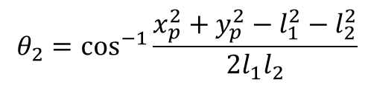
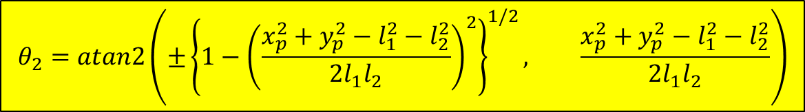

Consequently from (1) have
$$θ_{2}=\cos^{−1}{\frac{x_{p}^{2}+y_{p}^{2}−l_{1}^{2}−l_{2}^{2}}{2l_{1}l_{2}}}$$
(2)
Inverse cos is inaccurate with small angles. Hence, re-express (2) using inverse tan:
$$l_{2}$$
$$\left(x_{p},y_{p}\right)$$
$$\sin^{2}θ_{2}+\cos^{2}θ_{1}=1$$
$$\sin{θ_{2}=±{\left\{1−\cos^{2}θ_{2}\right\}}^{1/2}}$$
(3)
$$l_{1}$$
Observe that (3) has two solutions representing elbow up/down configuration
$$θ_{2}=atan2\left(±{\left\{1−{\left(\frac{x_{p}^{2}+y_{p}^{2}−l_{1}^{2}−l_{2}^{2}}{2l_{1}l_{2}}\right)}^{2}\right\}}^{1/2}, \frac{x_{p}^{2}+y_{p}^{2}−l_{1}^{2}−l_{2}^{2}}{2l_{1}l_{2}}\right)$$
(4)
Sine part from (3)
Cosine part from (2)
© Copyright Paul Oh 2020

Slide 4










Step 2: Solve for $θ_{1}$
Adding the variables in red, one has
$$k_{1}=l_{1}+l_{2}\cos{θ_{2}}$$
$$k_{2}=l_{2}\sin{θ_{2}}$$
$$r_{p}^{2}=k_{1}^{2}+k_{2}^{2}$$
$$γ=\tan^{−1}\left(\frac{k_{2}}{k_{1}}\right)$$
$$k_{1}=r_{p}\cos{γ}$$
$$k_{2}=r_{p}\sin{γ}$$
One can derive the following:
$$x_{p}=k_{1}\cos{θ_{1}−k_{2}\sin{θ_{1}}}$$
(5)
$$y_{p}=k_{1}\sin{θ_{1}+k_{2}\cos{θ_{1}}}$$
(6)
Substituting for $k_{1}$and $k_{2}$ one can rewrite (5) and (6) to yield:
$$θ_{1}=atan2\left(y_{p},x_{p}\right)−atan2\left(k_{2},k_{1}\right)$$
(7)
© Copyright Paul Oh 2020

Slide 5





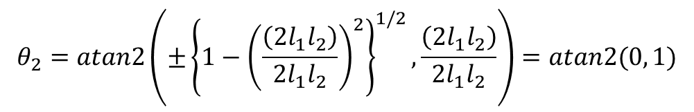



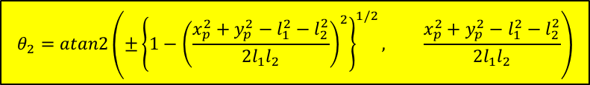
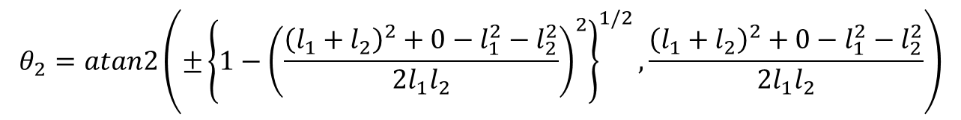





Sanity Check:
$$\left(x_{p},y_{p}\right)$$
$$θ_{2}=atan2\left(±{\left\{1−{\left(\frac{x_{p}^{2}+y_{p}^{2}−l_{1}^{2}−l_{2}^{2}}{2l_{1}l_{2}}\right)}^{2}\right\}}^{1/2}, \frac{x_{p}^{2}+y_{p}^{2}−l_{1}^{2}−l_{2}^{2}}{2l_{1}l_{2}}\right)$$
$$l_{2}$$
Recall
(4)
$$l_{1}$$
$$θ_{1}=atan2\left(y_{p},x_{p}\right)−atan2\left(k_{2},k_{1}\right)$$
Recall
(7)
$$y_{0}$$
$$l_{2}$$
Case 1: If $\left(x_{p}, y_{p}\right)≜ \left(l_{1}+l_{2},0\right)$ then?
Can envision should have $θ_{1}=θ_{2}=0$:
$$l_{1}$$
With $x_{p}=l_{1}+l_{2}$ and $y_{p}=0$ then (4) yields:
$$x_{0}$$
$$θ_{2}=atan2\left(±{\left\{{1−\left(\frac{{\left(l_{1}+l_{2}\right)}^{2}+0−l_{1}^{2}−l_{2}^{2}}{2l_{1}l_{2}}\right)}^{2}\right\}}^{1/2},\frac{{\left(l_{1}+l_{2}\right)}^{2}+0−l_{1}^{2}−l_{2}^{2}}{2l_{1}l_{2}}\right)$$
$$θ_{2}=atan2\left(±{\left\{{1−\left(\frac{\left({2l}_{1}l_{2}\right)}{2l_{1}l_{2}}\right)}^{2}\right\}}^{1/2},\frac{\left({2l}_{1}l_{2}\right)}{2l_{1}l_{2}}\right)=atan2(0, 1)$$
or, $θ_{2}=0$
Also, have from (5):
QED
$$θ_{1}=atan2\left(0, l_{1}+l_{2}\right)−atan2(0, l_{1}+l_{2})$$
Hence, $θ_{1}=0$
© Copyright Paul Oh 2020

Slide 6







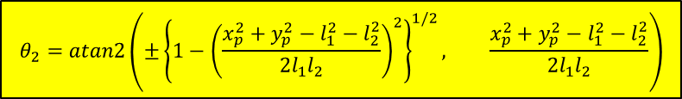
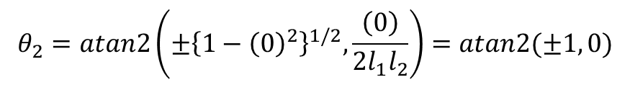

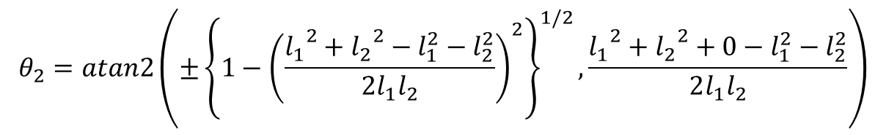



P.Oh added 04/08/19
Another Sanity Check:
$$l_{2}$$
$$\left(x_{p},y_{p}\right)$$
$$θ_{2}=atan2\left(±{\left\{1−{\left(\frac{x_{p}^{2}+y_{p}^{2}−l_{1}^{2}−l_{2}^{2}}{2l_{1}l_{2}}\right)}^{2}\right\}}^{1/2}, \frac{x_{p}^{2}+y_{p}^{2}−l_{1}^{2}−l_{2}^{2}}{2l_{1}l_{2}}\right)$$
$$l_{1}$$
$$θ_{1}=atan2\left(y_{p},x_{p}\right)−atan2\left(k_{2},k_{1}\right)$$
$$k_{1}=l_{1}+l_{2}\cos{θ_{2}}$$
$$k_{2}=l_{2}\sin{θ_{2}}$$
$$y_{0}$$
Case 2: If $\left(x_{p}, y_{p}\right)≜ \left(l_{1},−l_{2}\right)$ then?
Can envision should have $θ_{1}=0, θ_{2}=90$:
$$l_{2}$$
With $x_{p}=l_{1}$and $y_{p}=−l_{2}$then (4) yields:
$$l_{1}$$
$$x_{0}$$
$$θ_{2}=atan2\left(±{\left\{{1−\left(\frac{{l_{1}}^{2}+{l_{2}}^{2}−l_{1}^{2}−l_{2}^{2}}{2l_{1}l_{2}}\right)}^{2}\right\}}^{1/2},\frac{{l_{1}}^{2}+{l_{2}}^{2}+0−l_{1}^{2}−l_{2}^{2}}{2l_{1}l_{2}}\right)$$
$$θ_{2}=atan2\left(±{\left\{{1−\left(0\right)}^{2}\right\}}^{1/2},\frac{\left(0\right)}{2l_{1}l_{2}}\right)=atan2(±1, 0)$$
or, $θ_{2}=±90$
Choose -90
i.e. negative root
Also, have from (5):
$$θ_{1}=atan2\left(−l_{2}, l_{1}\right)−atan2(l_{2}, l_{1})$$
Hence, $θ_{1}=0$
© Copyright Paul Oh 2020

Slide 7
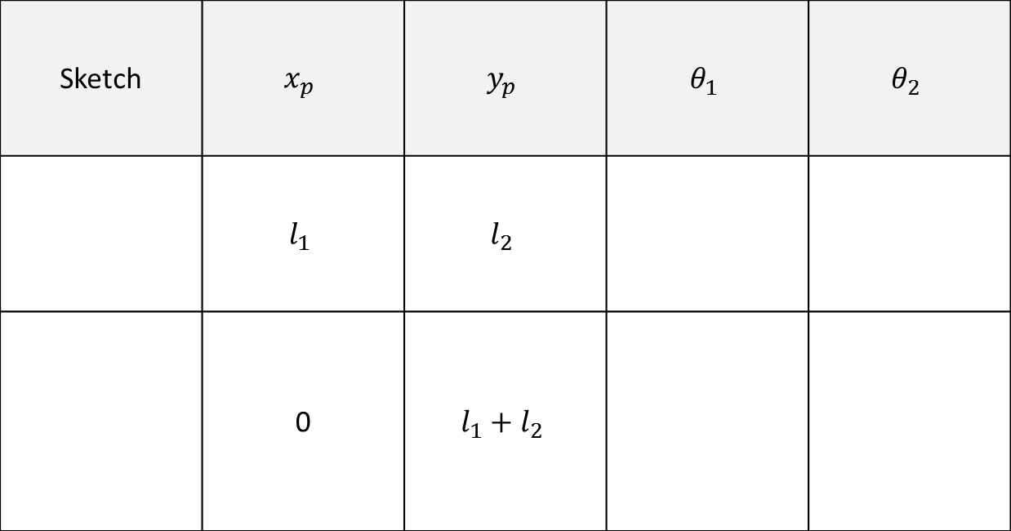
Other configurations can be shown, yielding required $θ_{1}$and $θ_{2}$
Sketch | $$x_{p}$$ | $$y_{p}$$ | $$θ_{1}$$ | $$θ_{2}$$
 | $$l_{1}$$ | $$l_{2}$$
 | 0 | $$l_{1}+l_{2}$$
$$l_{2}$$
0 90 deg
$$l_{1}$$
$$l_{2}$$
90 deg 0
$$l_{1}$$
© Copyright Paul Oh 2020

