Slide 1
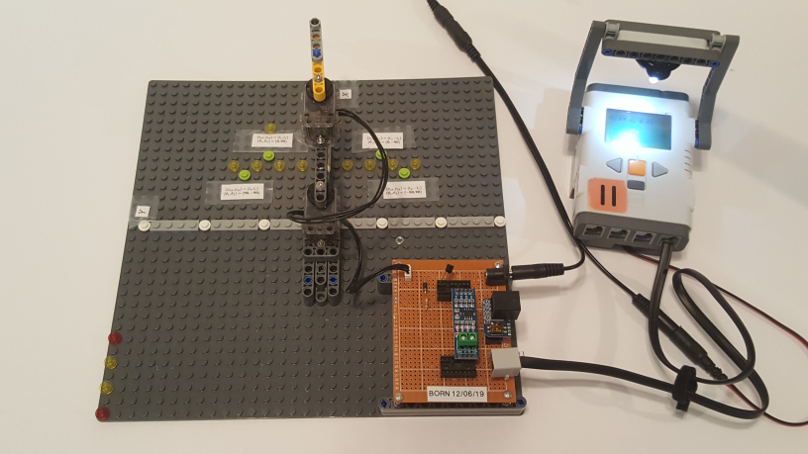
© Paul Oh, 2019
Last updated 12/31/19
Dynamixel XL-320 Lego-Based 2-DOF Planar Manipulator
Preamble: Previous labs demonstrated using M2.5 fasteners to attach the Dynamixel XL-320 servo to Lego pieces. The XL-320’s size, weight, power and accuracy are advantages over conventional Lego motors. Moreover, Lego bricks use a standard; stud-to-stud spacing is 8 mm. This consistent spacing allows one to gage positioning accuracy when calculating forward and inverse kinematics.
Objective: Construct Lego-based 2-DOF Planar Manipulator using two XL-320 servos
XL-320 Servos
XY calibration points
XY axes
LEGO Base Plate
RS485 to TTL Module Board
2-DOF Planar Manipulator using Legos and two XL-320 Servos

Slide 2
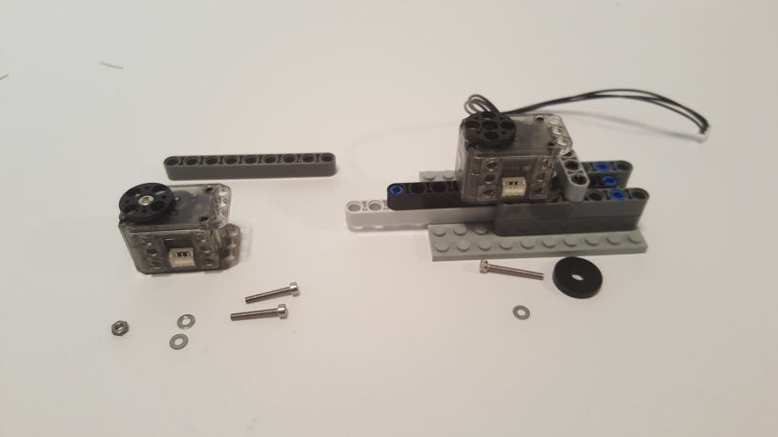
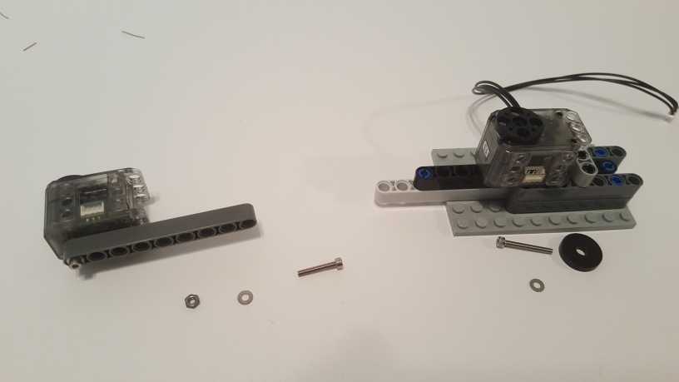
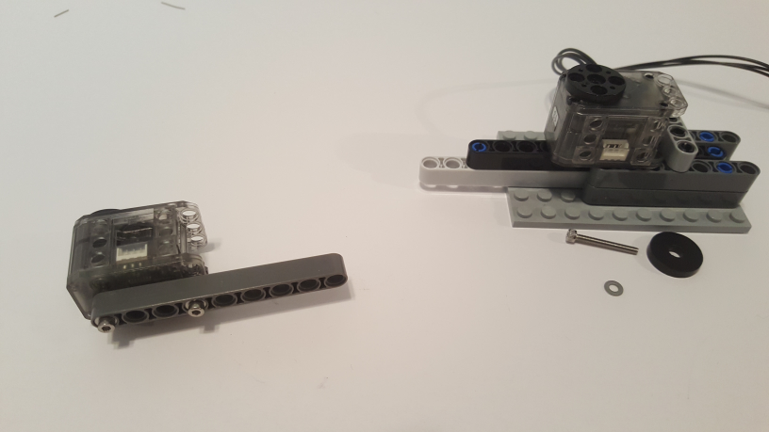
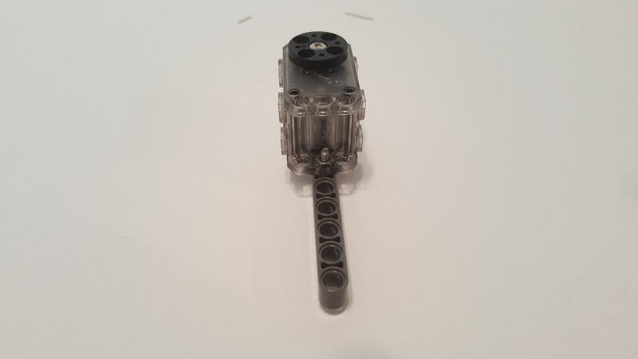
© Paul Oh, 2019
Last updated 12/31/19
Step 1: Joint 1 to Joint 2 Link
XL-320 Servo from Lego-Mount Lab
1 Beam 9
(64289)
2 M2.5 x 16 MM screw
1 M2.5 washer
1 2.5 nut
1 M2.5 x 20 MM Screw
1 M2.5 Washer
1 3/8M Flat Washer (OD 21/32”)
1A: Lego-Mount Lab’s XL-320 serves as base joint. Additional XL-320 will be second joint
1B: Secure M2.5 x 16 MM screw thru washer and Beam 9 and into XL-320’s left mounting hole (red)
M2.5 nut
1C: Secure M2.5 x 16 MM screw thru washer and Beam 9, and fasten M2.5 nut (see red arrows)
Alternative view of Step 1C. Red circle shows fastened M2.5 nut

Slide 3
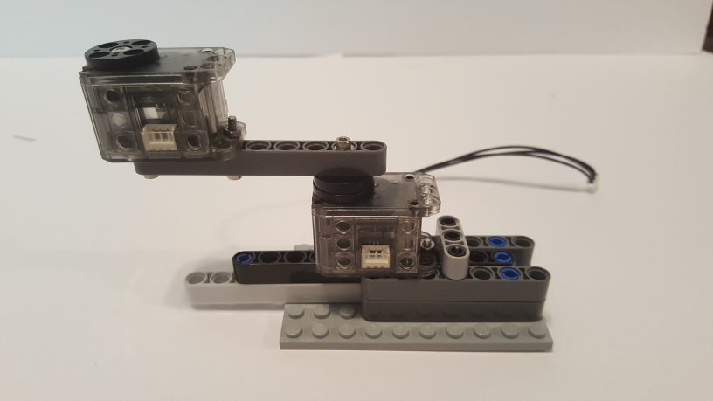
© Paul Oh, 2019
Last updated 12/31/19
2nd hole from right
Joint 2
Joint 1
1D: Screw M2.5 x 20 MM into washer, Beam 9 and into Joint 1 horn

Slide 4
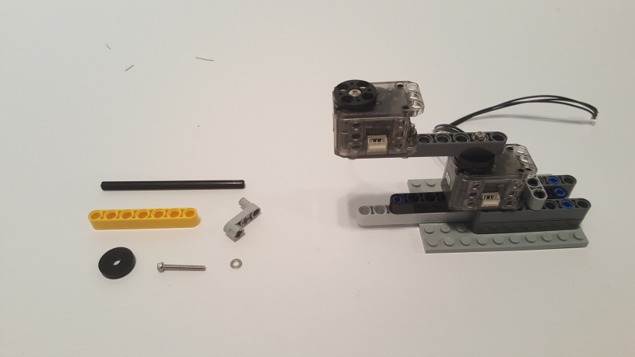
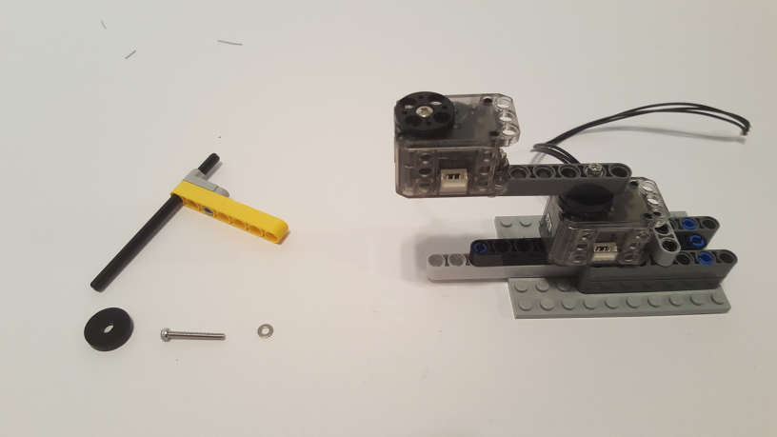
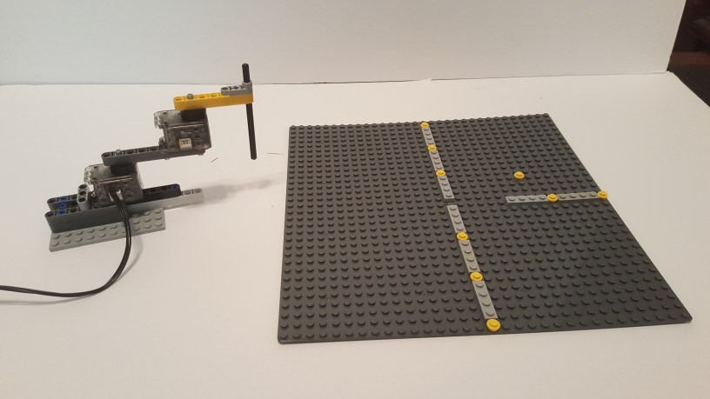
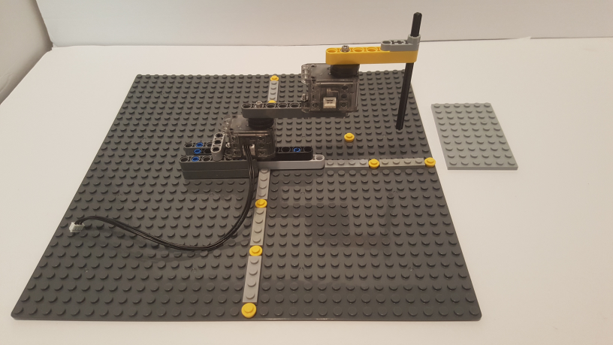

© Paul Oh, 2019
Last updated 12/31/19
Step 2: Link 2
1 Axle 10 (3737)
1 Liftarm 1 x 3 Crank
(33299)
1 Beam 7
(32524)
1 M2.5 x 16 MM screw
1 M2.5 washer
1 3/8M Flat Washer (OD 21/32”)
2A: Gather components
2B: Slide Axle 10 thru Beam 7 and Crank
2C:Secure M2.5 x 16 MM screw thru washer, flat washer and into 2nd XL-320’s horn
2D:Secure resulting 2-DOF manipulator to 32 x 32 base plate. Create $±X$ and $Y$ axes

Slide 5
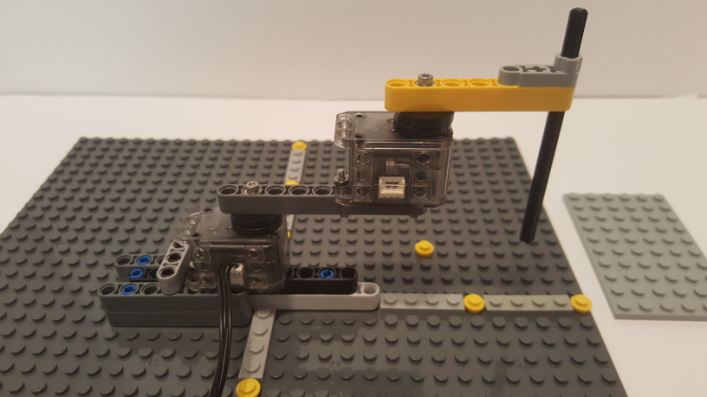
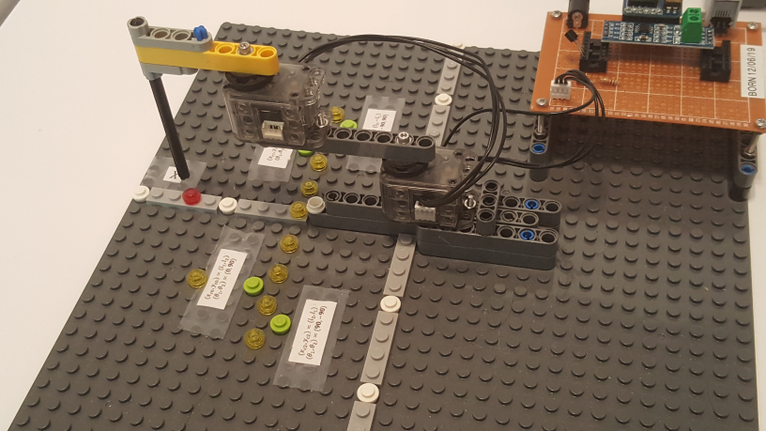
© Paul Oh, 2019
Last updated 12/31/19
y = 7
y = 0
y = 12
(x,y) = (0,0)
y = 12
2E: Note that end-effector (Axle 10) hovers over y=12 position when manipulator’s two links are aligned with Y-axes
Alternative view: Red colored stud is the y=12 position and end-effector hovers over it.
Congratulations! Completed Lego-based 2-DOF XL-320 Manipulator

