Slide 1
Robotics
Forward Kinematics, Denavit-Hartenberg, Transformation Matrices
Reference: lectureDenavitHartenberg-103116.pptx
© Copyright Paul Oh 2020

Slide 2
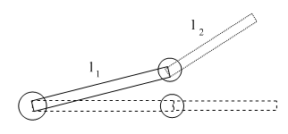
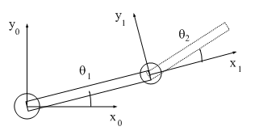
Forward Kinematics
Big Question: Want robot’s end-effector at desired point. What joint angles are needed?
Inverse Kinematics is the topic that answers this
Solution (if any) likely is non-linear, transcendental, and often non-unique
Demands inverting a (transformation) matrix – multiple techniques
Solution begins by understanding the transformation matrix
So must first understand Forward Kinematics
Sanity Check: Given the 2-link planar manipulator below, what is the $\left(x,y\right)$ position of the end-point $p$?
p
Solution: Recall Relative Reference Frames from Physics, Mechanics and Kinematics
Step 1: Assign a reference frame
© Copyright Paul Oh 2020

Slide 3









Step 2: Apply vectors
$$\vec{r_{po}}$$
$$\vec{r_{p1}}$$
$$\vec{r_{po}}=\vec{r_{10}}+\vec{r_{p1}}$$
$$\vec{r_{10}}$$
Have the following:
$$\vec{r_{10}}=l_{1}\cos{θ_{1}\hat{i}+l_{1}\sin{θ_{1}\hat{j}}}$$
$$\vec{r_{p1}}=l_{2}\cos{θ_{2}\hat{i′}+l_{2}\sin{θ_{2}\hat{j′}}}$$
Can show:
$$x_{po}=l_{1}c_{1}+l_{2}c_{12}$$
$c_{k}=\cos{θ_{k}}$ and $s_{k}=\sin{θ_{k}}$
where
(1)
$$y_{po}=l_{1}s_{1}+l_{2}s_{12}$$
$$c_{12}=\cos\left(θ_{1}+θ_{2}\right)=\cos{θ_{1}\cos{θ_{2}−\sin{θ_{1}\sin{θ_{2}}}}}$$
$$s_{12}=\sin\left(θ_{1}+θ_{2}\right)=\sin{θ_{1}\cos{θ_{2}+\sin{θ_{2}\cos{θ_{1}}}}}$$
Take-away:
The reference frames’ poses are not unique – can position and orient anywhere
Solving for absolute position for N-links, where N is large, is tedious
© Copyright Paul Oh 2020

Slide 4

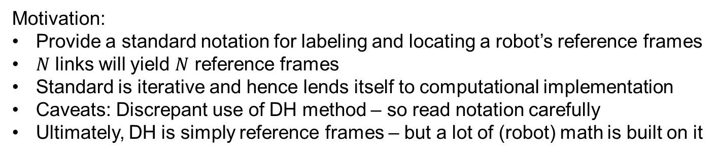


Denavit-Hartenberg Notation
Motivation:
Provide a standard notation for labeling and locating a robot’s reference frames
$N$ links will yield $N$ reference frames
Standard is iterative and hence lends itself to computational implementation
Caveats: Discrepant use of DH method – so read notation carefully
Ultimately, DH is simply reference frames – but a lot of (robot) math is built on it
Illustrative Example: Given the 2-link planar manipulator below, apply DH notation and solve for end-effector’s absolute location
Step 1: Count $n,$number of links. Place (arbitrary) origin of base frame $x_{0}y_{0}z_{0}$
$$y_{0}$$
$n=2$ links
$$x_{0}$$
© Copyright Paul Oh 2020

Slide 5














Step 2: Label and locate joint axes $z_{0},z_{1}⋯z_{n−1}$and end-effector frame $z_{n}$
$$y_{0}$$
$$z_{2}$$
$$z_{1}$$
$$z_{0}$$
$$x_{0}$$
Step 3: Position axes $x_{1},x_{2}⋯x_{n}$along link (observing right-hand reference frame)
$$y_{2}$$
$$x_{2}$$
$$y_{0}$$
$$y_{1}$$
$$z_{2}$$
$$x_{1}$$
$$z_{1}$$
$$z_{0}$$
$$x_{0}$$
© Copyright Paul Oh 2020

Slide 6






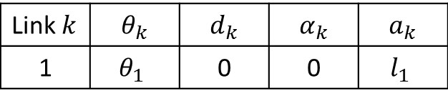



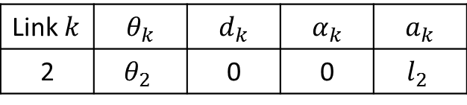


Step 4: Identify link parameters to DH definitions
$a_{i}≜$ distance along $x_{i}$ from $O_{i}$ to the intersection of $x_{i}$ and $z_{i−1}$axes
$d_{i}≜$ distance along $z_{i−1}$ from $O_{i−1}$ to the intersection of $x_{i}$ and $z_{i−1}$axes
$α_{i}≜$ angle between $z_{i−1}$ and $z_{i−1}$ measured about $x_{i}$ (right-hand rule)
$θ_{i}≜$ angle between $x_{i−1}$ and $x_{i−1}$ measured about $z_{i−1}$ (right-hand rule)
Link $k$ | $$θ_{k}$$ | $$d_{k}$$ | $$α_{k}$$ | $$a_{k}$$
1 | $$θ_{1}$$ | 0 | 0 | $$l_{1}$$
$$y_{2}$$
$$x_{2}$$
$$y_{0}$$
$$y_{1}$$
$$z_{2}$$
$$x_{1}$$
Link $k$ | $$θ_{k}$$ | $$d_{k}$$ | $$α_{k}$$ | $$a_{k}$$
2 | $$θ_{2}$$ | 0 | 0 | $$l_{2}$$
$$z_{1}$$
$$θ_{2}$$
$$z_{0}$$
$$x_{0}$$
$$θ_{1}$$
This table is the DH notation for the 2-link planar manipulator
NB: If joint $k$is revolute (like above), then $d_{k}=0$. If joint $k$ is prismatic, then $a_{k}=0$
This video may be helpful for visualization https://www.youtube.com/watch?v=rA9tm0gTln8
© Copyright Paul Oh 2020

Slide 7
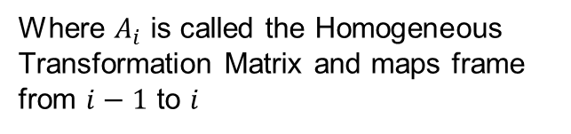
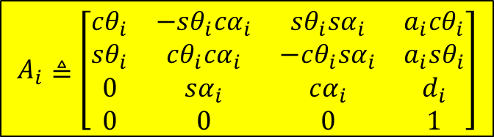

Homogeneous Transformation Matrix
Assigning reference frames is non-unique
But DH notation serves as a kind of “standard” by roboticists
Much (robot) math (and simulators) builds upon using this DH “standard”
Homogeneous Transformation Matrix and Tool Frame are examples
$$A_{i}≜\left[\begin{aligned}\begin{matrix}cθ_{i} & −sθ_{i}cα_{i} & sθ_{i}sα_{i} & a_{i}cθ_{i} \\ sθ_{i} & cθ_{i}cα_{i} & −cθ_{i}sα_{i} & a_{i}sθ_{i} \\ 0 & sα_{i} & cα_{i} & d_{i} \\ 0 & 0 & 0 & 1\end{matrix}\end{aligned}\right]$$
Where $A_{i}$ is called the Homogeneous Transformation Matrix and maps frame from $i−1$ to $i$
Tool Frame $T_{n}^{0}$: More interested in knowing the transformation from robot’s base (origin) to robot’s end-effector (tool) frames
$$T_{n}^{0}=A_{1}A_{2}⋯A_{n}$$
© Copyright Paul Oh 2020

Slide 8




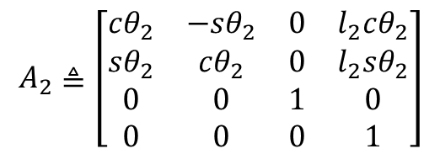
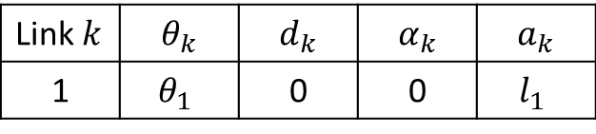
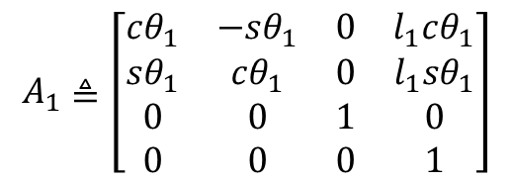



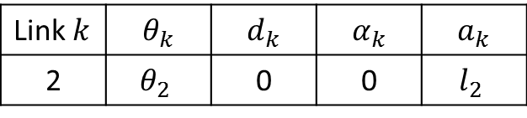




Sanity Check: Try homogeneous and tool transformation matrices with 2-link planar manipulator
Link $k$ | $$θ_{k}$$ | $$d_{k}$$ | $$α_{k}$$ | $$a_{k}$$
1 | $$θ_{1}$$ | 0 | 0 | $$l_{1}$$
$$y_{2}$$
$$x_{2}$$
$$y_{0}$$
$$y_{1}$$
$$z_{2}$$
$$x_{1}$$
Link $k$ | $$θ_{k}$$ | $$d_{k}$$ | $$α_{k}$$ | $$a_{k}$$
2 | $$θ_{2}$$ | 0 | 0 | $$l_{2}$$
$$z_{1}$$
$$θ_{2}$$
$$z_{0}$$
$$x_{0}$$
$$θ_{1}$$
Step 1: Solve individual homogeneous transformation matrices $A_{i}$
$$A_{1}≜\left[\begin{aligned}\begin{matrix}cθ_{1} & −sθ_{1} & 0 & l_{1}cθ_{1} \\ sθ_{1} & cθ_{1} & 0 & l_{1}sθ_{1} \\ 0 & 0 & 1 & 0 \\ 0 & 0 & 0 & 1\end{matrix}\end{aligned}\right]$$
$$A_{2}≜\left[\begin{aligned}\begin{matrix}cθ_{2} & −sθ_{2} & 0 & l_{2}cθ_{2} \\ sθ_{2} & cθ_{2} & 0 & l_{2}sθ_{2} \\ 0 & 0 & 1 & 0 \\ 0 & 0 & 0 & 1\end{matrix}\end{aligned}\right]$$
and
Footnote: hand-checked A1 and A2 10/31/16, 11/04/16; and 04/04/19.
Also see Spong pg. 84-85 Robot Modeling and Control 2006 Edition
© Copyright Paul Oh 2020

Slide 9

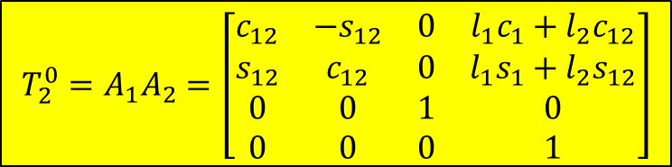

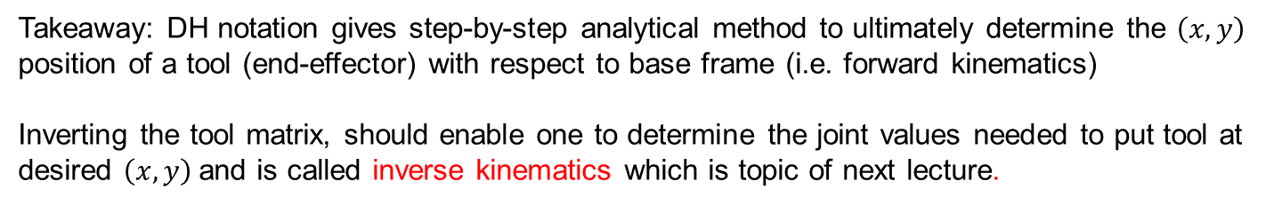


Step 2: Solve product of homogeneous transformation matrices $A_{i}$
$$T_{2}^{0}=A_{1}A_{2}=\left[\begin{aligned}\begin{matrix}c_{12} & −s_{12} & 0 & l_{1}c_{1}+l_{2}c_{12} \\ s_{12} & c_{12} & 0 & l_{1}s_{1}+l_{2}s_{12} \\ 0 & 0 & 1 & 0 \\ 0 & 0 & 0 & 1\end{matrix}\end{aligned}\right]$$
$c_{k}=\cos{θ_{k}}$ and $s_{k}=\sin{θ_{k}}$
where
$$c_{12}=\cos\left(θ_{1}+θ_{2}\right)=\cos{θ_{1}\cos{θ_{2}−\sin{θ_{1}\sin{θ_{2}}}}}$$
$$s_{12}=\sin\left(θ_{1}+θ_{2}\right)=\sin{θ_{1}\cos{θ_{2}+\sin{θ_{2}\cos{θ_{1}}}}}$$
Note: The last column gives $\left(x,y\right)$ position of end-point. Compare to (1) from before
$$x_{po}=l_{1}c_{1}+l_{2}c_{12}$$
$$y_{po}=l_{1}s_{1}+l_{2}s_{12}$$
Takeaway: DH notation gives step-by-step analytical method to ultimately determine the $\left(x,y\right)$ position of a tool (end-effector) with respect to base frame (i.e. forward kinematics)
Inverting the tool matrix, should enable one to determine the joint values needed to put tool at desired $\left(x,y\right)$and is called inverse kinematics which is topic of next lecture.
Footnote: hand-checked ${T_{2}}^{0}$ 10/31/16, 11/04/16; and 04/04/19.
Also see Spong pg. 84-85 Robot Modeling and Control 2006 Edition
© Copyright Paul Oh 2020

