Slide 1
© Paul Oh, 2019
Last updated 12/14/19
Dynamixel XL-320 Servo Mount for Lego
Preamble: The Dynamixel XL-320 servo is both light-weight and physically small. It has sufficient torque and a joint encoder to prototype manipulators. Moreover, it has mounting holes that can secure to Lego pieces with M2.5 fasteners
Objective: Construct Lego-based servo mount for XL-320 as seen below
XL-320 Lego-based Motor Mount

Slide 2
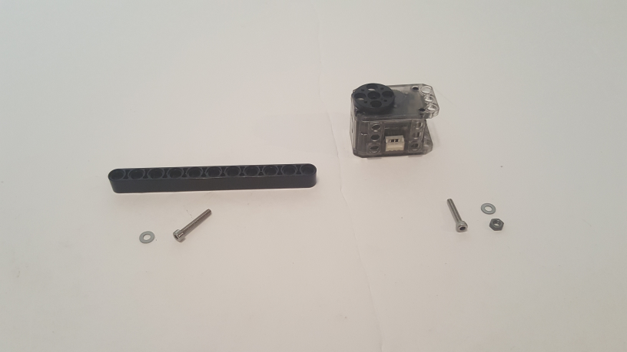
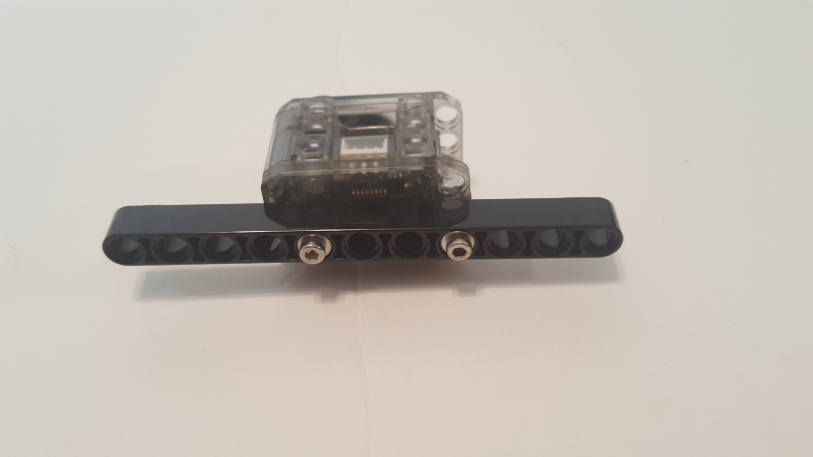
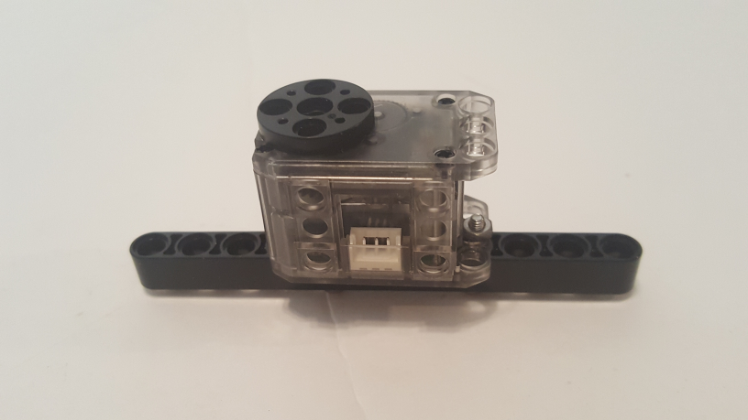
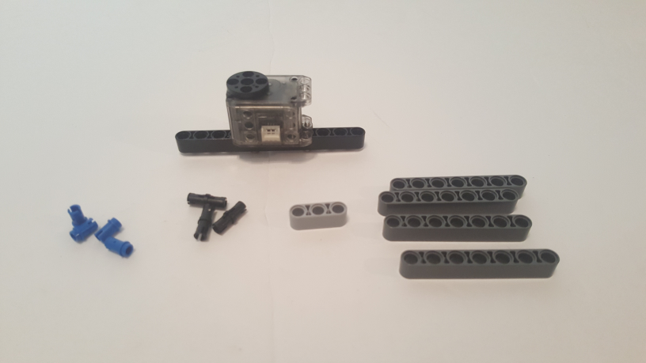
© Paul Oh, 2019
Last updated 12/14/19
Step 1: Servo Beam Sub-Assembly
1 XL-320 Servo
Mounting hole
1 Beam 11 (64290)
1 M2.5 Screw
1 M2.5 x 16 MM hex screw
1 M2.5 x 14 MM hex screw
2 M2.5 Washer
5th hole from left
(M2.5 x 16 MM screw)
4th hole from right
(M2.5 x 14 MM screw)
1B: Secure M2.5 screw thru washers as shown. See 1C for fastening nut
Servo horn end
M2.5 nut
4 Technic Pin 1/2
(4274)
1 Beam 3
(32523)
1A: Gather parts
3 Friction Peg
(2780)
4 Beam 7
(32524)
1C: Secure M2.5 nut from “1B”
1D: Gather parts

Slide 3
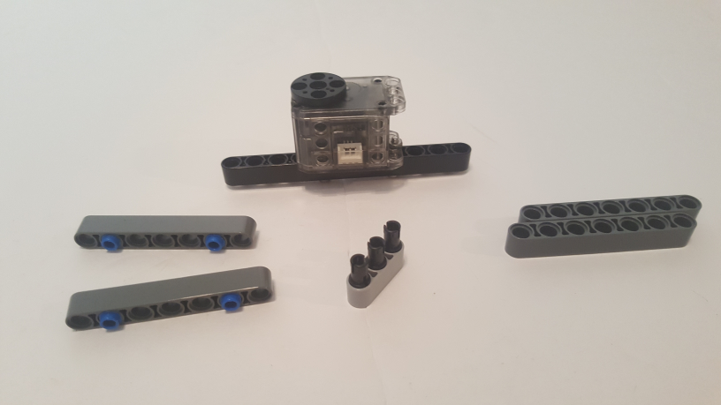
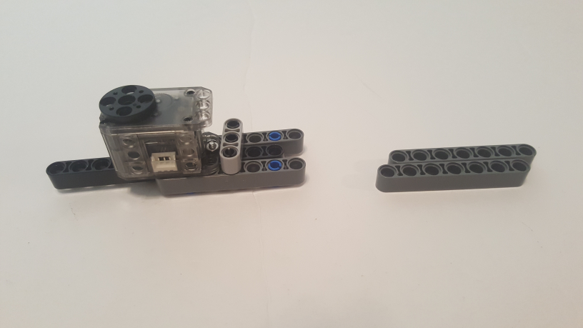
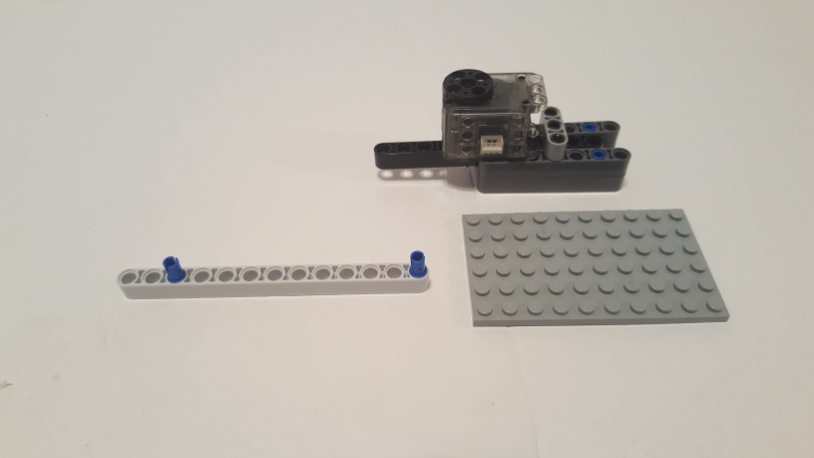
© Paul Oh, 2019
Last updated 12/14/19
Step 2: Base Arms Sub-Assembly
2A: Insert friction pegs in Beam 3. Insert Pin 1/2 in both Beam 7s.
2B: Align two Beam 7s beneath motor and secure to Beam 3
2 Technic Pin 1/2
(4274)
1 Beam 13
(41239)
1 Plate 6 x 10
(3033)
3rd hole from left
1 Base Plate 6 x 10
(???)
2C: Gather parts
2D: Insert Pin 1/2 into Beam 13 as shown

Slide 4
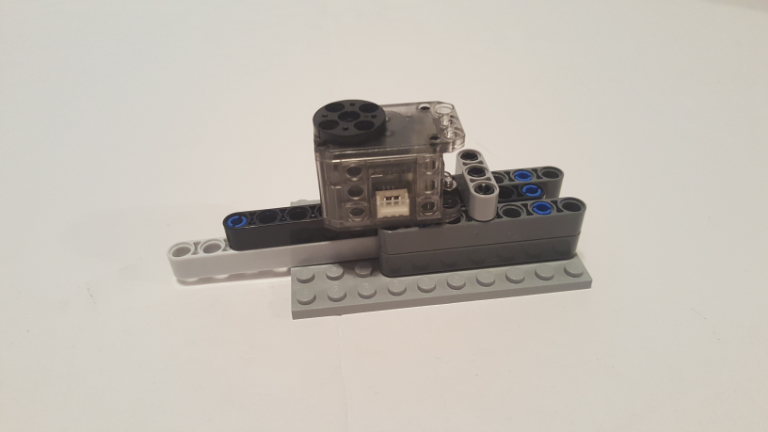
© Paul Oh, 2019
Last updated 12/14/19
Congratulations! Completed XL-320 Lego-based Motor Mount

