Slide 1
Robot Path Planning and Computer Vision
© Copyright Paul Oh 2016

Slide 2
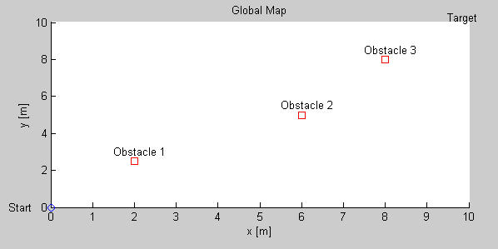
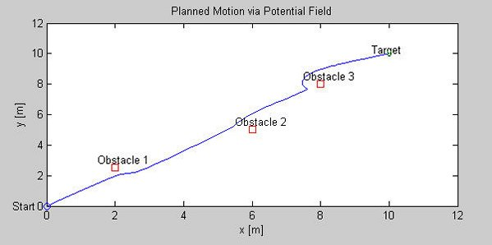
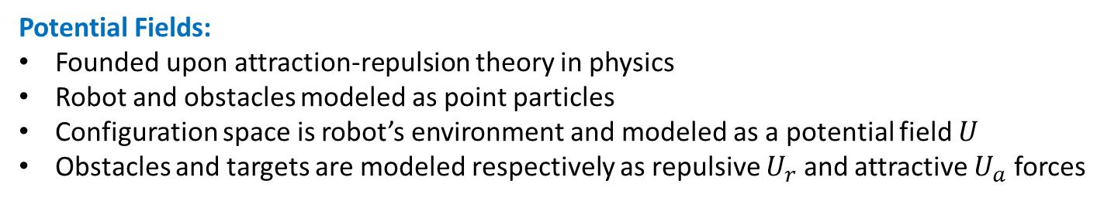
Path Planning – Potential Fields
Objective: Given known obstacle locations, plan a suitable path for the robot to move from start to goal positions
Robot must navigate from start (0,0) to goal (10,10) positions without colliding into 3 obstacles (squares)
One solution: path (blue line) generated by Potential Fields method appears to work
Potential Fields:
Founded upon attraction-repulsion theory in physics
Robot and obstacles modeled as point particles
Configuration space is robot’s environment and modeled as a potential field $U$
Obstacles and targets are modeled respectively as repulsive $U_{r}$ and attractive $U_{a}$ forces
© Copyright Paul Oh 2016

Slide 3





Potential fields are thus mathematically modeled as
$$U\left(q\right)=U_{a}\left(q\right)+U_{r}(q)$$
(1)
Where $q$ is called a configuration vector i.e. the robot’s current location
$$q=\left[\begin{matrix}x \\ y\end{matrix}\right]$$
(2)
Gradients yield directions of maximum increase. The gradient of the potential field moves robot away from obstacles and towards the target. Thus define:
$$\dot{q}=−∇_{q}\left\{U_{a}\left(q\right)+U_{r}(q)\right\}$$
(3)
Negative means to move in the direction opposite of maximum.
So, what is a suitable $U_{r}$ and $U_{a}$?
Attractive Potential $U_{a}$
Must be differentiable across entire configuration space
Should increase as robot moves away from target

Slide 4
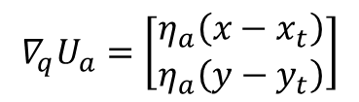

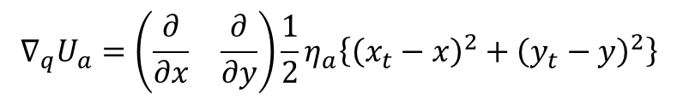




One choice is a parabola:
$$U_{a}=\frac{η_{a}}{2}ρ_{t}^{2}(q)$$
(4)
Where
$$ρ_{t}=\sqrt{{\left(x_{t}−x\right)}^{2}+{\left(y_{t}−y\right)}^{2}}$$
(5)
And
$η_{a}$: attractive potential constant
$\left(x_{t}, y_{t}\right)$: target location
$ρ_{t}$: distance to target
Problem: Derive the gradient for the attractive potential given by (4) and (5)
Solution: Recall that gradient of vector given by
$$∇_{q}U_{a}=\left(\begin{matrix}\frac{∂}{∂x} & \frac{∂}{∂y}\end{matrix}\right)\frac{1}{2}η_{a}\left\{{\left(x_{t}−x\right)}^{2}+{\left(y_{t}−y\right)}^{2}\right\}$$
Hence have
$$∇_{q}U_{a}=\left[\begin{matrix}η_{a}\left({x−x}_{t}\right) \\ η_{a}\left(y−y_{t}\right)\end{matrix}\right]$$
(6)

Slide 5
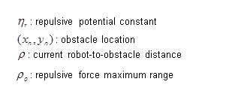
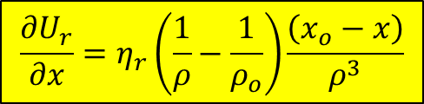

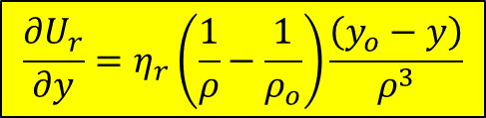
Repulsive Potential $U_{r}$
Must be differentiable across entire configuration space
Should decrease as robot moves away from obstacles
One suitable candidate is
(7)
Where
(8)
Can derive:
$$\frac{∂U_{r}}{∂x}=η_{r}\left(\frac{1}{ρ}−\frac{1}{ρ_{o}}\right)\frac{\left(x_{o}−x\right)}{ρ^{3}}$$
(11)
$$\frac{∂U_{r}}{∂y}=η_{r}\left(\frac{1}{ρ}−\frac{1}{ρ_{o}}\right)\frac{\left(y_{o}−y\right)}{ρ^{3}}$$
(13)

Slide 6
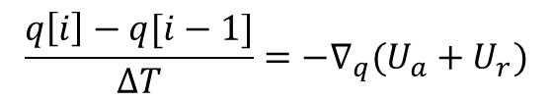


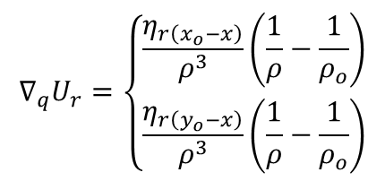
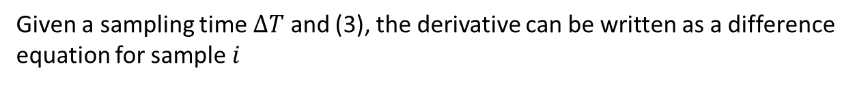



Which results with a gradient:
$$∇_{q}U_{r}=\left\{\begin{matrix}\frac{η_{r\left(x_{o}−x\right)}}{ρ^{3}}\left(\frac{1}{ρ}−\frac{1}{ρ_{o}}\right) \\ \frac{η_{r\left(y_{o}−x\right)}}{ρ^{3}}\left(\frac{1}{ρ}−\frac{1}{ρ_{o}}\right)\end{matrix}\right.$$
when $ρ≤ρ_{o}$
(14)
$$∇_{q}U_{r}=\left[\begin{matrix}0 \\ 0\end{matrix}\right]$$
when $ρ>ρ_{o}$
Updating Robot Positions
Given a sampling time $ΔT$ and (3), the derivative can be written as a difference equation for sample $i$
Recall:
$$\dot{q}=−∇_{q}\left\{U_{a}\left(q\right)+U_{r}(q)\right\}$$
(3)
So:
$$\frac{q\left[i\right]−q[i−1]}{ΔT}=−∇_{q}(U_{a}+U_{r})$$
Or, the update rule is:
$$q\left[i\right]=q\left[i−1\right]− ∆T∇_{q}(U_{a}+U_{r})$$

Slide 7

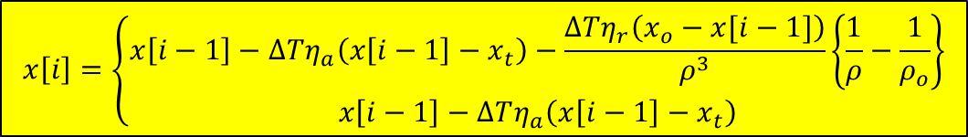
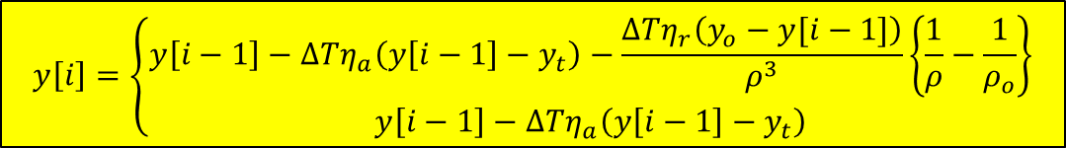




Update for robot’s $x$location using $x$components of both (6) and (14) yield:
$$x\left[i\right]=\left\{\begin{matrix}x\left[i−1\right]−∆Tη_{a}\left(x\left[i−1\right]−x_{t}\right)−\frac{ΔTη_{r}\left(x_{o}−x[i−1]\right)}{ρ^{3}}\left\{\frac{1}{ρ}−\frac{1}{ρ_{o}}\right\} \\ x\left[i−1\right]−ΔTη_{a}\left(x\left[i−1\right]−x_{t}\right)\end{matrix}\right.$$
when $ρ≤ρ_{o}$
(15)
when $ρ>ρ_{o}$
Likewise for $y$:
$$y\left[i\right]=\left\{\begin{matrix}y\left[i−1\right]−∆Tη_{a}\left(y\left[i−1\right]−y_{t}\right)−\frac{ΔTη_{r}\left(y_{o}−y[i−1]\right)}{ρ^{3}}\left\{\frac{1}{ρ}−\frac{1}{ρ_{o}}\right\} \\ y\left[i−1\right]−ΔTη_{a}\left(y\left[i−1\right]−y_{t}\right)\end{matrix}\right.$$
when $ρ≤ρ_{o}$
(16)
when $ρ>ρ_{o}$

Slide 8
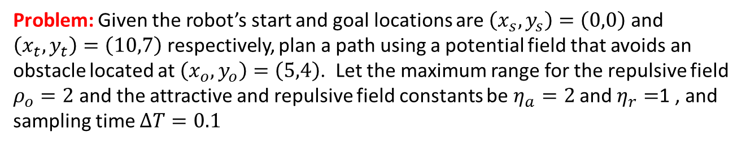
Problem: Given the robot’s start and goal locations are $\left(x_{s},y_{s}\right)=\left(0,0\right)$ and $\left(x_{t},y_{t}\right)=\left(10,7\right)$ respectively, plan a path using a potential field that avoids an obstacle located at $\left(x_{o},y_{o}\right)=\left(5,4\right)$. Let the maximum range for the repulsive field $ρ_{o}=2$ and the attractive and repulsive field constants be $η_{a}=2$ and $η_{r}=$1 , and sampling time $ΔT=0.1$
Solution:
Let’s take 100 iterations to compute the path. Set up a for-loop that calculates equations (5), (8), (11), (13), (15) and (16). First, declare/initialize suitable variables:
In SciLab, create program named potField1_0.sce
clear // clear all memory
// Variables
iterations = 100; // total number of iterations
T = 0.1; // sampling time [sec]
xTarget = 10; // Target location
yTarget = 7;
xObstacle = 5; // Obstable location
yObstacle = 4;
rho0 = 2; // repulsive field maximum
nRepulse = 1; // repulsive field constant
nAttract = 2; // attractive field constant
t(1) = 0;
rhoTarget(1) = 0;
x(1) = 0;
y(1) = 0;
rho(1) = 0;

Slide 9
// Begin update
for i=2:iterations // Run algorithm for 100 sample periods
t(i-1) = T*(i-1); // time in seconds
// Distance to target (Eqn 5)
rhoTarget(i-1) = sqrt(((yTarget-y(i-1))^2) + ((xTarget-x(i-1))^2));
// Distance to an obstacle (Eqn 8)
rho(i-1) = sqrt( ((yObstacle-y(i-1))^2) + ((xObstacle-x(i-1))^2) );
// Calculate gradient (Eqns 11 and 13)
if rho(i-1) < rho0 then
ur_x = nRepulse*( (1/rho(i-1))-(1/rho0) ) * (xObstacle - x(i-1)) / rho(i-1)^3;
ur_y = nRepulse*( (1/rho(i-1))-(1/rho0) ) * (yObstacle - y(i-1)) / rho(i-1)^3;
else
ur_x = 0;
ur_y = 0;
end
// Calculate new robot position (Eqns 15 and 16)
x(i) = x(i-1) - T*nAttract*(x(i-1)-xTarget) - T*ur_x;
y(i) = y(i-1) - T*nAttract*(y(i-1)-yTarget) - T*ur_y;
end // end of for
Fill in this with equation 5
Fill in this with equation 8
Fill in this with equation 11 and 13
Fill in this with equation 11 and 13
Fill in this with equation 15 and 16
Next plot results
clf; // refresh plot
xlabel("Robot x position"); // caption x-axis
ylabel("Robot y position"); // caption y-axis
title("Potential Field example"); // title the plot
plot(x(1), y(1), "ob"); // plot start position in blue circle
plot(xTarget, yTarget, "og"); // plot target position in green circle
plot(xObstacle, yObstacle, "xr"); // obstacles in red x
plot(x,y, "k"); // plot solution path in black solid line

Slide 10
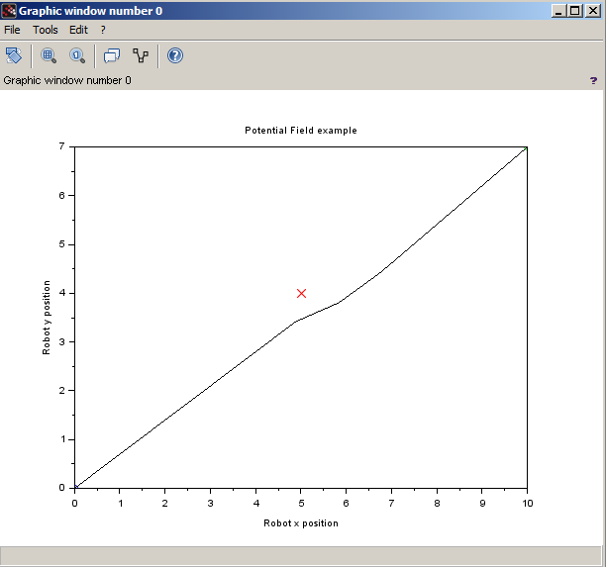
Results:
Conclusion: Potential Field (PF) yields a simple path-planning solution when obstacles, start and goal locations are known a priori. PF is iterative, hence moving obstacles can be handled. A caveat for PF arises from gradients which can yield local (rather than global) minima which “trap” the robot.

