Slide 1
Week 13 Summary
© Copyright Paul Oh 2016

Slide 2

Recall from Week 1:
Plan given a 1-course constraint
Constraint: Inefficient – fabrication and trouble-shooting of circuits and parts
Overcome: LEGO provides fabrication/interface freedom and standardization
Constraint: Inefficient – programming and debugging
Overcome: C or C-like environment; software libraries/repositories. Used NXC
Constraint: Unclear – Project Learning Outcomes
Overcome: Initiation thru turn-key labs; self-discovery thru team projects
Week | Focus | Project | Learning Outcome
3 | Robot Sensing | 1 | Design of digital hardware and software
4 | Robot Actuation
5 | Robot Communications
9-10 | Robot Control | 2 | Design and synthesis of controllers
13 | Robot Computer Vision | 3 | Design and implementation of algorithms
14 | Robot Path Planning
Binary, Voltage Dividers, ADC
Aliasing, Temp sensor, op-amps
Aliasing, Temp sensor, op-amps
I2C Digital I/O
Robot Interfacing
Relays, Transistors, H-bridge, 2-link manipulator
Robot Kinematics, IK
Potential Fields, AR Toolkit
© Paul Oh, 2016

Slide 3
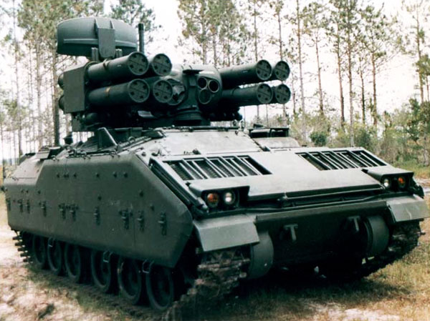

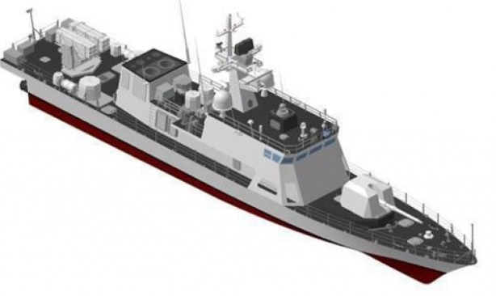


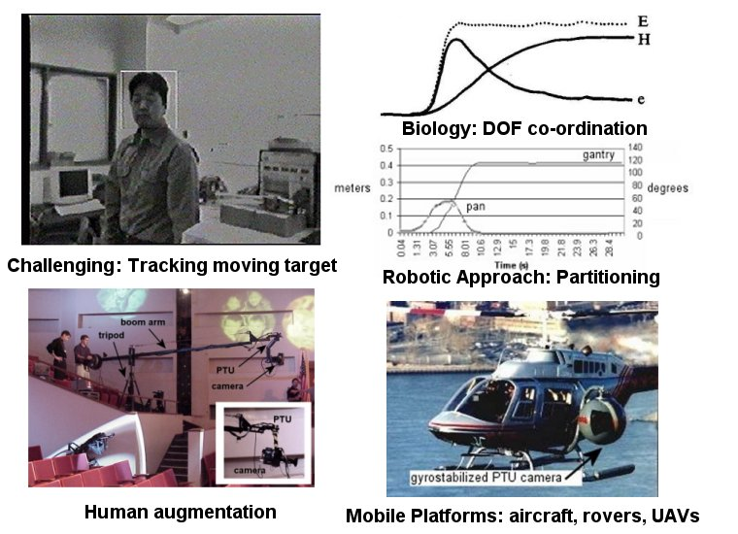
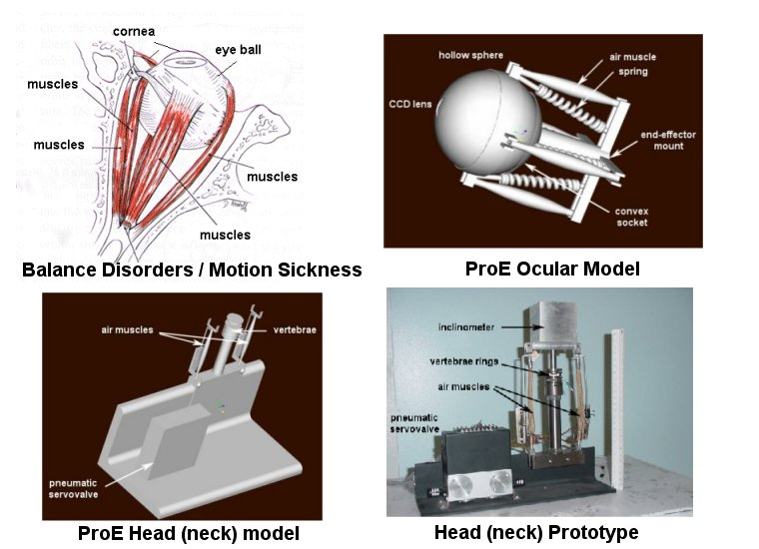
2-Link Manipulator: How is this useful?
Junior year Summer project (mid-80s)
ADATS (Air Defense Anti-Tank System) Oerlikon Aerospace
Course (base) vs. Fine (turret) motion-control
High-speed travel with persistent target-lock
MS project/thesis (early-90s)
Hi-speed Patrol Gun Boats
Course (base) vs. Fine (turret) motion-control
High-speed travel with persistent target-lock
Philosophy “Partitioned DOF”; fast (and stable) tracking with course/fine motion-control

Slide 4

Oh, P.Y., Stanciu, R., "Visual Servoing to Help Camera Operators Track Better," IEEE International Conference on Intelligent Robots and Systems, Beijing China, Oct. 2006 - Video Submission
Stanciu, R., Oh, P.Y., "Human-in-the-Loop Camera Control for a Mechatronic Broadcast Boom," IEEE Trans Mechatronics, V12, N1, pp. 41-52, Feb. 2007

Slide 5
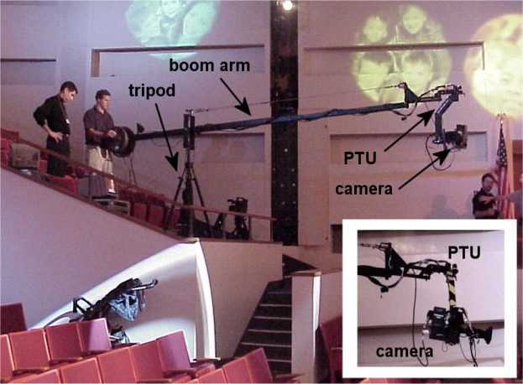

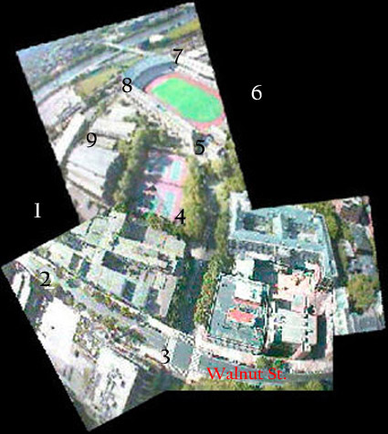
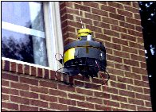
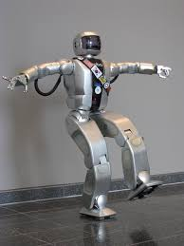
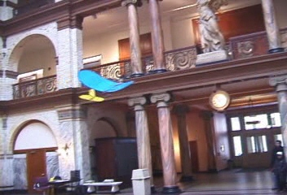
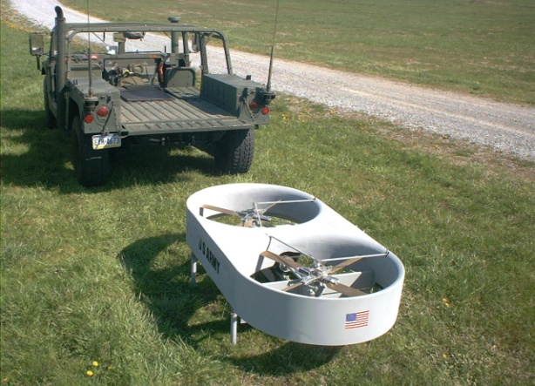
Camera Boom System
LEAP: Low-Elevation Aerial Platform
3DR: rapid reconstruction from kite
Rapid (aerial) computer vision
33rd
St
Leg: Just a 3-link Planar Manipulator

