Slide 1
Robot Control – Part 3
Inverse Kinematics and Jacobians
© Copyright Paul Oh 2016

Slide 2
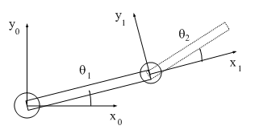

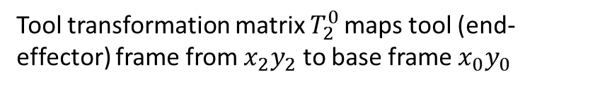
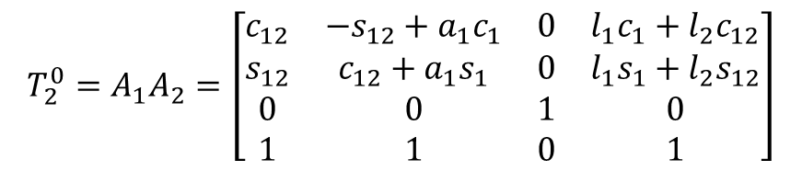




Inverse Kinematics
Big Question: Inverse kinematics (IK) asks what joint parameters are needed to place robot’s end-effector at desired point?
Recall from study of 2-link planar manipulator:
$$T_{2}^{0}=A_{1}A_{2}=\left[\begin{aligned}\begin{matrix}c_{12} & −s_{12}+a_{1}c_{1} & 0 & l_{1}c_{1}+l_{2}c_{12} \\ s_{12} & c_{12}+a_{1}s_{1} & 0 & l_{1}s_{1}+l_{2}s_{12} \\ 0 & 0 & 1 & 0 \\ 1 & 1 & 0 & 1\end{matrix}\end{aligned}\right]$$
$$l_{2}$$
$$\left(x_{p},y_{p}\right)$$
$$l_{1}$$
Tool transformation matrix $T_{2}^{0 }$maps tool (end-effector) frame from $x_{2}y_{2}$ to base frame $x_{0}y_{0}$
Problem (was Homework Problem): Solve $θ_{1}$ and $θ_{2}$ as a function of $x_{p}$ and $y_{p}$
Solution (Algebraic Approach):
Step 1: Solve for $θ_{2}$
From last column of Tool transformation matrix, and figure, see that
$$x_{p}^{2}+y_{p}^{2}=l_{1}^{2}+l_{2}^{2}+2l_{1}l_{2}\cos{θ_{2}}$$
(1)
© Copyright Paul Oh 2016

Slide 3

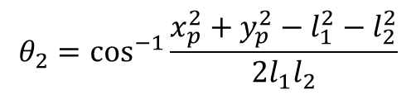
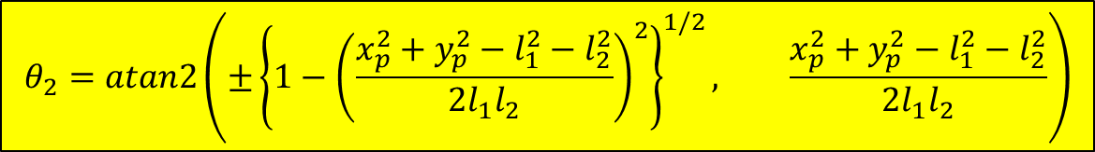

Consequently from (1) have
$$θ_{2}=\cos^{−1}{\frac{x_{p}^{2}+y_{p}^{2}−l_{1}^{2}−l_{2}^{2}}{2l_{1}l_{2}}}$$
(2)
Inverse cos is inaccurate with small angles. Hence, re-express (2) using inverse tan:
$$l_{2}$$
$$\left(x_{p},y_{p}\right)$$
$$\sin^{2}θ_{2}+\cos^{2}θ_{1}=1$$
$$\sin{θ_{2}=±{\left\{1−\cos^{2}θ_{2}\right\}}^{1/2}}$$
(3)
$$l_{1}$$
Observe that (3) has two solutions representing elbow up/down configuration
$$θ_{2}=atan2\left(±{\left\{1−{\left(\frac{x_{p}^{2}+y_{p}^{2}−l_{1}^{2}−l_{2}^{2}}{2l_{1}l_{2}}\right)}^{2}\right\}}^{1/2}, \frac{x_{p}^{2}+y_{p}^{2}−l_{1}^{2}−l_{2}^{2}}{2l_{1}l_{2}}\right)$$
(4)

Slide 4










Step 2: Solve for $θ_{1}$
Adding the variables in red, one has
$$k_{1}=l_{1}+l_{2}\cos{θ_{2}}$$
$$k_{2}=l_{2}\sin{θ_{2}}$$
$$r_{p}^{2}=k_{1}^{2}+k_{2}^{2}$$
$$γ=\tan^{−1}\left(\frac{k_{2}}{k_{1}}\right)$$
$$k_{1}=r_{p}\cos{γ}$$
$$k_{2}=r_{p}\sin{γ}$$
One can derive the following:
$$x_{p}=k_{1}\cos{θ_{1}−k_{2}\sin{θ_{1}}}$$
(5)
$$y_{p}=k_{1}\sin{θ_{1}+k_{2}\cos{θ_{1}}}$$
(6)
Substituting for $k_{1}$and $k_{2}$ one can rewrite (5) and (6) to yield:
$$θ_{1}=atan2\left(y_{p},x_{p}\right)−atan2\left(k_{2},k_{1}\right)$$
(7)

Slide 5




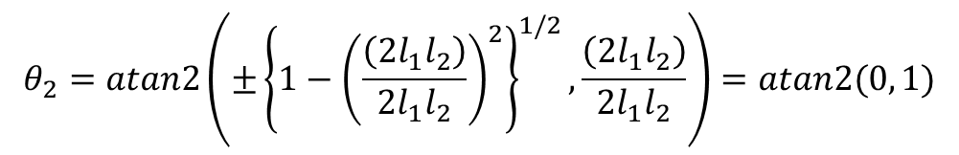
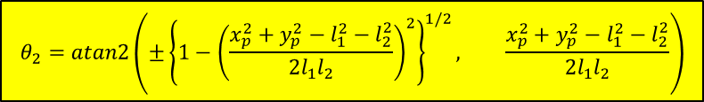
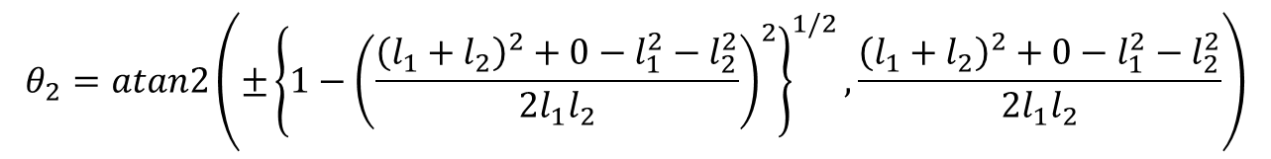





Sanity Check:
$$l_{2}$$
$$\left(x_{p},y_{p}\right)$$
$$θ_{2}=atan2\left(±{\left\{1−{\left(\frac{x_{p}^{2}+y_{p}^{2}−l_{1}^{2}−l_{2}^{2}}{2l_{1}l_{2}}\right)}^{2}\right\}}^{1/2}, \frac{x_{p}^{2}+y_{p}^{2}−l_{1}^{2}−l_{2}^{2}}{2l_{1}l_{2}}\right)$$
$$l_{1}$$
$$θ_{1}=atan2\left(y_{p},x_{p}\right)−atan2\left(k_{2},k_{1}\right)$$
Case 1: If $\left(x_{p}, y_{p}\right)≜ \left(l_{1}+l_{2},0\right)$ then?
$$θ_{1}=θ_{2}=0$$
With $x_{p}=l_{1}+l_{2}$ and $y_{p}=0$ then (4) yields:
$$θ_{2}=atan2\left(±{\left\{{1−\left(\frac{{\left(l_{1}+l_{2}\right)}^{2}+0−l_{1}^{2}−l_{2}^{2}}{2l_{1}l_{2}}\right)}^{2}\right\}}^{1/2},\frac{{\left(l_{1}+l_{2}\right)}^{2}+0−l_{1}^{2}−l_{2}^{2}}{2l_{1}l_{2}}\right)$$
$$θ_{2}=atan2\left(±{\left\{{1−\left(\frac{\left({2l}_{1}l_{2}\right)}{2l_{1}l_{2}}\right)}^{2}\right\}}^{1/2},\frac{\left({2l}_{1}l_{2}\right)}{2l_{1}l_{2}}\right)=atan2(0, 1)$$
or, $θ_{2}=0$
Also, have from (5):
$$θ_{1}=atan2\left(0, l_{1}+l_{2}\right)−atan2(0, l_{1}+l_{2})$$
Hence, $θ_{1}=0$

Slide 6

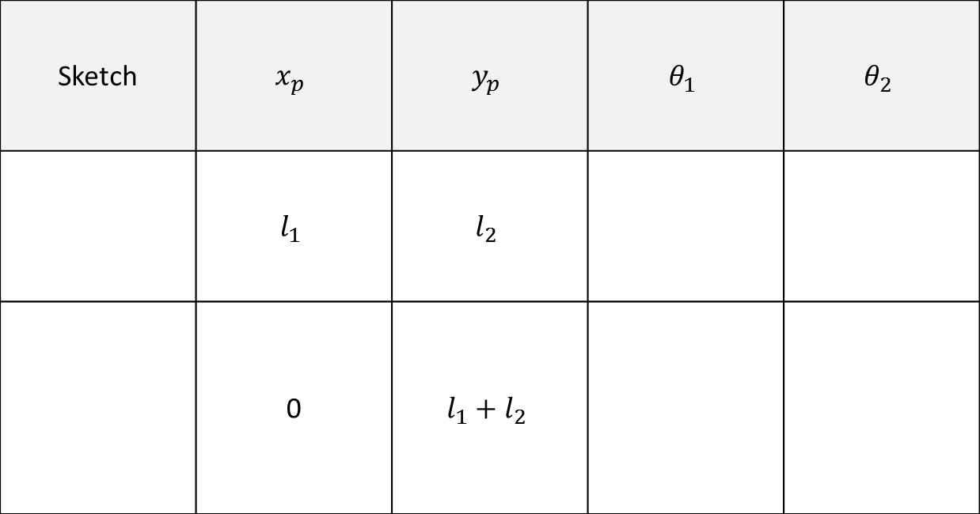


Other configurations can be shown, yielding required $θ_{1}$and $θ_{2}$
Sketch | $$x_{p}$$ | $$y_{p}$$ | $$θ_{1}$$ | $$θ_{2}$$
 | $$l_{1}$$ | $$l_{2}$$
 | 0 | $$l_{1}+l_{2}$$
$$l_{2}$$
0 90 deg
$$l_{1}$$
$$l_{2}$$
90 deg 0
$$l_{1}$$

Slide 7

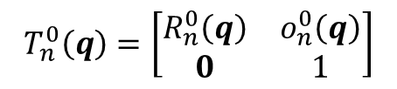


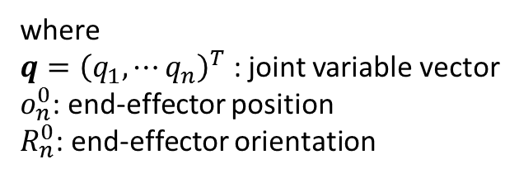
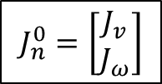
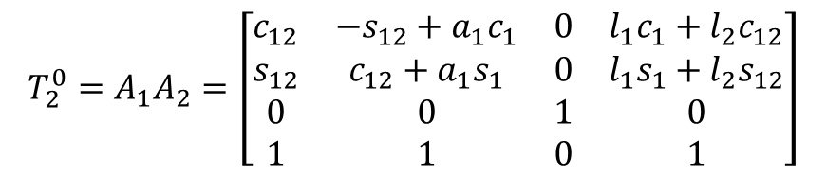
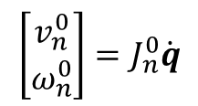
Jacobians
Definition: map differential changes from one space to another
$$T_{2}^{0}=A_{1}A_{2}=\left[\begin{aligned}\begin{matrix}c_{12} & −s_{12}+a_{1}c_{1} & 0 & l_{1}c_{1}+l_{2}c_{12} \\ s_{12} & c_{12}+a_{1}s_{1} & 0 & l_{1}s_{1}+l_{2}s_{12} \\ 0 & 0 & 1 & 0 \\ 1 & 1 & 0 & 1\end{matrix}\end{aligned}\right]$$
Recall for 2-link:
Consider general tool transformation matrix for an n-link manipulator with joint variables $q_{1}⋯q_{n}$
where
$q={\left(q_{1}, ⋯q_{n}\right)}^{T}$ : joint variable vector
$o_{n}^{0}$: end-effector position
$R_{n}^{0}$: end-effector orientation
$$T_{n}^{0}\left(q\right)=\left[\begin{matrix}R_{n}^{0}\left(q\right) & o_{n}^{0}\left(q\right) \\ 0 & 1\end{matrix}\right]$$
Objective: Relate linear and angular velocities of end-effector to vector of joint velocities
Define the following:
$$S\left(ω_{n}^{0}\right)=\dot{R_{n}^{0}}{\left(R_{n}^{0}\right)}^{T}$$
End-effector’s angular velocity vector $ω_{n}^{0}$
$$v_{n}^{0}=\dot{o_{n}^{0}}$$
End-effector’s linear velocity vector
Want:
$$\left[\begin{matrix}v_{n}^{0} \\ ω_{n}^{0}\end{matrix}\right]=J_{n}^{0}\dot{q}$$
$$J_{n}^{0}=\left[\begin{matrix}J_{v} \\ J_{ω}\end{matrix}\right]$$
where
is called the Manipulator Jacobian

Slide 8
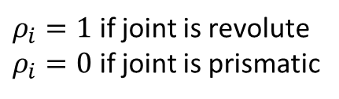


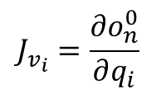

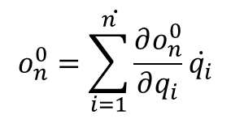
Angular Velocity: Can be shown that generally
$$J_{ω}=\left[\begin{matrix}ρ_{1}z_{0} & … & ρ_{n}z_{n−1}\end{matrix}\right]$$
$ρ_{i}=1$ if joint is revolute
$ρ_{i}=0$ if joint is prismatic
Where have
Linear Velocity: Just take derivatives
$$\dot{o_{n}^{0}=\sum_{i=1}^{n}{\frac{∂o_{n}^{0}}{∂q_{i}}\dot{q_{i}}}}$$
Column $i$ of $J_{v}$ would be given by
$$J_{v_{i}}=\frac{∂o_{n}^{0}}{∂q_{i}}$$
where
$$J_{v}=\left[\begin{matrix}J_{v_{1}} & … & J_{v_{n}}\end{matrix}\right]$$

Slide 9
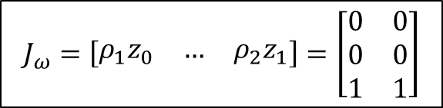
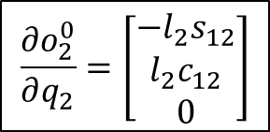


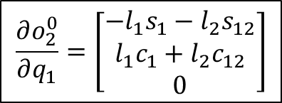
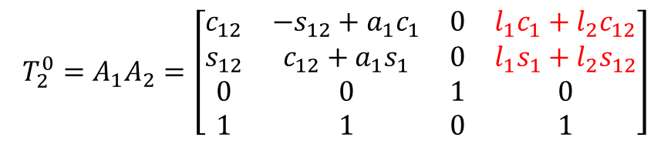
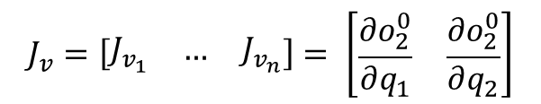
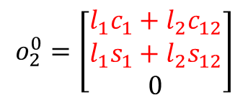
Sanity Check: Calculate Jacobian for 2-link planar manipulator
$$J_{2}^{0}=\left[\begin{matrix}J_{v} \\ J_{ω}\end{matrix}\right]$$
$$J_{ω}=\left[\begin{matrix}ρ_{1}z_{0} & … & ρ_{2}z_{1}\end{matrix}\right]=\left[\begin{matrix}0 & 0 \\ 0 & 0 \\ 1 & 1\end{matrix}\right]$$
Hence, we have
$$J_{v}=\left[\begin{matrix}J_{v_{1}} & … & J_{v_{n}}\end{matrix}\right]= \left[\begin{matrix}\frac{∂o_{2}^{0}}{∂q_{1}} & \frac{∂o_{2}^{0}}{∂q_{2}}\end{matrix}\right]$$
We also have
Recall our Tool Transformation Matrix:
$$l_{2}$$
$$\left(x_{p},y_{p}\right)$$
$$T_{2}^{0}=A_{1}A_{2}=\left[\begin{aligned}\begin{matrix}c_{12} & −s_{12}+a_{1}c_{1} & 0 & l_{1}c_{1}+l_{2}c_{12} \\ s_{12} & c_{12}+a_{1}s_{1} & 0 & l_{1}s_{1}+l_{2}s_{12} \\ 0 & 0 & 1 & 0 \\ 1 & 1 & 0 & 1\end{matrix}\end{aligned}\right]$$
$$l_{1}$$
$$o_{2}^{0}=\left[\begin{matrix}l_{1}c_{1}+l_{2}c_{12} \\ l_{1}s_{1}+l_{2}s_{12} \\ 0\end{matrix}\right]$$
Hence:
$$\frac{∂o_{2}^{0}}{∂q_{1}}=\left[\begin{matrix}{−l_{1}s}_{1}−l_{2}s_{12} \\ l_{1}c_{1}+l_{2}c_{12} \\ 0\end{matrix}\right]$$
$$\frac{∂o_{2}^{0}}{∂q_{2}}=\left[\begin{matrix}−l_{2}s_{12} \\ l_{2}c_{12} \\ 0\end{matrix}\right]$$
Thus
and

Slide 10
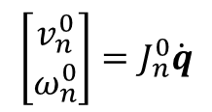
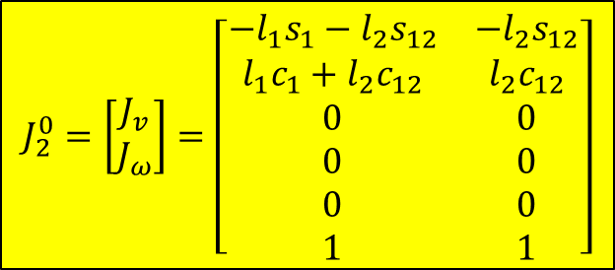

$$J_{2}^{0}=\left[\begin{matrix}J_{v} \\ J_{ω}\end{matrix}\right]=\left[\begin{matrix}{−l_{1}s}_{1}−l_{2}s_{12} & −l_{2}s_{12} \\ l_{1}c_{1}+l_{2}c_{12} & l_{2}c_{12} \\ 0 & 0 \\ 0 & 0 \\ 0 & 0 \\ 1 & 1\end{matrix}\right]$$
Since:
$$\left[\begin{matrix}v_{n}^{0} \\ ω_{n}^{0}\end{matrix}\right]=J_{n}^{0}\dot{q}$$
$$v_{2}^{0}=\left({−l_{1}s}_{1}−l_{2}s_{12}\right)\dot{θ_{1}}−l_{2}s_{12}\dot{θ_{2}}$$
then
$$ω_{2}^{0}=\left(l_{1}c_{1}+l_{2}c_{12}\right)\dot{θ_{1}}+l_{2}c_{12}\dot{θ_{2}}$$

