Slide 1
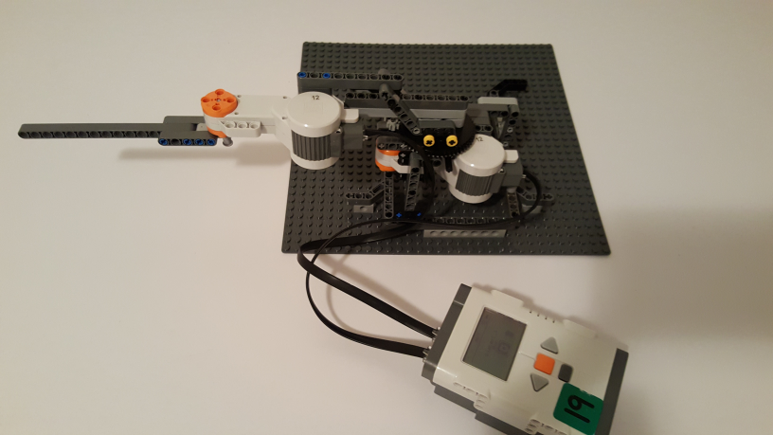
Build Plans: 2 DOF Planar Robot (from NXT 9797 Kit)
14 Steps
Copyright © Paul Oh: 2016

Slide 2
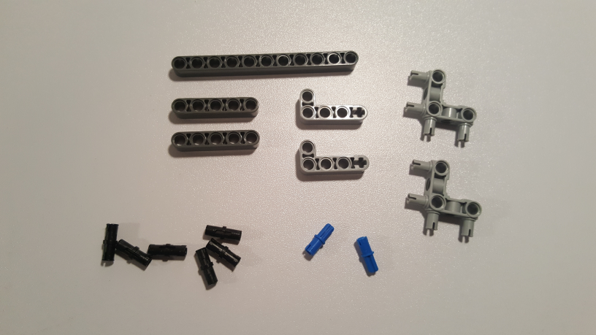
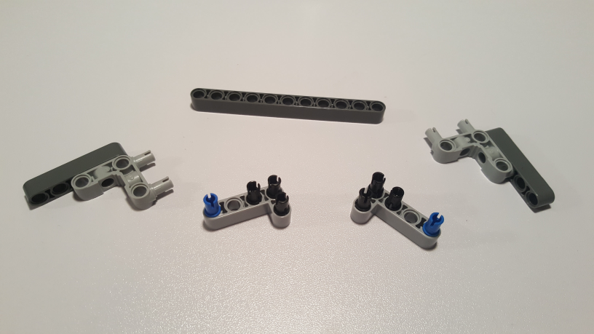
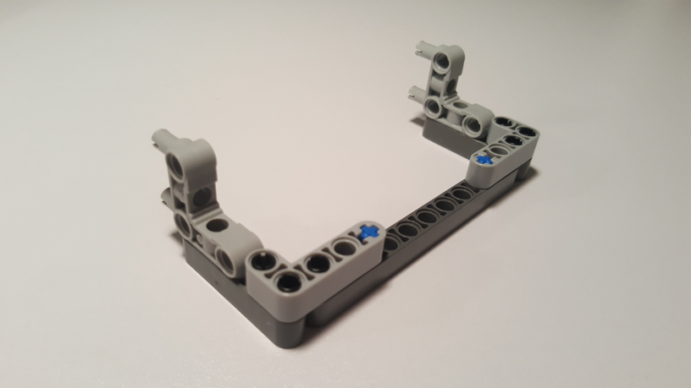
Step 1: Arm Overhang Brace
Beam 11 (64290)
2x Beam 5 (32316)
2x Angular Beam 90 deg (55615)
2x Angle Beam 4x2 (32140)
6x Friction Pin (2780)
2x Cross Axle Peg (43093)
Copyright © Paul Oh: 2016

Slide 3
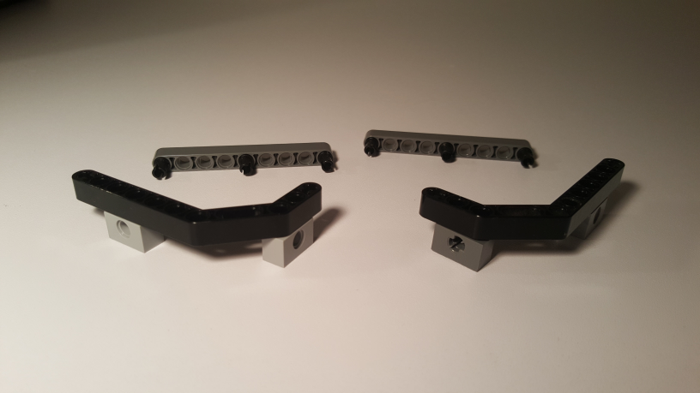
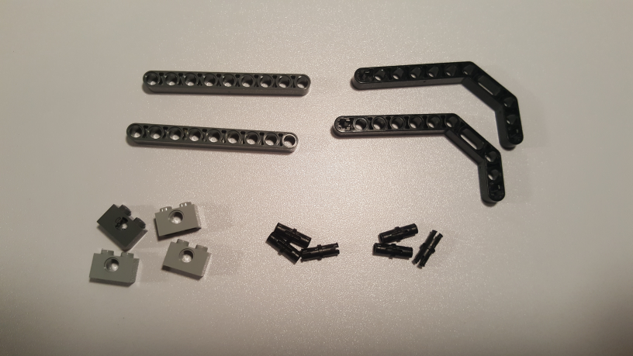
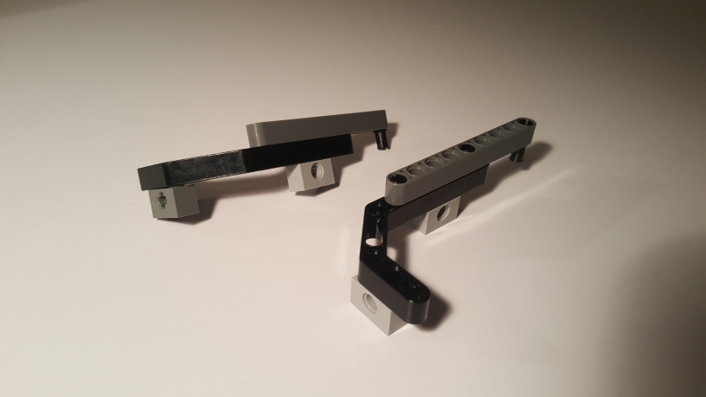
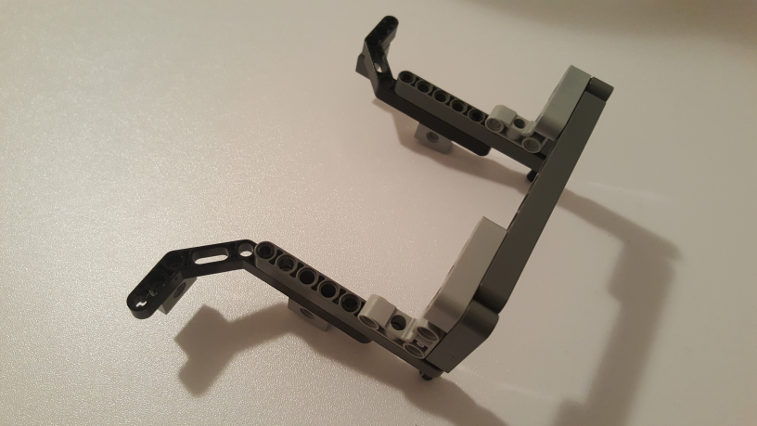
Step 2: Base Feet (Free-end Side)
2x Beam 3x7 45-deg (32009)
2x Beam 9 (64289)
6x Friction Pin (2780)
4x Brick 1x2 (3700)
Attach Overhang Brace (Step 1) to Base Feet (Step 2)
Copyright © Paul Oh: 2016

Slide 4
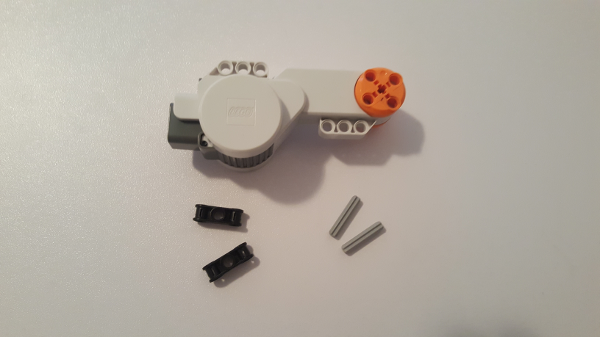
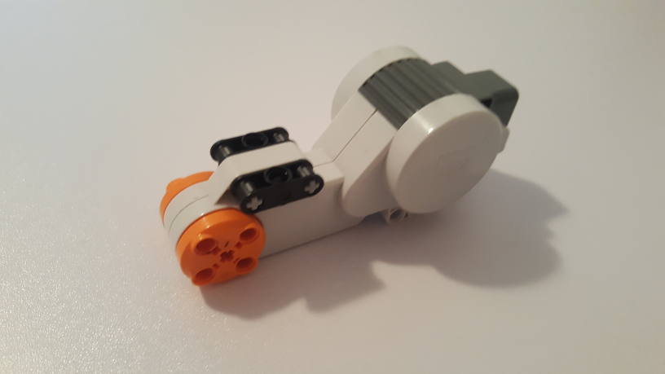
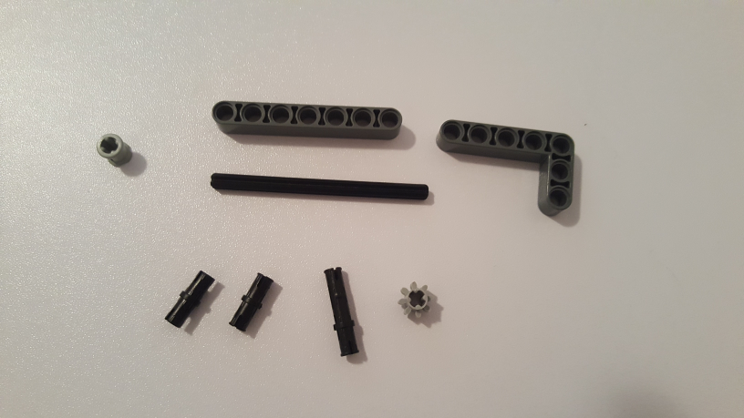
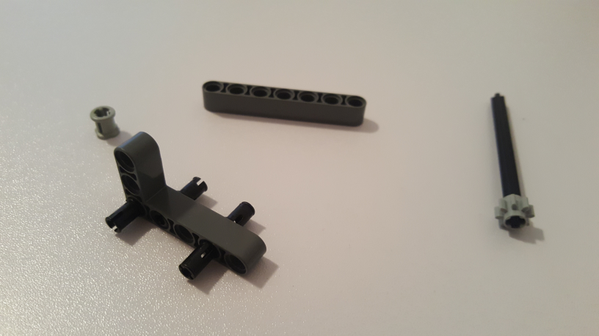
Step 3: First DOF (Motor Mount)
Tacho Motor (53787)
2x Double Cross Block (32184)
2x Cross Axle 3 (4519)
Cross Axle Bush (6590)
Beam 7 (32524)
Angle Beam 3x5 (32526)
Cross Axle 8M (3707)
Gear 8T (3647)
2x Friction Pin (2780)
3M Long Peg (6558)
Copyright © Paul Oh: 2016

Slide 5
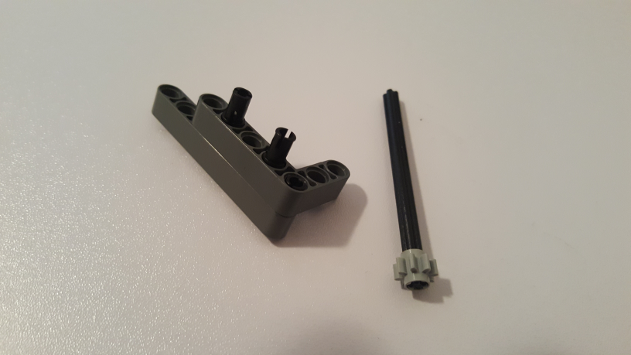
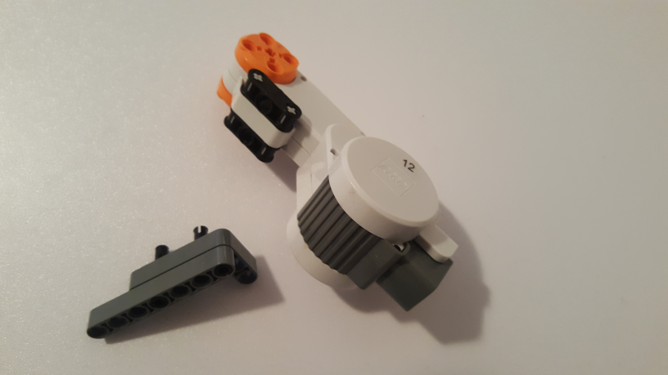
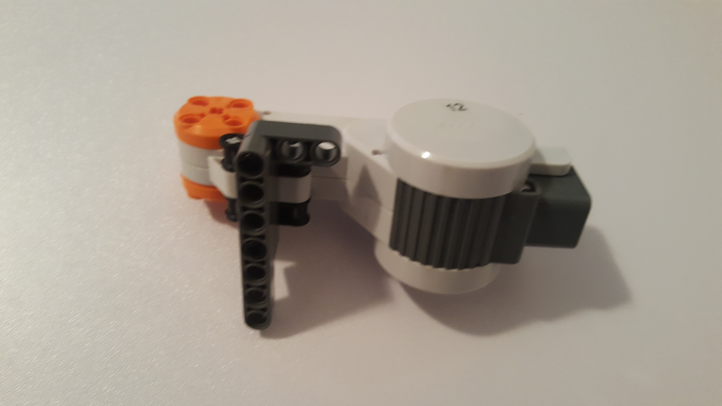
Step 3 cont’d: First DOF (Motor Mount)
Copyright © Paul Oh: 2016

Slide 6
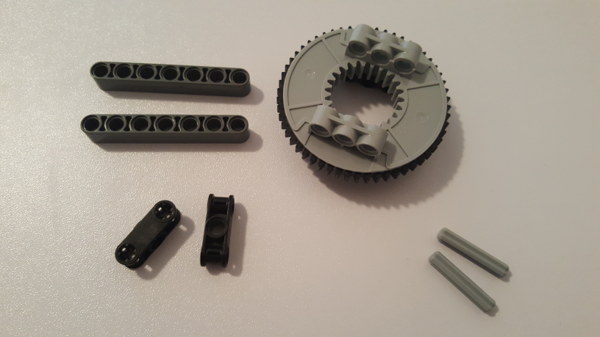
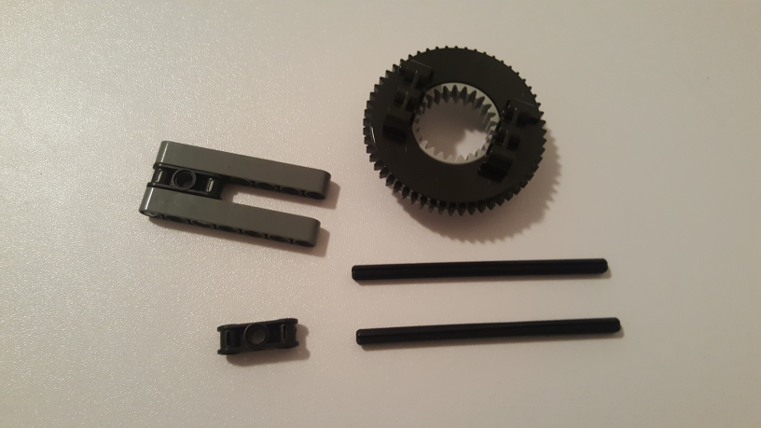
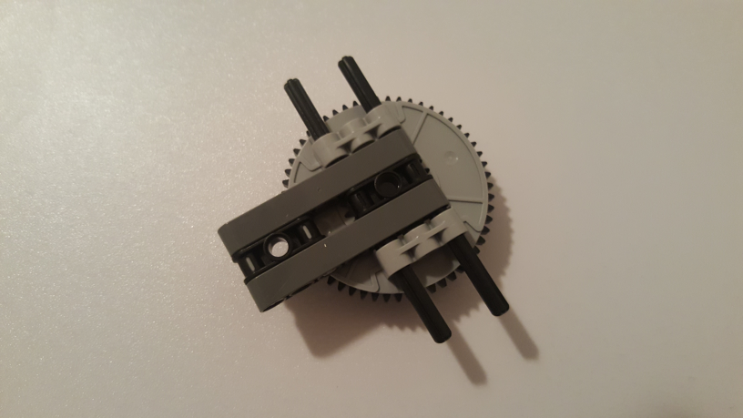
Step 4: First DOF (Turntable)
Beam 7 (32524)
Turntable 56T (50163)
2x Cross Axle 3 (4519)
2x Double Cross Block (32184)
2x Cross Axle 10 (3737b)
Copyright © Paul Oh: 2016

Slide 7
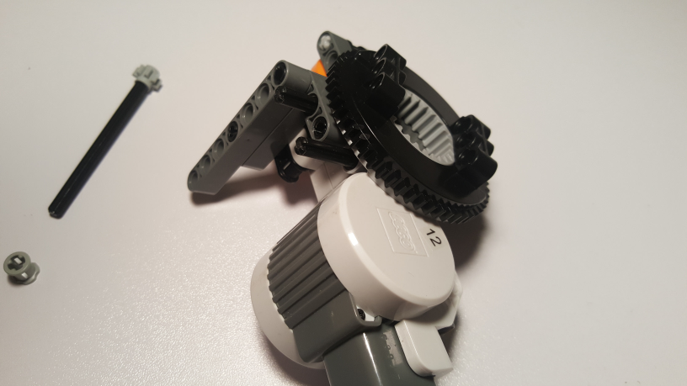
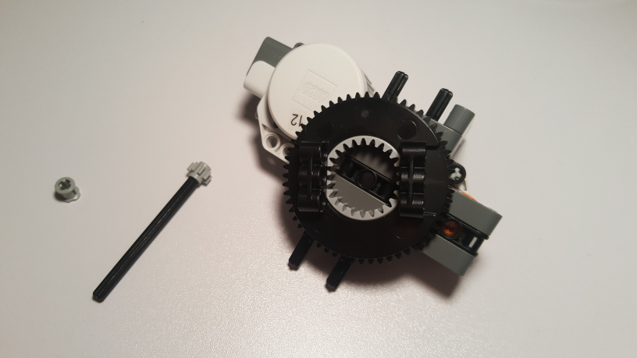
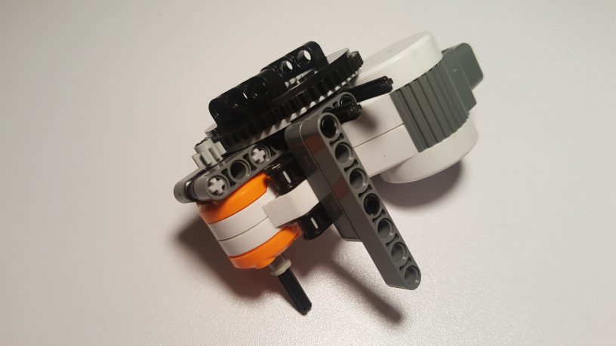
Step 5: First DOF (Motor Assembly = Motor Mount + Turntable)
Attach Turntable (Step 4) to Motor Mount (Step 3)
Top View
Thread Axle Thru Motor. Secure with Bush
Copyright © Paul Oh: 2016

Slide 8
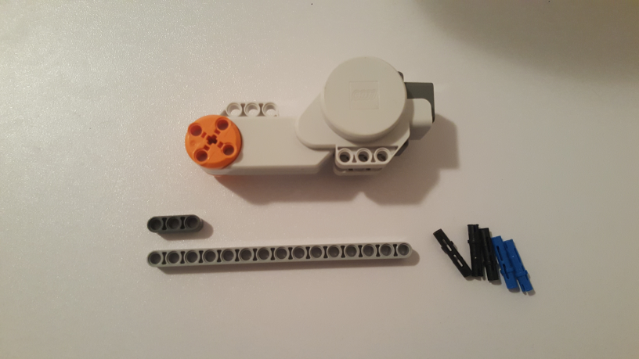
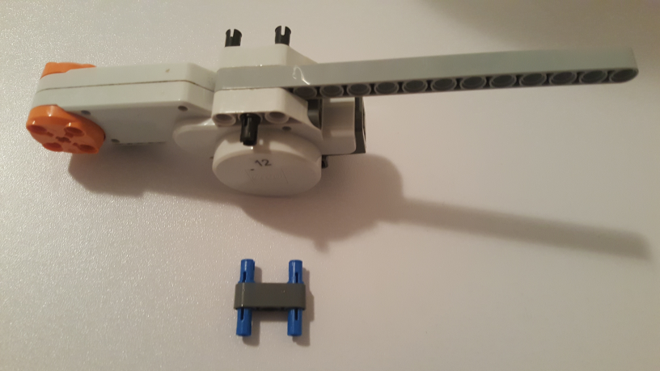
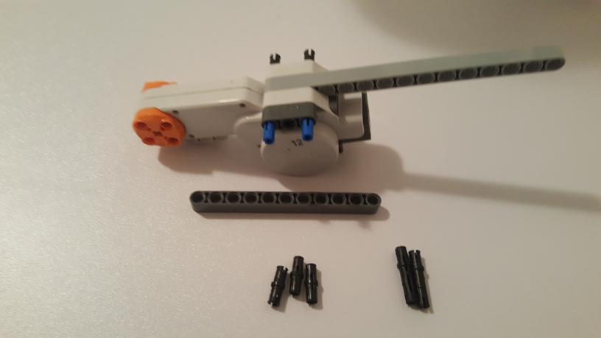
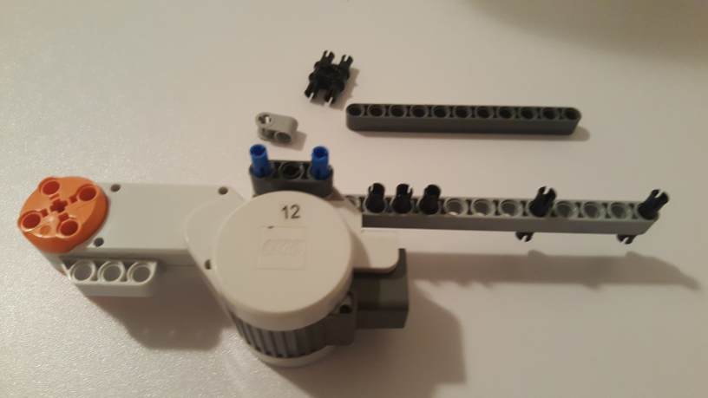
Step 6: Second DOF (Motor Mount)
Tacho Motor (53787)
Beam 3 (32523)
Beam 15 (64871)
5x 3M Long Peg (6558)
Module Bush (32138)
Cross Block 90-Deg (6536)
Beam 11(64290)
2x 3M Long Peg (6558)
3x Friction Pin (2780)
Copyright © Paul Oh: 2016

Slide 9
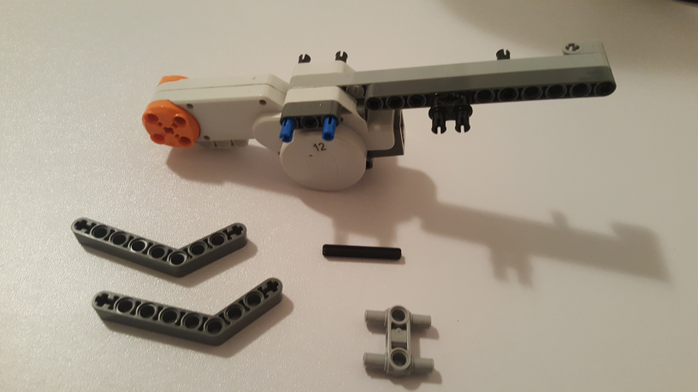
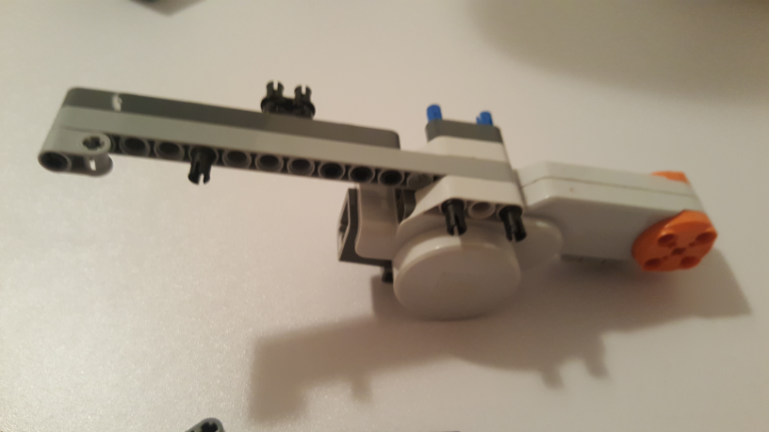
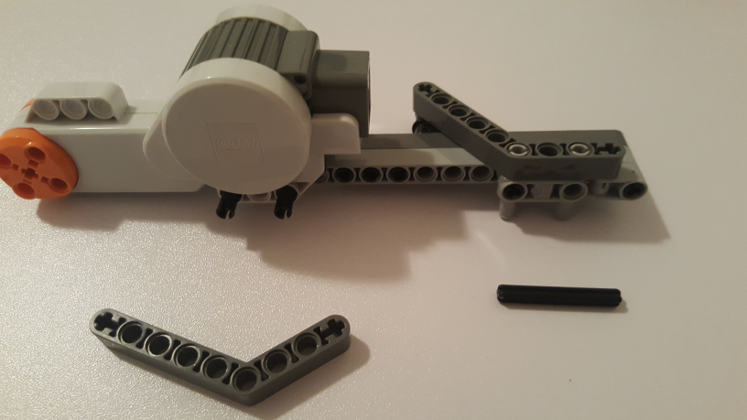
Step 7: Second DOF (Motor Truss)
2x Angular Beam 4x6 (6629)
Beam 4M (3705)
Beam 3M W/4 Snaps (48989)
Alternate View
Copyright © Paul Oh: 2016

Slide 10
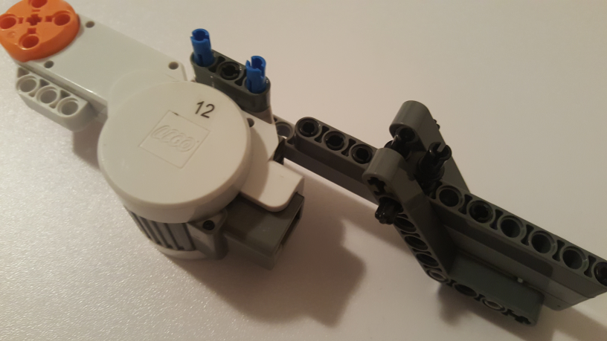
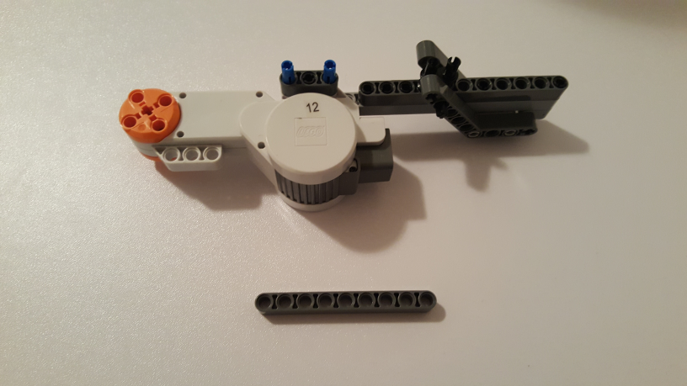
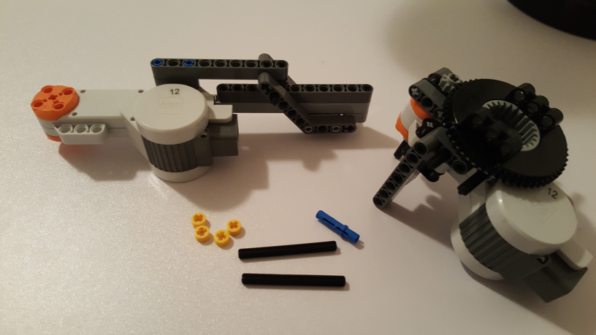
Step 7 Cont’d: Second DOF (Motor Truss)
Beam 4M
Beam 9M (64289)
Beam 4M thru Angle Beams and Module Bush
First DOF Motor Assembly (from Step 5)
4x 1/2 Bush (32123)
3M Long Peg (6558)
2x Beam 6M (3706)
Copyright © Paul Oh: 2016

Slide 11
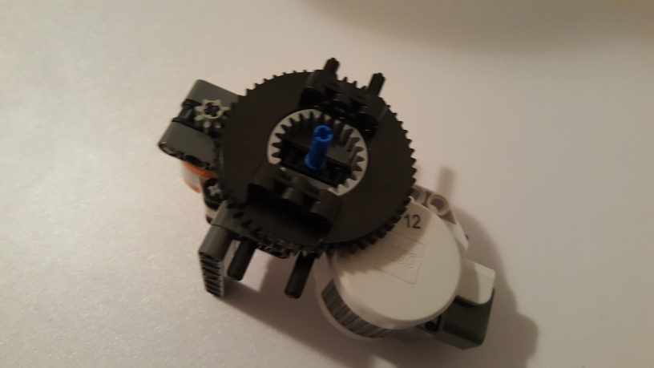
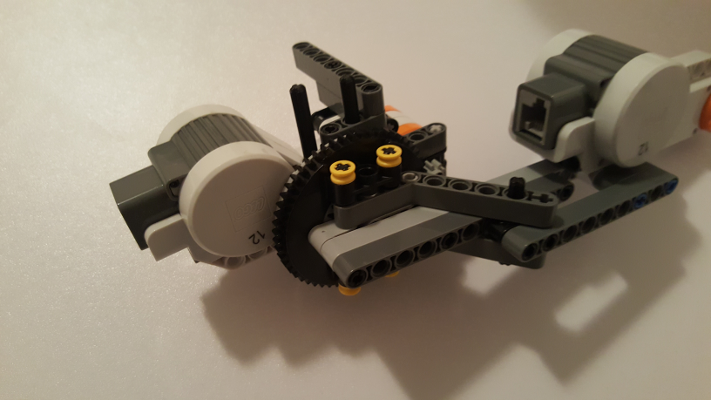
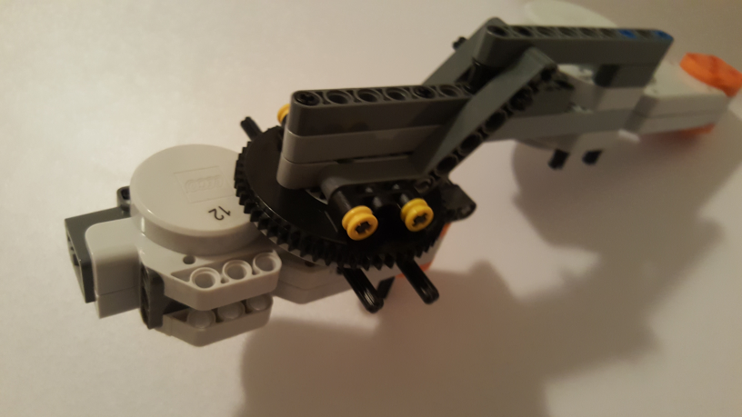
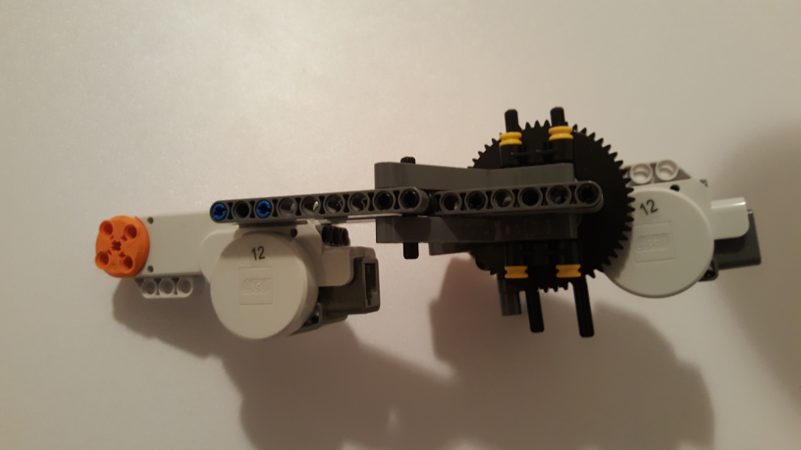
Step 8: Second DOF (Motor Assembly: Motor Mount + Truss)
Long Peg in First DOF Motor Assembly (from Step 5)
Second DOF Motor Assembly (from Step 7) into First DOF Motor Assembly: Secure with two Beam 6M
Alternative Views
Copyright © Paul Oh: 2016

Slide 12
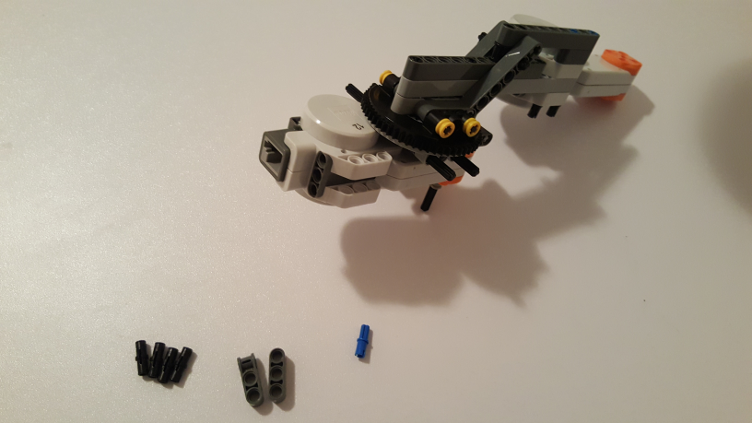
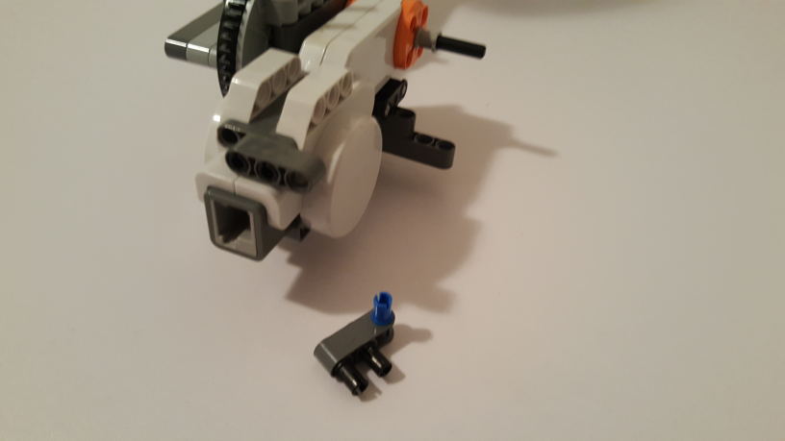
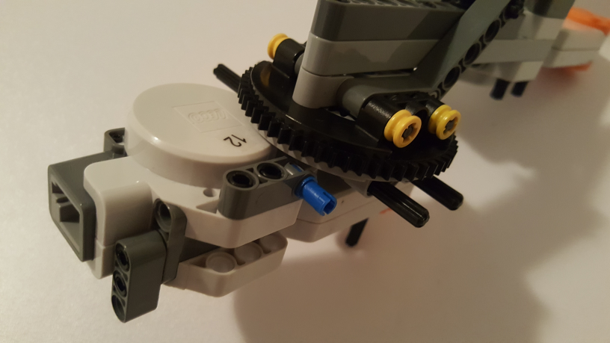
Step 8: Arm Rear Mount
4x Friction Pin (2780)
Cross Block 3m (42003)
Cross Axle Peg (43093)
Beam 3 (32523)
Copyright © Paul Oh: 2016

Slide 13
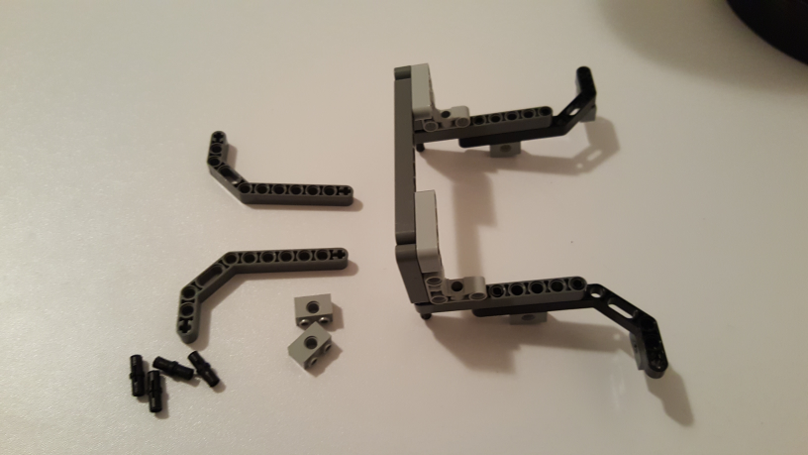
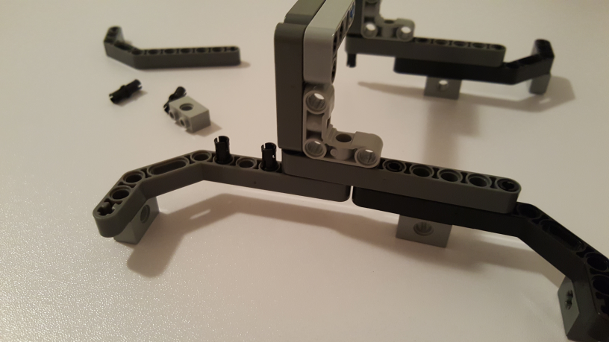
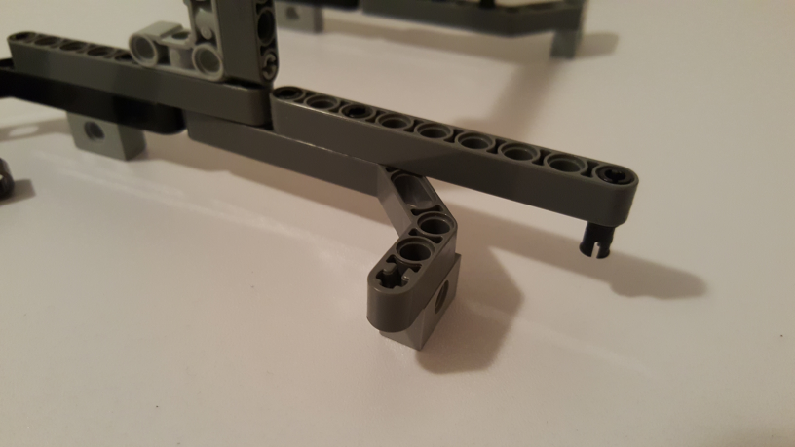
Step 9: Base Feet (Motor-End Side)
2x Beam 3x7 45-deg (32009)
Arm Overhang Brace from Step 1
4x Friction Pin (2780)
2x Brick 1x2 (3700)
Copyright © Paul Oh: 2016

Slide 14
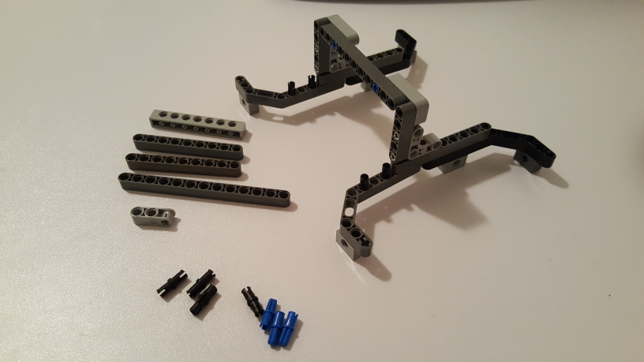
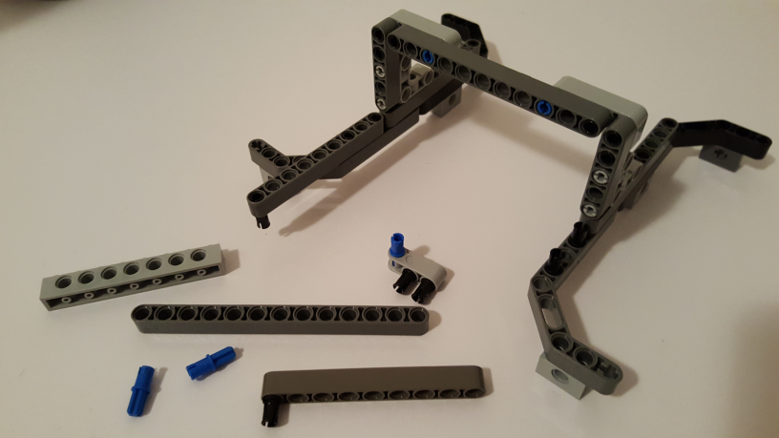
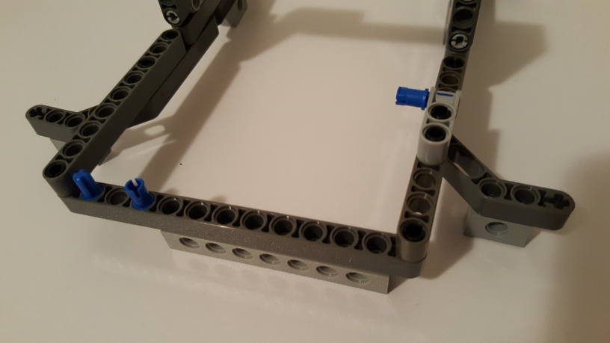
Step 9 Cont’d: Base Feet (Motor-End Side)
Brick 1x8 (3702)
2x Beam 9M (64289)
Beam 13M (41239)
Cross Block 3m (42003)
4x Friction Pin (2780)
3x Cross Axle Peg (43093)
Copyright © Paul Oh: 2016

Slide 15
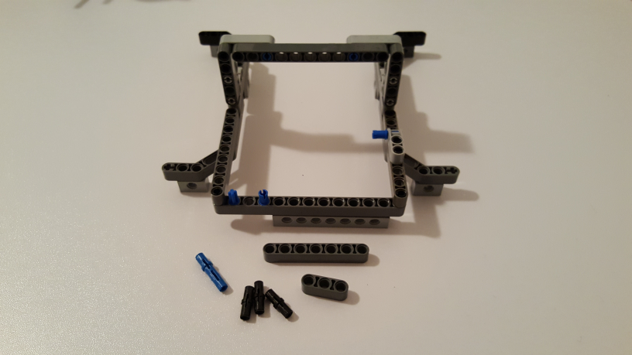
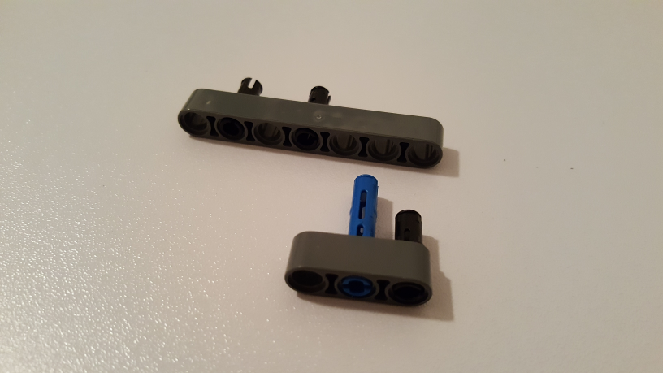
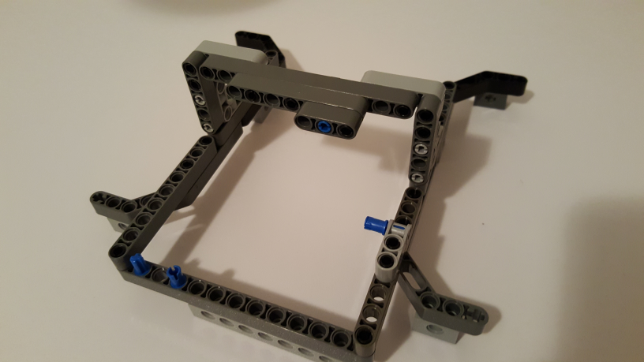
Step 10: Arm Top Mount
3M Long Peg (6558)
Beam 7 (32524)
3x Friction Pin (2780)
Beam 3 (32523)
Copyright © Paul Oh: 2016

Slide 16
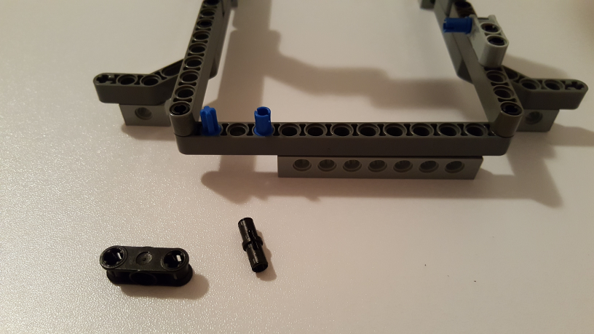
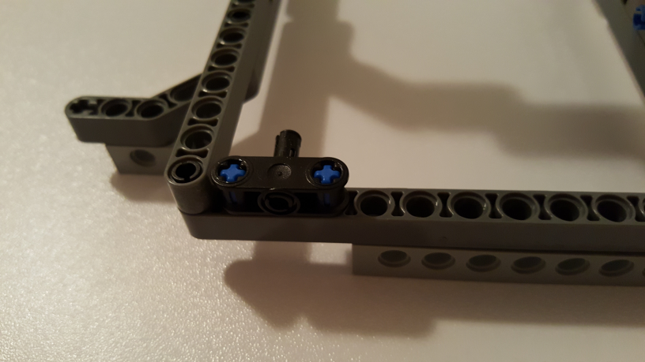
Step 11: Arm Bottom Mount
Double Cross Block (32184)
3x Friction Pin (2780)
Copyright © Paul Oh: 2016

Slide 17
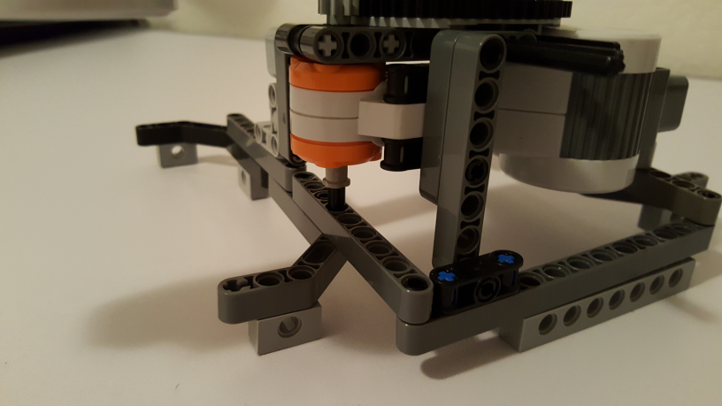



Step 12: Attach Arm to Base
Cross Axle Bush (6590)
First DOF Axle into Beam. Lock Arm into Base Feet (Motor-End Side)
Push Axles and lock with Bush
Lock Arm Rear Mount
Copyright © Paul Oh: 2016

Slide 18



Step 13: Attach Arm to Overhang
Cross Block 3m (42003)
4x 3M Long Peg (6558)
Cross Axle Bush (6590)
Cross Axle 5M (32073)
Beam 5M (32316)
Beam 15M (64871)
Step 14: End Effector
Copyright © Paul Oh: 2016

Slide 19




Step 14 Cont’d: End Effector
Attach End Effector to Second DOF Motor. Secure with Bush
Step 15 Final: Secure 2DOF Planar Robot to 10x10 Lego Base
First DOF Motor (Port A), Second DOF Motor (Port B)
Copyright © Paul Oh: 2016

