Slide 1
Robot Control – Part 1
© Copyright Paul Oh 2016

Slide 2

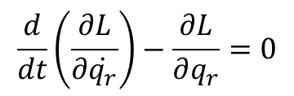

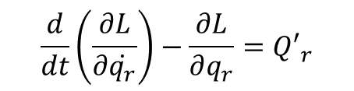
Lagrangian Method - Review
Lagrangian Method (Analytical Mechanics)
Are valid in any coordinates (inertial or a combination of inertial and non-inertial)
Forces of constraint, for smooth holonomic constraints are eliminated
Based on scalar quantities: kinetic and potential energy and virtual work
Eliminates recourse to formal vector methods
Conservative Systems:
$$\frac{d}{dt}\left(\frac{∂L}{∂\dot{q_{r}}}\right)−\frac{∂L}{∂q_{r}}=0$$
where
$$L=T−V$$
Non-Conservative Systems:
$$\frac{d}{dt}\left(\frac{∂L}{∂\dot{q_{r}}}\right)−\frac{∂L}{∂q_{r}}={Q′}_{r}^{}$$
where
$$L=T−V′$$
© Copyright Paul Oh 2016

Slide 3
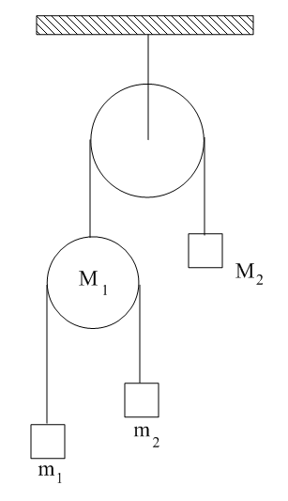
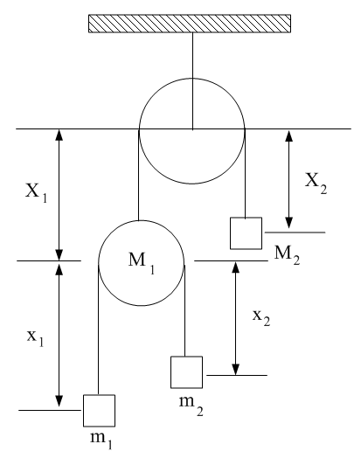
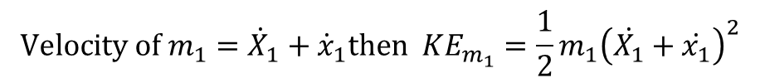

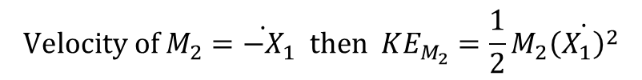
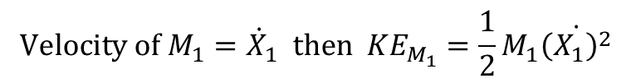
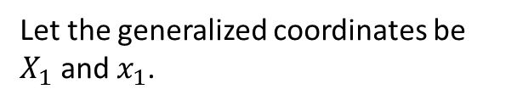


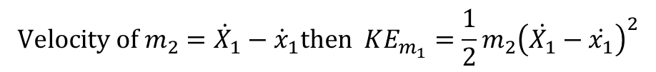
Problem: Derive the pulley system’s equations of motion (EOM)
Solution:
+
Step 1: Find the generalized coordinates
V=0 line
Let the generalized coordinates be $X_{1}$ and $x_{1}$.
Because if we know these two, then we can find the positions of the others from:
$$X_{1}+X_{2}=a$$
where
$$a,b:$$
constants
$$x_{1}+x_{2}=b$$
Step 2: Find the KE of the system.
First need to calculate the velocities
$$\text{Velocity} \text{of} M_{1}={\dot{X}}_{1} \text{then} {KE}_{M_{1}}=\frac{1}{2}M_{1}\dot{{\left(X_{1}\right)}^{2}}$$
$$\text{Velocity} \text{of} M_{2}={\dot{−X}}_{1} \text{then} {KE}_{M_{2}}=\frac{1}{2}M_{2}\dot{{\left(X_{1}\right)}^{2}}$$
$$\text{Velocity} \text{of} m_{1}={\dot{X}}_{1}+{\dot{x}}_{1}\text{then} {KE}_{m_{1}}=\frac{1}{2}m_{1}{\left(\dot{X_{1}}+\dot{x_{1}}\right)}^{2}$$
$$\text{Velocity} \text{of} m_{2}={\dot{X}}_{1}−{\dot{x}}_{1}\text{then} {KE}_{m_{1}}=\frac{1}{2}m_{2}{\left(\dot{X_{1}}−\dot{x_{1}}\right)}^{2}$$
© Copyright Paul Oh 2016

Slide 4

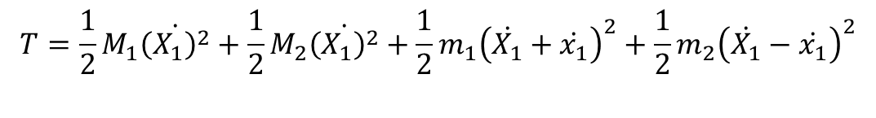





Thus, the total KE is given by
$$T=\frac{1}{2}M_{1}\dot{{\left(X_{1}\right)}^{2}}+\frac{1}{2}M_{2}\dot{{\left(X_{1}\right)}^{2}}+\frac{1}{2}m_{1}{\left(\dot{X_{1}}+\dot{x_{1}}\right)}^{2}+\frac{1}{2}m_{2}{\left(\dot{X_{1}}−\dot{x_{1}}\right)}^{2}$$
Step 3: Find the PE of the system.
$${PE}_{M_{1}}=M_{1}g\left(−X_{1}\right)$$
$${PE}_{m_{1}}=m_{1}g\left(−\left(X_{1}+x_{1}\right)\right)$$
$${PE}_{M_{2}}=M_{2}g\left(−X_{2}\right)$$
$${PE}_{m_{2}}=m_{2}g\left(−\left(X_{1}+x_{2}\right)\right)$$
Thus, the total PE is given by
$${V= −M}_{1}gX_{1}{−M}_{2}gX_{2}−m_{1}g\left(X_{1}+x_{1}\right)−m_{2}g\left(X_{1}+x_{2}\right)$$
However, we want $V$ expressed in generalized coordinates $X_{1}$ and $x_{1}$
$$X_{2}=a−X_{1}$$
$$x_{2}=b−x_{1}$$
Hence:
$${V= −M}_{1}gX_{1}{−M}_{2}g\left(a−X_{1}\right)−m_{1}g\left(X_{1}+x_{1}\right)−m_{2}g\left(X_{1}+b−x_{1}\right)$$
© Copyright Paul Oh 2016

Slide 5
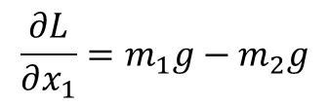
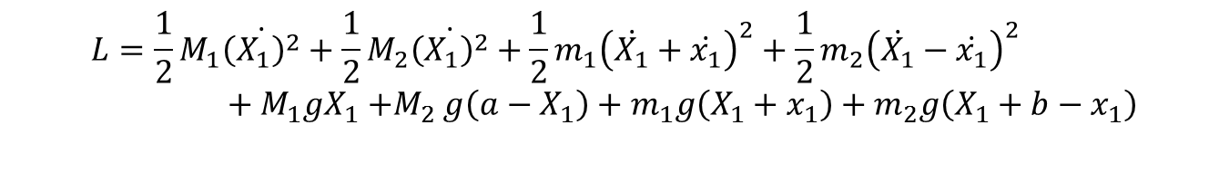
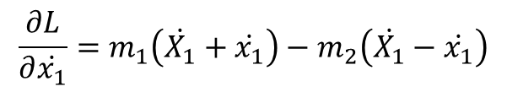

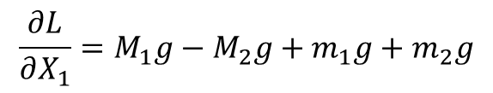
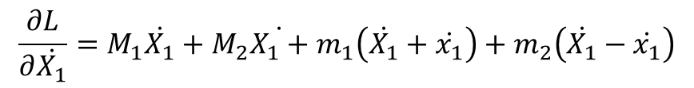
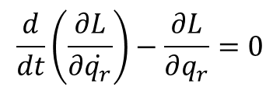
Step 4: Calculate the Lagrangian $L=T−V$
$$L=\frac{1}{2}M_{1}\dot{{\left(X_{1}\right)}^{2}}+\frac{1}{2}M_{2}\dot{{\left(X_{1}\right)}^{2}}+\frac{1}{2}m_{1}{\left(\dot{X_{1}}+\dot{x_{1}}\right)}^{2}+\frac{1}{2}m_{2}{\left(\dot{X_{1}}−\dot{x_{1}}\right)}^{2}+M_{1}gX_{1}{+M}_{2}g\left(a−X_{1}\right)+m_{1}g\left(X_{1}+x_{1}\right)+m_{2}g\left(X_{1}+b−x_{1}\right)$$
Step 5: Calculate Lagrange’s Equations (for conservative system)
$$\frac{d}{dt}\left(\frac{∂L}{∂\dot{q_{r}}}\right)−\frac{∂L}{∂q_{r}}=0$$
$$\frac{∂L}{∂\dot{X_{1}}}=M_{1}\dot{X_{1}}+M_{2}\dot{X_{1}+}m_{1}\left(\dot{X_{1}}+\dot{x_{1}}\right)+m_{2}\left(\dot{X_{1}}−\dot{x_{1}}\right)$$
$$\frac{∂L}{∂X_{1}}=M_{1}g−M_{2}g+m_{1}g+m_{2}g$$
$$\frac{∂L}{∂\dot{x_{1}}}=m_{1}\left(\dot{X_{1}}+\dot{x_{1}}\right)−m_{2}\left(\dot{X_{1}}−\dot{x_{1}}\right)$$
$$\frac{∂L}{∂x_{1}}=m_{1}g−m_{2}g$$
© Copyright Paul Oh 2016

Slide 6
Rewrite equations (do in homework derivation) to get:
$$\left(M_{1}+M_{2}+m_{1}+m_{2}\right)\ddot{X_{1}}+\left(m_{1}−m_{2}\right)\ddot{x_{1}}=\left(M_{1}+M_{2}+m_{1}+m_{2}\right)g$$
and
$$\left(m_{1}−m_{2}\right)\ddot{X_{1}}+\left(m_{1}+m_{2}\right)\ddot{x_{1}}=\left(m_{1}−m_{2}\right)g$$
© Copyright Paul Oh 2016

