Slide 1
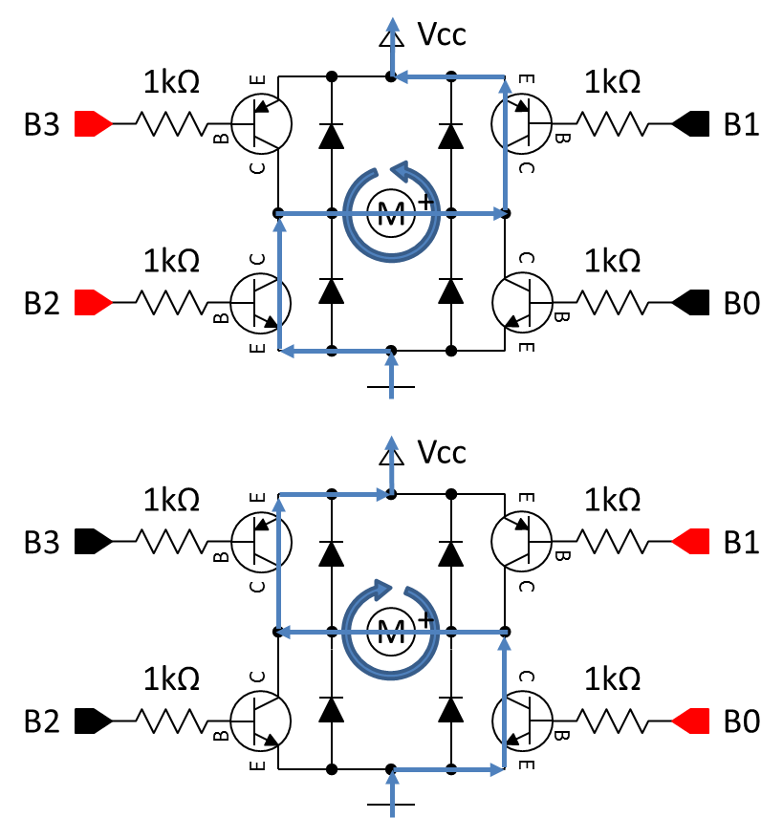
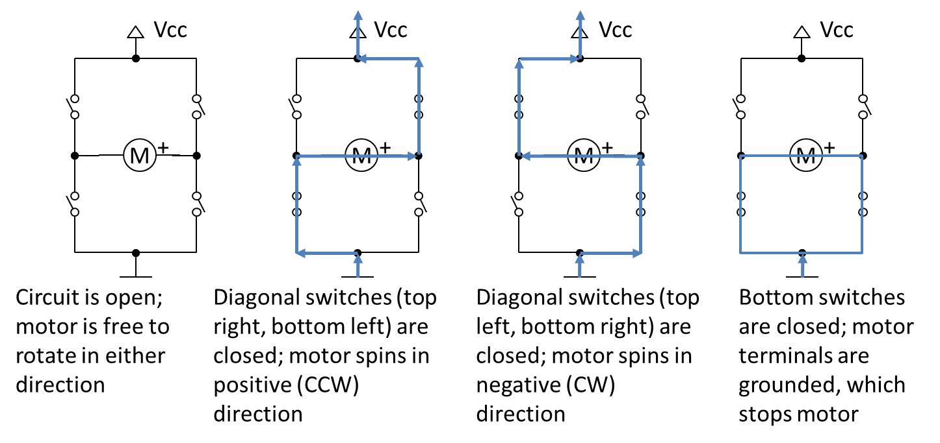
Action | B3 | B2 | B1 | B0
Free rotation | 1 | 0 | 1 | 0
Forward (CCW) | 1 | 1 | 0 | 0
Backward (CW) | 0 | 0 | 1 | 1
Brake | 1 | 1 | 1 | 1

Slide 2

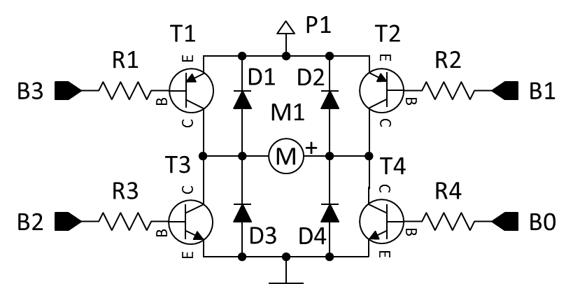
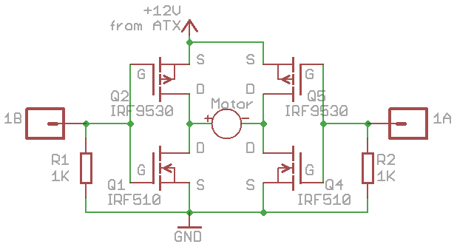
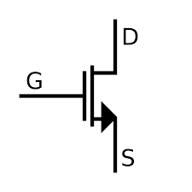
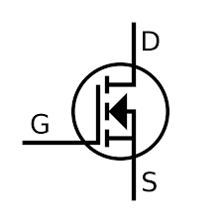
IRF
9530
TIP32
G D S
P-Channel
MOSFET
P-Channel
MOSFET
PNP
PNP
NPN
NPN
N-Channel
MOSFET
N-Channel
MOSFET
IRF510
http://rayshobby.blogspot.com/
G D S

Slide 3
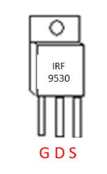
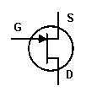
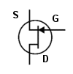
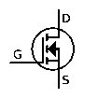
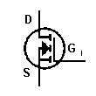
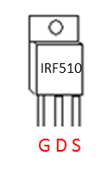
IRF
9530
D3
Motor Power Supply
D1
Q2
IRF9530
Q3
IRF9530
G D S
+
-
P-Channel
MOSFET
P-Channel
MOSFET
Q1
IRF510
Q4
IRF510
D2
D0
N-Channel
MOSFET
N-Channel
MOSFET
http://rayshobby.blogspot.com/
IRF510
G D S

