Slide 1
H-Bridges
© Copyright Paul Oh, 2007, Rich Vallett 2011; Updated 2016

Slide 2
H-Bridges
Circuits that uses switches to reverse the direction of the current
Vcc
Vcc
Vcc
Vcc
M
+
M
+
M
+
M
+
Circuit is open; motor is free to rotate in either direction
Diagonal switches (top right, bottom left) are closed; motor spins in positive (CCW) direction
Diagonal switches (top left, bottom right) are closed; motor spins in negative (CW) direction
Bottom switches are closed; motor terminals are grounded, which stops motor

Slide 3
Direction Control (Transistor H-Bridges)
Vcc
Action | B3 | B2 | B1 | B0
Free rotation | 1 | 0 | 1 | 0
Forward | 1 | 1 | 0 | 0
Backward | 0 | 0 | 1 | 1
Brake | 1 | 1 | 1 | 1
1kΩ
1kΩ
B3
B
B
B1
C
E
C
E
M
+
1kΩ
1kΩ
B2
B
B
B0
E
C
E
C
Vcc
Transistors act as electronic switches which can be controlled by the digital output of a microcontroller and can direct the flow of current in the circuit with little current applied to the base of each transistor
1kΩ
1kΩ
B3
B
B
B1
C
E
C
E
M
+
1kΩ
1kΩ
B2
B
B
B0
E
C
E
C
http://www.robotroom.com/BipolarHBridge.html

Slide 4
Lab
Brushed DC Motor Control
  Building and controlling a brushed DC motor using an H-bridge circuit and the NXT Sensor Expansion Kit

Slide 5
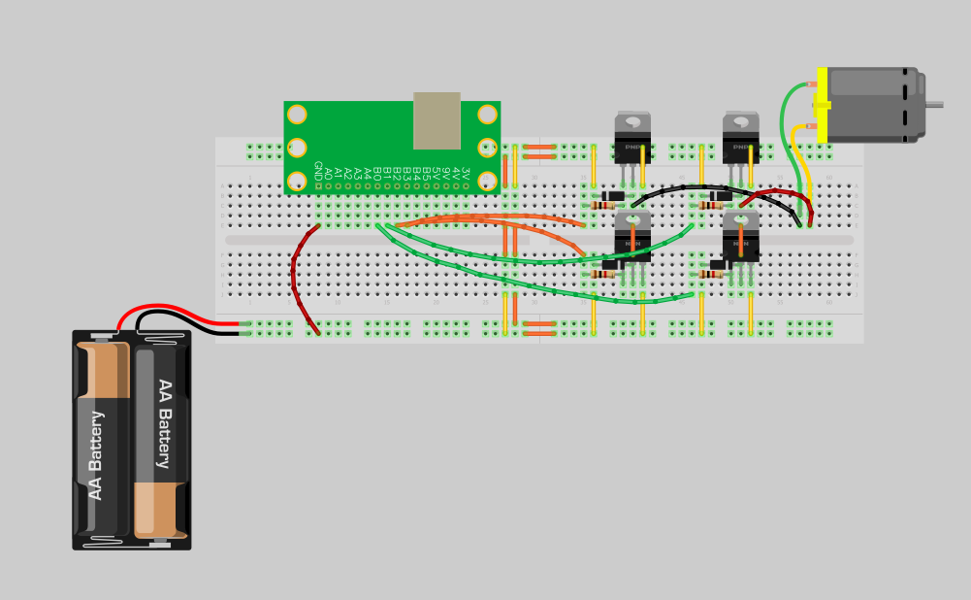
Transistor H-Bridge
Part | Name | Value
Resistor | R1 | 1kΩ
 | R2 | 1kΩ
 | R3 | 1kΩ
 | R4 | 1kΩ
Transistor | T1 | PNP
 | T2 | PNP
 | T3 | NPN
 | T4 | NPN
Diode | D1 | Power
 | D2 | Power
 | D3 | Power
 | D4 | Power
Motor | M1 | Brushed
Battery | P1 | 9V
T1
P1
T2
R1
R2
B3
B
D1
D2
B
B1
C
E
M1
C
E
M
+
T3
T4
R3
R4
B2
B
B
B0
E
C
D3
D4
E
C

Slide 6
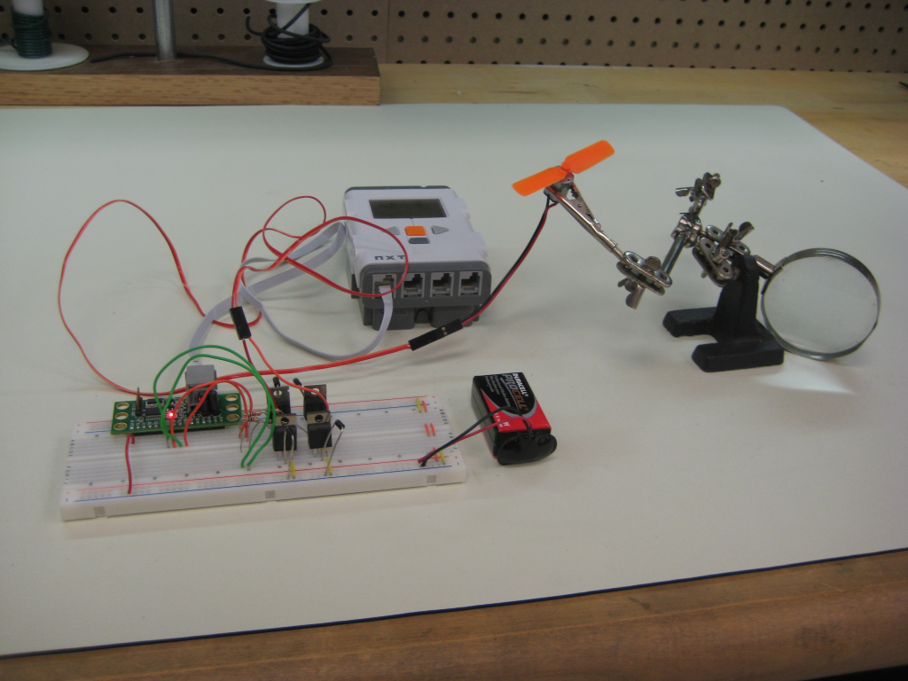
Lab Setup
Brushed DC motor
NXT
Wire holder
Proto-board
9V Battery and plug
H-Bridge

Slide 7
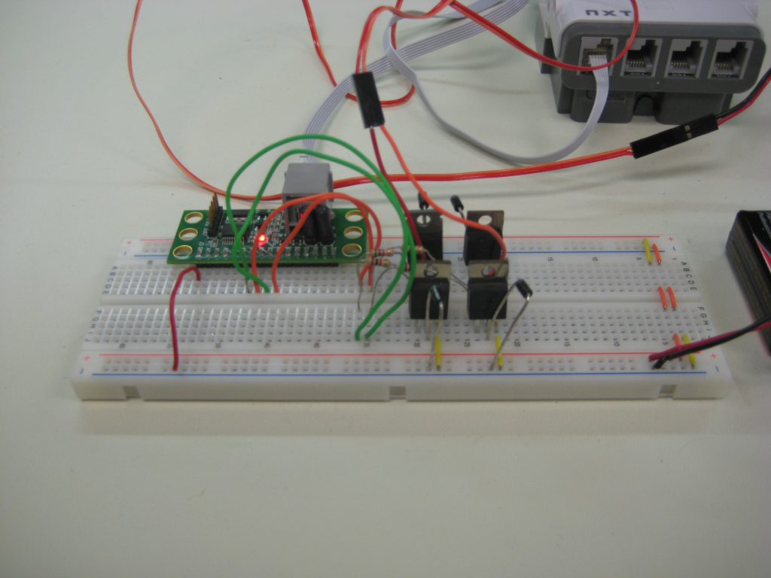
Circuit
PNP
Bridge both power and ground rails
Connect the proto-board GND pin to common ground
NPN
9V Battery and plug

Slide 8
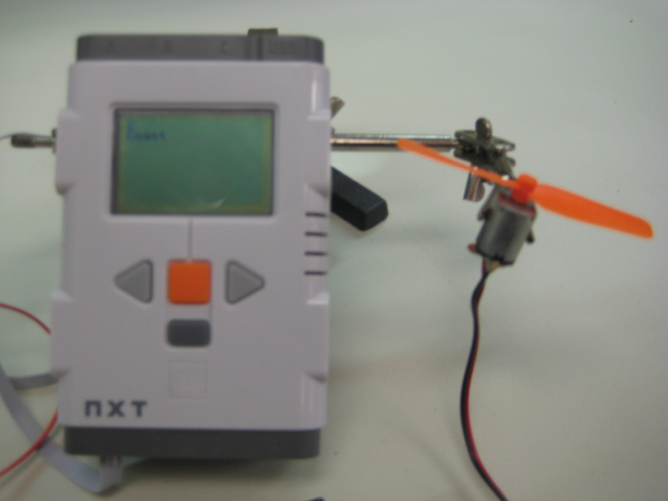
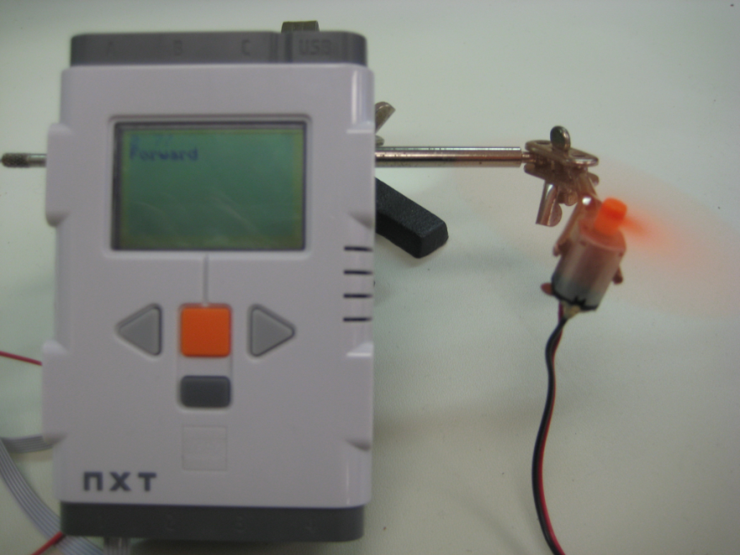
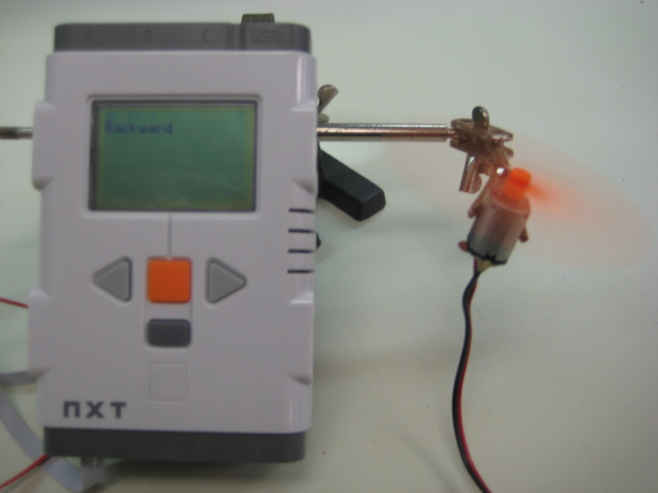
Output
Press the center button □ to let the motor spin freely
Press the left button < to drive the motor forward
Press the right button > to drive the motor backward

