Slide 1
V
NXT 4.3V (Pin 4)
V
V
V
M
PCF8574 (D0)
V
D0 = HI then Switch OPEN; Motor OFF
D0 = LO then Switch CLOSED; Motor ON
NXT 4.3V (Pin 4)
External Voltage Source
M
PCF8574 (D0)
D0 = HI then Switch OPEN; Motor OFF
D0 = LO then Switch CLOSED; Motor ON

Slide 2
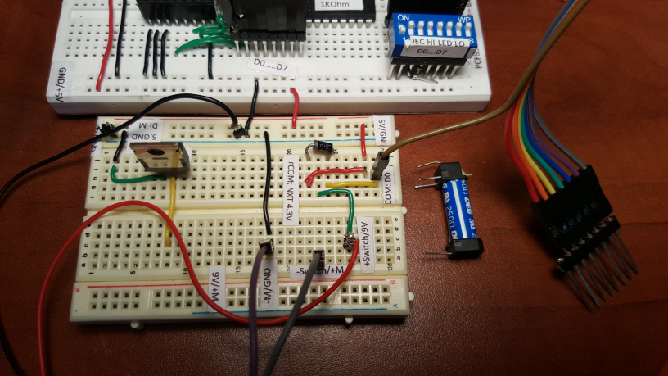
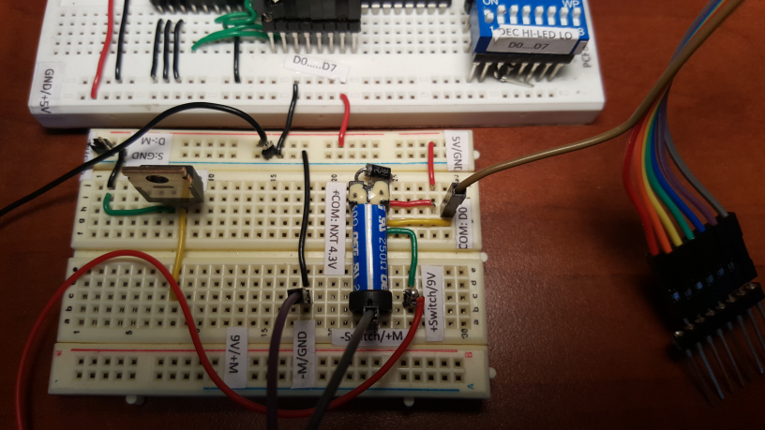
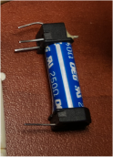
Switch
Coil

Slide 3
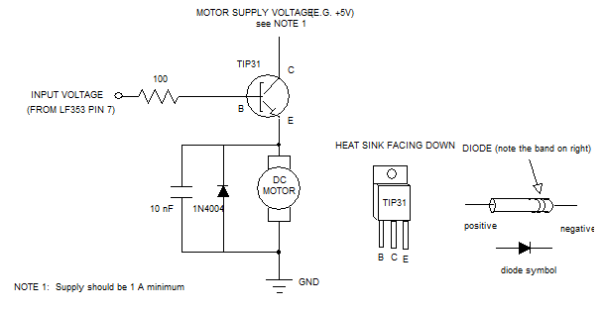

Motor Power Supply
Motor Power Supply
IRF510
G D S
B
C
G
D
PCF8574 (D0)
PCF8574 (D0)
E
S
D0 = HI then Switch OPEN; Motor OFF
D0 = LO then Switch CLOSED; Motor ON
D0 = HI then Switch OPEN; Motor OFF
D0 = LO then Switch CLOSED; Motor ON

Slide 5
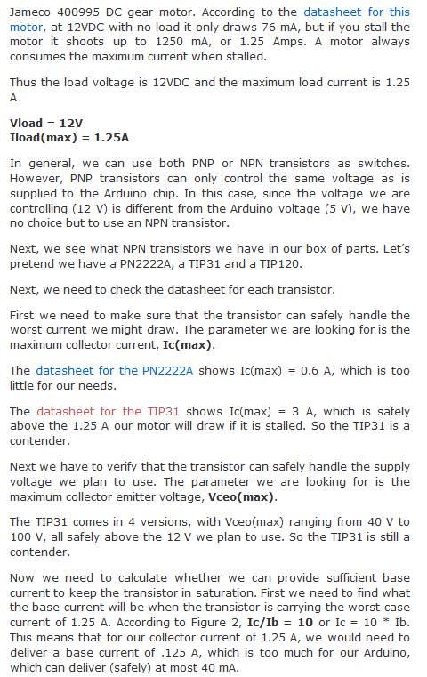
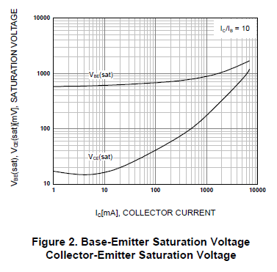
https://teachmetomake.wordpress.com/how-to-use-a-transistor-as-a-switch/

