Slide 1
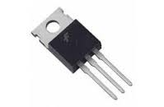
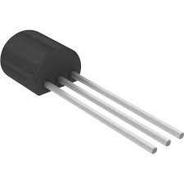
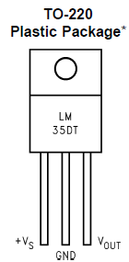
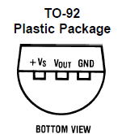
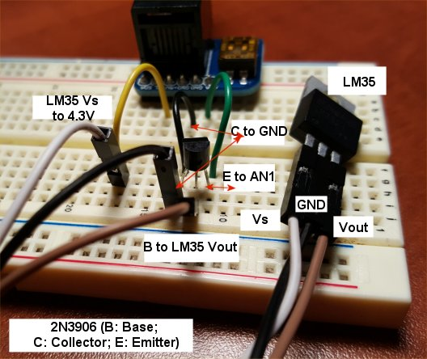
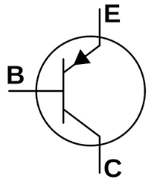
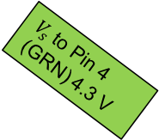
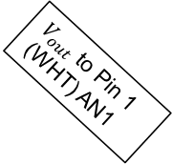

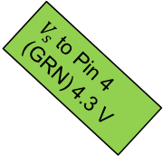

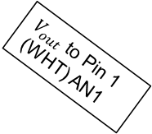
$V_{s}$ to Pin 4 (GRN) 4.3 V
$V_{out}$ to Pin 1 (WHT) AN1
$V_{out}$ to Pin 1 (WHT) AN1
GND to Pin 2 (BLK) GND
GND to Pin 2 (BLK) GND
$V_{s}$ to Pin 4 (GRN) 4.3 V
To NXT Port 1
To NXT Port 1
NXT PIN 1 (AN1)
LM35’s $V_{out}$
E
NXT PIN 2 (GND)
C
B
2N3906 PNP
2N3906 PNP

