Slide 1
Electronic Components, Basic Circuits
© Copyright Paul Oh, 2016

Slide 2
An Introduction to Circuits
Basic Electronic Components
  Capacitors
  Resistors
  Diodes
  Switches
  Power supplies
© Copyright Paul Oh, 2016

Slide 3
Capacitors
What are They?
  Parallel conductive plates separated by an insulator
Uses in Circuits
  Store and disperse charge (denouncing circuits)
Types of Capacitors
  Fixed-capacitance
  Variable capacitance
Connections
  Dedicated + and – terminals (2 leads)
© Copyright Paul Oh, 2016

Slide 4
Resistors
What are They?
  High-resistive metal alloy surrounded by a carbon casing
Uses in Circuits
  Limit voltage and current
Types of Resistors
  Fixed-resistance
  Rheostat
  Potentiometer
Connections
  2 terminals (voltage independent), 3 terminals (+, –, and signal)
© Copyright Paul Oh, 2016

Slide 5
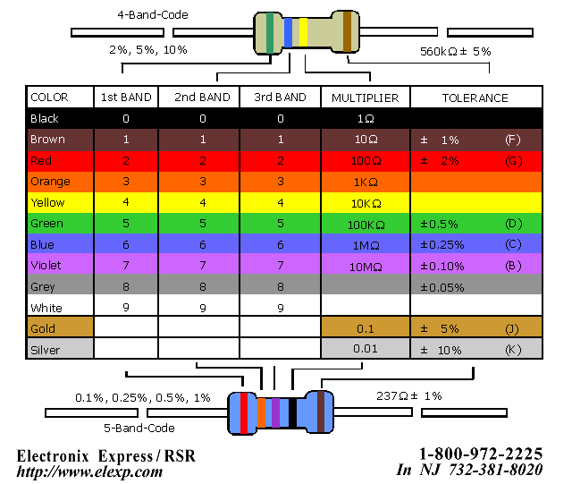
Resistors (cont.)
Reading Resistor Color Codes
  4 and 5 color band resistors
  Resistance measured in ohms (Ω)
  Last band measures tolerance (%)
© Copyright Paul Oh, 2016

Slide 6
Diodes
What are They?
  Insulated p-type and n-type silicon plates
Uses in Circuits
  Allow the flow of current only in one direction
Types of Diodes
  LEDs (Light Emitting Diodes)
  Zener/Schottky diodes (voltage regulation)
Connections
  Dedicated + and – terminals (2 or 3 leads)
© Copyright Paul Oh, 2016

Slide 7
Switches
What are They?
  Breakable connections within a circuit
Uses in Circuits
  Opens or closes a circuit, switches connections
Types of Switches
  ON/OFF
  ON/OFF/ON
Connections
  Varies (usually 2 or 3 terminals, no dedicated leads)
© Copyright Paul Oh, 2016

Slide 8
Transistors
What are They?
  Solid-state silicon switch
Uses in Circuits
  Switches or amplifies electronic signals
Types of Transistors
  PNP
  NPN
Connections
  Dedicated terminals for base, collector, and emitter pins (BCE)
© Copyright Paul Oh, 2016

Slide 9
Power Supplies
What are They?
  Power cells or batteries
Uses in Circuits
  Create voltage to drive circuits
Types of Power Supplies
  Single power cell
  Battery
Connections
  Dedicated terminals for + and – leads
© Copyright Paul Oh, 2016

Slide 10
An Introduction to Circuits
Network Capacitors and Resistors
  Capacitors in series and parallel configuration
  Resistors in series and parallel configuration
© Copyright Paul Oh, 2016

Slide 11
Capacitors in Series and Parallel
Series Configuration
  Current remains constant; voltage does not
  Net capacitance: 1/C₁ + 1/C₂ + … + 1/C_{n} = 1/C_{c}
Parallel Configuration
  Voltage remains constant; current does not
  Net capacitance: C₁ + C₂ + … + C_{n} = C_{c}
C₁
C₂
C_{n}
C₁
C₂
C_{n}
Series configuration
Parallel configuration
© Copyright Paul Oh, 2016

Slide 12
Resistors in Series and Parallel
Series Configuration
  Current remains constant; voltage does not
  Net resistance: R₁ + R₂ + … + R_{n} = R_{r}
Parallel Configuration
  Voltage remains constant; current does not
  Net resistance: 1/R₁ + 1/R₂ + … + 1/R_{n} = 1/R_{r}
R₁
R₂
R_{n}
R₁
R₂
R_{n}
Series configuration
Parallel configuration
© Copyright Paul Oh, 2016

Slide 13
An Introduction to Circuits
Laws of Circuits
  Ohm’s Law
  Watt’s Law
  Kirchhoff’s Law
© Copyright Paul Oh, 2016

Slide 14
Ohm’s Law
Description
  Relates the difference in potential (voltage) of a circuit as a function of the current and the resistance of the circuit
Formula
  V = I·R
Example
  (V₁ – V₂) = I·R
  (5V – 3V) = I·(1000Ω)
  I = 2V/1000Ω = 0.002A
R = 1kΩ
V1 = 5V
V2 = 3V
I = ?
© Copyright Paul Oh, 2016

Slide 15
Watt’s Law
Description
  Relates the power of a circuit as a function of the voltage and current of the circuit
Formula
  P = V·I = I²R
Example
  P = (V₁ – V₂)·I
  P = (5V – 3V)·(0.010A)
  P = 0.02W
V1 = 5V
V2 = 3V
I = 0.010A
P = ?
© Copyright Paul Oh, 2016

Slide 16
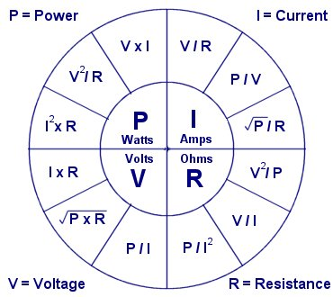
Watt’s Law (cont.)
Relationship of Voltage, Current, and Resistance
© Copyright Paul Oh, 2016

Slide 17
Kirchhoff’s Law
Descriptions
  Indicates that the sum of the potential differences through the circuit must be zero (Voltage Law)
  Indicates that the sum of the currents from a wire branch must be equal to the input current (Current Law)
Formulas
  ΣV = 0
  I_{s} = I₁ + I₂ + … + I_{n}
© Copyright Paul Oh, 2016

Slide 18
Kirchhoff’s Law (cont.)
Examples
  I = V/R
  R_{r} = R₁ + R₂
  R_{r} = 12kΩ
  I = (5V – 0V)/12kΩ = 4.167·10⁻⁴A
  V_{a} = 5V – I· R₁
  V_{a} = 5V – (4.167·10⁻⁴A) · 2kΩ = 4.167V
2kΩ
10kΩ
a
V_{a}, I = ?
0V
5V
© Copyright Paul Oh, 2016

Slide 19
Kirchhoff’s Law (cont.)
1kΩ
5kΩ
I₂ = ?
Examples
  ΣV = 0
  5V – I₁·1kΩ – I₂·5kΩ = 0V
  5V – I₁·1kΩ – I₃·15kΩ = 0V
  I₁ = I₂ + I₃, I₂ = I₁ - I₃
  3 linear equations, 3 variables
  I₁ = 1.053 mA
  I₂ = 0.789 mA
  I₃ = 0.264 mA
I₁ = ?
0V
5V
15kΩ
I₃ = ?
0V
© Copyright Paul Oh, 2016

Slide 20
Additional Resources
Wikipedia
  http://www.wikipedia.org/
Circuit Info
  http://www.kpsec.freeuk.com/index.htm
© Copyright Paul Oh, 2016

