Slide 1
UNLV ME729 – Advanced Robotics
Introduction and Course Philosophy
© Paul Oh, 2016

Slide 2

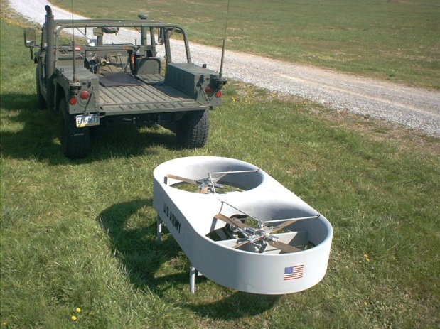
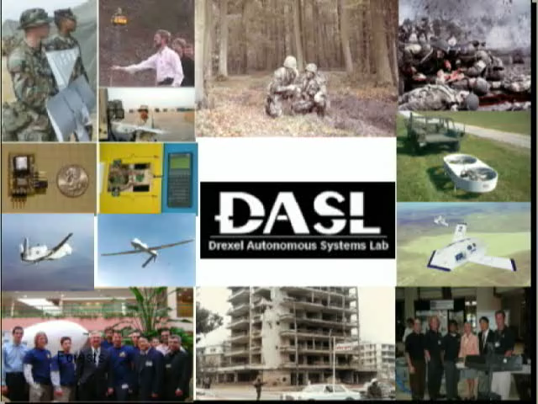
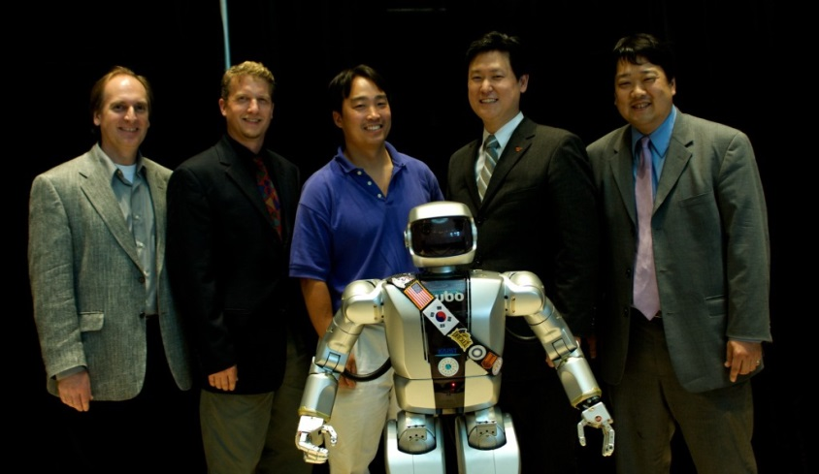
Paul Oh: Background
5+ years industry before Drexel
ME Professor since 2000
Advisor: ASME 10-years
Advisor: 8+ SD teams
3 SD awards (COE, ASME, Baiada)
$14M+ in research/design funds
100+ Journals, Books, Proceedings
Drexel Autonomous Systems Lab
NASA, ONR, Boeing Fellow
NSF Robotics Program Director (2008-2010)
Enjoy creating courses where labs reinforce theory
© Paul Oh, 2016

Slide 3
Motivation for UNLV Advanced Robotics Course
More Background:
Need 1: Robotics, especially unmanned systems, identified as economic engine in NV
Evidence: FAA Test Site designation; Governor Sandoval CES 2016 announcement
Relevance: Demands appropriate engineering workforce; not just “testing”
Need 2: Lack of Advanced Robotics courses at UNLV
Evidence: ME729 is the only course listed in catalog; no robotics “program” at UNLV;
ME729 has not been offered in past 5+ years
Relevance: Need to revamp and retool our courses and graduates
Gap 1: Advanced Robotics – taught from kinematics perspective
ME: heavy focus on Denavit-Hartenberg reference frames; Euler/Lagrange equations
EE: Existing courses in computer vision and embedded hardware don’t tie to robotics
Gap-Fill: Broaden ME729 with a “systems” approach and train ME/EE/CS skillsets
Gap 2: State-of-the-Art has rapidly advanced since last offering of ME729 (circa 2010)
Hardware: off-the-shelf, quick interfacing, communications
Software: open-source community resources
Gap-Fill: Balance efficiency and effectiveness goals; proven tools reduce time-wasters
Resources: Mathematical theory versus Experiential discovery
Advanced Robotics demands appreciation and application of community resources
and “accepted” hardware/standards – which are best learned through experience
(Bicycle-riding analogy).
© Paul Oh, 2016

Slide 4
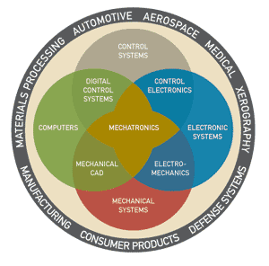
My “Issues” with ME729
Issue 1: UNLV does not have a Robotics “program”
2 courses in catalog? (ME 425/625 and 729)
1 professor? Roboticist or “does” robotics?
Issue 2: Foundation lacking – Advanced Robotics demands:
Advanced math (statistics), control (stochastic)
Advanced programming (computer vision)
Hardware experience (interfaces, networks)
Issue 3: Partnerships and Role Models lacking
“Made in Nevada”? Consumer rather than Provider
“Competitions” rather than research
Robotics is applied engineering – not hacking
Issue 4: Books and courses lack
All very similar: focus on basic equations, kinematics, dynamics
Balance needed between basic and advanced concepts
© Paul Oh, 2016

Slide 5
Paradigm Shifts in Teaching, Learning and Design
Old: Just-in-Case Teaching
Paradigm Shift
New: Just-in-Time Learning
Old: 3 R’s (Reading, Writing and Arithmetic)
Paradigm Shift in
Skill Development
New: 3 S’s (Search, Share and Simulate)
Yesterday
Tomorrow
Rules of Thumb
Build Prototypes
Expensive Testing
Demonstration
Prototyping
Prototyping Systems
Feasibility
Analytical Synthesis Methods
Building Models
Simulation
Visualization
Rapid Prototyping
Virtual Reality
Optimal Solutions
Paradigm Shift
In Design
© Paul Oh, 2016

Slide 6
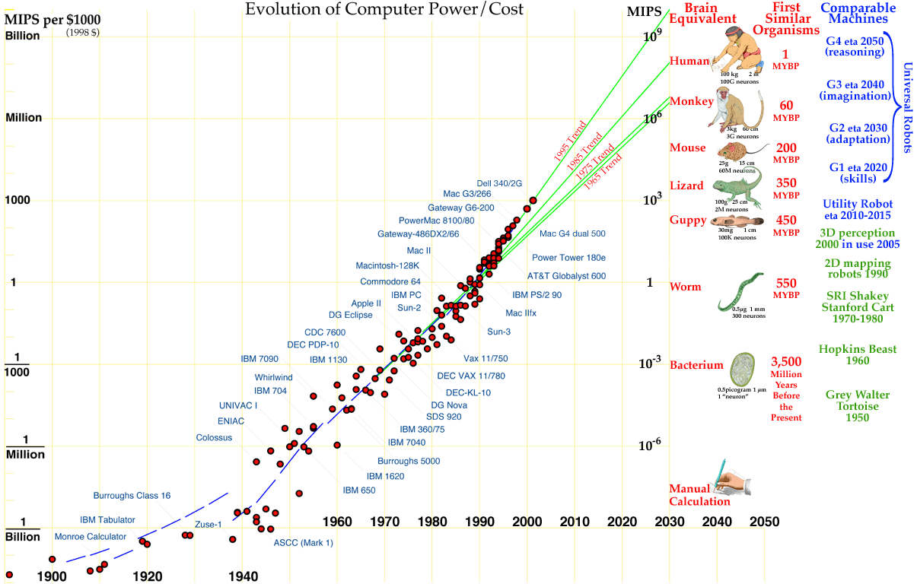
Source: Hans Moravec “When Will Computer Hardware Match the Human Brain”, 1997
© Paul Oh, 2016

Slide 7
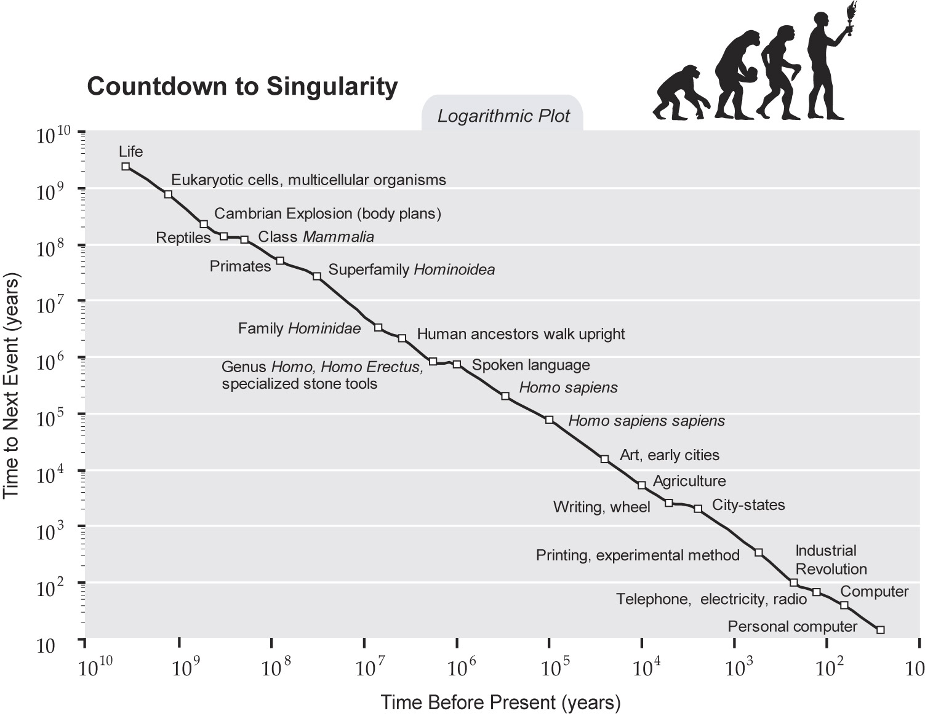
Biological evolution and human technology both show continual acceleration.
The time between events continues to decrease; 2B years from the origin of
life to cells and 14 years between the PC and World Wide Web.
© Paul Oh, 2016

Slide 8
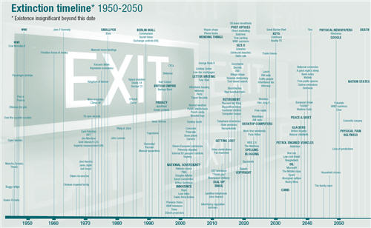
2014: Getting Lost
2019: Libraries
2020: Copyright
2030: Keys
2033: Coins
2036: IC cars
2050+: Ugliness, Nation States, Death
Source: “What’s Next” and the
“Future Exploration Network”
© Paul Oh, 2016

Slide 9
Erosion of Boundaries in the Information Age
Between products and services: think cell phones
Between producers and users: think social media
Between IT, comm, media, consumer electronics: think Amazon
Between IT and non-IT industries: think Walmart
Between academia, industry, disciplines, theory, applied research
1895: “Heavier than air flying machines are impossible”, Lord Kelvin
1943: “I think there’s a world market for maybe 5 computers”, Thomas Watson
1977: “There is no reason why anyone should have a PC in their home”, Ken Olsen
1981: “640K ought to be enough for anyone”, Bill Gates
48 years
34 years
4 years
What can we expect in the next 111 years?
i.e. 7 years (decimal)
2
© Paul Oh, 2016

Slide 10
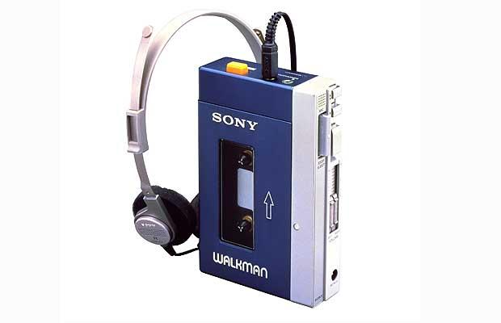
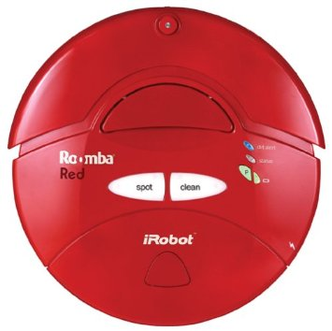
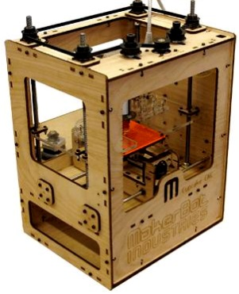
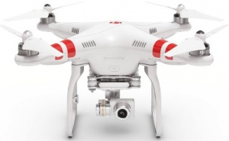
My “ideal” (Advanced) Robotics Courses
1979: Sony Walkman kicks off “consumer electronics”
2002: Roomba launched. 10M units sold. The “Walkman” of Vacuum Cleaners
2009: Makerbot launched. 100K sold. “Walkman” manufacturing for the “masses”
2013: DJI Phantom released. 70% of market. The “Walkman” of quadcopters
“The lines between consumer electronics and consumer robots will be blurry”
Easier, powerful, connected, cheap: microprocessors and sensing
Ubiquitous data and algorithm access: cloud-computing
Networking at zero-marginal cost: IOT
Quick, customizable, affording manufacturing: 3D printing
Advances in data-analysis and visualization: big data and VR
What were the technologies and science that enabled these “Walkman” products?
© Paul Oh, 2016

Slide 11
Plan given a 1-course constraint
Constraint: Inefficient – fabrication and trouble-shooting of circuits and parts
Overcome: LEGO provides fabrication/interface freedom and standardization
Constraint: Inefficient – programming and debugging
Overcome: C or C-like environment; software libraries/repositories
Constraint: Unclear – Project Learning Outcomes
Overcome: Initiation thru turn-key labs; self-discovery thru team projects
Week | Focus | Project | Learning Outcome
3 | Robot Sensing | 1 | Design of digital hardware and software
4 | Robot Actuation
5 | Robot Communications
9-10 | Robot Control | 2 | Design and synthesis of controllers
13 | Robot Computer Vision | 3 | Design and implementation of algorithms
14 | Robot Path Planning
© Paul Oh, 2016

Slide 12
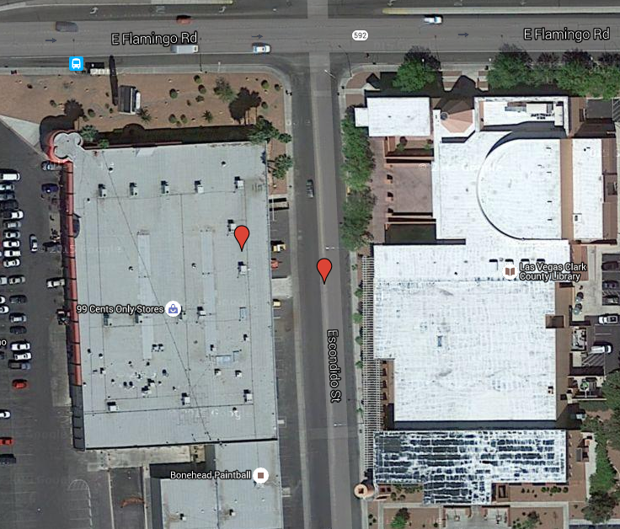
Next Steps
Pick up NXT Kit ($50 post-dated check; check cancelled when all parts returned
Propose: Lecture/Lab: Every Monday 18:00-21:00 (1325 E. Flamingo Rd)
Bring NXT Kit (at least Brick, USB and NXT cables) to every class
99-cent Store
CC Library
© Paul Oh, 2016

