Slide 1
ME 425/625 – Robotics
Closing Remarks
Copyright Paul Oh

Slide 2
Review
Lecture 01: Simple Machine I: Levers, Shafts, And Cranks
Hands-on Lab
Homework
Simple Crank
Crank 3-bar
Crankshaft
Complex Crank
Constructed slider-crank mechanism
Lecture 02: Simple Machine II: Cams, Springs, And Linkages
Hands-on Lab
Homework
Complexity Level
Cam Follower
Cam Follower Vehicle
Torsional Linkage
Multi-jointed Torsional Linkage
4-bar linkage walker
Flat folding chair
Lecture 03: Simple Machine III: Ratchets, Drives, And Gearing
Hands-on Lab
Homework
Planetary Gears
Bevel Gears (and Pin Wheel)
Worm Gears
Rack-and-Pinion
Windshield Wiper
Result is a cookbook with fundamental
recipes. Now, you can create a meal
Copyright Paul Oh

Slide 3
Reinforce Fundamentals
Project : Automata Project “Putting it all together”
Mid-term assessed
  fundamentals learned about simple machines
  hands-on realization of simple machines
Lecture 04-07: NXC Programming
  Motors, Sensors
  File handling
  Timers
Exploration
Lecture 08-10: Robot (Wheeled Inverted Pendulum), Intro to PID
Lecture 11-13: DC Motor Characterization (Winch-and-Cart)
Lecture 14-15: System ID and PID
Copyright Paul Oh

Slide 4
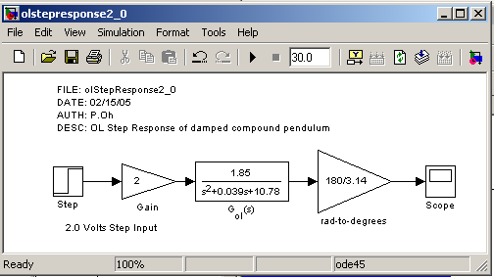
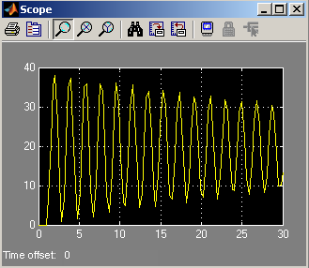
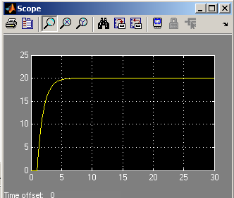
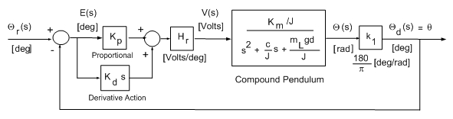
Clearly – Control Improves Performance!
Open-Loop
PID
Copyright Paul Oh

Slide 5
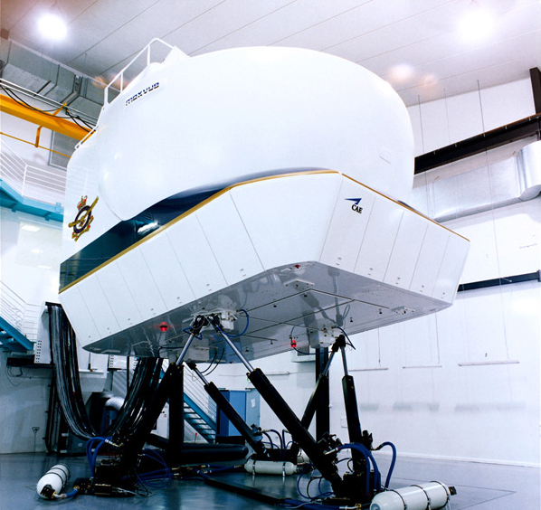
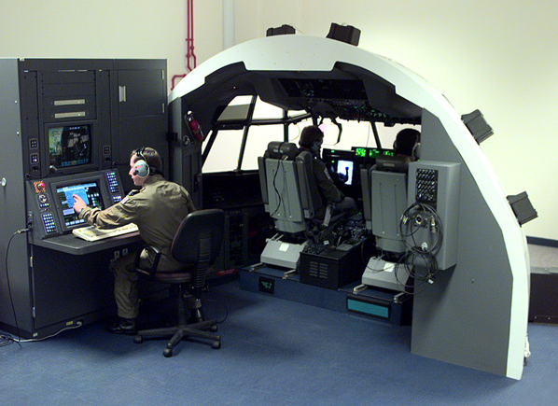
PID Control Used Throughout the Industry
6-DOF Flight Simulator
Talk to pilots and tune gains
Control Designer’s Goal:
Place poles in desired locations to yield desired response (damping, settling time etc)
Copyright Paul Oh

Slide 6
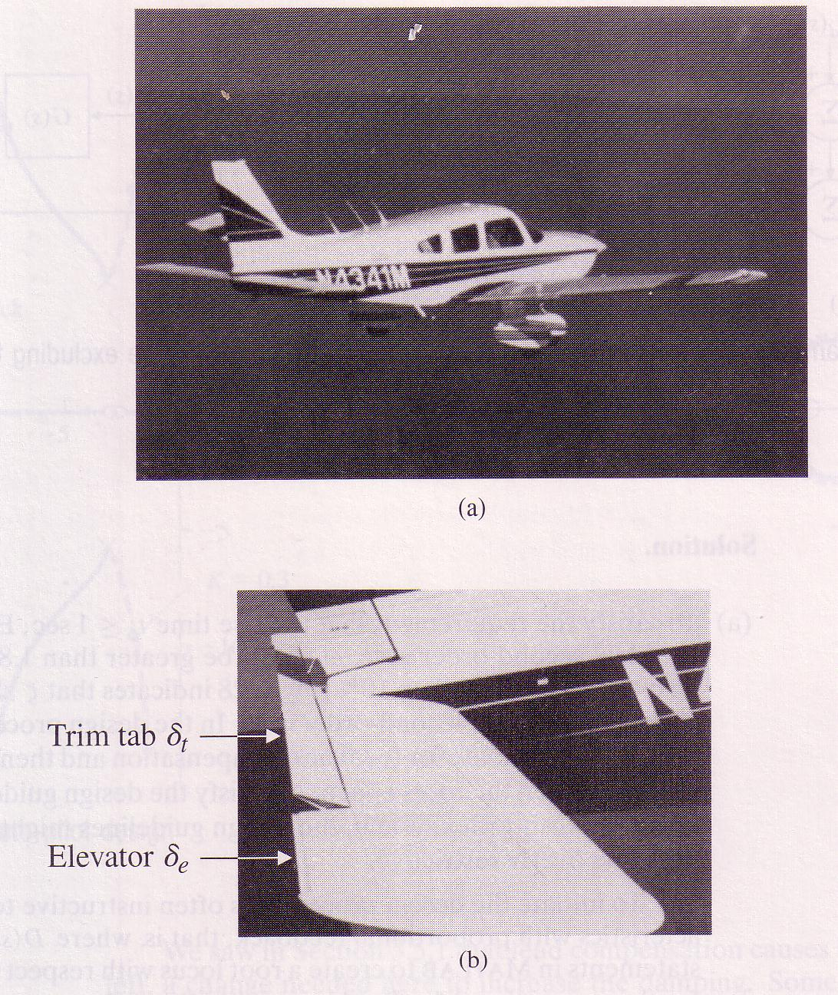
Other Examples where you can go…
Airplane aileron: 4th order
2nd order “pendulum”
2nd order hydraulics
Copyright Paul Oh

Slide 7
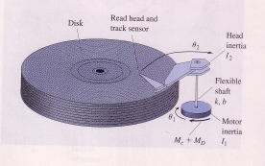
Hard Drive: double-pendulum…
Copyright Paul Oh

Slide 8
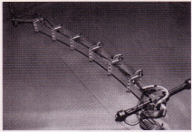

Robot Arms and Manipulators
2nd order system for each link
Copyright Paul Oh

Slide 9
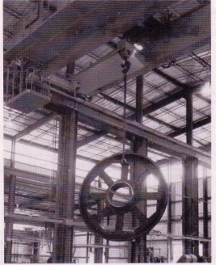
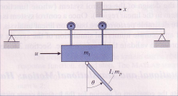
Cranes, Gantries, Booms
4th order system
Copyright Paul Oh

Slide 10
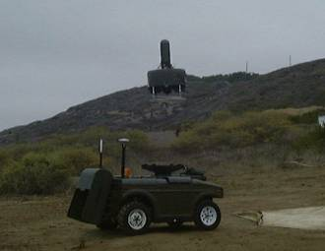
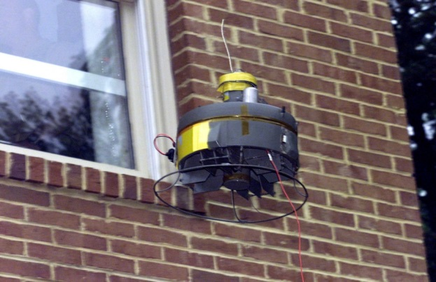
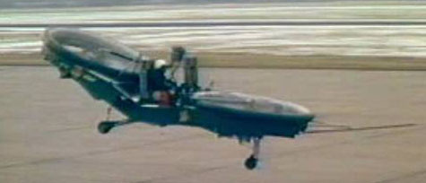
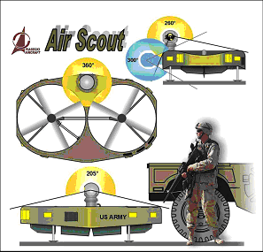
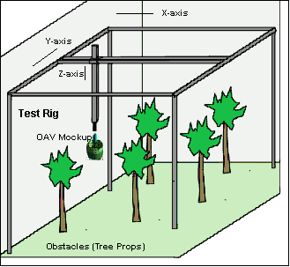
Future Combat Systems
UAV Test Rig
Copyright Paul Oh

