Slide 1
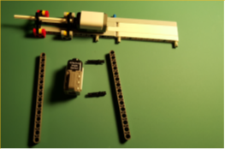
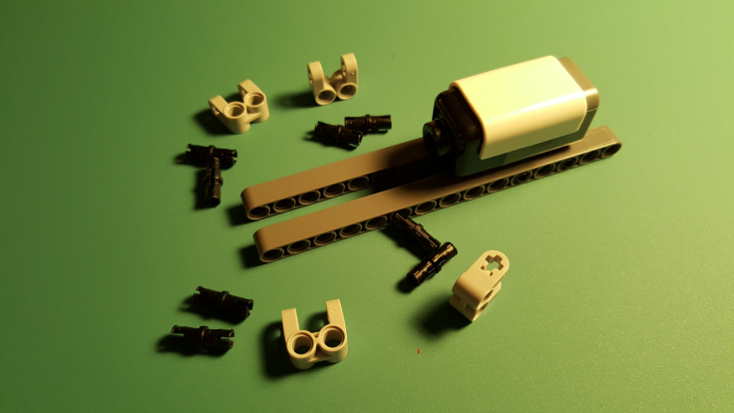
Damped Compound Pendulum – Build Instructions
Step 1: Sensor Mount
Base Assembly
Sensor Mount
The sensor mount will be integrated into a base assembly. The base assembly will eventually be clamped to a desk. The axle on the sensor will hang over the desk.
2 Technic Beam 15
(32278)
2 Technic pin Long
(32556)
HiTechnic Angle Sensor
1-1: Insert long pin through first Beam 15 at holes marked by arrows. Attach angle sensor. Attach second Beam 15
4 Technic Cross Block 2x2 split (41678)
8 Technic Pin
(3673)
1-2: Pin cross blocks onto Beam 15 at positions shown above

Slide 2
4 Technic Axle 2 (3704)
4 Technic Bush 1/2
(4265)
1 Technic Axle 12 (3708)
2 Technic Beam 5 x 3 x 0.5
Liftarm Triangle (2905)
1-3: Insert Axle-2 through bush and triangle liftarm. Do this four times. Insert Axle-12 through triangle liftarm and into angle sensor
Step 2: Base Assembly
1 Technic Beam 13 (41239)
2 Technic pin Long (32556)
2-1: Pin Beam 13 to sensor mount between the two Beam 15 from previous steps
2 Technic Beam 11 (32525)
2 Technic pin Long (32556)
4 Technic Pin (3673)
2-2: Insert two long pins onto Beam 13 from previous step. Affix two Beam 11 pieces to Beam 13. Insert two pins at each end of a Beam 11

Slide 3
3 Technic Pin (3673)
1 Technic Axle Pin (43093)
2 Technic Beam 15
(32278)
2-3: Affix pin to one end of a Beam 15. Attach Beam 15 to Beam 11 from previous step. Repeat for other second Beam 15. Affix pin and axle pin to Beam 15 shown above (right photo)
Step 3: Motor Driver Mount
A Mindsensors MTRMX-NX motor driver will be attached to the Base Assembly
1 Technic Axle 2 (3704)
1 Technic Axle Pin (43093)
2 Technic Bush 1/2
(4265)
1 Technic Beam
3 x 3.8 x 7 Liftarm Bent 45 Double (32009)
3-1: Affix Bent 45 liftarm to Beam 15 from previous step. Insert Axle 2 and Axle Pin to Bent 45 liftarm (see right photo)
3-2: Affix the MTRMX-NX motor driver to the Bent 45 liftarm. Secure with 1/2 Bushes. Use above left and right photos for correct location and orientation

Slide 4
Step 4: Pendulum
One end of the pendulum will attach to the sensor mount. A motorized propeller will attach to the other end of the pendulum.
2 Technic Axle Connector (6538b)
1 Technic Axle Connector with Axle Hole
(32039)
2 Technic Axle 32 (50450)
2 Technic 3 x 0.5 Liftarm (6632)
4-1: (right photo – top) Slide 3 x 0.5 liftarm and “axle connector with axle hole” on first Axle 32. Attach axle connector to one end. (right photo – bottom) Slide 3 x 0.5 liftarm onto second Axle 32.
4-2: Join the two Axle 32 pieces (above left). Affix pendulum to angle sensor (above right)

Slide 5
Step 5: Motor Mount
The motor mount consists of a motorized propeller ziptied to a 1 x 4 liftarm. The 4.5 V motor (Digikey #P14354-ND) has a 1.0 mm shaft diameter. The 2.5-inch diameter propeller (GWS EP2510) is pushfit onto the motor shaft.
2 Technic Axle Connector (6538b)
1 Technic Axle Connector with Axle Hole
(32039)
GWS EP2510 Propeller
4.5 V Motor
Ziptie
1 Technic Liftarm 1 x 4 thin with stud connector (2825)
5-1: Pushfit propeller onto motor shaft. Loop zip tie on 1 x 4 liftarm. Insert motorized propeller in loop and tighten zip tie.
5-2: (Left) Affix motor mount onto end of pendulum i.e. bottom Axle 32 part. Thread motor wires through holes of the 3 x 0.5 liftarm (from Pendulum building step). (Right) Thread female-female jumper through 3 x 0.5 liftarm of top Axle 32 part. Connect one end of jumper to pins on MTRMX-Nx motor driver. Connect other end of jumper to male pins of motor

Slide 6
Reference Photos
MTRMX-NX
Pin 1
Thread thru liftarm
Female-female jumper
Pigtail
Pigtail
Thread thru liftarm
Pigtail connects to wallwart
Motor wires
MTRMX-NX Pin 1

