Slide 1
PID Case Study: Velocity Control of a Motorized Winch-and-Cart
Copyright © Paul Oh

Slide 2
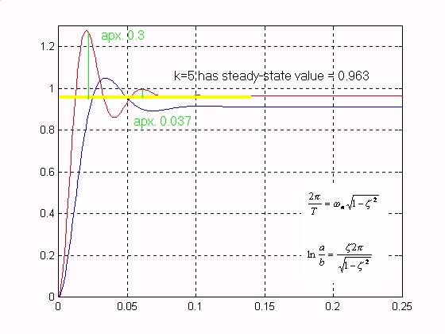
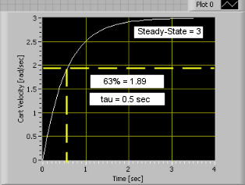
Objective:
System Identification
System ID attempts to capture a plant’s characteristics such as transient response (i.e. rise time) and its stability (steady-state)
Typical 2nd Order Response
Typical 1st Order Response
Car shock absorbers
Pneumatic pistons
Economic systems
DC motors
Damped hydraulics
Grandmother Explanation?
Copyright © Paul Oh

Slide 3
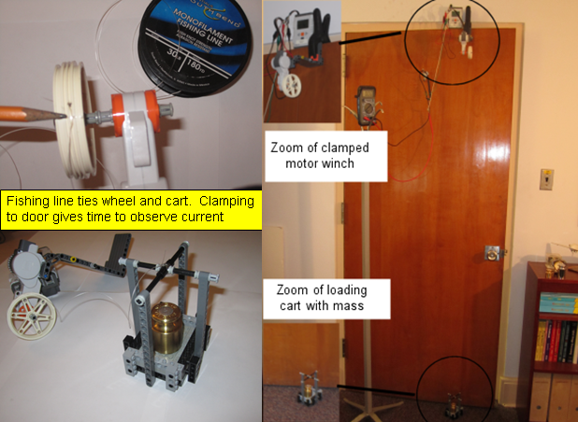
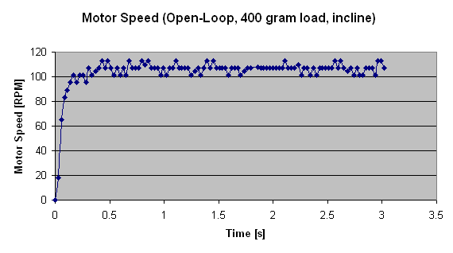
Lego-Based Motorized Winch-and-Cart
Control Goal: Winch load at constant velocity
Practical Applications:
Tow truck
Jeep winches
Elevators
Winch at constant velocity
regardless of load
Step 1: Need to characterize open-loop system
Recall: motorized winch-and-cart max power occurs for 400 gram mass (0.12 Nm)
For inclined surface, winch speed will be faster. Need step response
NXT commanded at 100% level
Steady state velocity about 107 RPM
63% of 107 RPM = 67.4 RPM
Copyright © Paul Oh

Slide 4
Steady-state = 107 RPM
63% of steady-state = 67.4 RPM
Rise Time about 0.06 seconds
NB: Want sampling time about 10 to 20 times faster than rise time.
Hence sampling time should be about 3 to 6 milliseconds
Copyright © Paul Oh

Slide 5
Brick Motor Level input to the cart motor, yields velocity output
Consequently have:
(1)
where
is the time constant and
is the steady-state gain (to be determined)
The Laplace form of (1) yields:
(2)
The input-output transfer function becomes
(3)
Also, the solution to the first-order differential equation given in (1) is
(4)
Copyright © Paul Oh

Slide 6
To calculate the steady-state gain, apply a step input
where is a constant
At steady-state, with step input, (1) becomes:
0
or
=
Y
ss
=
Steady State Velocity [RPM]
(5)
k
A
Step Input Level [Motor %]
Step response for
Steady-state = 107 RPM
Eyeballing, observe that:
63% of steady-state = 67.4 RPM
Y
=
107
RPM
ss
Rise Time about 0.06 seconds
Hence:
Y
ss
107 RPM
=
1.07 RPM/Level
k
=
=
A
100% Level
Copyright © Paul Oh

Slide 7
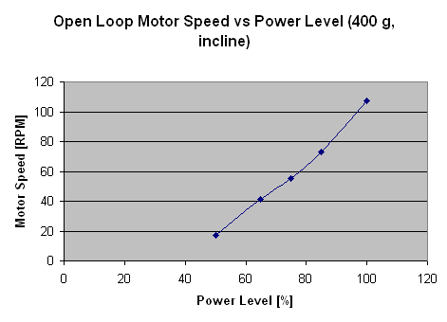
Power Level [%] | Steady-State Speed [RPM]
100 | 107
85 | 73
75 | 55
65 | 41
50 | 17
Blah: check this slope calculation…
Copyright © Paul Oh

Slide 8
Recall (4)
at
63% value is about
Y
=
67.4
RPM
Steady-state = 107 RPM
Hence
τ
=
0
.
06
sec
63% of steady-state = 67.4 RPM
Rise Time about 0.06 seconds
Copyright © Paul Oh

Slide 9
Thus from (3) open-loop transfer function due to step input of 100% motor level yields:
where
τ
=
0
and
=
.
06
sec
k
1.07
.
RPM/Level
(6)
The block diagram representing (6) is simply:
F(s)
17.83
Y(s)
[Level]
s+16.7
[RPM]
Copyright © Paul Oh

Slide 10
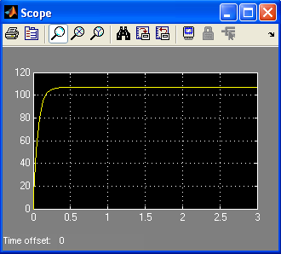
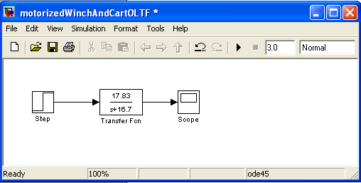
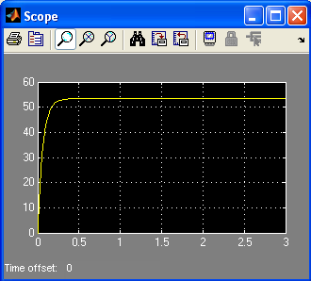

Simulink of (6)
100% motor level (400 g, incline)
~53 RPM
~27 RPM
50% motor level (400 g, incline)
25% motor level (400 g, incline)
Copyright © Paul Oh

Slide 11
Note similarity between experimental and simulated plots
Copyright © Paul Oh

Slide 12
PID Control (Closed-Loop) of Motorized Winch-and-Cart
Goal: Want cart velocity to always be 63 RPM
Even if load changes (within motor limits)
Even if Brick voltage changes (within limits)
PID is the most common form of closed-loop control:
Why?
Copyright © Paul Oh

Slide 13
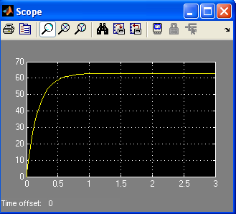

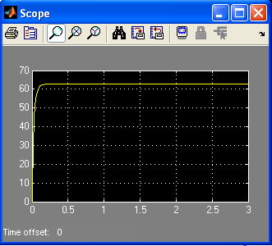
Answer: One can tune for desired performance without full knowledge of dynamics
Without Control
(i.e. Open-loop)
Copyright © Paul Oh

Slide 14
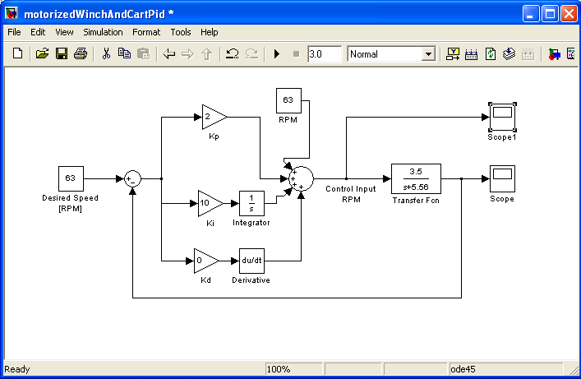
PID Simulink Simulation
May need to multiply desired and set point values to 100/63
Copyright © Paul Oh

Slide 15
However, tuning can be very tedious. Some knowledge of system type aids in tuning, make performance expectations realistic and avoid instability.
Analysis:
Input-Output Relationship given by:
(1)
Copyright © Paul Oh

Slide 16
Can reduce to show that (1) becomes:
(2)
Case Study 1: Proportional only control
So (2) becomes:
(3)
Final Value Theorem states that:
Thus steady-state part of (3) becomes:
(4)
Copyright © Paul Oh

Slide 17
Given that cart velocity has an open-loop transfer function of the following form:
(5)
Substitution of (5) into (4) yields
Applying L’Hopital to calculate the limit yields:
Note: If is very large, then
Will always have steady-state error
Copyright © Paul Oh

Slide 18
Case Study 2: Proportional + Integral control
So (2) becomes:
Apply Final Value Theorem:
(6)
Substituting the OLTF (2) into (6) yields:
Hence integral action ensures zero steady-state error
Copyright © Paul Oh

Slide 19
Systems like the motorized cart are called Type 0 systems:
All transfer functions can be factored into the general form:
Type 0 System
Type 1 System
Type 2 System
General form any TF
A Type i system is the number of “free” integrators, i. The motorized tethered cart, for velocity control, is a Type 0 system
For Type 0 Systems:
Will always have steady-state error (with proportional only control): see Case 1
Integral action will eliminate steady-state error (see Case 2)
Derivative action may increase transient response but cause instability
Copyright © Paul Oh

Slide 20
Conclusion:
Open-loop Step Response shows motorized winch-and-cart is a First Order System
Resulting PID closed-loop transfer function yields Type 0
Type 0 systems just need PI (no derivative) control. Steady-state error will be 0
Copyright © Paul Oh

