Slide 1
PID Control
© Copyright Paul Oh

Slide 2
Proportional Even Better Than Unity Feedback
Recall: Unity Feedback
Given step input
Inverse Laplace:
Steady-state:
As feedback gain
increases, output attenuates
Inverse Laplace
Steady-state:
As gain increases, proportional output reaches 1 (as desired)
© Copyright Paul Oh

Slide 3
Review: Proportional-Integral-Derivative Control
I improves steady-state accuracy
at the expense of stability
D improves stability at the expense
of steady-state accuracy
PD improves stability
without degrading accuracy much
PI improves steady-state accuracy
without degrading stability much
Case Study: Proportional only control
Step input
Final Value Theorem
General PID CLTF
Response depends on OLTF poles and zeros
© Copyright Paul Oh

Slide 4
System Type: Keys to PID Design
Type 0 System
Type 1 System
(1)
Type 2 System
Proportional only control
General form any TF
Case 1: Type 0 System (step response)
NB: There is a discrete error, but if
then
Case 2: Type 1 System (step response)
No error! Type 1 and 2 systems have no error with step response
© Copyright Paul Oh

Slide 5
Goal: Increase System Type with Integrator
General PID CLTF
Case 1: Pure Integrator
Step input
Substituting OLTF general form from (1)
Thus, adding an integrator yields
irregardless of system type
© Copyright Paul Oh

Slide 6
Goal: Decrease System Type with Derivative
General PID CLTF
Case 2: Pure Derivative
Step input
then
Substituting OLTF general form from (1)
Derivative will yield
if
© Copyright Paul Oh

Slide 7
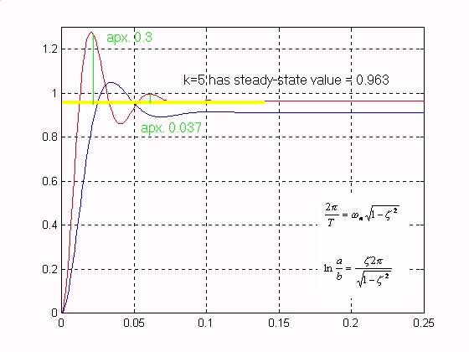
Case Studies: Matlab Simulations
Recall motor given by:
Type 0 system
For
For
Matlab confirmed that NON-ZERO steady-state error (see mtr_p.m)
© Copyright Paul Oh

Slide 8
Case Studies: Matlab Simulations – Pure Integrator
Problem: Given
1-1: Show that the CLTF is
1-2:
Show that for a unit step response that
1-3:
In Matlab, simulate and display the unit step response with
and
© Copyright Paul Oh

Slide 9
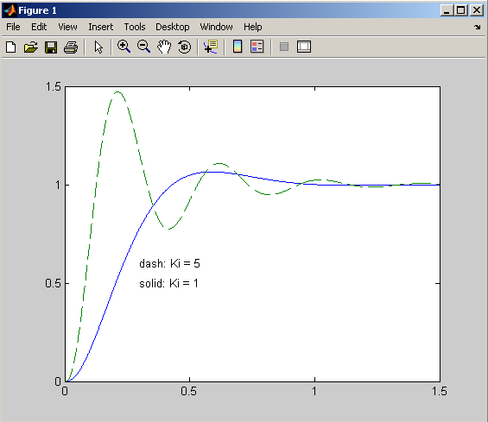
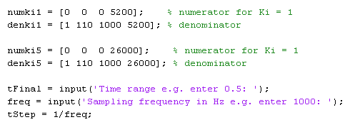
Pure Integrator Control
Code snippet
© Copyright Paul Oh

Slide 10
Case Studies: Matlab Simulations – PI control
Problem: Given
2-1: Show that the CLTF is
2-2:
In Matlab, simulate and display the unit step response with
A.
B.
C.
D.
© Copyright Paul Oh

Slide 11
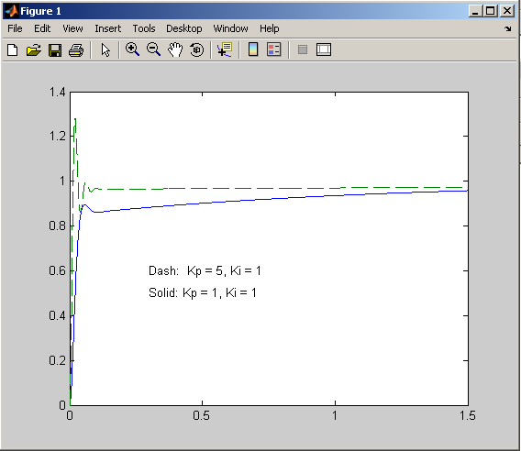
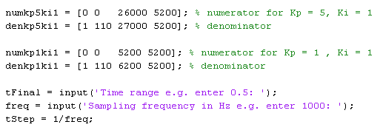
PI Control
Code snippet
© Copyright Paul Oh

Slide 12
Conclusions
Pure Integrator Control
PI Control
I improves steady-state accuracy
at the expense of stability
PI improves steady-state accuracy
without degrading stability much
Just like was stated in the beginning (see Slide3)
© Copyright Paul Oh

