Slide 1
Automata: Putting it all together
© Copyright Paul Oh

Slide 2
Tentative Schedule
18:00 Guest Lecture
18:30 Lab “Putting it All Together”: Automata example (The Gymnast)
19:15 Project Time: Form (2-3 person) team; Automata sites and concept sketches
20:00 Email Team Proposal (3-slides: inspirational video and sketches)
20:15 Clean up and Adjourn
© Copyright Paul Oh

Slide 3
Review
Lab 1: Simple Machine I: Levers, Shafts, And Cranks
Hands-on Lab
Homework
Simple Crank
Crank 3-bar
Crankshaft
Complex Crank
Constructed slider-crank mechanism
Lab 2: Simple Machine II: Cams, Springs, And Linkages
Hands-on Lab
Homework
Complexity Level
Cam Follower
Cam Follower Vehicle
Torsional Linkage
Multi-jointed Torsional Linkage
4-bar linkage walker
Flat folding chair
Lab 3: Simple Machine III: Ratchets, Drives, And Gearing
Hands-on Lab
Homework
Planetary Gears
Bevel Gears (and Pin Wheel)
Worm Gears
Rack-and-Pinion
Windshield Wiper
Result is a cookbook with fundamental
recipes. Now, you can create a meal
© Copyright Paul Oh

Slide 4
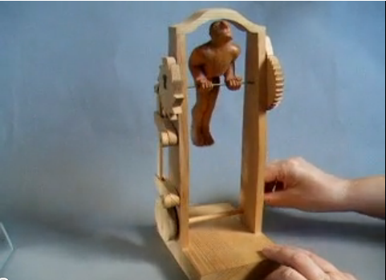
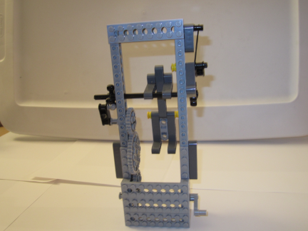
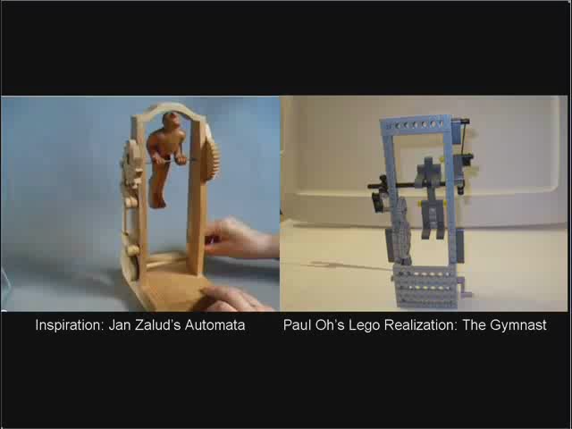
Input: handle crank (Lab 1)
Cam and follower (Lab 2)
Follower pushes ratchet (Lab 3)
Conversion of translation to stepped rotation
Detent prevents ratchet 2 from reversing
Output: multi-link figure rotates
http://www.youtube.com/watch?v=zy5B_bzNlD4
Lego-based Automata – The Gymnast
Video
© Copyright Paul Oh

Slide 5
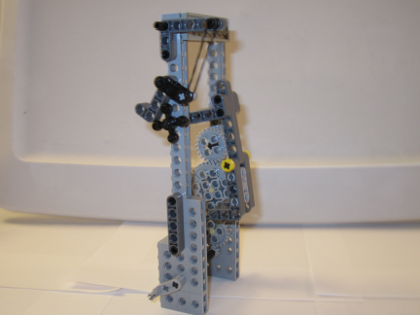
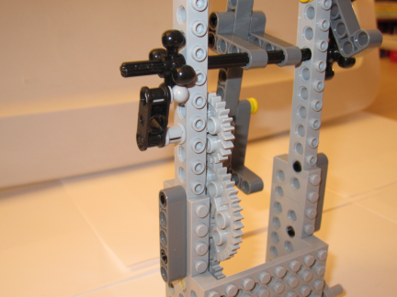
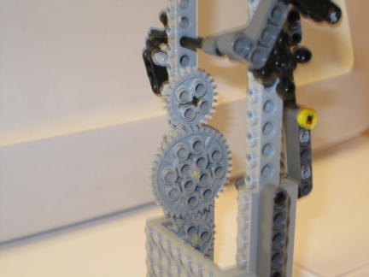
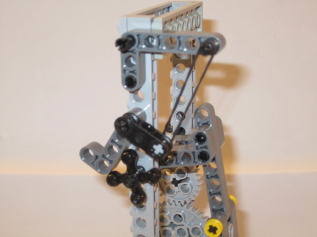
Pin Wheel
(Lab 3)
Figure is Linkage
(Figure 03)
Drive Train
(Lab 3)
Crank Handle
(Lab 1)
Cam Follower
(Lab 2)
Spring
(Lab 2)
Ratchet
With Detent
(Lab 3)
Drive Train
(Lab 3)
© Copyright Paul Oh

Slide 6
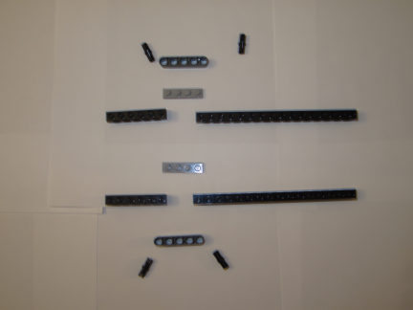
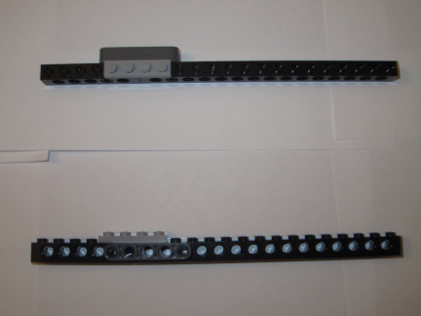
Lego-Based Automata: The Gymnast
Step 1: Assemble rails
2x Beam 5
3216
2x Brick 1x6
3894
2x Brick 1x16
3703
2x Plate 1x4
3710
4x Pin With Friction
4459
Connect the 2 bricks with a plate. Secure connection with a beam. Construct 2 of these
© Copyright Paul Oh

Slide 7
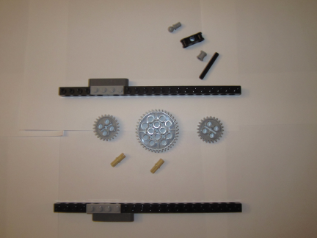
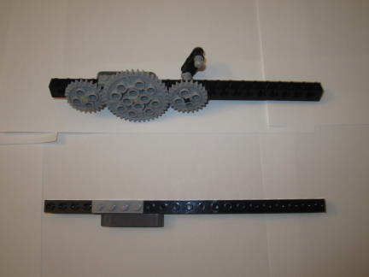
Step 2: Assembly Gear Train
Axle Towball 2736
Cross Block 1x3
32184
Bush 3713
Axle 5 3705
2x Gear 24T
3648
2x Axle Pin
3749
Gear 40T
3649
Align and insert first 24T Gear. Mesh and insert 40T Gear. Align second 24T gear and thread
Axle-5. Secure with bush and attached cross block. Insert Axle Towball in cross block
© Copyright Paul Oh

Slide 8
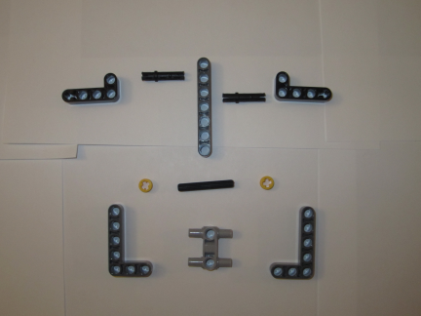
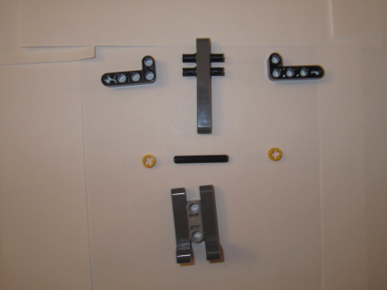
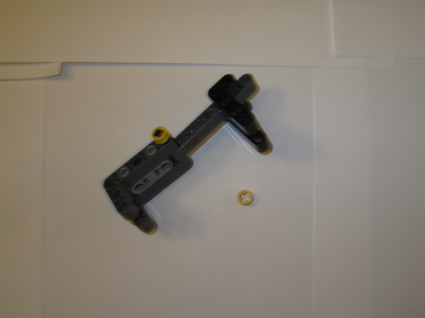
Step 3: Construct the gymnast figure
2x Beam 2x4 Liftarm Bent 90 (32140)
2x Pin Long (32556)
Beam 7 (32524)
2x Bush 1/2 Type 1
(4265A)
2x Beam 3x5
Bent 90
(32526)
Axle 4 (3705)
Cross Block 1x3 with 4 pins (48989)
Create upper body by inserting long pins in
Beam 7. Create arms by attaching 2x4 liftarms.
Create lower body by connecting 3x5 beams to
cross block. Attach lower and upper bodies
with axle. Secure with1/2 bushes
© Copyright Paul Oh

Slide 9
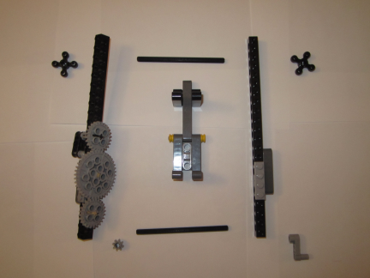
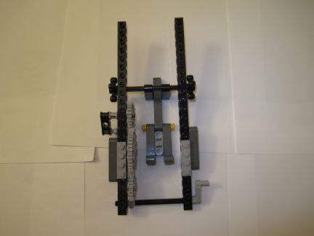
Step 4: Attach gymnast to rails
2x Axle 10 (3737)
2x Gear 4 Knob (32072)
Beam 3x0.5 Liftarm (33299)
Gear 8T (3647)
Align and thread Axle 10 through gymnast. Secure with 4 knob.
Align and thread Axle 10 at rail bottom. Mesh 8T gear. Secure at end with 3x0.5 liftarm (handle)
© Copyright Paul Oh

Slide 10
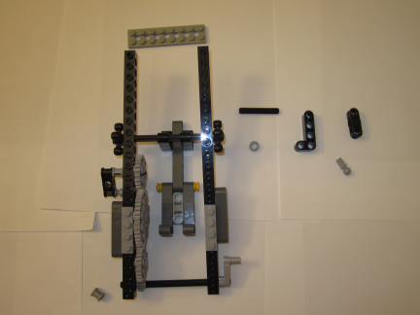
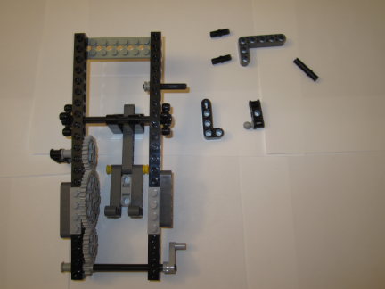
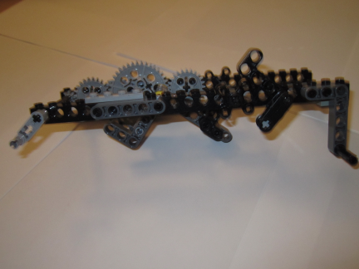
Step 5
Plate 2x8
(3034)
Beam 2x4 Liftarm Bent 90 (32140)
Cross Block 1x3
(32184)
Beam 3x5 Bent 90
(32526)
Axle Towball 2736
Bush 1/2 Type 1
(4265A)
Pin Long (32556)
Bush 3713
2x Pin With Friction
(4459)
Axle 4 (3705)
Construct detent by threading Axle 4 through
2x4 liftarm. Secure with 1/2 bush and cross block.
Attach towball to cross block. Secure rails with
plate. Secure crank axle with bush.
A rubber band will be used for the detent.
Attach the 3x5 liftarm to top of rail. Rubber
band will be looped to towball and long pin
© Copyright Paul Oh

Slide 11
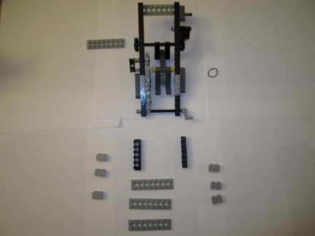
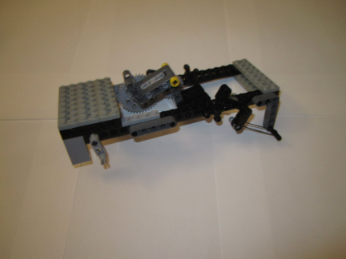
Step 6
4x Plate 2x8
(3034)
Rubber Band
2x Brick 1x6
(3894)
6x Brick 1x2
(3004)
Use 2x8 plates to secure rails at top and bottom. Brace 1x6 bricks at bottom of rail
structure. Use 1x2 bricks to complete brace. Loop rubber band at towball and 3x5 liftarm
© Copyright Paul Oh

Slide 12
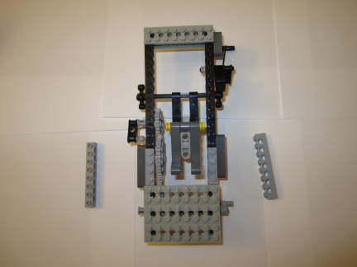
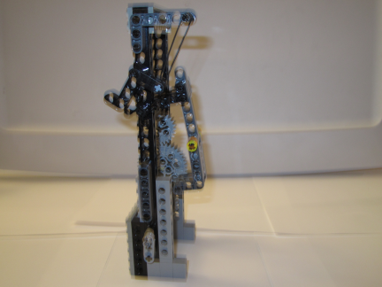
Step 7
2x Brick 1x8
with holes
(3702)
Secure 1x8 bricks at underneath rails (towards bottom)
© Copyright Paul Oh

Slide 13
Automata Project
19:15 Project Time: Form 2-3 person team. Automata sites and concept sketches
Grading Criteria:
NB: Project counts towards 25% to 35% of final grade
Automata must consist of at least 2 simpler mechanisms e.g. crank and ratchet
Must be only Lego pieces (can self-purchase extra parts if needed)
Option to work on a 2-3 person team
15%: Brief explanation of how automata works
15%: Video (20-seconds) compares role model and your creation
25%: MLCAD Build instructions including Bill of Materials
25%: Step-by-step build instructions (photo-based). Bring hardcopy to class next week
20%: Oral Presentation (5-min) showcasing the 4 points above
20:15 Email Team Proposal (3-slides: inspirational video and sketches)
Web search for Automata that you’d like (and have parts) to reproduce
  Slide: results of web search
Concept sketches
  Slide: scan of concept sketches
Prototypes: some possible reproductions in Lego
  Slide: Photos of reproductions, MLCAD constructions
© Copyright Paul Oh

