Slide 1
Mechanisms and Algorithms
Simple Machines I: Levers, Shafts and Cranks

Slide 2
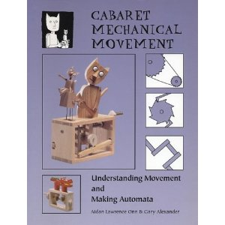
Cabaret Mechanical Movement
By Aidan Lawrence Onn and Gary Alexander
Excellent reference book
Lectures reference figures from this book
Good concept book but no kinematic synthesis
Wood and paper, but not Lego

Slide 3
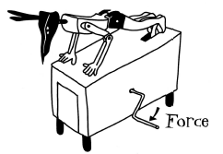
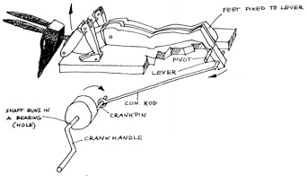
Some Principles
History of Automata circa 500 BC
Movements of today’s machines (e.g. industrial robots) still use same mechanisms
Observations: Appearances can be deceptive. Motion is not always obvious
Explain how this works
http://www.youtube.com/watch?v=YFqkKn9PgNg
Anubis by Paul Spooner and Matt Smith
Hands are fixed to the floor
Lever: Feet (load), Pivot (fulcrum), Effort (Connecting Rod)
Effort generated by Crank and Connecting Rod
Effort acts on feet thus appears Anubis is doing push-ups

Slide 4
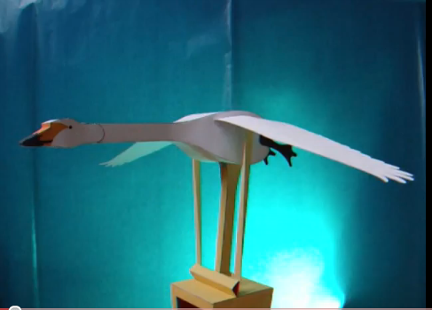
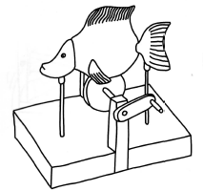
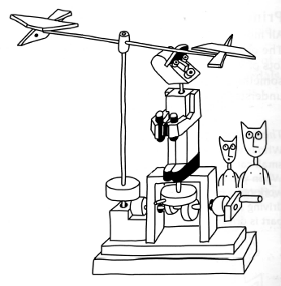
Body moves vertically on shafts
Body rests on cam
Rotating crank, rotates cam
Appears that fish undulating
http://www.youtube.com/watch?v=ClQyF_4bTy0
Wriggling Fish by Jan Zalud
Explain how this works
Turning handle causes man’s head to turn side-to-side
Birds just rotate
If you want to make things move, spend time
studying how other things move
Birdwatcher by Peter Markey

Slide 5
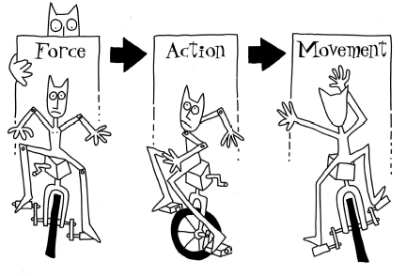
Machines:
A machine is something that modifies force
Input is when force comes from an outside source
The mechanical action of the machine produces output
Q1: What is the input?
A1: Legs pushing on pedals
Q2: What is the output?
A2: Wheel rotation
Mechanics: The study of the motions and
forces that occur between input and output

Slide 6
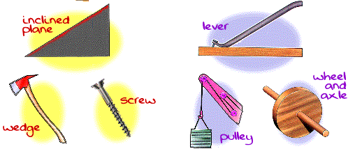
Mechanics:
Origins trace back to ancient Egypt
Archimedes: first recorded scientific foundations for mechanics circa 3rd BC
Archimedes: formulas for equilibrium of simple levers and centers of gravity
Galileo: circa 1564 used mathematics to solve physical problems
Galileo advanced Archimedes’ work and developed the science of Dynamics
Newton: circa 1642 developed the 3 laws of motion
Law 1: motion does not require force; force only needed to accelerate motion
Law 2: the greater the force, the greater the acceleration
Law 3: action and reaction; if object pushed, it will push equally in opposite direction
All mechanical systems are made from combining 5 basic ones:
Inclined Plane (or slope)
Wedge
Screw
Lever
Wheel
But…
Wedge is 2 inclined planes joined together
Thus: Only lever and inclined plane
are really the only 2 basic mechanisms
Screw is inclined plane wrapped around shaft
Wheel is a lever that rotates 360 degrees

Slide 7

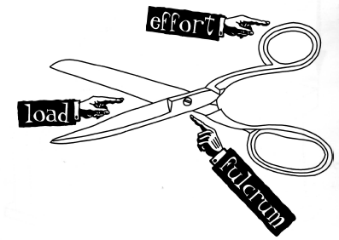
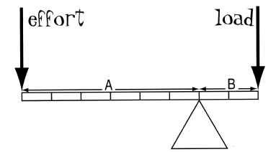
Levers
All machines (almost) always employ at least one lever
Lever of the First Order:
Fulcrum is always between the load and the effort
Can you think of examples?
Mechanical Advantage
Mechanical advantage is ratio of load versus effort
Leverage is ratio distances of the effort and load to fulcrum
Example
Leverage is ratio of A and B = 6:2 = 3:1
Mechanical Advantage =
Thus, effort of 1 could move a load of 3

Slide 8

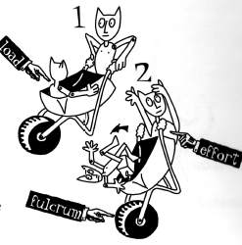
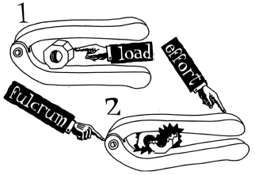
Lever of the Second Order:
Load lies between fulcrum and the effort
Can you think of examples?
Also known as a force multiplier (having very good mechanical advantage)
Effort must move greater distance than the load

Slide 9
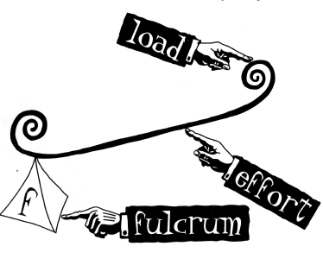
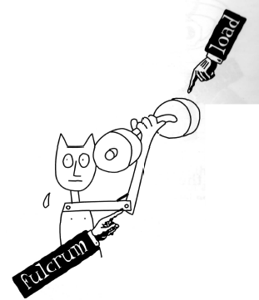
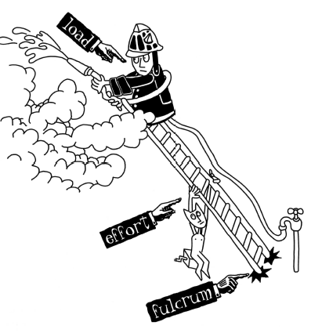
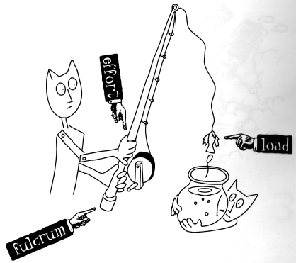
Lever of the Third Order:
Effort applied between fulcrum and load
Can you think of examples?
Human Arm: Fulcrum (elbow), Effort (bicep muscle attached to forearm, just below elbow), Load (held in hand)
Ladder: Fulcrum (ground), Effort (person supporting ladder). Higher firefighter ascends, the greater the effort needed
Fishing Rod: Fulcrum (left hand grasps bottom), Effort (right hand move rod up and down), Load (tackle, bait, fish)
Also known as a force reducer (efforts always greater than load)
Load moves faster than the effort (can call this a movement amplifier)

Slide 10
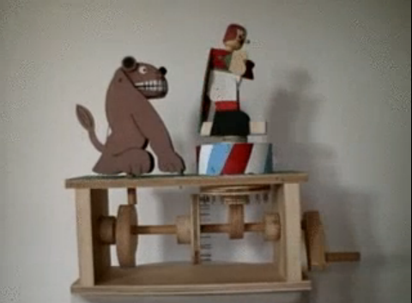
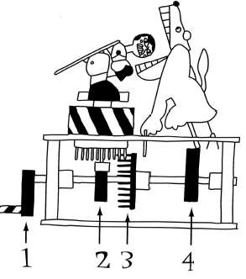
Shafts (and Bearings)
Often, all mechanisms attach to the shaft (or axle). If not shaft not smooth, machine not smooth
The Lion Tamer by Ron Fuller
http://www.youtube.com/watch?v=zic2c080f_Y
The handle (or crank)
Eccentric cam (tamer stoops up and down)
Pin wheel (rotates tamer)
Snail cam (opens lion’s mouth then snaps down)
For sequence to remain constant, mechanisms are fixed to shaft so that lion’s mouth is always open when the tamer’s head is in lion’s mouth

Slide 11
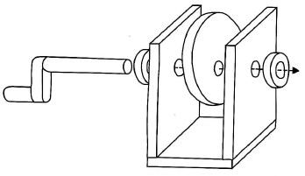
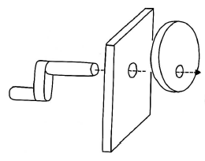
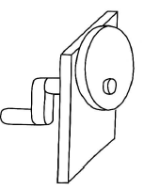
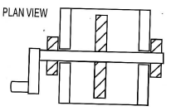
Shafts:
Shafts can be anything: from stiff piece of wire or wooden dowel, to accurately engineered rod
Part with hole that supports shaft is called the bearing
Shaft must be strong enough to support mechanisms they carry
Shaft must fit the bearings; not too tight (friction) or not too loose (wobble)
Bearings:
Bearing keeps the rotating shaft stable and running smoothly
Must be chosen together with shaft
Ball Bearings:
Outer race is fixed while inner race rotates with shaft
Balls roll with small contact area, hence friction is low
Polished steel bearings help reduce friction too
Simple Example
Shaft passes through single bearing
Shaft is attached to handle and a disc
Off-center hole in disc will yield wobble
Add second bearing for better support
Add collars to prevent side-to-side movement

Slide 12
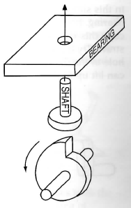
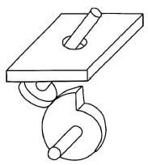
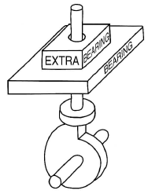
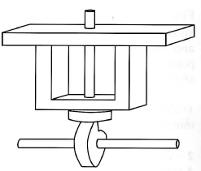
Snail Cam:
Shafts don’t only rotate in bearings
Snail cam pushes shaft upwards
Shaft also needs support of a bearing
If bearing (hole) is too big, shaft moves off-center (jamming)
If bearing too far from cam, then also jamming
Add thickness to bearing
Results in more predictable up-and-down movement of cam-follower
Hole diameter: just big enough to allow free up-and-down movement
Add U-shaped bracket
Positions bearing as close as possible to end of shaft where cam pushes

Slide 13
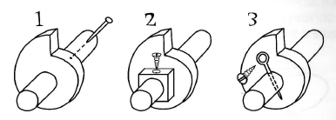
Fixing:
1. Pin the cam: pin pushed through pre-drilled hole into the cam and the shaft
2. Cam with hub: Hub is part of the cam or glued to it. Screw passed through hub and
into the shaft. This keeps the fixing away from the radial surface of the cam
3. Screwed cross pin: Similar to 2 but easier to make. A wire or split-pin passes through
the shaft only. A screw in the cam holds it in place

Slide 14
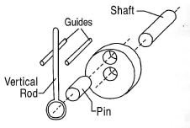
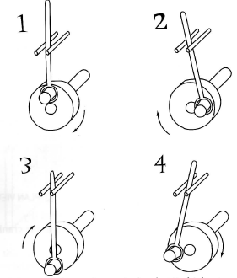
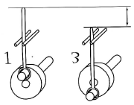
Cranks
A lever attached to a rotating shaft – cranks convert rotation to reciprocation
Crank: circular disk with a pin
Pin: connected to a vertical rod (loose enough to allow crank to rotate)
Rod: constrained by guides
When shaft rotates, rod reciprocates (moves up and down)
At “1” vertical rod at highest point
At “3” vertical rod at lowest point
CW rotation thru 360-degrees

Slide 15
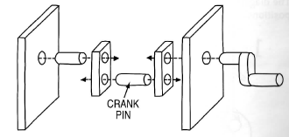
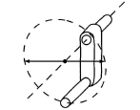
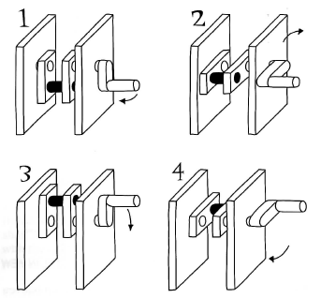
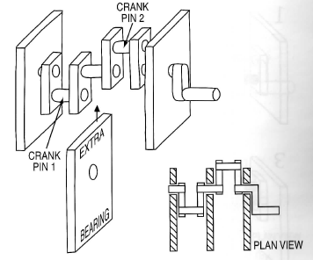
Rotating shaft needs bearings on both sides of crank
Arrows show throw of the crank
Throw: diameter of the path crank travels
Can add many cranks (but need more bearings)
Crank rotation thru 360-degrees
Offset cranks so at different positions at different times
Crank pin (black) simply repeats motion of the handle
Above: one crank is down when other crank is up

Slide 16
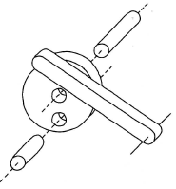
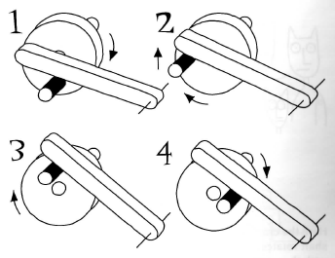
Using Cranks to Operate Levers
As shaft rotates, crank will lift lever
Lever traces a small arc
Gravity keeps lever in contact with crank pin
At “1”, lever is in lowest position
At “3”, lever is in highest position
Fast shaft rotation = lever breaks contact with crankshaft
Lever may bounce (higher than expected) if struck hard
Too little fall time when crankshaft at lowest position
Any Possible Solutions?
Crank rotation thru 360-degrees

Slide 17
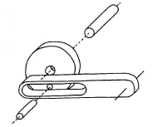
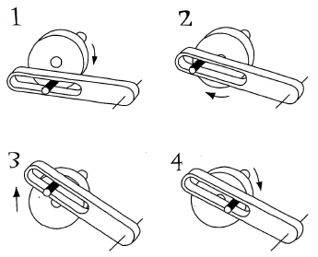
Use a slot
Lever is driven up and down by crank
This “positive” connection doesn’t depend on gravity
Lever will always move through expected path
Crank rotation thru 360-degrees

Slide 18
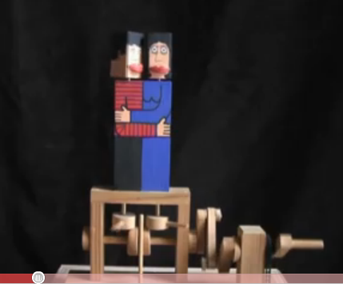
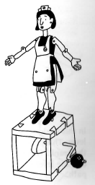
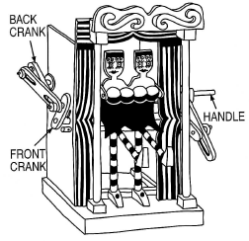
Jumping Nurse by Paul Spooner
Loose joints (shoulders, elbows, etc)
Crank and cam push her up
Looseness provides joint “movement”
Kissing Couple
http://www.youtube.com/watch?v=3EJQcexRMig
Handle rotates crank at back
Crank at back connected to crank at the front
Connecting piece has 2 slots to allow cranks to rotate
What motion does the front crank follow?
Dancing Girls by Peter Markey

Slide 19
Next Week: Simple Machines II: Cams, Springs and Linkages

